Slide 1
An Exploratory Analysis of Alzheimer's and Dementia Patient Disposition Following Hospital Admission in Maryland
MPH Capstone May 11th, 2022
Daniel Johan Kamyab

Slide 2
Agenda
Burden of Alzheimer’s & Dementia
What Happens When Patients Can’t Be Taken Care of At Home?
Existing Literature
Capstone Question
Dataset
Exploratory Analysis

Slide 3
Burden of Alzheimer’s
& Dementia

Slide 4
⅓
6M+
83%
Patients in the US Live With Alzheimer's
Of Seniors Die with Either Alzheimer’s or Dementia
Of Help Provided to Seniors Comes from Family or Friends
“$271.6 Billion Worth of Care is Provided by Family Members and Other Unpaid Caregivers”
Source: Alzheimer’s Association
Notes:
https://www.alz.org/alzheimers-dementia/facts-figures

Slide 5
What Happens When Patients Can’t Be Taken Care of At Home?
Skilled Nursing Facilities
Assisted Living Facilities
Alzheimer’s Special Care Units
Life Plan Communities
Source: Alzheimer’s Association

Slide 6
Existing Literature:
What Influences the Likelihood of Being Admitted to a Non-Home Location?
Poor cognition, behavior, and psychological symptoms¹
Incidence of Hip Fracture prior to diagnosis¹
Advice of Patient’s Physician²
Advice of Social Workers²
Source: Toot et al. (2016)¹
Cox et al. (1996)²

Slide 7
Capstone Question:
What Other Factors May Be Associated With Ending Up at a Non-Home Location?

Slide 8
Maryland Health Services Cost Review Commission (HSCRC) Non-Confidential Inpatient and Hospital-Based Outpatient Data Set
De-identified Hospital Discharge Data from Maryland
Detailed Diagnoses Data
FY 2017 - 2019
“Disposition” Data

Slide 9
Exploratory Analysis

Slide 10
Patient Count of Alzheimer’s & Dementia Related Patients
Patients
Financial Year | Total Patient Count
2017 | 41,656
2018 | 40,885
2019 | 41,278
Total | 123,819
Diagnosis Type | Financial Year | Total Patient Count
Alzheimer | 2017 | 7,467
Alzheimer | 2018 | 6,705
Alzheimer | 2019 | 6,209
Dementia | 2017 | 34,189
Dementia | 2018 | 34,180
Dementia | 2019 | 35,069
Total | - | 123,819

Slide 11
Percentage Breakdown of Source & Discharge Disposition
 | Home (Discharge) | Non-Home (Discharge) | Total
Home (Source)
Non-Home (Source)

Slide 12
Percentage Breakdown of Source & Discharge Disposition
 | Home (Discharge) | Non-Home (Discharge) | Total
Home (Source) | 43.4% | 56.6% | 100% (n = 93,924)
Non-Home (Source) | 22.9% | 77.1% | 100% (n = 29,892)

Slide 13
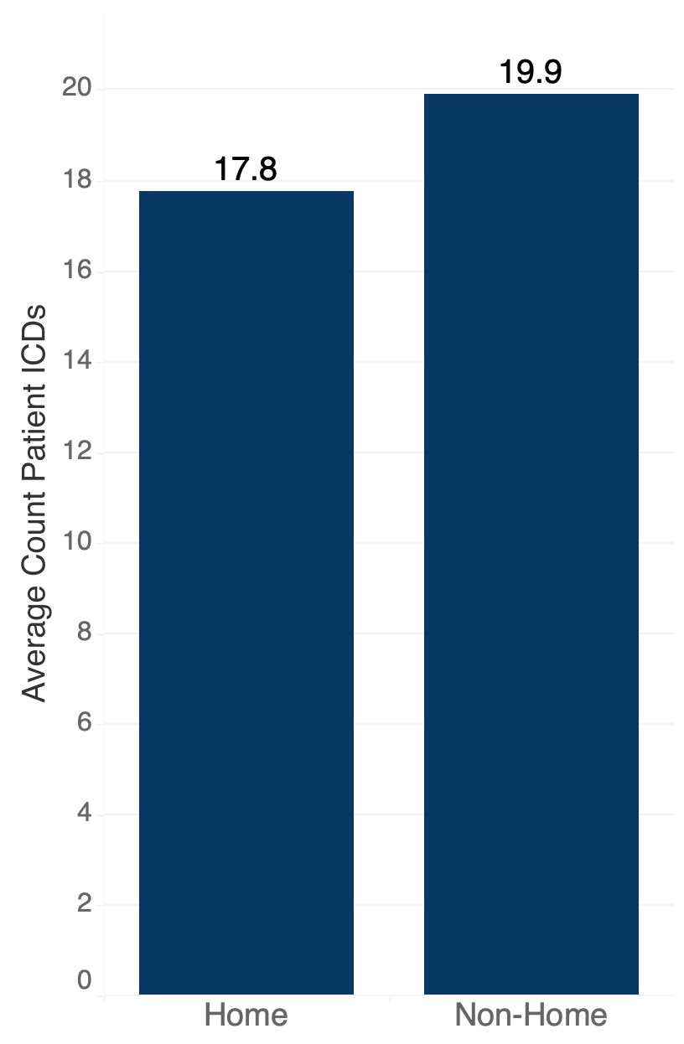
Average Count of ICDs Per Patient
by Discharge Disposition

Slide 14
Percentage Breakdown of Diagnosis Type by Discharge Disposition
 | Home (Discharge) | Non-Home (Discharge) | Total
Alzheimer’s | 40.0% | 60.0% | 100% (n = 20,381)
Dementia | 38.1% | 61.9% | 100% (n = 103,435)

Slide 15
Percentage Breakdown of Sex by Discharge Disposition
 | Home (Discharge) | Non-Home (Discharge) | Total
Male | 37.8% | 62.2% | 100% (n = 52,710)
Female | 38.9% | 61.1% | 100% (n = 71,106)

Slide 16
Percentage Breakdown of Age by Discharge Disposition
Age (Years) | Home (Discharge) | Non-Home (Discharge) | Total
0-49 | 60.3% | 39.7% | 100% (n = 2,163)
50-59 | 48.1% | 51.9% | 100% (n = 4,287)
60-69 | 40.5% | 59.5% | 100% (n = 12,912)
70-79 | 39.0% | 61.0% | 100% (n = 30,816)
80-89 | 37.1% | 62.9% | 100% (n = 48,682)
90-99 | 35.6% | 64.4% | 100% (n = 24,168)
100+ | 38.2% | 61.8% | 100% (n = 788)

Slide 17
Percentage Breakdown of Patient Race by Discharge Disposition
Race | Home (Discharge) | Non-Home (Discharge) | Total
White | 37.7% | 62.3% | 100% (n = 77,383)
Black or African-American | 39.0% | 61.0% | 100% (n = 39,474)
Asian | 43.7% | 56.3% | 100% (n = 2,442)
American Indian or Alaskan Native | 47.8% | 52.2% | 100% (n = 268)
Hawaiian or Pacific Islander | 38.4% | 61.6% | 100% (n = 112)
Other | 46.5% | 53.5% | 100% (n = 2,855)
Declined to Answer | 33.5% | 66.5% | 100% (n = 528)
Unknown | 34.3% | 65.7% | 100% (n = 522)
Multiracial | 42.7% | 57.3% | 100% (n = 232)

Slide 18
Percentage Breakdown of Marital Status by Discharge Disposition
Marital Status | Home (Discharge) | Non-Home (Discharge) | Total
Single | 36.3% | 63.7% | 100% (n = 24,086)
Married | 42.2% | 57.8% | 100% (n = 41,725)
Widow/Widower | 37.0% | 63.0% | 100% (n = 43,950)
Divorced | 35.5% | 64.5% | 100% (n = 10,341)
Separated | 40.0% | 60.0% | 100% (n = 1,356)
Unknown | 32.1% | 67.9% | 100% (n = 2,358)

Slide 19
Charlson Index
What’s The Charlson Index?
Weighted Score of Co-morbidities and Age
Designed to Predict Risk of Death On a Patient Level
A Higher Charlson Index Score is Associated With a Higher Risk of Death
Source: Sundararajan et al. (2004)

Slide 20
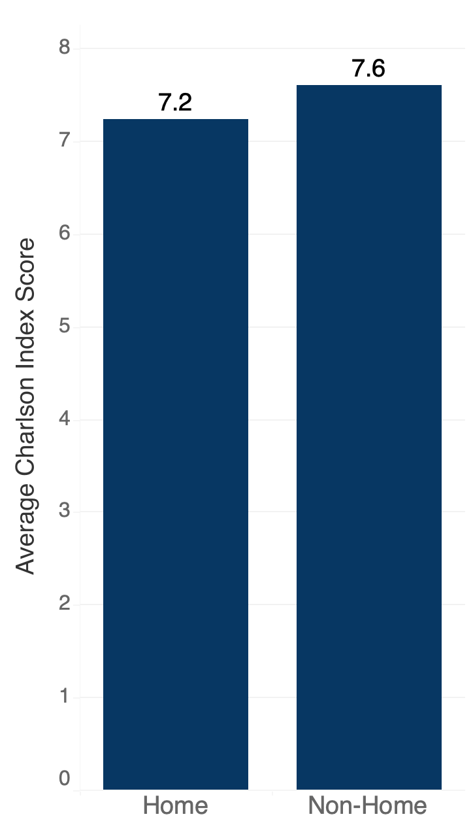
Charlson Index
What’s The Charlson Index?
Weighted Score of Co-morbidities and Age
Designed to Predict Risk of Death On a Patient Level
A Higher Charlson Index Score is Associated With a Higher Risk of Death
Source: Sundararajan et al. (2004)

Slide 21
One Tiny Problem
Lots of Potential Confounding
Multiple Logistic Regression!

Slide 22
Reference Group
(Multiple Logistic Regression)
Covariates | Reference Value
Y Covariate
Discharge Disposition | Home
X Covariates
Source of Admission | Home
Diagnosis | Dementia
Sex | Male
Race | White
Marital Status | Single

Slide 23
Multiple Logistic Regression (1 of 2)
Covariate | Odds Ratio | P-value
Source of Admission Non-Home | 2.550 | <0.001
Count of ICD | 1.058 | <0.001
Age | 1.036 | <0.001
Alzheimer | 0.918 | <0.001
Female | 0.896 | <0.001
Patient Race (American Indian or Alaskan Native) | 0.687 | 0.003
Patient Race (Asian) | 0.871 | <0.001
Patient Race (Black or African-American) | 1.000 | 0.996
Patient Race (Declined) | 1.132 | 0.198
Patient Race (Hawaiian or Pacific Islander) | 1.134 | 0.532
Patient Race (Multi-racial) | 0.778 | 0.072
Patient Race (Other) | 0.775 | <0.001
Patient Race (Unknown) | 0.918 | 0.380
* Bold signifies statistically significance

Slide 24
Multiple Logistic Regression (2 of 2)
Covariate | Odds Ratio | P-value
Marital Status (Married) | 0.685 | <0.001
Marital Status (Separated) | 0.828 | 0.002
Marital Status (Divorced) | 0.924 | 0.002
Marital Status (Widow/Widower) | 0.790 | <0.001
Marital Status (Unknown) | 1.079 | 0.119
Charlson Index Score | 1.149 | <0.001
Interaction Term 1 (Count of ICD * Charlson Index Score) | 1.000 | 0.042
Interaction Term 2 (Age * Charlson Index Score) | 0.998 | <0.001

Slide 25
Takeaways
Patient Source Location is Highly Associated With Discharge Location
Higher Age, ICD Count, and Charlson Score are associated with an Increase in Non-Home discharges
Being Female, Asian, American Indian/Alaskan Native, and Married are Each Associated With a Reduction in Non-Home Discharges

Slide 26
Further Areas of Interest
Which ICD Codes are Most Associated with Non-Home Discharge
Hospital Length of Stay
Patient Zipcode of Residence

Slide 27
Learnings & New Competencies
Data Prepping | Data Analysis | Conceptual
ICD Coding Crosswalk Charlson Index Calculation Working with Large Datasets | Microsoft Access SQL Subqueries Joins Group Bys R Filtering Data Casting Covariates Data Types Logistic Regression Reordering reference groups Recoding Covariates Scatterplots Object-Oriented Programing Tableau Custom visuals | Working with Discharge Data Charlson Index & Quantifying Comorbidity Severity Alzheimer’s and Dementia familiarity Formulating a narrow problem out of a vast dataset

Slide 28
Acknowledgments
A Big Thank You to Dr. Conan Dickson!

Slide 29
Questions?

Slide 30
References
Alzheimer's disease facts and figures. Alzheimer's Disease and Dementia. (n.d.). Retrieved May 10, 2022, from https://www.alz.org/alzheimers-dementia/facts-figures
Cox, C. B. (1996). Discharge planning for dementia patients: Factors influencing caregiver decisions and satisfaction. Health & Social Work, 21(2), 97–104. https://doi.org/10.1093/hsw/21.2.97
Sundararajan, V., Henderson, T., Perry, C., Muggivan, A., Quan, H., & Ghali, W. A. (2004). New ICD-10 version of the Charlson Comorbidity Index predicted in-hospital mortality. Journal of Clinical Epidemiology, 57(12), 1288–1294. https://doi.org/10.1016/j.jclinepi.2004.03.012
Toot, S., Swinson, T., Devine, M., Challis, D., & Orrell, M. (2016). Causes of nursing home placement for older people with dementia: A systematic review and meta-analysis. International Psychogeriatrics, 29(2), 195–208. https://doi.org/10.1017/s1041610216001654

