Slide 1
Extending Richardson’s Arms Race Model: Grievance as a Variable
Alan Estrada, Daniel Kang, Jordan Rogers

Slide 2
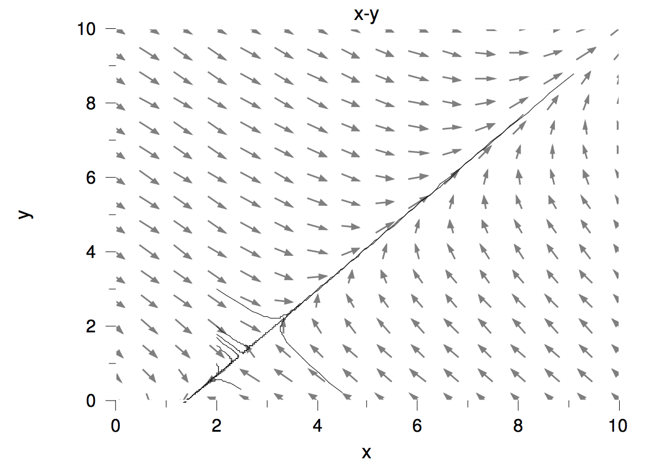
Richardson’s Model
Peace or M.A.D.
Does not account for carrying capacity
Outdated
Notes:
a,b = aggression coefficients; m,n = fatigue coefficients; r,s = grievance coefficients

Slide 3
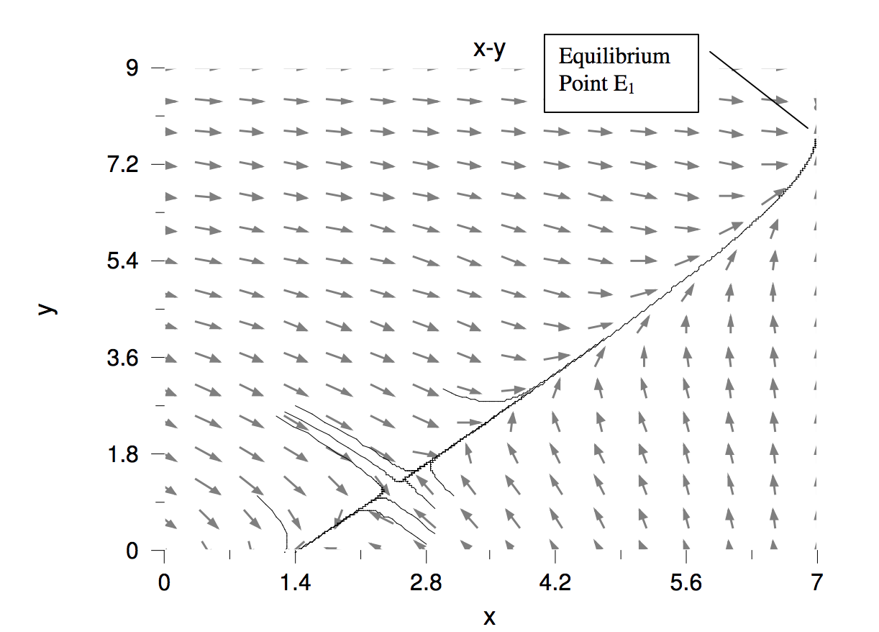
Amended Richardson Model
Adds non-peace stable points
Does not account for rate of change of arsenal

Slide 4
Grievance as a Variable Model
Retains non-peace stable points
Retains external pressures (r & s constants)
Accounts for effect of rate of change on armament
Notes:
Beta and Gamma are coefficients for the reaction to opponents rate of armament

Slide 5
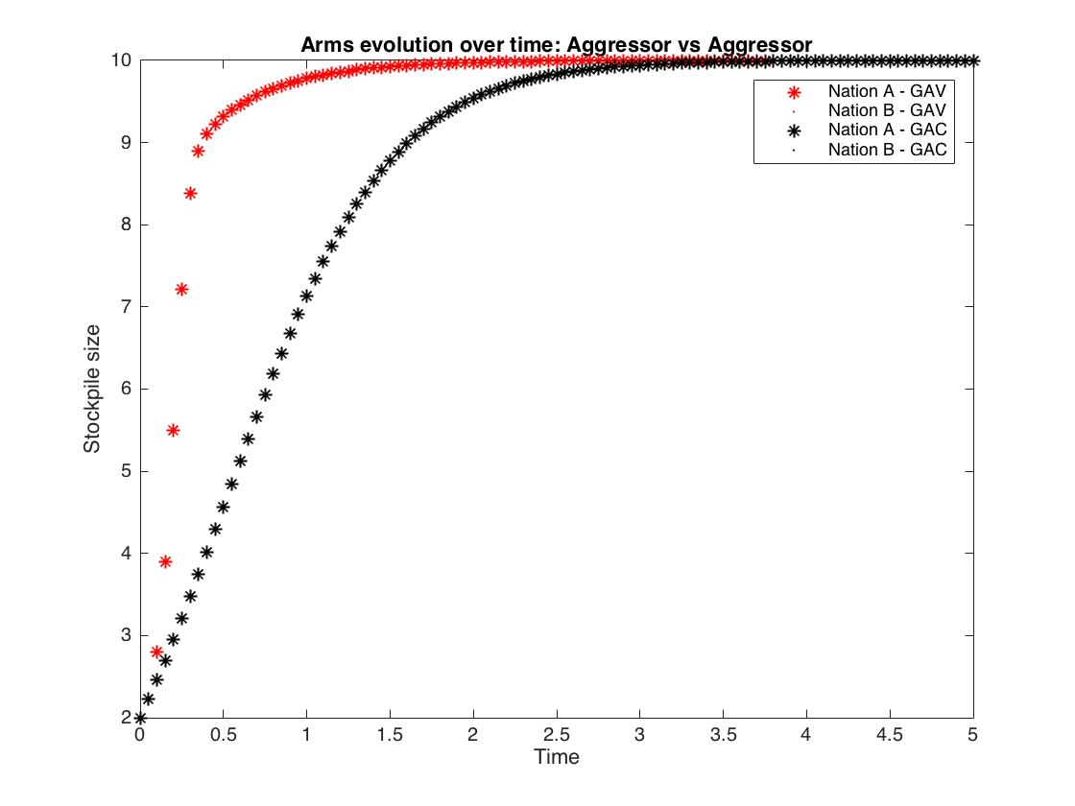
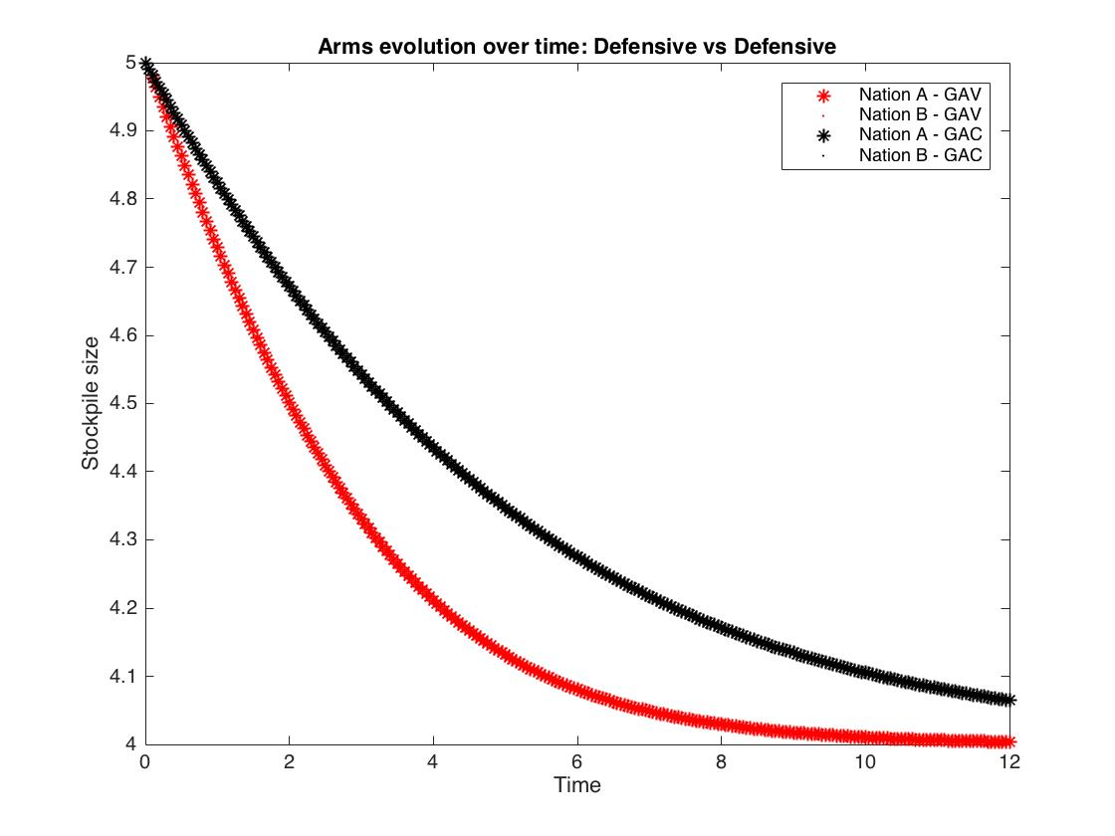
Results
Our Grievance as a Variable (GAV) model more rapidly converges to the stable point by enabling each country to react proportionally to their opponent’s rate of armament
This aligns better with real world stand-offs/disarmaments during and after the cold war, such as the Cuban Missile Crisis (1962) and the Ukraine/Belarus Disarmament (1996)
Notes:
By characterizing three different types of countries (Aggressive, Defensive, Diplomatic) and comparing arms race results between our model and the amended Richardson Model we see several key differences in evolution:

Slide 6
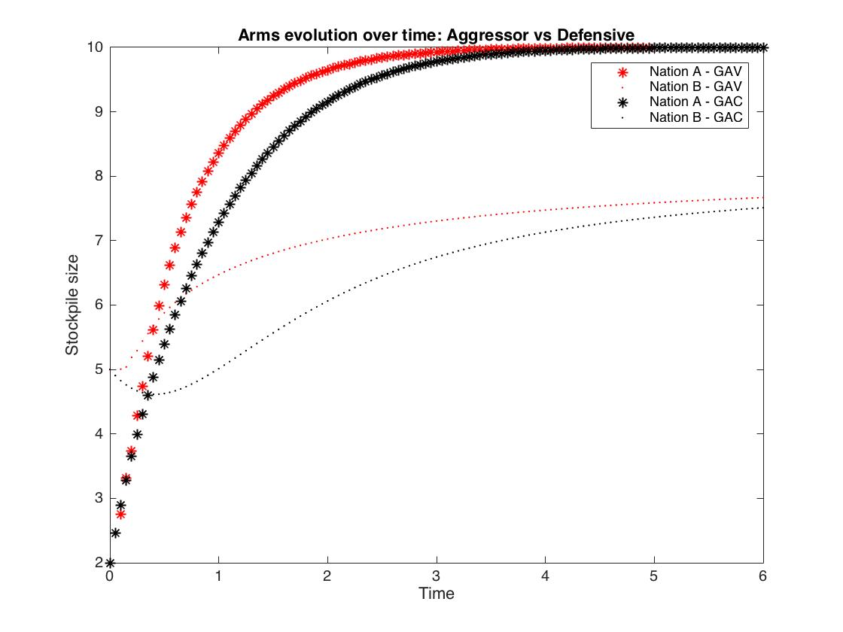
Results (cont.)
Unlike the amended Richardson model, our model does not under react when an opponent has a small arsenal but is rapidly arming

Slide 7
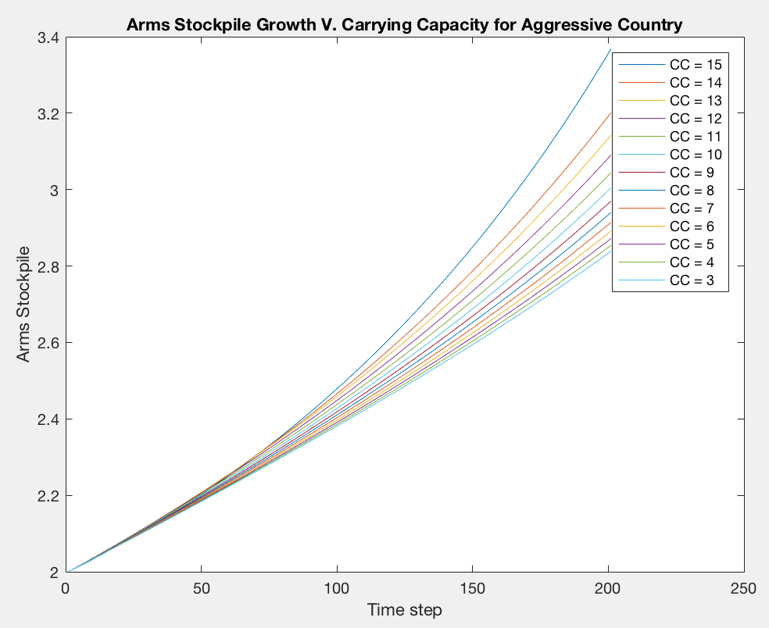
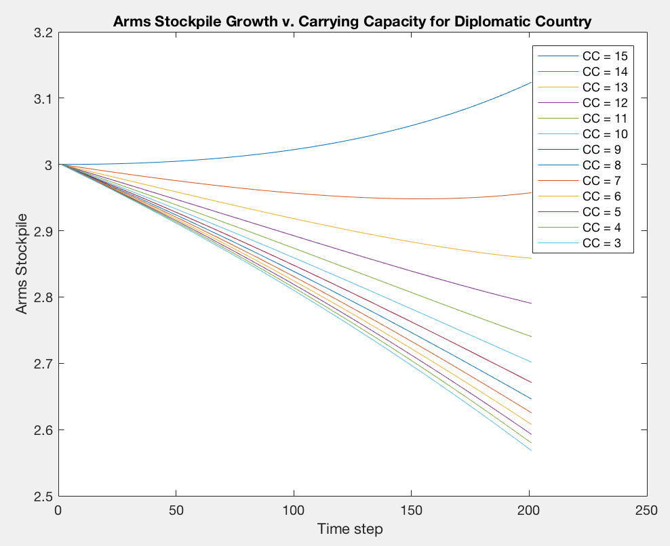
Sensitivity
Changing Carrying Capacity
(Aggressive v. Diplomatic)

Slide 8
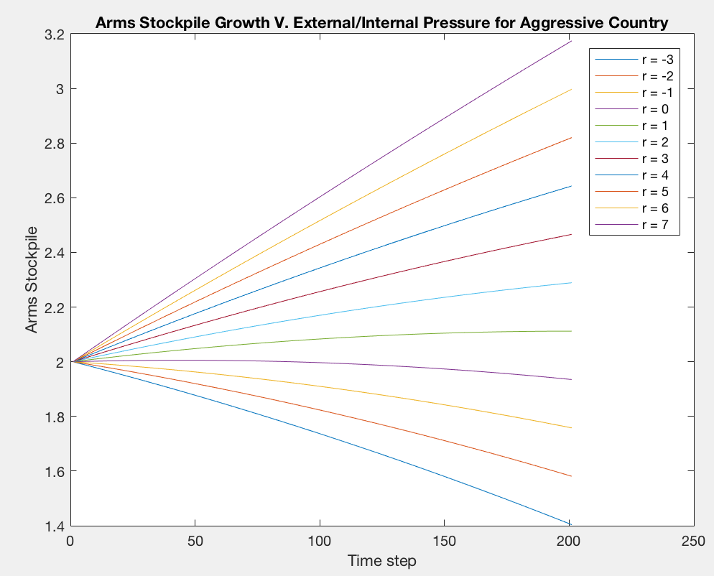
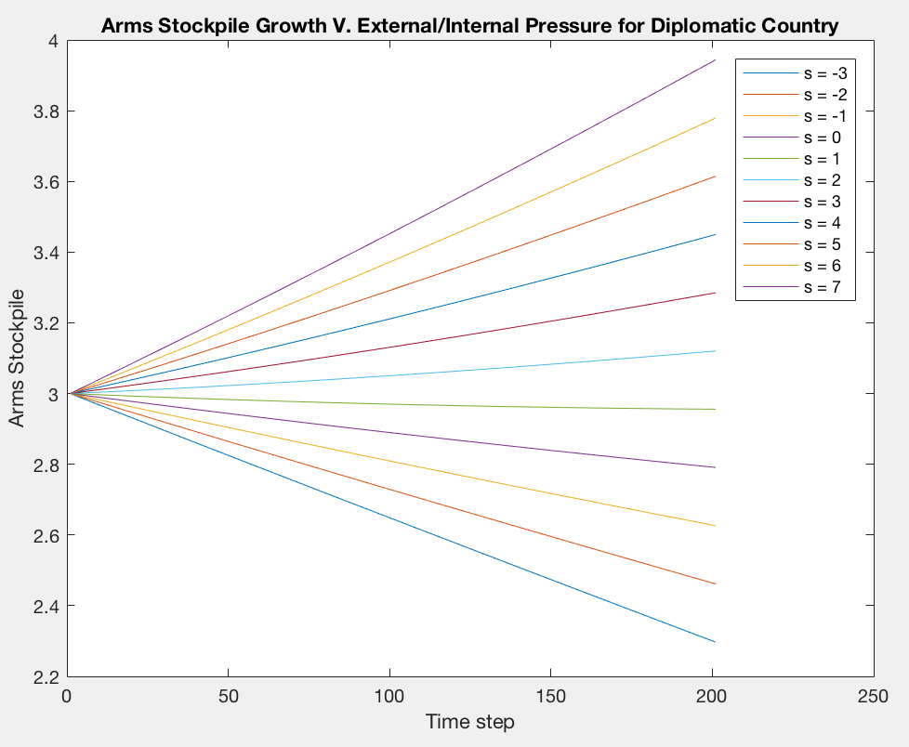
Sensitivity (cont.)
Changing Internal/External Pressures
(Aggressive v. Diplomatic)

Slide 9
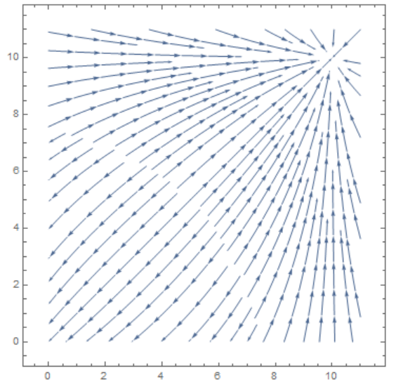
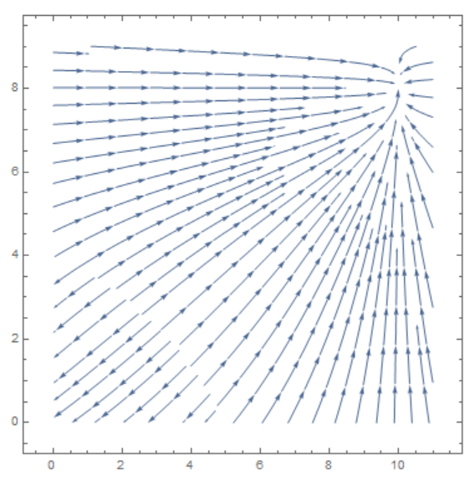
Sensitivity (cont.)
Changing Initial Arms Level
Aggressive v. Aggressive
Aggressive v. Defensive

Slide 10
Limitations
Continuous model, fractions of armaments not meaningful
3 simplistic country “play styles”, does not account for wealth of country; simplifies at the cost of potential over-generalization
No production lag in response to opponent’s armament
Could also be influenced by countries’ wealth and/or infrastructure/resources
Assumes rate of change of opponent’s arsenal does not affect how aggressive a country is (i.e. no y*dy/dt term in dx/dt and vice versa)
Notes:
When interpreting data on the scale of 1000s of arms, or treating fractions as arms in production but not finished, continuous functions less of an issue

Slide 11
Conclusion
Grievance has important implications on the timing of responses
GAV model aligns better with more recent historical events (esp. in the nuclear age)
“Russia’s Putin unveils ‘invincible’ nuclear weapons”
“The New Arms Race in AI”
Can be extended to capture even more complex relations

