Slide 1
Sky Quest
Coaches Clinic Presentation 2018

Slide 2
Overview
Teams will be assessed on their knowledge of the solar system and constellations.
Teams of 2 are suggested, but you can have one student.
Teams bring writing materials, no notes or binders.
Station format, likely 20ish stations that are 2ish minutes each

Slide 3
Topics
Earth/Sun relationship
Sun/Earth/Moon Relationship
Bodies in our Solar System
Identification of Major Constellations (from list) and their Alpha stars, if noted

Slide 4
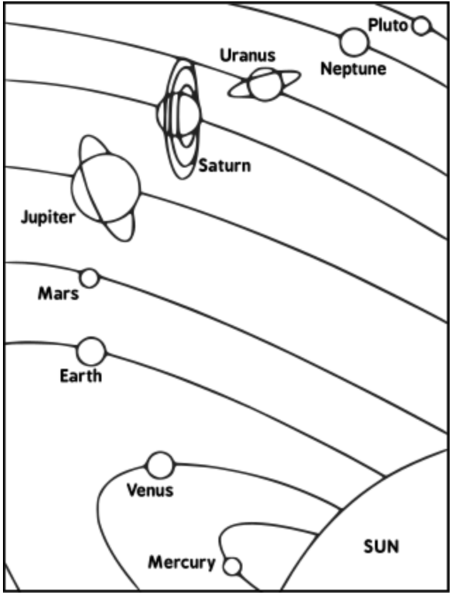
What will this look like?
While students need to know basic facts about the solar system (i.e. Jupiter is the biggest, the one with all the rings is Saturn, Venus is full of greenhouse gases), this will not be a quiz bowl on obscure solar system facts
There will likely be a ‘name the planets’ question, but it might also ask them to draw in the asteroid belt
RIP Pluto.

Slide 5
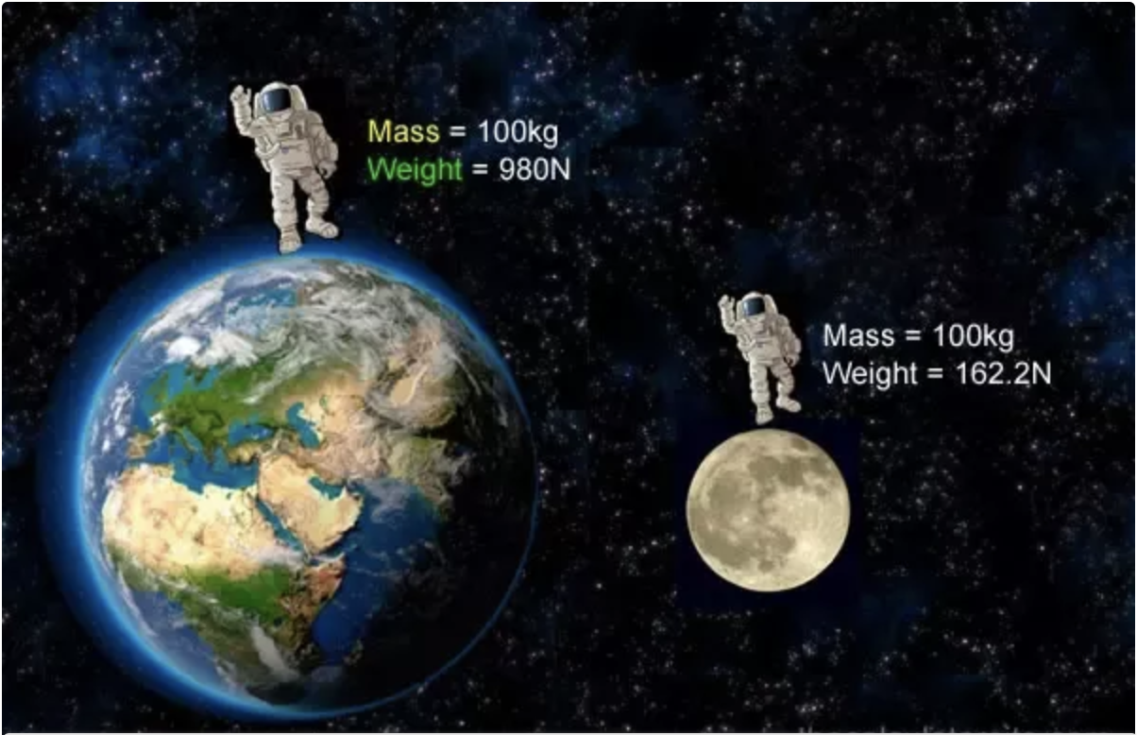
What will this look like?
Expect application questions
Ex: Here is a can, pick it up. Which of these other cans represents what the can would weigh on the moon?
Examples would be one that weighs the same, one that ways much more and one that weighs much less.
Source: https://www.quora.com/If-I-weigh-42-kilograms-on-earth-will-my-mass-remain-constant-on-the-moon

Slide 6
What will this look like?
Planet | revolution (in Earth Days or Years)
Earth | 365.256 days
Jupiter | 11.862 years
Mars | 686.98 days
Mercury | 87.969 days
Neptune | 164.79 years
Pluto | 247.68 years
Saturn | 29.457 years
Uranus | 84.011 years
Venus | 224.701 days
Expect some graphs and charts
Give this data, who has the shortest year?
Which planet takes about twice as long to go around the Sun as the Earth?

Slide 7
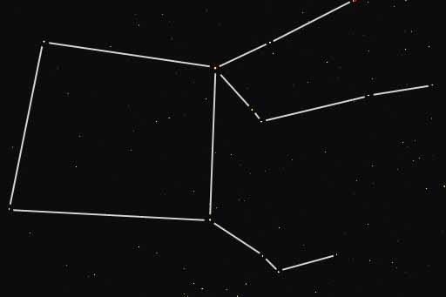
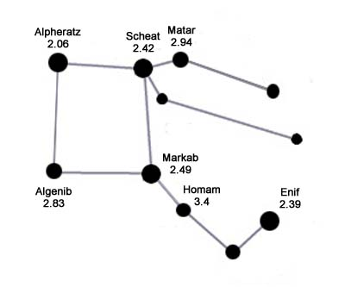
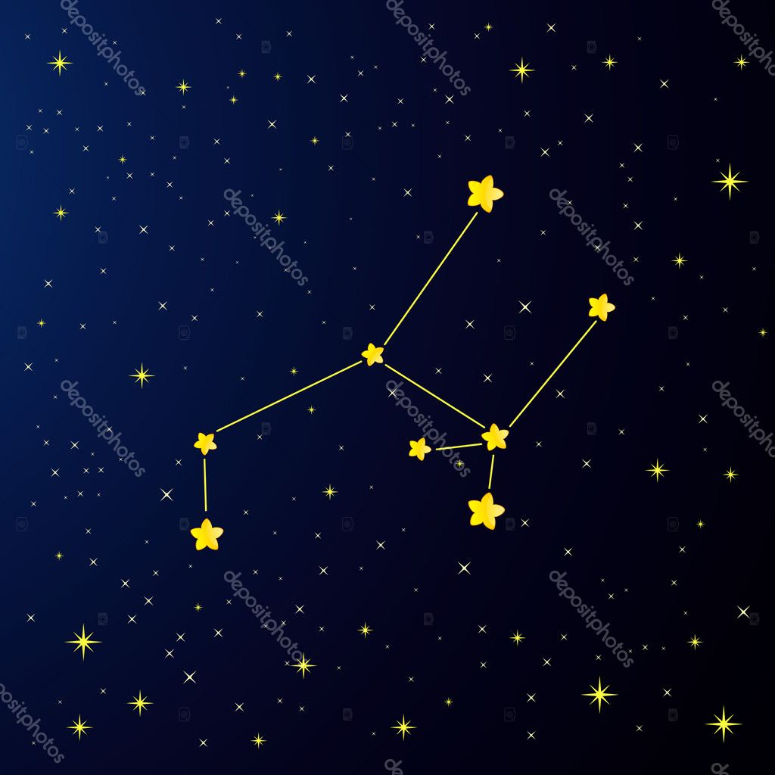
What will this look like?
Constellation identification
The only way to do this is with practice
It might be pictures, it might be pinhole tubes to look through
Many pictures on the internet look different
They might be turned sideways or upside down, especially if they are looking through a tube

Slide 8
How to prepare for this event
Astronomy is fun and interesting and hard to conceptualize - do hands on as much as possible! Let’s try this!
dkarkada@gmail.com

