Slide 1

Inverse Probability Weighting
In Multiple Groups
Balancing Baseline Characteristics and Improving Precision
of Average Treatment Effect Estimation
Dimitris Karletsos November 2025
PHUSE 2025

Slide 2
The Challenge
Heterogeneity Across Trials
Different trials enroll systematically different populations
Varying inclusion criteria, geographic regions, recruitment periods
Pooling placebo arms creates imbalanced comparison groups
How do we balance baseline characteristics across trial arms?

Slide 3
Traditional Approaches vs. Our Method
Traditional IPTW: Models treatment propensity (P(Treatment|X))
• ATE: Average Treatment Effect across entire population
• ATT: Average Treatment effect on the Treated
Our Adaptation: Models trial membership propensity (P(Trial|X))
• Goal: Balance baseline characteristics across trial placebo arms
• Creates comparable control groups when pooling heterogeneous trials

Slide 4
Standard Propensity Score Formulas
Propensity Score: e(X) = P(T = 1 | X)
Average Treatment Effect (ATE):
Weight for treated (T=1): w₁ = 1 / e(X)
Weight for control (T=0): w₀ = 1 / (1 - e(X))
where T = 1 indicates treatment, T = 0 indicates control, and X represents baseline covariates

Slide 5
Standard Propensity Score Formulas
Propensity Score: e(X) = P(T = 1 | X)
Average Treatment Effect on the Treated (ATT):
Weight for treated (T=1): w₁ = 1
Weight for control (T=0): w₀ = e(X) / (1 - e(X))
where T = 1 indicates treatment, T = 0 indicates control, and X represents baseline covariates

Slide 6

Our Approach
Adapt IPTW to model trial membership propensity instead of treatment propensity
Use multinomial logistic regression to estimate probability of trial membership
Weight each participant by inverse of their trial membership probability
Create pseudo-population where trial membership is independent of covariates

Slide 7
Step 1: Fit Multinomial Logistic Regression
Model trial membership as a function of baseline covariates:
log(P(Trial = k | X) / P(Trial = ref | X)) = β₀ₖ + β₁ₖX₁ + ... + βₚₖXₚ
For K trials:
• Creates K-1 equations (one trial used as reference)
• Naturally handles multiple groups without pairwise comparisons
• Probabilities sum to 1 across all trials for each participant

Slide 8
Step 2: Calculate Propensity Scores
Extract predicted probability for each participant's observed trial:
PS_i = P̂(Trial = j | X_i)
where j is the trial that participant i actually belongs to
Propensity score range in our simulation: 0.18 to 0.92
• Median: 0.45
• Indicates moderate separability with no extreme probabilities

Slide 9
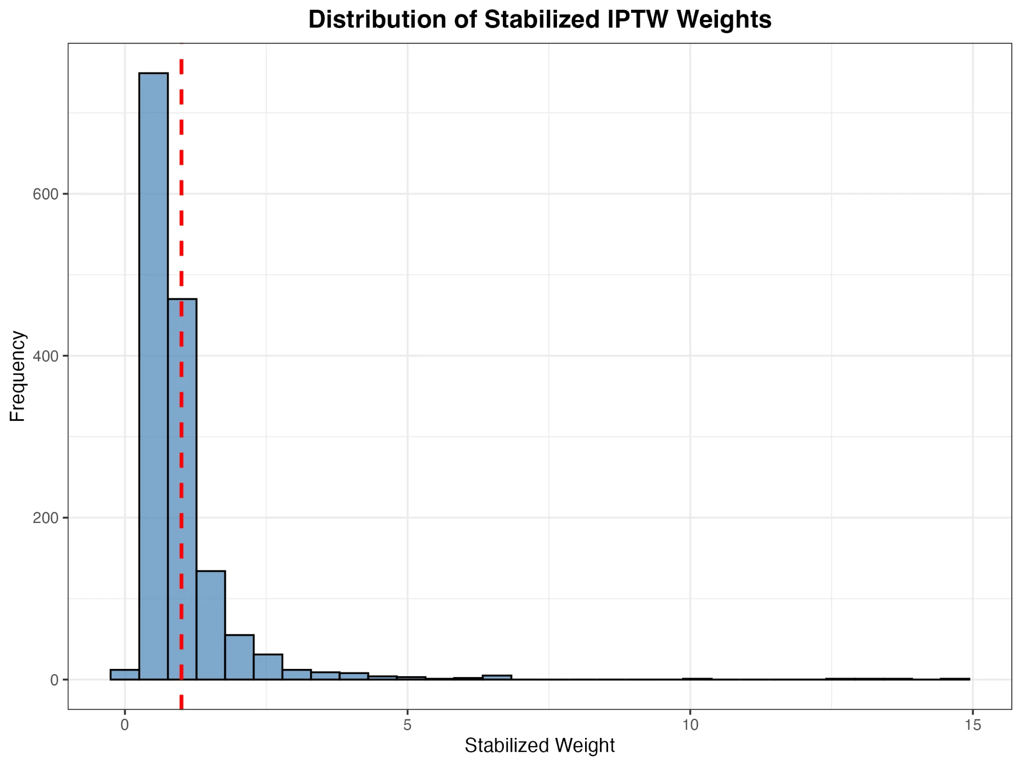
Step 3: Compute Stabilized IPTW Weights
Calculate stabilized weights for each participant:
SW_i = P(Trial = j) / P̂(Trial = j | X_i)
where P(Trial = j) is the marginal probability (proportion in trial j)
• Mean ≈ 1 by construction
• Lower variance than unstabilized weights
• More stable statistical estimates

Slide 10
Step 4: Assess Balance Using SMD
Calculate Standardized Mean Differences (SMDs) for each covariate:
SMD = (X̄_trial - X̄_pooled) / SD_pooled
Assess balance before and after weighting:
• |SMD| < 0.1 indicates adequate balance
• Compare pre-weight vs. post-weight SMDs

Slide 11
Step 4: Assess Balance Using SMD
Calculate Standardized Mean Differences (SMDs) for each covariate:
SMD = (X̄_trial - X̄_pooled) / SD_pooled
Monitor effective sample size:
• ESS = (Σw_i)² / Σ(w_i²)
• ESS < 50% suggests extreme heterogeneity

Slide 12
Methods
Stabilized Weight = P(Trial = j) / P(Trial = j | X)
1
2
Fit multinomial logistic regression for trial membership
Calculate propensity scores for each participant
3
4
Compute stabilized IPTW weights
Assess balance using standardized mean differences

Slide 13
Simulation Design
Baseline Covariates
Age (continuous, trial means: 55-70 years)
Sex (binary)
Disease severity (continuous, 0-100)
Comorbidity count (0-5)

Slide 14
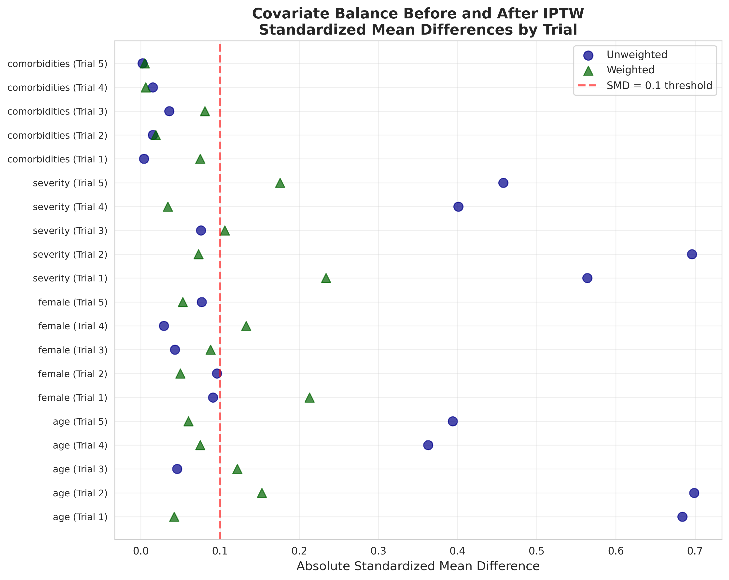
Results: Balance Improvement
Max SMD Before
0.70
Max SMD After
0.23
↓ 67% reduction
Effective Sample Size
24%
retained

Slide 15
Key Findings
✓ Improved Balance
! Efficiency Trade-off
All SMDs reduced below 0.25, with most variables achieving excellent balance
Effective sample size reduced to 24%, indicating heterogeneous trial populations
✓ Valid Estimates
✓ Practical Feasibility
Weighted HR: 0.73 (95% CI: 0.64-0.83), properly adjusted for baseline differences
Method successfully implemented with standard statistical software (R/Python)

Slide 16
Implementation Considerations
Best Practices
Potential Issues
Include all relevant confounders
Check propensity score overlap
Monitor weight distribution
Calculate effective sample size
Extreme weights (consider truncation)
Poor covariate overlap
Model misspecification
Limited trial number
When ESS < 50% of N, carefully evaluate whether trials are too heterogeneous to pool

Slide 17

Conclusions
IPTW adapted for trial membership effectively balances baseline characteristics across heterogeneous trial populations in IPD meta-analysis.
The method provides a principled approach to creating comparable control groups when trials enroll systematically different patient populations.
Careful monitoring of effective sample size and weight diagnostics is essential for practical implementation.
A valuable tool for IPD meta-analysts facing baseline heterogeneity across trials

Slide 18
Thank You
Questions?
Code and supplementary materials available
https://github.com/dkarletsos/multigroup_iptw
dimitris.karletsos@gmail.com

