Slide 1
United States Public Health 101 [Individuals and organizations may customize and use the following slides for their own informational and educational purposes]
Office for State, Tribal, Local and Territorial Support
Centers for Disease Control and Prevention
November 2013
Centers for Disease Control and Prevention
Office for State, Tribal, Local and Territorial Support

Slide 2
Key Questions We’ll Discuss
What is public health? Why is it important?
What are the 3 core functions and 10 essential services, and how do they impact the public’s health?
How is public health structured in the United States to deliver these core functions and services?
What are the responsibilities at the federal, state, and local levels? For tribes and territories?
What other groups are important?

Slide 3
Learning Objectives
At the end of this session, you will be able to
Describe the roles and responsibilities of public health
Describe the 3 core functions and 10 essential services of public health
Describe the unique roles and responsibilities of public health at the federal, state, local, tribal, and territorial levels

Slide 4
Public Health: An Overview
Centers for Disease Control and Prevention
Office for State, Tribal, Local and Territorial Support

Slide 5


Health is…
…a dynamic state of complete physical, mental, spiritual, and social well-being and not merely the absence of disease or infirmity.*
Public health is “What we as a society do collectively to assure the conditions in which people can be healthy.”**
and…
Source: *WHO, 1998; **IOM, 1988
Notes:
If we look at the definition of health, we see that it encompasses a broad range of conditions.
Health requires
physical,
mental,
spiritual, and
social well-being.
Ensuring conditions so that people can be healthy is the job of public health. And in order to ensure physical, mental, spiritual, and social well-being, public health requires that society work together, collectively.

Slide 6
Vision:
Healthy People in Healthy Communities
Mission:
Promote Physical and Mental Health
Prevent Disease, Injury, and Disability
Notes:
Public Health in America – Vision and Mission
The Public Health In America statement shown here was developed in 1994 by the Public Health Steering Committee, composed of representatives from public health agencies (e.g., CDC, HRSA) and key national public health organizations. It expanded on the discussion of core functions outlined in the 1988 Institute of Medicine report, “The Future of Public Health.”
It provides a vision and mission for public health as well as the context of what public health should be prepared to do, and how public health service is delivered.
The vision for public health is broad—“Healthy People in Healthy Communities.” The mission identified is to “Promote Physical and Mental Health and Prevent Disease, Injury, and Disability.”

Slide 7
Public Health
Prevents epidemics and the spread of disease
Protects against environmental hazards
Prevents injuries
Promotes and encourages healthy behaviors
Responds to disasters and assists communities in recovery
Assures the quality and accessibility of health services
Notes:
The Public Health in America statement also includes a section that defines the purpose of public health, which includes
Preventing epidemics and the spread of disease
Protecting against environmental hazards
Preventing injuries
Promoting and encouraging healthy behaviors
Responding to disasters and assisting communities in recovery
Assuring the quality and accessibility of health services

Slide 8
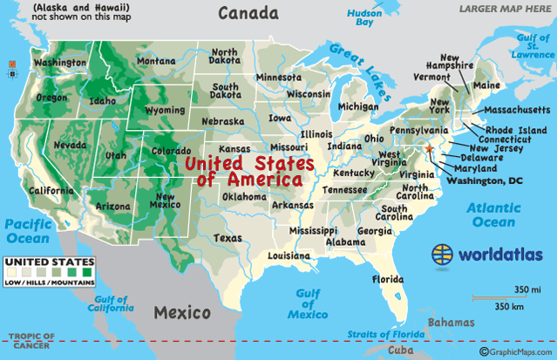
Recent Health Threats/Events in US
Hurricane Sandy in 2012
(NJ and NY)
Salmonella in peanut butter
in 2011
H1N1 epidemic in 2009
Hurricane Katrina in 2005
(New Orleans, LA & Mississippi)
9/11 attacks on the US in 2001 (New York City)
These events required responses from more than one geographical area and more than one agency, increasing collaboration and cooperation.
Notes:
In recent years, a series of different public health threats emphasized the context of public health in the US. These events required responses from more than one geographic area and more than one agency.
Hurricane Sandy: hit the US in October 2012; was the largest Atlantic hurricane on record; approx. $71 Billion in damages; affected 24 states, but most severe damage in New Jersey and New York, with sea water flooding streets, tunnels, and subway lines.
Salmonella contamination of peanut butter: in 2011, the US Food and Drug Administration (FDA), the CDC, and state and local public health officials investigated a multistate (20) outbreak of salmonella infections linked to peanut butter, of special concern because many children eat peanut butter. The collaborative work identified the origin and shut it down quickly. (Source: FDA)
H1N1 Epidemic: the H1N1 flu virus caused a worldwide pandemic in 2009 as a new strain of swine origin. It caused about 17,000 deaths by the start of 2010.
In the interest of time, let’s talk about only the last two in a little more detail
Hurricane Katrina in 2005
9/11 attacks on the US in 2001

Slide 9
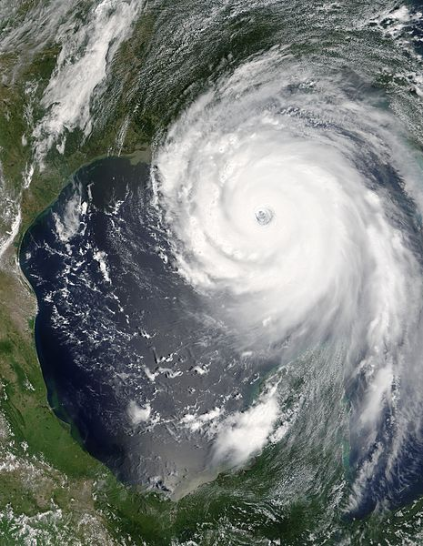
Hurricane Katrina, 2005
Second-strongest hurricane ever recorded in the US
Devastated Louisiana and Mississippi
(Gulf Coast)
Storm surge of 20 feet
Greatest number of deaths were in New Orleans; 80% of the city was flooded
About $75 billion in physical damages
Economic impact in Louisiana and Mississippi >$110 billion
Costliest hurricane in US history
Affected about 90,000 square miles
NASA Photo
Notes:
The second-strongest hurricane ever recorded in the United States, covered most of Gulf of Mexico
The most deaths occurred in New Orleans, Louisiana, which flooded as the levee system catastrophically failed. Eventually 80% of the city and neighboring parishes became flooded, and the floodwaters lingered for weeks.
The worst property damage occurred in coastal areas, such as all the beachfront towns in Mississippi, which were flooded over 90% within hours, with waters reaching 6–12 miles inland (10–19 kilometers) from the beach.
Due to these events, much federal funding and focus was placed on preparedness and emergency response.
However, state and local health departments are still responsible for addressing those population-based health issues in their communities.

Slide 10
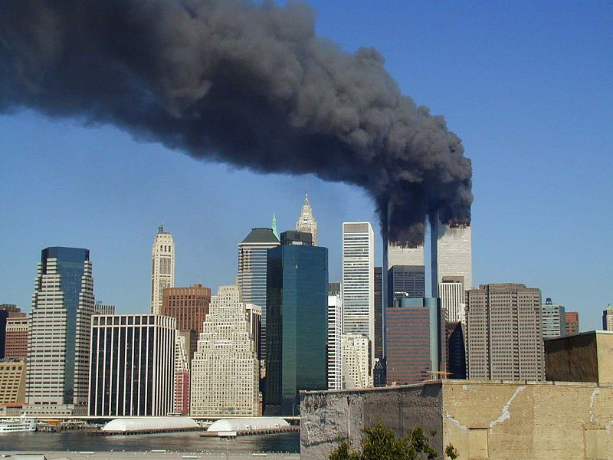
9/11 Attack, 2001
On September 11, 2001, 19 terrorists associated with al-Qaeda launched four coordinated attacks on the US.
They hijacked four airplanes. Two crashed into the World Trade Center (NY) and one into the Pentagon (Washington, DC).
The fourth plane crashed in a field in Pennsylvania after passengers tried to overcome the hijackers. It had targeted the US Capital.
More than 3,000 people were killed during these attacks.
Photo by Michael Foran
Notes:
Two planes crashed into the north and south towers of the World Trade Center in New York.
A third plane crashed into the Pentagon in Washington DC (the headquarters of the US Department of Defense).
The fourth plane crashed into a field in Pennsylvania after the passengers tried to overcome the hijackers. It had originally targeted the US Capitol in Washington DC.
Over 3,000 people were killed during the attacks in New York City and Washington, DC, including more than 400 police officers and firefighters.
The attacks fundamentally changed the attitude toward terrorist attacks in the US and prompted increased planning and funding for preparedness.

Slide 11
Top 10 Causes of Death in the US
Source: National Vital Statistics Reports, Vol. 61, No. 6, October 10, 2012.
Notes:
The more traditional view of public health has been on the top 10 causes of death in the US:
Heart Disease 596,339
Cancer 575,313
Chronic lower respiratory diseases 143,382
Stroke (cerebrovascular disease) 128,931
Accidents (unintentional injuries) 122,777
Alzheimer's disease 84,691
Diabetes 73,282
Influenza and Pneumonia 53,667
Kidney disease 45,731
Intentional injuries self-harm (suicide)—new to top 10 38,285
Many of these causes of death can be prevented by public health services and programs.
Have we made progress toward reducing or preventing these deaths? If so, how?

Slide 12
What does What does medicine do? public health do?
Saves lives one at a time Saves lives millions at a time
Notes:
Public health touches EVERY individual, EVERY day.
Addressing the cause of death and emergencies cannot be done one person at a time.
Population-based public health means strategy is needed.

Slide 13
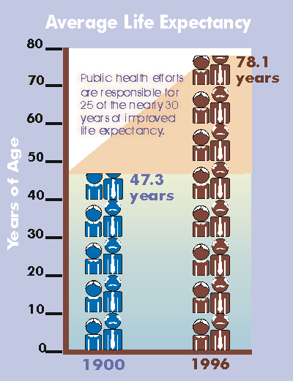
Average Life Expectancy
Thanks to
public health
for the extra 25 years of life!
Source: National Vital Statistics System, National Center for Health Statistics
Notes:
Public health efforts are responsible for 25 of the nearly 30 years of improved life expectancy in the US from 1900 to 1996.

Slide 14

Ten Great US Public Health Achievements (1900–1999)
Vaccinations
Safer workplace
Safer and healthier food
Motor vehicle safety
Control of infectious diseases
Decline in deaths from coronary heart disease and stroke
Family planning
Recognition of tobacco use as a health hazard
Healthier mothers and babies
Fluoridation of drinking water
Source: http://www.cdc.gov/mmwr/preview/mmwrhtml/00056796.htm
Notes:
[Note to Presenter: You might focus on 2 or 3, not all]
Current life expectancy in 2013 is 78.7 years
Life expectancy has been extended (in part) by these achievements:
Vaccination—There are now 50,000 fewer cases of smallpox than occurred in 1900; 900,000 fewer cases of measles than occurred in 1941; 21,000 fewer cases of polio than occurred in 1951. Programs of population-wide vaccinations resulted in the eradication of smallpox; elimination of polio in the Americas; and control of measles, rubella, tetanus, and diphtheria in the US and other parts of the world.
Motor vehicle safety—Since 1925, the annual death rate from motor vehicle travel has decreased 90%. Seat belts have saved approximately 85,000 lives; child safety seats have reduced risk of infant death by 69%. Community awareness and DWI (driving while intoxicated) regulations have helped reduce alcohol-related deaths by 32%.
Control of infectious diseases—Infections (such as typhoid and cholera), major causes of illness and death early in the 20th century, have been reduced dramatically by improved sanitation. Also, the discovery of antimicrobial therapy has been critical to successful public health efforts to control infections such as tuberculosis and sexually transmitted diseases.
Decline in deaths from coronary heart disease and stroke—Deaths from coronary heart disease and stroke have declined due to risk-factor modification, such as smoking cessation and blood pressure control. Since 1972, death rates for coronary heart disease has decreased 51%.
Recognition of tobacco use as a health hazard—Recognition of tobacco use as a health hazard in 1964 has resulted in reduced use and reduced exposure to secondhand tobacco smoke.
Healthier mothers and babies—Healthier mothers and babies are a result of better hygiene and nutrition, antibiotics, access to health care, technology in maternal and neonatal medicine, and immunizations. Since 1900, infant mortality has decreased more than 90%, and maternal mortality has decreased 99%.

Slide 15
How Has Public Health Extended Life Expectancy?
The foundation for public health lies within the 3 core functions defined by the IOM:
Assessment
Policy Development
Assurance
Public health is guided by the Ten Essential Public Health Services and is applied to every facet of public health (national → state → local and tribes and territories)
Source of core functions: Institute of Medicine. The Future of Public Health. 1988.
Source of Ten Essential Public Health Services: Core Public Health Functions Steering Committee, 1994
Notes:
The foundation for public health lies within the 3 core functions mentioned earlier and defined by the Institute of Medicine:
Assessment
Policy Development
Assurance
The Public Health Steering Committee further developed these core functions in 1994 into the Ten Essential Public Health Services, applied to every facet of public health (national→state→local and tribes and territories).
Let’s look at these in more detail.
(See next slides for details)

Slide 16

Essential Public Health Services
Developed by the Core Public Health Functions Steering Committee (1994)
Included reps from national organizations and federal agencies
Charge: To provide a description and definition of public health
Developed the “Public Health in America” statement
Source of Ten Essential Public Health Services: Core Public Health Functions Steering Committee, 1994

Slide 17
Essential Services of Public Health
Monitor health status
Diagnose and investigate
Inform, educate, and empower
Mobilize community partnerships
Develop policies and plans
Enforce laws and regulations
Link people to needed services/assure care
Assure a competent workforce
Evaluate health services
Research
Source of Ten Essential Public Health Services: Core Public Health Functions Steering Committee, 1994
Notes:
The last part of the Public Health in America statement that defined public health also defines the “Essential Services of Public Health.” The ten essential services are shown here.
Monitor health status to identify and solve community health problems
Diagnose and investigate health problems and health hazards in the community
Inform, educate, and empower people about health issues
Mobilize community partnerships to identify and solve health problems
Develop policies and plans that support individual and community health efforts
Enforce laws and regulations that protect health and ensure safety
Link people to needed personal health services and assure the provision of health care when otherwise unavailable
Assure a competent public and personal healthcare workforce
Evaluate effectiveness, accessibility, and quality of personal and population-based health services
Research for new insights and innovative solutions to health problems

Slide 18
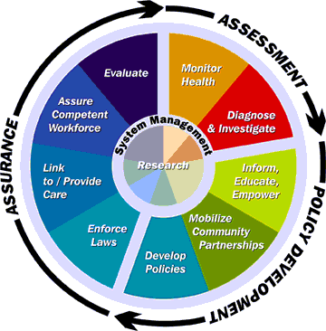
Public Health Core Functions and 10 Essential Services
Source of Ten Essential Public Health Services: Core Public Health Functions Steering Committee, 1994
Notes:
The Ten Essential Services relate to the Three Core Functions.
Public health in the United States is framed around three core functions of public health:
assessment
policy development, and
assurance.
Each core function is linked to essential services that a public health department should be providing, at the state or local level.
Under the core function of assessment:
surveillance and
disease investigations.
Under policy development:
education,
partnership mobilization, and
policies.
Under assurance:
enforcement of public health laws,
linkage of citizens to needed care,
developing the public health workforce, and
evaluation.
At the heart of the core functions and the essential services are the two keys without which public health cannot function:
system management, and
research.

Slide 19
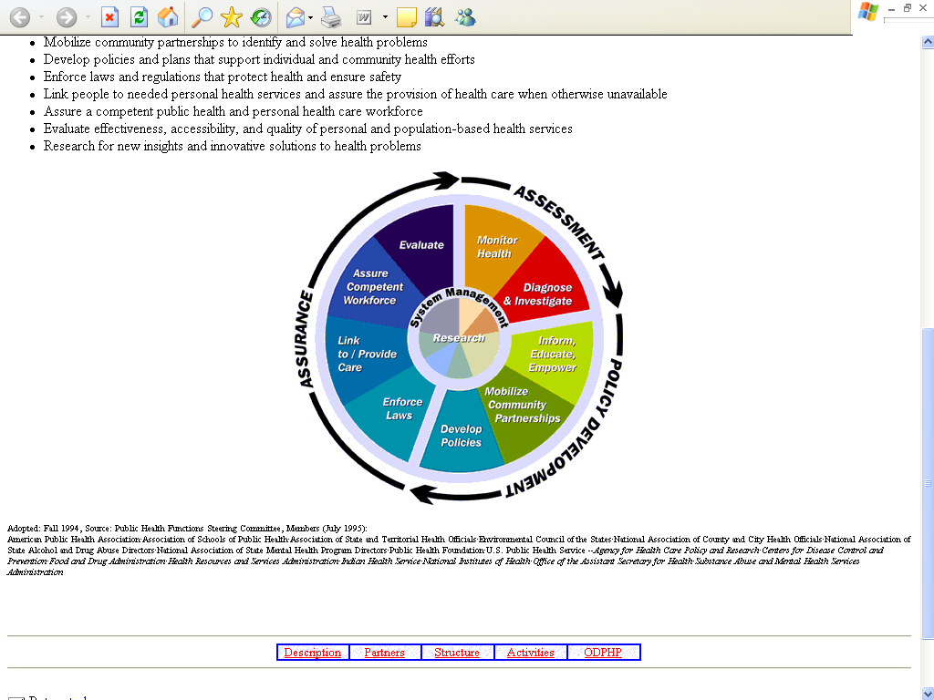
The Essential Public Health Services
Identifying and sharing best practices; participation in research
Evaluation and continuous quality improvement
Community health assessment; registries
Public health workforce and leadership
Investigate infectious water-, food-, and vector-borne disease outbreaks
Access to care, link with primary care
Health education and health promotion
Enforcement, review of laws
Partnerships with private sector, civic groups, NGOs, faith community, etc.
Strategic planning; community health improvement planning
Notes:
Assessment
Monitor health status to identify community health problems—identify health risks, vital stats, and disparities; identify assets and resources
Diagnose and investigate health problems and health hazards in the community, identify and investigate health threats, assess laboratory capacity and response plans for major health threats
Policy Development
Inform, educate, and empower people about health issues—build knowledge, shape attitudes; inform decision-making choices
Mobilize community partnerships to identify and solve health problems—coalition development; informal and formal partnerships
Develop policies and plans that support individual and community health efforts
Assurance
Enforce laws and regulations that protect health and ensure safety; Advocate and educate about regulations and laws needed to promote health
Link people to needed personal health services and assure the provision of health care when otherwise unavailable
Assure a competent public health and personal health care workforce
Evaluate effectiveness, accessibility, and quality of personal and population-based health services
Research in all 3 core functions—for new insights and innovative solutions to health problems; epidemiological studies

Slide 20
Structure of Public Health in the United States
Centers for Disease Control and Prevention
Office for State, Tribal, Local and Territorial Support

Slide 21
Framework for Improving the Performance of Public Health
Health
Department
+
PH System
+
Community
Partners
+
Workforce
Operational
Capacity
(Infrastructure)
Every
Community
Program and
Public Health
Activity
(Chronic Disease,
Inf. Disease, EH)
Better Health
Outcomes
Reduced
Disparities
Better
Preparedness
Which
leads
to
Builds
Impacts
Investments here
Pay big dividends here
Source: D. Lenaway. Centers for Disease Control and Prevention, Office of Chief of Public Health Practice. 2009 (unpublished)
Notes:
So how does this all fit together?
<1> Investments in the health department and the public health system by community partners and funders, including developing the workforce,
<2> builds operational infrastructure and capacity.
<3> This capacity impacts all community programs and public health activities, and
<4> leads to better health outcomes, reduced disparities, and better preparedness to meet public health challenges.
The National Public Health Performance Standards and the accreditation program are ways to identify what investments are needed in public health, and the National Public Health Improvement Initiative is a way of building operational capacity to address those needs.
<5> Investments in the three core functions of public health, directed by a PHSSR (Public Health Services and Systems Research) research agenda, lead to big dividends in public health outcomes over the long term.

Slide 22
Governmental Public Health
State and Local Health Departments
Retain the primary responsibility for health under the US Constitution
State and the District of Columbia Health Departments
51**
Tribal Health Departments
Local Health Departments
2,565*
Territorial Health Departments
8**
* Number based on 2010 National Profile of Local Health Departments (NACCHO, 2011)
** Numbers cited from ASTHO, Profile of State Public Health, Volume Two, 2011

Slide 23
Federal Public Health Roles and Responsibilities
Centers for Disease Control and Prevention
Office for State, Tribal, Local and Territorial Support
Notes:
Let’s start our more detailed look with the federal public health system.

Slide 24
Federal Public Health Responsibilities
Ensure all levels of government have the capabilities to provide essential public health services
Act when health threats may span more than one state, a region, or the entire nation
Act where the solutions may be beyond the jurisdiction of individual states
Act to assist the states when they lack the expertise or resources to effectively respond in a public health emergency (e.g., a disaster, bioterrorism, or an emerging disease)
Facilitate the formulation of public health goals (in collaboration with state and local governments and other relevant stakeholders)
Source: Trust for America’s Health. Public Health Leadership Initiative: An Action Plan for Healthy People in Healthy Communities in the 21st Century. Washington, DC. 2006.
Notes:
[NOTE to Presenter: Pick one or two to discuss/elaborate; all are listed for completeness]
Ensure all levels of government have the capabilities to provide essential public health services
Act when health threats may span more than one state, a region, or the entire nation
Act where the solutions may be beyond the jurisdiction of individual states
Act to assist the states when they lack the expertise or resources to effectively respond in a public health emergency (e.g., a disaster, bioterrorism, or an emerging disease)
Facilitate the formulation of public health goals (in collaboration with state and local governments and other relevant stakeholders)

Slide 25
Other Roles of Federal Public Health
Federal government plays a crucial role in
Providing leadership, through regulatory powers, in setting health
Goals
Policies
Standards
Contributing operational and financial resources
Financing research and higher education
Supporting the development of scientific and technological tools needed to improve the effectiveness of public health infrastructure at all levels

Slide 26
State Health Departments Roles and Responsibilities
Centers for Disease Control and Prevention
Office for State, Tribal, Local and Territorial Support

Slide 27
State Roles
Screening for diseases and conditions
Treatment for diseases
Technical assistance and training
State laboratory services
Epidemiology and surveillance
Notes:
Screening for diseases and conditions (e.g., newborn screening, HIV/AIDS, TB, diabetes)
Treatment for diseases (e.g., TB, STDs, HIV/AIDS, diabetes)
Technical Assistance and Training (e.g., emergency responders, hospitals, data management, policy development, local health departments)
State Laboratory Services (e.g., bioterrorism agents test, food-borne illness testing, influenza typing, environmental toxins, newborn screening)
Epidemiology and Surveillance (e.g., data collection and epidemiology on behavioral risk factors, communicable/infectious diseases, vital statistics, chronic diseases)

Slide 28

State Health Agency Funding by Source (n=48)
Source: ASTHO: Profile of State Public Health, Volume Two, 2011
Notes:
In 2011, the largest source of state health agency revenue was federal funds, followed by state general funds.
Medicare and Medicaid revenue was the smallest revenue source for state health agencies.
Within the revenue categories, reimbursements to third-party providers for clinical services to the Medicaid-eligible population were excluded from the state health agency revenue and expenditures.

Slide 29
Local Health Departments Roles and Responsibilities
Centers for Disease Control and Prevention
Office for State, Tribal, Local and Territorial Support

Slide 30
State and Local Health Department Governance Classification System
Local/Decentralized—Local health departments are units led by local governments, which make most fiscal decisions.
Mixed—Some local health departments are led by state government, and some are led by local government. No one arrangement predominates in the state.
State/Centralized—All local health departments are units of state government, which makes most fiscal decisions.
Shared—All local health departments are governed by both state and local authorities.
Source: ASTHO Profile of State Public Health, Volume Two, 2011
Notes:
There are several ways that local health departments function:

Slide 31
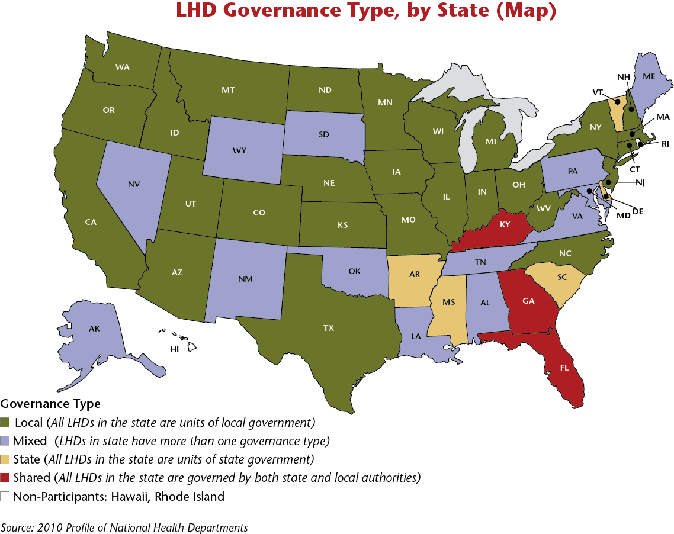
National Profile of Local Health Departments
Source: 2010 National Profile of Local Health Departments—NACCHO
Notes:
This map indicates which states are governed in which way: local, mixed, state, and shared.
Speaker: Discussion here about
Mixed vs. state/centralized system vs. local system—pros & cons
How is your state or country set up?

Slide 32
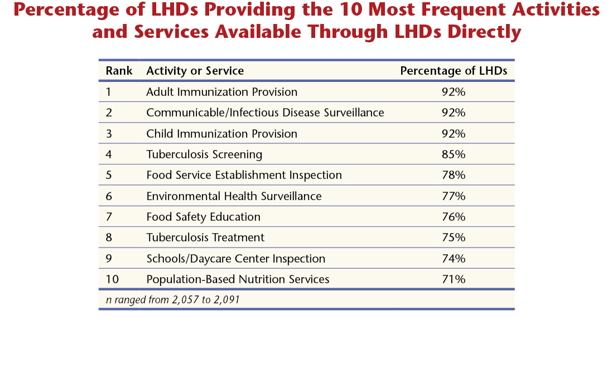
National Profile of Local Health Departments
Source: 2010 National Profile of Local Health Departments—NACCHO
Notes:
These are the most frequent services and activities provided by local health departments in the US.

Slide 33
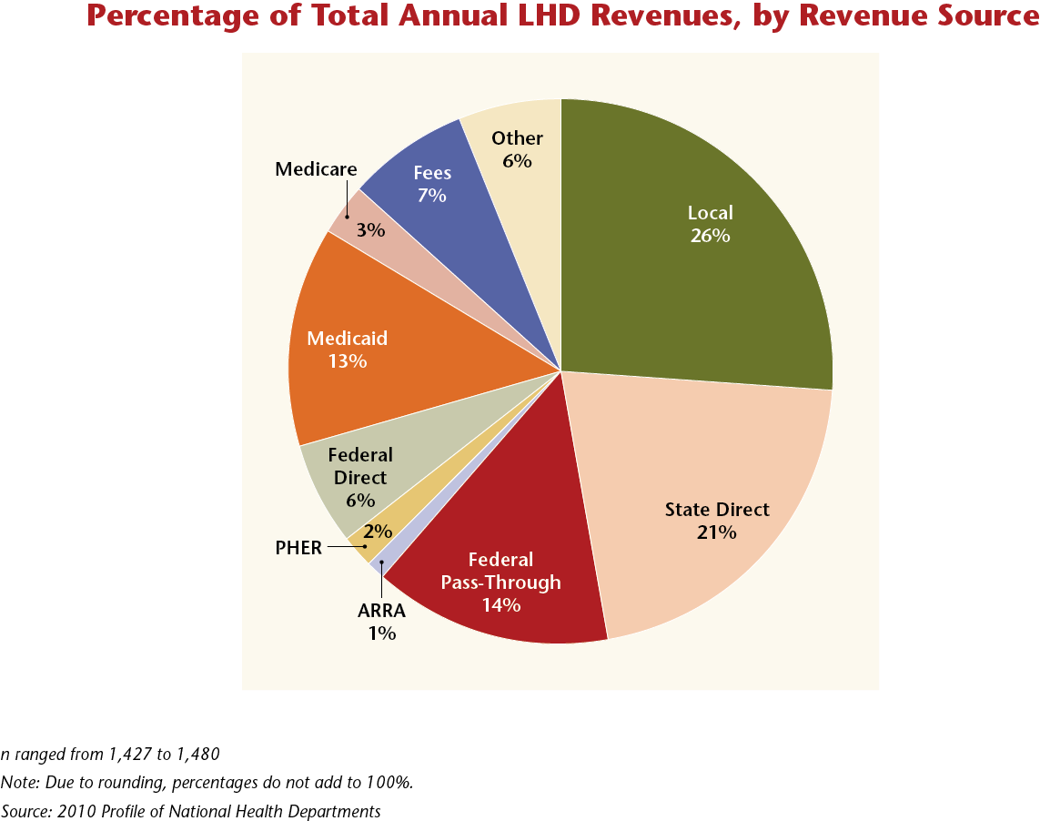
National Profile of Local Health Departments
Source: 2010 National Profile of Local Health Departments—NACCHO

Slide 34
Local Boards of Health Roles and Responsibilities
Centers for Disease Control and Prevention
Office for State, Tribal, Local and Territorial Support

Slide 35
A Local Board of Health
Is a legally designated body whose role is to protect and promote the health of its community
Most
Provide oversight to the public health agency
Foster activities such as community health assessment, assurance, and policy development
Source: National Association of Local Boards of Health. www.academyhealth.org/files/2012/monday/branco.pdf

Slide 36
Top 10 Responsibilities Boards Have Authority To Perform
 | Functions Performed | Percentage of LHDs
1. | Review public health regulations | 93.5%
2. | Recommend public health policies | 88.7%
3. | Recommend community public health priorities | 88.5%
4. | Recommend health department priorities | 87.7%
5. | Propose public health regulations | 86.8%
6. | Collaborate with health department for strategic plan | 86.6%
7. | Collaborate with health department to establish priorities | 85.6%
8. | Ensure that a community health assessment is completed | 83.3%
9. | Revise public health regulations | 82.5%
10. | Establish community public health priorities | 82.3%
Source: National Association of Local Boards of Health. www.academyhealth.org/files/2012/monday/branco.pdf

Slide 37
Top Fiscal Responsibilities
Source: National Association of Local Boards of Health. www.academyhealth.org/files/2012/monday/branco.pdf

Slide 38
Public Health in the US Insular Areas (Territories and Freely Associated States)
Centers for Disease Control and Prevention
Office for State, Tribal, Local and Territorial Support

Slide 39
What are the US Insular Areas?
The 5 US territories
Puerto Rico
Guam
US Virgin Islands
American Samoa
Commonwealth of the Northern Mariana Islands
The 3 Freely Associated States (sovereign nations in a Compact of Free Association with the US)
Republic of the Marshall Islands
Federated States of Micronesia
Republic of Palau
Notes:
The 5 US territories
Puerto Rico
Guam
US Virgin Islands
American Samoa
Commonwealth of the Northern Mariana Islands
The 3 Freely Associated States—sovereign nations in a Compact of Free Association (COFA) with the US
The COFA is a long-term agreement between the US and 3 countries that were formerly part of the Trust Territory of the Pacific Islands. The COFA guarantees financial assistance in exchange for full international defense authority and responsibility. It helps protect our strategic interests in the Pacific region. The 3 countries are
Republic of the Marshall Islands
Federated States of Micronesia
Republic of Palau
Even though they are sovereign nations, the Freely Associated States are typically eligible for the same federal public health grants as the US states.

Slide 40
Public Health Challenges in the US Insular Areas
Geography
Culture
Economy
Education
Morbidity and mortality
Notes:
Geography—Insular Areas are typically isolated and remote islands with small and widely dispersed populations (except Puerto Rico); poses challenges to access to public health services and difficulty in implementing programs (e.g., the Federated States of Micronesia are made up of more than 600 islands spread out over an area that would span about 2/3 of the way across the US, but their population is just over 100,000).
Culture—Caribbean and Pacific Island cultures, values, customs, beliefs, and social norms often are very different from the American mainland. Federally funded and designed public health programs may be less relevant.
Economy—Economies are typically very small and fragile, resulting in inadequate public health systems that rely almost exclusively on support from the US.
Education—Access to quality education at the primary, secondary, and college level is very limited; those who get a good education often leave the islands for greater career opportunities, thus the public health workforce is often underqualified and underpaid.
Morbidity and mortality—The Insular Areas lie somewhere between developed and developing countries and unfortunately their public health problems include the worst of both. On the one hand, they suffer from developing world public health threats like multidrug-resistant TB, Dengue fever and Hansen’s disease. On the other hand, they have some of the highest rates of obesity and diabetes in the world. And they are particularly vulnerable to becoming a corridor for emerging public health threats originating in Asia to make their way to the US.

Slide 41
How can federal public health address the unique challenges of the Insular Areas?
Work with Insular Area public health leadership to better tailor our assistance to meet their needs
Work within and between agencies to better coordinate public health support
Place more federal personnel in the region
Notes:
Work with Insular Area public health leadership to better tailor our assistance to meet their needs
Solicit feedback from jurisdictional public health program managers and health officials on ways we can better support their public health system.
Consider flexibility in grant requirements that fits better with Insular Area public health needs and capacity.
Work within and between agencies to better coordinate public health support
Regularly convene agency work groups composed of representatives from different program areas who work with the Insular Areas.
Identify and coordinate with other agencies that provide support to the Insular Areas, including other countries or multilateral organizations (like the World Health Organization).
Place more federal personnel in the region
Because of the need for federal public health funders to understand the context in which their grant programs are being administered, face-to-face, onsite technical support is needed more in the Insular Areas.
Insular Areas typically receive less of this much-needed support from federal public health partners due to time, distance, and travel costs factors.
Therefore, it is critical to have more federal staff placed within the region
[continued on next slide]

Slide 42
How can federal public health address the unique challenges of the Insular Areas? (continued)
Explore and pilot more initiatives that are better suited to small, limited resource jurisdictions
Program integration and coordination
Regional collaboration
Peer-to-peer sharing of best/promising practices
Grants and program management capacity
Notes:
Explore and pilot more initiatives that are better suited to small, limited resource jurisdictions
Program integration and coordination—which is often much easier and more practical in smaller, more isolated jurisdictions
Regional collaboration—for example, through groups like the Pacific Island Health Officers Association
Peer-to-peer sharing of best/promising practices—which is often much more beneficial when it is between peers in similar jurisdictions who face similar challenges
Grants and program management capacity—which is often a particularly big problems in Insular Area public health departments; they often have much more limited capacity and competency in the area of business services and management

Slide 43
Public Health in American Indian and Alaska Native Tribes
Centers for Disease Control and Prevention
Office for State, Tribal, Local and Territorial Support

Slide 44
Tribal Public Health
Tribal Health Department—a corporation or organization operated under the jurisdiction of a federally recognized tribe, or association of federally recognized tribes, and is funded by the tribe(s) and/or contract service(s) from the Indian Health Service (IHS).
Tribal Health Organizations—include Tribal Health Departments, Indian Health Service Units, Area Indian Health Boards and Urban Indian Health Centers (a much broader group, and relates to a variety of entities that might provide health services in a tribal setting).
Notes:
Tribal health:
There are organizations defined or recognized as tribal health departments, but then there is also a broader set of organizations or entities that provide services in a tribal setting.
Tribal Health Department—a health department, corporation or organization operated under the jurisdiction of a federally recognized tribe or association of federally recognized tribes, and funded by the tribe(s) and/or contract service(s) from the Indian Health Service.
Tribal Health Organization—Tribal Health Organizations include Tribal Health Departments, Indian Health Service Units, Area Indian Health Boards and Urban Indian Health Centers. (A much broader group that relates to a variety of entities that might provide health services in a tribal setting.)

Slide 45
Nongovernmental Organizations Roles and Responsibilities
Centers for Disease Control and Prevention
Office for State, Tribal, Local and Territorial Support
Notes:
Government is not alone in developing, designing, or delivering public health—”it takes a village.”

Slide 46
“…The determinants of health are beyond the capacity of any one practitioner or discipline to manage….We must collaborate to survive, as disciplines and as professionals attempting to help our communities and each other.”
—Institute of Medicine, 1999

Slide 47
“It is logical to expect that there is strength in numbers and that partnerships can mobilize material and human resources and be more effective at achieving desired goals than individuals working alone.”
– Karen Glanz, Health Behavior and Health Education, 2002

Slide 48
A Well-Functioning Public Health System Has
Strong partnerships where partners recognize they are part of the public health system
Effective channels of communication
System-wide health objectives
Resource sharing
Leadership by governmental public health agency
Feedback loops among state, local, tribal, territorial, and federal partners

Slide 49
Public Health System
Civic Groups
Schools
Nursing Homes
EMS
Neighborhood Organizations
Community Centers
Nonprofit
Organizations
Hospitals
Home Health
Drug Treatment
Public Health Agency
Laboratories
Doctors
Mental Health
Law Enforcement
Faith Institutions
Fire
Transit
CHCs
Tribal Health
Employers
Elected Officials
Corrections
Source: Public Health Practice Program Office, Centers for Disease Control and Prevention , National Public Health Performance Standards Program, User Guide (first edition), 2002. (Current version available at www.cdc.gov/nphpsp)
Notes:
Overall public health system
The public health system includes all public, private, and voluntary entities that contribute to public health activities within a given area.
Entities within a public health system can include hospitals, physicians, managed care organizations, environmental agencies, social service organizations, educational systems, community-based organizations, religious institutions, and many others.
All of these organizations play a role in working to improve the public’s health.

Slide 50
A system of partnerships that includes, but is not limited to . . .
Media
Churches
Schools
Businesses
Philanthropy
Federal DHHS
State Health Departments
Local Health Departments
Tribal Health
Healthcare
Providers
Justice and Law
Enforcement
Environmental
Health
Community
Coalitions
Mental
Health
Transportation
Community
Services
Notes:
We can “chunk” the partners on the previous slide into these general categories.
(next slide shows the connectivity)

Slide 51
Our goal is an integrated system of partnerships
Media
Churches
Schools
Businesses
Philanthropy
Federal DHHS
State Health Departments
Local Health Departments
Tribal Health
Healthcare
Providers
Justice & Law
Enforcement
Environmental
Health
Community
Coalitions
Mental
Health
Transportation
Community
Services
Notes:
Our goal is to have a system of partnerships that interact collaboratively and effectively with the federal, state, local, and tribal levels and with each other.

Slide 52
Questions?
Centers for Disease Control and Prevention
Office for State, Tribal, Local and Territorial Support

