Slide 1
Asthma Prevalence in the United States
June 2014
National Center for Environmental Health
Division of Environmental Hazards and Health Effects

Slide 2

CDC’s National Asthma Control Program (NACP) was created in 1999 to help the millions of people with asthma in the United States gain control over their disease. The NACP conducts national asthma surveillance and funds states to help improve asthma surveillance and to focus efforts and resources where needed.

Slide 3
Introduction
Asthma:
is a chronic disease of the lungs
affects adults and children of all ages
is characterized by repeated episodes of wheezing, breathlessness, chest tightness, and nighttime or early morning coughing
Notes:
Asthma is a chronic disease of the lungs.
It affects adults and children of all ages and is characterized by repeated episodes of wheezing, breathlessness, chest tightness, and nighttime or early morning coughing.

Slide 4
Introduction
In most cases, we don’t know the exact causes of asthma and we don’t know how to cure it
Most people with asthma can control their symptoms by:
avoiding things that trigger an asthma attack and
receiving appropriate medical care
Without proper management, asthma can result in frequent emergency department (ED) visits, hospitalizations, and premature deaths.
Notes:
In most cases, we don’t know the exact causes of asthma and we don’t know how to cure it.
However, most people with asthma can control their symptoms by avoiding things that trigger an asthma attack and by receiving appropriate medical care.
Without proper management, asthma can result in frequent emergency department (ED) visits, hospitalizations, and premature deaths.

Slide 5
Introduction
Asthma:
affects 25.7 million people, including 7.0 million children under 18;
is a significant health and economic burden to patients, their families, and society:
In 2010, 1.8 million people visited an ED for asthma-related care and 439,000 people were hospitalized because of asthma
Notes:
Asthma affects 25.7 million people (2010) , including 7.0 million children under age 18 (2010); therefore, it is a significant health and economic burden to patients, their families, and society.
In 2010, almost 1.8 million people visited an ED for asthma-related care and 439,000 people were hospitalized because of asthma.

Slide 6
Introduction
Asthma prevalence is an estimate of the percentage of the U.S. population with asthma. Prevalence estimates help us understand the burden of asthma on the nation.
Asthma “period prevalence” is the percentage of the U.S. population that had asthma in the previous 12 months.
“Current” asthma prevalence is the percentage of the U.S. population who had been diagnosed with asthma and had asthma at the time of the survey.
Asthma “period prevalence” was the original prevalence measure (1980-1996). The survey was redesigned in 1997 and this measure was replaced by lifetime prevalence (not presented in slides) and asthma episode or attack in the past 12 months. In 2001, another measure was added to assess current asthma prevalence.
Notes:
To describe the burden of asthma in the United States, we present two types of prevalence estimates.
Asthma “period prevalence” was the original measure (1980-1996) of U.S. asthma prevalence and estimated the percentage of the population that had asthma in the previous 12 months.
Beginning in 2001, current asthma prevalence was measured by the question, ‘‘Do you still have asthma?’’ for those with an asthma diagnosis and was introduced to identify all persons with asthma.

Slide 7
Asthma Period Prevalence and Current Asthma Prevalence: United States, 1980-2010
Current asthma prevalence, 2001-2010
Asthma period prevalence, 1980-1996
The percentage of the U.S. population with asthma increased from 3.1% in 1980 to 5.5% in 1996 and 7.3% in 2001 to 8.4% in 2010.
Notes:
Asthma prevalence increased from 3.1% in 1980 to 5.5% in 1996 and 7.3% in 2001 to 8.4% in 2010.

Slide 8
Current Asthma Prevalence: United States, 2001-2010
Total number of persons
Percent
Year
One in 12 people (about 26 million, or 8% of the U.S. population) had asthma in 2010,
compared with 1 in 14 (about 20 million, or 7%) in 2001.
Notes:
One in 12 people (about 26 million, or 8% of the population) had asthma in 2010, compared with 1 in 14 (about 20 million, or 7%) in 2001.

Slide 9
Current Asthma Prevalence by Race and Ethnicity: United States, 2001-2010
Blacks are more likely to have asthma than both Whites and Hispanics.
Notes:
Blacks are more likely to have asthma than both Whites and Hispanics.

Slide 10
Current Asthma Prevalence by Age Group, Sex, Race and Ethnicity, Poverty Status, Geographic Region, and Urbanicity: United States, Average Annual 2008-2010
Children, females, Blacks, and Puerto Ricans are more likely to have asthma.
People with lower annual household income were more likely to have asthma.
Residents of the Northeast and Midwest were more likely to have asthma.
Living in or not in a city did not affect the chances of having asthma.
Notes:
Some people are more likely to have asthma than others.
Current asthma occur more in children (9.5%) than in adults (7.7%) and females (9.2%) than males (7.0%). (yellow bars)
Regarding race and ethnicity, asthma prevalence was higher among black persons (11.2%) and was lower among Asian (5.2%) and Hispanic persons (6.5%) compared with white persons (7.7%). Among Hispanics, Puerto Ricans (16.1%) were more likely to have asthma compared with Mexican persons (5.4%).
Current asthma prevalence increased with decreasing annual household income.
As far as geographic region, current asthma prevalence was higher in the Northeast (8.8%) than in the South (7.6%) or in the West (8.0%), and was higher in the Midwest (8.7%) than in the South (7.6%). Prevalence rate did not differ between metropolitan and nonmetropolitan areas.

Slide 11
Child and Adult Current Asthma Prevalence by Age and Sex: United States, 2006-2010
Among children aged 0-14, boys were more likely than girls to have asthma.
Boys and girls aged 15-17 years had asthma at the same rate..
Among adults women were more likely than men to have asthma.
Notes:
Among children, current asthma prevalence was higher among male children aged 0 to 4 years (7.7%) and aged 5 to 14 years (12.4%) compared with female children in the same age group (4.7% and 8.8%, respectively). Asthma prevalence was similar for male and female children aged 15-17 years.

Slide 12
Asthma Attack Prevalence among Children and Adults with Current Asthma: United States, 2001-2010
Children aged 0-17 years
Adults aged 18 and over
From 2001 to 2010 both children and adults had fewer asthma attacks.
For children, asthma attacks declined from at least one asthma attack in the previous 12 months for 61.7% of children with asthma in 2001 to 58.3% in 2010.
For adults, asthma attacks declined from at least one asthma attack in the previous 12 months for 53.8% of adults with asthma in 2001, to 49.1% in 2010.
Notes:
Both children and adults, showed a decrease in asthma attacks.
In 2001, 61.7% of children and 53.8% of adults with asthma had at least one asthma attack in the previous 12 months compared with 58.3% and 49.1% in 2010, respectively.

Slide 13
Asthma Attack Prevalence among Persons with Current Asthma by Age Group, Sex, Race and Ethnicity, Poverty Status, and Geographic Region: Unites States, Average Annual 2008-2010
From 2008 to 2010 asthma attacks occurred more often in children and women, among families whose income was below 100% of the federal poverty threshold, and in the South and West.
Race or ethnicity did not significantly affect asthma attack prevalence.
Notes:
Children with asthma were more likely to have had at least one asthma attack during the previous 12 months (56.5%) than adults (49.1%).
Asthma attacks occurred more often in females (52.7%) than males (49.2%) and, among those with a family income less than 100% of the federal poverty threshold (55.1%) than persons with income between 250% and less than 450% of the poverty threshold (47.9%), and among those living in South and West, than those living in Northeast.
Asthma attack prevalence did not differ by race or ethnicity.

Slide 14
Adult Self-Reported Current Asthma Prevalence (%) by
State or Territory, 2010
WA
ME
ID
MT
MN
VT
ND
OR
WI
NY
NH
SD
MI
WY
MA
RI
CA
IA
PA
CT
NV
NE
IL
OH
NJ
UT
IN
DE
CO
WV
MD
MO
VA
KS
KY
DC
NC
AZ
TN
NM
OK
TX
AR
SC
AL
GA
MS
LA
AK
FL
HI
PR
6.0 – 7.7
7.8 – 8.5
8.6 – 9.3
9.4 – 9.9
10.0 – 11.1
Notes:
Current asthma prevalence ranges from about 11.1% in Vermont to about 6.0% in Tennessee.

Slide 15
Technical Notes
Asthma Period Prevalence and Current Asthma Prevalence: Estimates of asthma prevalence indicate the percentage of the population with asthma at a given point in time and represent the burden on the U.S. population.
Asthma prevalence data are self-reported by respondents to the National Health Interview Survey (NHIS). Asthma period prevalence was the original measure (1980-1996) of U.S. asthma prevalence and estimated the percentage of the population that had asthma in the previous 12 months. From 1997-2000, a redesign of the NHIS questions resulted in a break in the trend data as the new questions were not fully comparable to the previous questions. Beginning in 2001, current asthma prevalence (measured by the question, ‘‘Do you still have asthma?’’ for those with an asthma diagnosis) was introduced to identify all persons with asthma. Current asthma prevalence estimates from 2001 onward are point prevalence (previous 12 months) estimates and therefore are not directly comparable with asthma period prevalence estimates from 1980 to 1996
Behavioral Risk Factor Surveillance System (BRFSS): State asthma prevalence rates on the map come from the BRFSS. The BRFSS is a state-based, random-digit-dialed telephone survey of the noninstitutionalized civilian population 18 years of age and older. It monitors the prevalence of the major behavioral risks among adults associated with premature illness and death. Information from the survey is used to improve the health of the American people. More information about BRFSS can be found at: http://www.cdc.gov/brfss/.

Slide 16
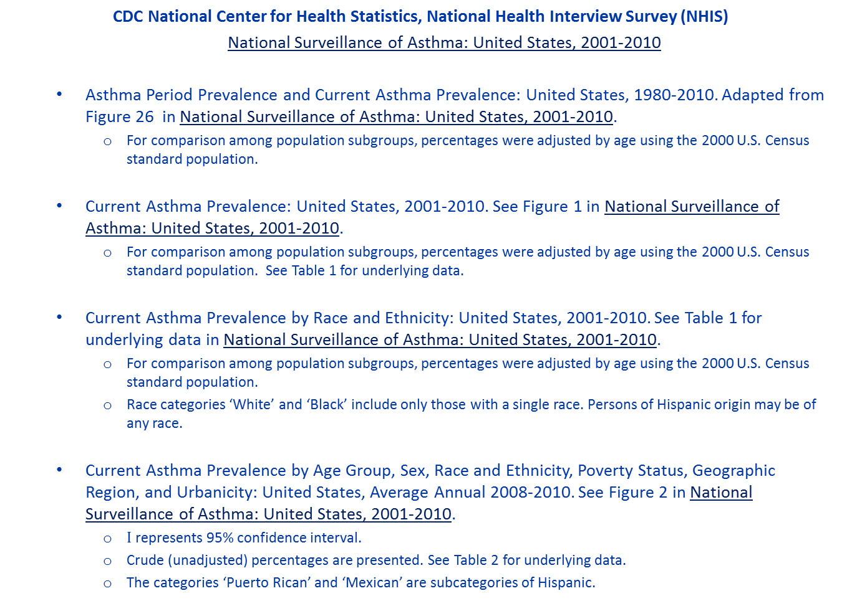
Sources
CDC National Center for Health Statistics, National Health Interview Survey (NHIS)
National Surveillance of Asthma: United States, 2001-2010
Asthma Period Prevalence and Current Asthma Prevalence: United States, 1980-2010. Adapted from Figure 26 in National Surveillance of Asthma: United States, 2001-2010.
For comparison among population subgroups, percentages were adjusted by age using the 2000 U.S. Census standard population.
Current Asthma Prevalence: United States, 2001-2010. See Figure 1 in National Surveillance of Asthma: United States, 2001-2010.
For comparison among population subgroups, percentages were adjusted by age using the 2000 U.S. Census standard population. See Table 1 for underlying data.
Current Asthma Prevalence by Race and Ethnicity: United States, 2001-2010. See Table 1 for underlying data in National Surveillance of Asthma: United States, 2001-2010.
For comparison among population subgroups, percentages were adjusted by age using the 2000 U.S. Census standard population.
Race categories ‘White’ and ‘Black’ include only those with a single race. Persons of Hispanic origin may be of any race.
Current Asthma Prevalence by Age Group, Sex, Race and Ethnicity, Poverty Status, Geographic Region, and Urbanicity: United States, Average Annual 2008-2010. See Figure 2 in National Surveillance of Asthma: United States, 2001-2010.
$Ι$represents 95% confidence interval.
Crude (unadjusted) percentages are presented. See Table 2 for underlying data.
The categories ‘Puerto Rican’ and ‘Mexican’ are subcategories of Hispanic.

Slide 17
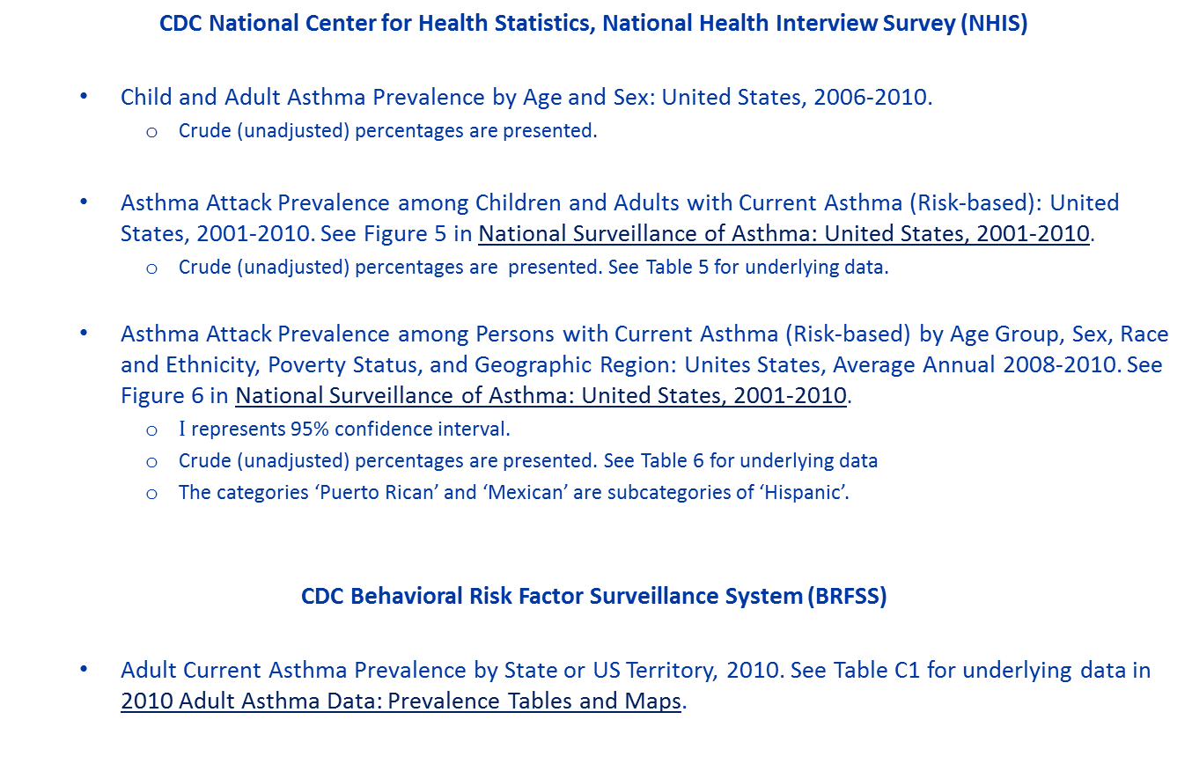
Sources (continued)
CDC National Center for Health Statistics, National Health Interview Survey (NHIS)
Child and Adult Asthma Prevalence by Age and Sex: United States, 2006-2010.
Crude (unadjusted) percentages are presented.
Asthma Attack Prevalence among Children and Adults with Current Asthma (Risk-based): United States, 2001-2010. See Figure 5 in National Surveillance of Asthma: United States, 2001-2010.
Crude (unadjusted) percentages are presented. See Table 5 for underlying data.
Asthma Attack Prevalence among Persons with Current Asthma (Risk-based) by Age Group, Sex, Race and Ethnicity, Poverty Status, and Geographic Region: Unites States, Average Annual 2008-2010. See Figure 6 in National Surveillance of Asthma: United States, 2001-2010.
$Ι$ represents 95% confidence interval.
Crude (unadjusted) percentages are presented. See Table 6 for underlying data
The categories ‘Puerto Rican’ and ‘Mexican’ are subcategories of ‘Hispanic’.
CDC Behavioral Risk Factor Surveillance System (BRFSS)
Adult Current Asthma Prevalence by State or US Territory, 2010. See Table C1 for underlying data in 2010 Adult Asthma Data: Prevalence Tables and Maps.

Slide 18
For more information please contact Centers for Disease Control and Prevention
1600 Clifton Road NE, Atlanta, GA 30333
Telephone: 1-800-CDC-INFO (232-4636)/TTY: 1-888-232-6348
Visit: www.cdc.gov | Contact CDC at: 1-800-CDC-INFO or www.cdc.gov/info
The findings and conclusions in this report are those of the authors and do not necessarily represent the official position of the Centers for Disease Control and Prevention.
National Center for Environmental Health
Division of Environmental Hazards and Health Effects

