Slide 1
The Youth Risk Behavior Surveillance System (YRBSS): 2015
National, State, and Local Data
National Center for HIV/AIDS, Viral Hepatitis, STD, and TB Prevention
Division of Adolescent and School Health
Notes:
This slide set contains information about and data from the Youth Risk Behavior Surveillance System or YRBSS. It includes national, state, and local data from the 2015 surveys.

Slide 2
Purposes of the YRBSS
Focus the nation on behaviors among youth causing the most important health problems
Assess how risk behaviors change over time
Provide comparable data
Notes:
The purposes of the YRBSS are to focus the nation on behaviors among youth causing the most important health problems, to assess how risk behaviors change over time, and to provide comparable data.

Slide 3
Priority Health-Risk Behaviors and Health Outcomes Monitored by YRBSS
Behaviors that contribute to the leading causes of mortality and morbidity
Unintentional injuries and violence
Sexual behaviors
Alcohol and other drug use
Tobacco use
Unhealthy dietary behaviors
Inadequate physical activity
Obesity
Asthma
Other priority health issues
Notes:
The YRBSS monitors priority health-risk behaviors that contribute to the leading causes of morbidity and mortality among youth and adults:
unintentional injuries and violence
sexual behaviors
alcohol and other drug use
tobacco use
unhealthy dietary behaviors
inadequate physical activity.
The YRBSS also monitors two health outcomes: obesity and asthma.

Slide 4
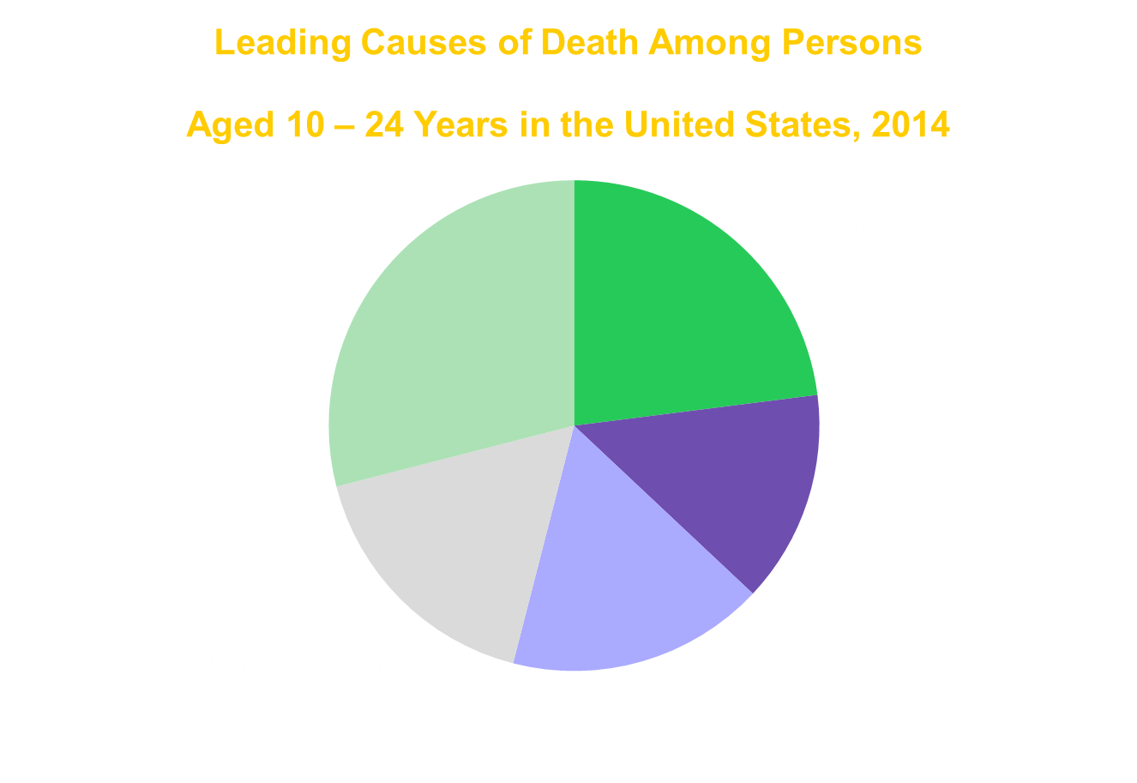
Notes:
This pie graph represents the leading causes of death among persons aged 10-24 years in the United States in 2014. In that year, motor vehicle crashes accounted for 23% of deaths, homicide for 14%, suicide for 17% of deaths, other unintentional injuries for 17%, and 29% of deaths were the result of other causes.

Slide 5
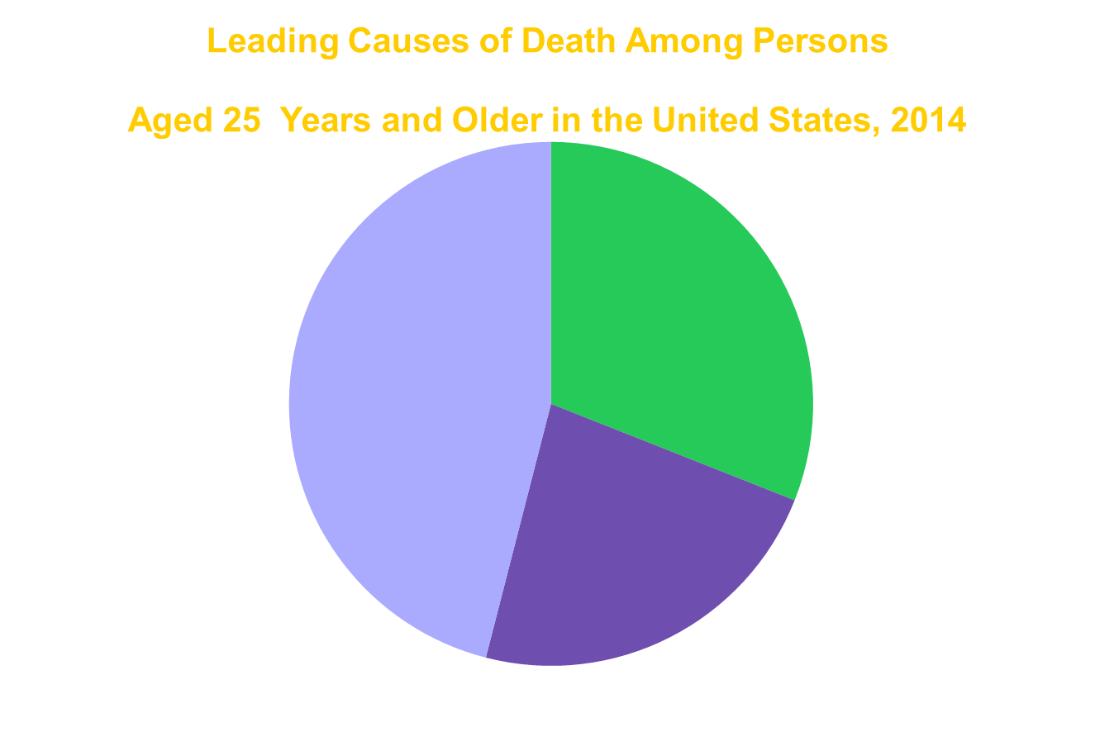
Notes:
This pie graph represents the leading causes of death among persons aged 25 years and older in the United States in 2014. In that year, 31% of deaths were the result of cardiovascular disease, 23% were the result of cancer, and 46% of deaths were due to other causes.

Slide 6
Impact of Sexual Behaviors
Reported among 15-19 year olds
273,105 births among females in 2013
451,208 cases of chlamydia, gonorrhea, and syphilis in 2014
1,828 diagnoses of HIV in 2014
Notes:
Impact of sexual behaviors:
273,105 births occurred among females aged 15 – 19 years
451,208 cases of chlamydia, gonorrhea, and syphilis were reported among persons aged 15 – 19 year
1,828 diagnoses of HIV among persons aged 15 – 19 years

Slide 7
Characteristics of the National, State, and Local School-Based YRBS
9th – 12th grade students
Probability samples of schools and students
Anonymous
Self-administered, computer-scannable questionnaire or answer sheet
Completed in one class period (45 minutes)
Conducted biennially usually during the spring
Notes:
The national, state, and local Youth Risk Behavior Surveys are administered to 9th through 12th grade students drawn from probability samples of schools and students. The questionnaire is anonymous and self-administered. The questionnaire booklet or answer sheet is computer-scannable. The surveys are completed in one 45-minute class period, and are conducted biennially usually during the spring.

Slide 8
2015 National YRBS
National probability sample of public and private schools
Total sample size = 15,624
School-level response rate = 69%
Student-level response rate = 86%
Overall response rate = 60%
Notes:
The 2015 National YRBS survey was administered to a national probability sample of public and private schools. The sample size is 15,624 students. The school-level response rate is 69% and the student-level response rate is 86%. The school response rate multiplied by the student response rate produces an overall response rate of 60%.

Slide 9
Response Rates and Sample Sizes National YRBS, 1991 – 2015
Year | School Response Rate | Student Response Rate | Overall Response Rate | Sample Size
1991 | 75% | 90% | 68% | 12,272
1993 | 78% | 90% | 70% | 16,296
1995 | 70% | 86% | 60% | 10,904
1997 | 79% | 87% | 69% | 16,262
1999 | 77% | 86% | 66% | 15,349
2001 | 75% | 83% | 63% | 13,601
2003 | 81% | 83% | 67% | 15,214
2005 | 78% | 86% | 67% | 13,917
2007 | 81% | 84% | 68% | 14,041
2009 | 81% | 88% | 71% | 16,410
2011 | 81% | 87% | 71% | 15,425
2013 | 77% | 88% | 68% | 13,583
2015 | 69% | 86% | 60% | 15,624
Notes:
This slide shows the school response rate, the student response rate, the overall response rates, and the sample size for the national YRBS from 1991 to 2015.
In 1991, the school response rate, student response rate, overall response rate, and sample size, respectively, were 75%, 90%, 68%, and 12,272.
In 1993, the school response rate, student response rate, overall response rate, and sample size, respectively, were 78%, 90%, 70%, and 16,296.
In 1995, the school response rate, student response rate, overall response rate, and sample size, respectively, were 70%, 86%, 60%, and 10,904.
In 1997, the school response rate, student response rate, overall response rate, and sample size, respectively, were 79%, 87%, 69%, and 16,262.
In 1999, the school response rate, student response rate, overall response rate, and sample size, respectively, were 77%, 86%, 66%, and 15,349.
In 2001, the school response rate, student response rate, overall response rate, and sample size, respectively, were 75%, 83%, 63%, and 13,601.
In 2003, the school response rate, student response rate, overall response rate, and sample size, respectively, were 81%, 83%, 67%, and 15,214.
In 2005, the school response rate, student response rate, overall response rate, and sample size, respectively, were 78%, 86%, 67%, and 13,917.
In 2007, the school response rate, student response rate, overall response rate, and sample size, respectively, were 81%, 84%, 68%, and 14,041.
In 2009, the school response rate, student response rate, overall response rate, and sample size, respectively, were 81%, 88%, 71%, and 16,410.
In 2011, the school response rate, student response rate, overall response rate, and sample size, respectively, were 81%, 87%, 71%, and 15,425.
In 2013, the school response rate, student response rate, overall response rate, and sample size, respectively, were 77%, 88%, 68%, and 13,583.
In 2015, the school response rate, student response rate, overall response rate, and sample size, respectively, were 69%, 86%, 60%, and 15,624.

Slide 10
YRBS Participation 1991 – 2015
 | 1991 | 1993 | 1995 | 1997 | 1999 | 2001 | 2003 | 2005 | 2007 | 2009 | 2011 | 2013 | 2015
# of states | 26 | 40 | 39 | 38 | 41 | 37 | 43 | 44 | 44 | 47 | 47 | 47 | 47
# of cities | 11 | 14 | 17 | 17 | 17 | 19 | 22 | 23 | 22 | 23 | 22 | 22 | 21
# of territories | 2 | 2 | 5 | 5 | 4 | 7 | 5 | 4 | 5 | 4 | 4 | 5 | 4
# of tribal governments | -- | -- | -- | -- | -- | -- | -- | -- | -- | 2 | 2 | 2 | 1
Total # of sites | 38 | 56 | 61 | 60 | 62 | 63 | 70 | 71 | 71 | 76 | 75 | 76 | 73
% of sites with weighted data | 45% | 59% | 61% | 72% | 61% | 60% | 80% | 90% | 93% | 87% | 93% | 92% | 82%
Notes:
This table reflects state and local participation in the YRBS for the years 1991 through 2015. Since its inception, participation has grown from 26 states to 47 states in 2015. The number of cities has increased from 11 in 1991 to 21 in 2015. 4 territories participated in 2015. In addition, one tribal government conducted a YRBS in 2015. The total number of sites conducting a 2015 YRBS is 73. Among these sites, 82% obtained weighted data in 2015.

Slide 11
Policy and Program Applications
Describe risk behaviors
Create awareness
Set program goals
Develop programs and policies
Support health-related legislation
Seek funding
Notes:
YRBS data are used at the national, state, and local levels in a variety of policy and program applications. YRBS data can be used to do the following:
Describe risk behaviors;
Create awareness;
Set program goals;
Develop programs and policies;
Support health-related legislation; and
Seek funding.

Slide 12
Describe Risk Behaviors
Overall and among subgroups of youth
How risk behaviors are interrelated
Notes:
The YRBS describes risk behaviors that affect youth, including select subgroups of youth that may be of interest. YRBS data also are used to demonstrate how risk behaviors are interrelated.

Slide 13
Create Awareness
Among:
Legislators, boards of education, and school administrators
Parents
Community members
School staff
Students
Media
Notes:
YRBS data are useful for creating awareness about health risk behaviors practiced by youth among such varied audiences as:
Legislators, boards of education, and school administrators;
Parents;
Community members;
School staff;
Students; and
Media.

Slide 14
Set Program Goals
Strategic plans for school health programs
Healthy People 2020 objectives
CDC Cooperative Agreement Performance Measures
Notes:
YRBS data are used to set program goals. For example, YRBS data are used in the development of strategic plans for school health programs, to set Healthy People 2020 objectives, and as part of CDC’s cooperative agreement performance measures.

Slide 15
Develop Programs and Policies
School health programs and policies
Programs and policies for youth in high risk situations
Instructional guides and materials
Professional development programs for teachers
Notes:
YRBS data have proven useful to help develop programs and policies, including school health programs and policies, programs and policies for youth in high risk situations, instructional guides and materials, and professional development programs for teachers.

Slide 16
Support Health-Related Legislation
School health program requirements
School health council requirements
Drug-free or weapon-free school zone laws
Minors’ access laws
Drinking and driving laws
Bans on billboards and other advertising
Competitive food policies
School health services policies
Anti-bullying legislation
School environment policies
Notes:
Data from the YRBS also are cited often to support health-related legislation such as:
School health program requirements;
School health council requirements;
Drug-free or weapon-free school zone laws;
Minors’ access laws;
Drinking and driving laws;
Bans on billboards and other advertising;
Competitive food policies;
School health services policies;
Anti-bullying legislation; and
School environment policies

Slide 17
Seek Funding
Support funding requests to federal, state, and private agencies and foundations
Notes:
YRBS data are a valuable resource to support funding requests to federal, state, and private agencies and foundations.

Slide 18
YRBSS Information
www.cdc.gov/yrbs
Youth Online
Questionnaire and item rationale
Morbidity and Mortality Weekly Report Surveillance Summaries
Data and codebooks for the national YRBS
Publications, journal articles, and fact sheets
Notes:
Comprehensive information about the YRBSS can be found on CDC’s Web site at www.cdc.gov/yrbs.
The site includes information such as a copy of the latest questionnaire and item rationale; links to the Morbidity and Mortality Weekly Report Surveillance Summaries that highlight YRBS data; Youth Online, which provides detailed results by location and health topic; the data and codebooks for the national YRBS; and related publications, journal articles, and fact sheets.

