Slide 1

The Transformed Civil Rights Data Collection (CRDC)
Revealing new truths about our nation’s schools
June 26, 2012
A New Website: http://ocrdata.ed.gov

Slide 2
What is the CRDC?
A collection of real school- and district-level data from thousands of school districts across the country.
Disaggregated by race, ethnicity, gender, disability, LEP status, and other factors.
Covers a broad range of topics:
School Characteristics
Staffing and Resources
Pathways to College and Career
College and Career Readiness
Discipline, Bullying & Harassment, Restraint & Seclusion

Slide 3
History of the CRDC
The Civil Rights Data Collection (CRDC) began in 1968
Primarily a biennial collection of school and district level data
Usually data comes from a representative sample of districts. Occasionally, however, the CRDC surveys the universe of all districts. This occurred in 1976, 2000, and is underway for 2011-2012.

Slide 4
2009-10 School Year Civil Rights Data Collection
More Detailed: Data are disaggregated by race and ethnicity, English learner status, sex, and by disability under the IDEA and Section 504 statutes.
More Comprehensive: New data on access to and success in college- and career-ready courses, teacher equity, retention, access to pre-K programs, bullying and harassment, discipline, and more.
Larger Sample Size: Increased from 6,000 to 7,000 school districts included.

Slide 5
2009-10 SY Civil Rights Data Collection (CRDC)
In 2009-10 SY, approximately 7,000 school districts and 72,000 schools were selected to participate in the CRDC, using a sampling method that ensures that a representative group from each state is included.
% of the nation’s schools in the CRDC
% of the nation’s students represented in the CRDC
Notes:
The Civil Rights Data Collection (CRDC) collects district- and school-level data directly from local education agencies and makes this information available to federal and state agencies, individual districts, researchers, advocacy groups, and the general public.
CRDC collects a variety of information, including student enrollment and educational programs and services disaggregated by race/ethnicity, sex, limited English proficiency, and disability.
2009-10 SY CRDC was collected in 2 Parts:
Part 1: Collected snapshot data, such as fall enrollment counts (available at ocrdata.ed.gov)
Part 2: Collected cumulative or year-end data, such as the number of students passing Algebra I (Available in the early fall)
The 2009-10 SY Part 1 Civil Rights Data Collection (CRDC) survey includes information such as,
How many advanced mathematics and science courses schools offer, as well as the demographic characteristics of students taking these courses.
How many students are participating in AP courses and gifted and talented programs
How many LEP students are also served by IDEA or Section 504
How many less experienced teachers are teaching LEP students

Slide 6
Why is the CRDC Important?
The CRDC makes public long-hidden data about equality and excellence in education for students that have traditionally been underserved.

Slide 7
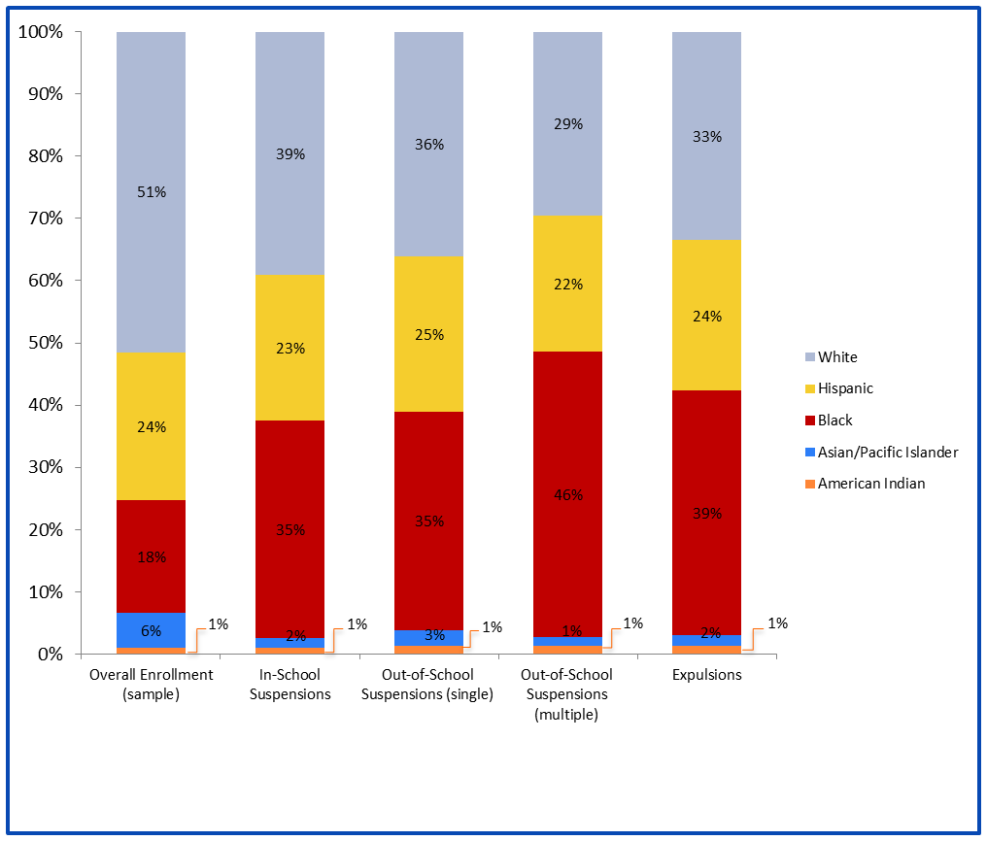
Discipline
Disparate Discipline Rates
The transformed CRDC makes public long-hidden data about which students are suspended, expelled, and arrested in school.

Slide 8
African-American students have the highest rate of out-of-school suspensions

Slide 9
Gifted & Talented & Gender
In districts offering Gifted and Talented Programs, white students are two times more likely to participate in gifted and talented programs than African-American students.

Slide 10
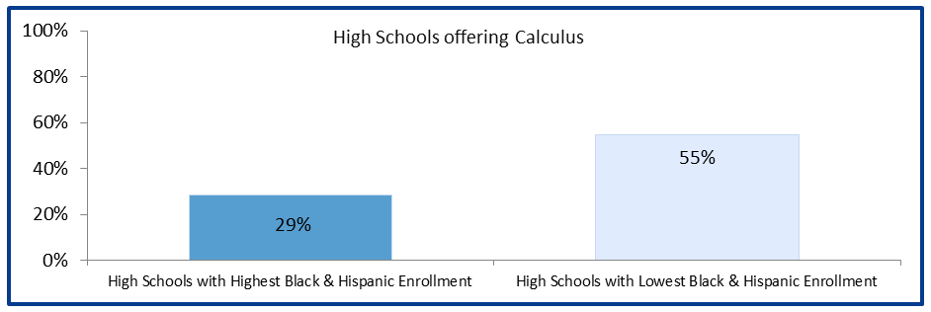
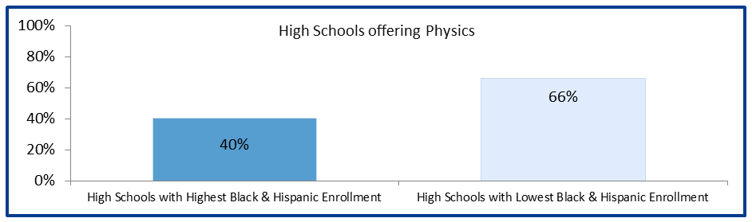
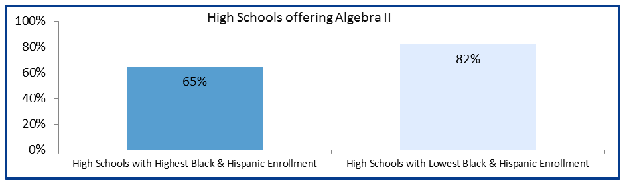
High and Low Minority Schools Offering Advanced Math and Science

Slide 11
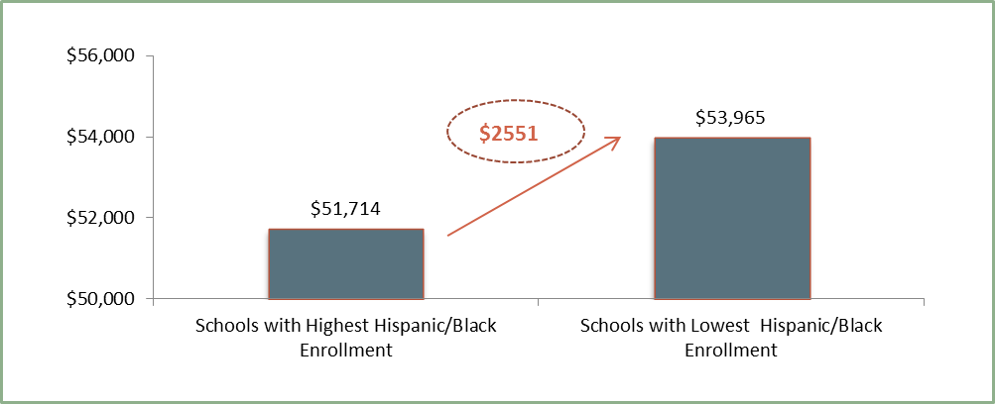
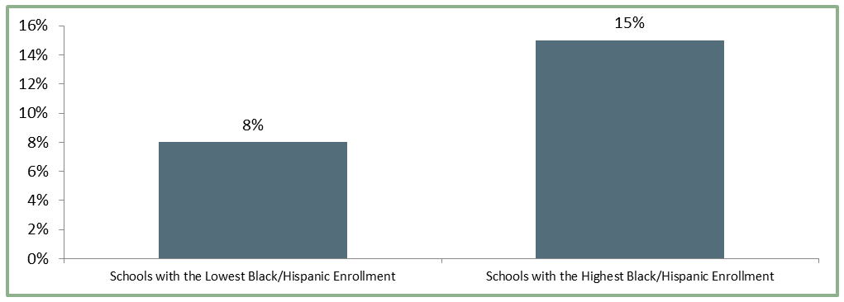
Teacher Equity
Teachers Matter Most: Novice Teachers
The 2009-2010 CRDC provides new insight into which schools employ the most novice teachers, pay the highest (or lowest) salaries, and have the highest rates of teacher absenteeism.
Teacher Salary Differences: Elementary Schools

Slide 12
The CRDC offers the chance to examine equity in your school and in your district.
Administrators and educators, as well as parents and advocates, can use these data to start discussions about the causes of these disparities in your schools and planning on where you want your school to go.
http://ocrdata.ed.gov

Slide 13
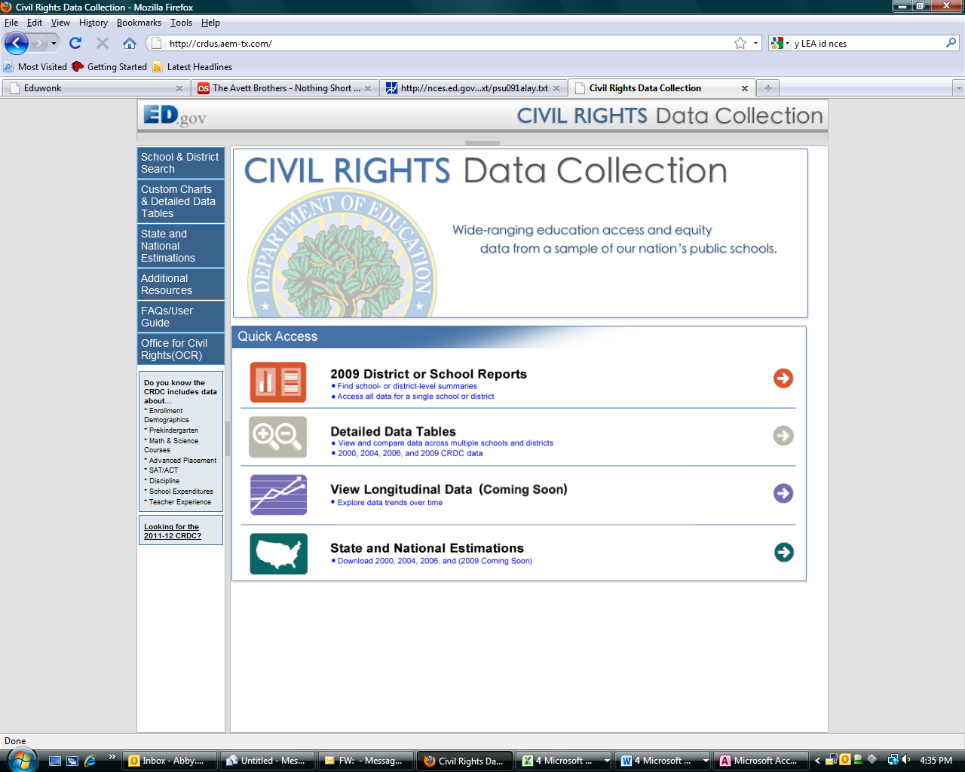

Slide 14
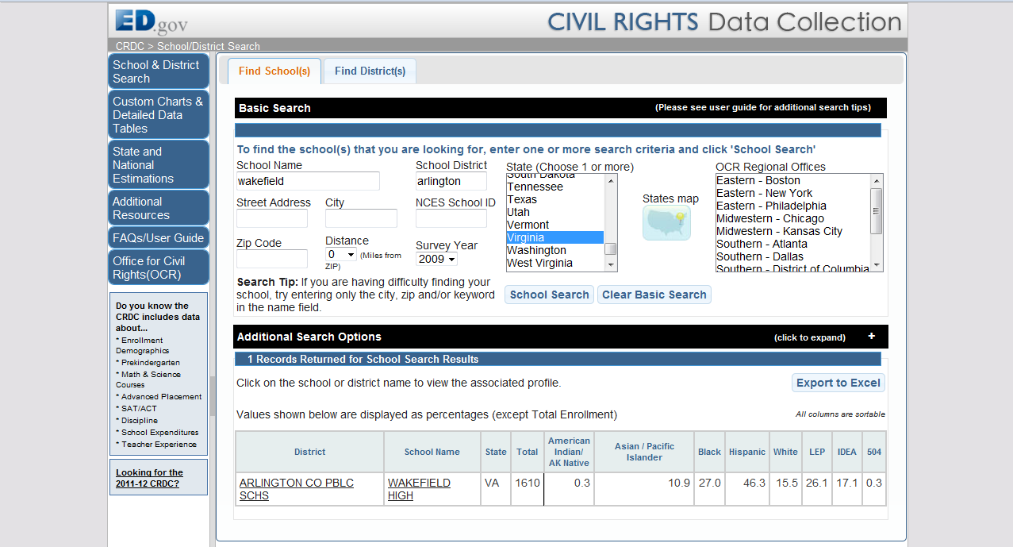

Slide 15
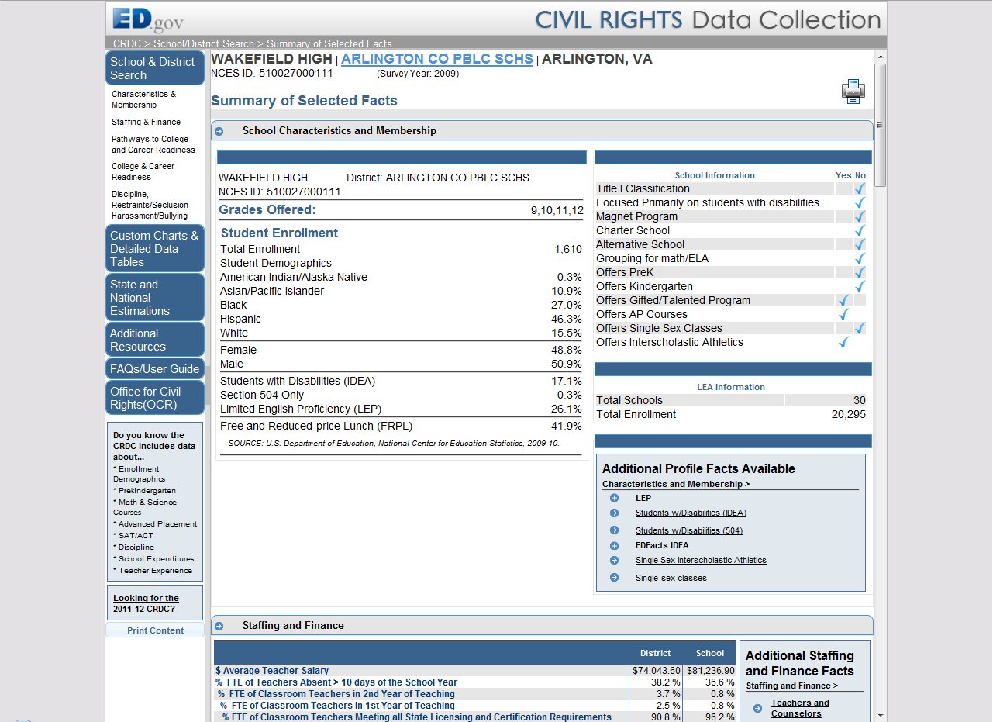

Slide 16
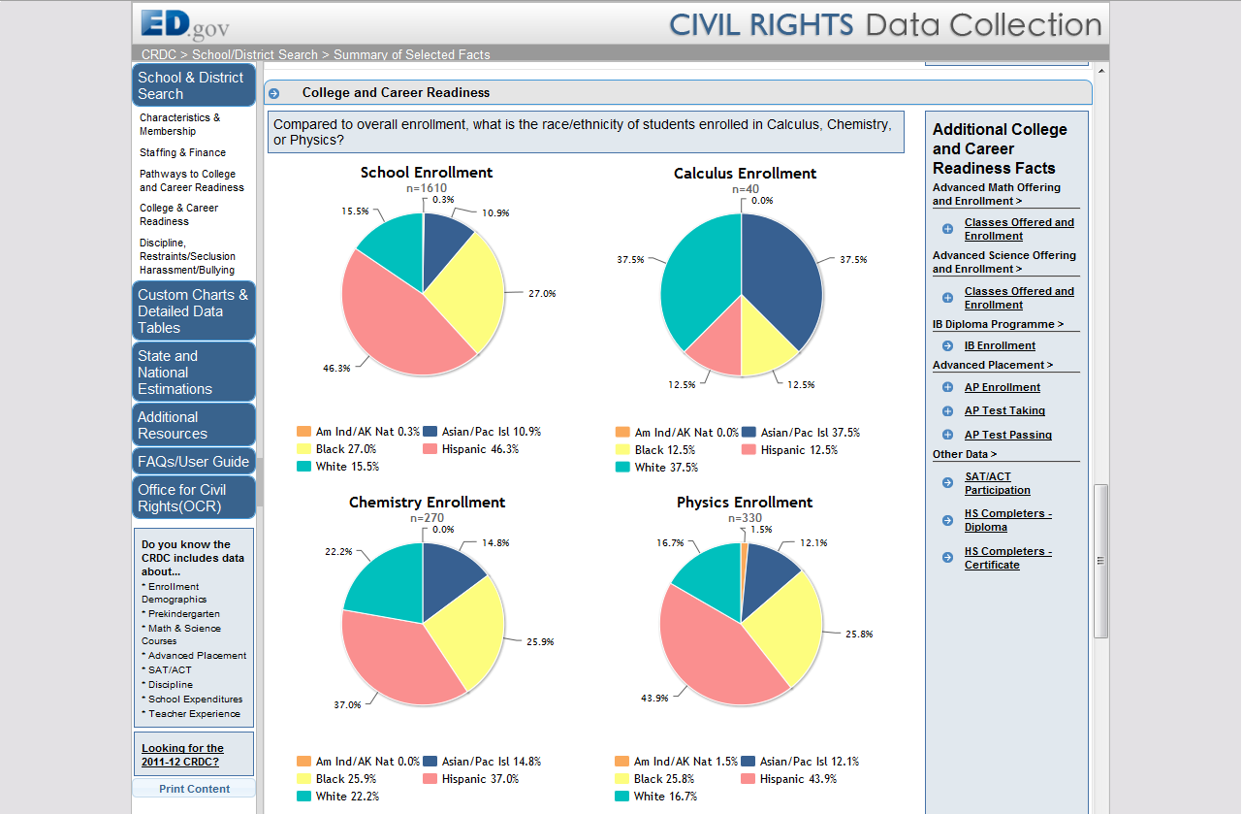

Slide 17
On the Horizon
Next Civil Rights Data Collection: 2011-12 SY
The 2011-12 SY CRDC will include all districts and all schools in the nation.
2011-12 CRDC data will be released in Summer 2013

Slide 18
Be Empowered With Data
“The power of the Civil Rights Data Collection is not only in the numbers themselves, but in the impact it can have when married with the courage and the will to change.
The undeniable truth is that the everyday educational experience for many students violates the principle of
equity at the heart of the American promise.
It is our collective duty to change that.”
-- Arne Duncan

