Slide 1
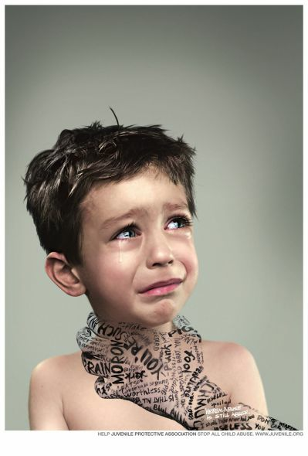
How can teachers prevent Bullying?
Things to remember:
Definition of Bullying Behavior (Physical, Verbal, Social, Cyber):
aggressive behavior meant to hurt, humiliate or harass another person.
repeatedly over time.
a relationship where there is a physical/social imbalance of power.
Not All Conflict is Bullying!
Teachers’ Role = to EDUCATE
You are all skilled educators not Judge/Jury or Detectives…
Use your strengths as educators and
TEACH appropriate behaviors

Slide 2
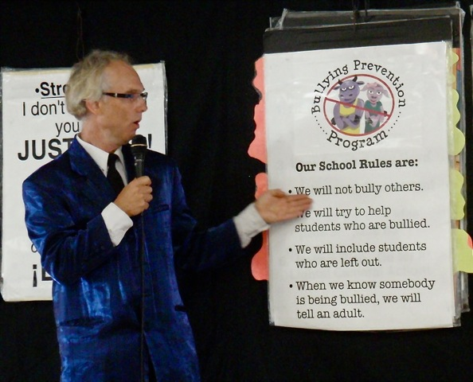
Proactive Measures
Empower Bystanders and Victims
Establish Clear & Specific Rules Against Bullying (Role Play situations class/online)
Conduct Weekly Classroom Climate Meetings
Encourage a School Wide Climate of Unity through School Wide Programs and Messages
Frequent Parent Contact of:
Victim= Encourage parents to: A) Normalize and accept their child's feelings. B) Share the “Online” experience with their child. C) Ask their child questions as if they don’t know what is going on. D) Emphasize “Defensive Driving”.
Bully= label the behavior as bullying and encourage the parents to role play situations.
Reporting Forms to Encourage Victims and Bystanders
Address and Challenge Gender
Stereotypes and Anti-Gay Epithets
Model an Atmosphere of Acceptance
Notes:
List Specific words that are not allowed in the classroom
Encourage ALL students to share. Create a sense of unity in the school.

Slide 3
Reactive Measures
Use the Bullying Intervention Card (B.I.C.)
Remove the bully from the situation immediately.
Speak with the Victim first once the bully and bully supporters are removed from the situation.
Treat the Victim as a Person in Crisis
Is this really Bullying?
Empathize avoid phrases like “I Understand” LISTEN=SILENT
Clarify the incident through reflection
Student’s point of view: No judgment
Brainstorm alternatives/available resources. “think for the student”
Procedural goals: time-limited & sensitive of student’s social network and barriers
Implement plan : evaluate the effectiveness
Follow-up
→ Terminate the established crisis relationship.
Notes:
If you speak with the Bully first it may give them the attention (Positive or Negative) they are seeking
Example: Girl Peer Aggression with Rumors

Slide 4
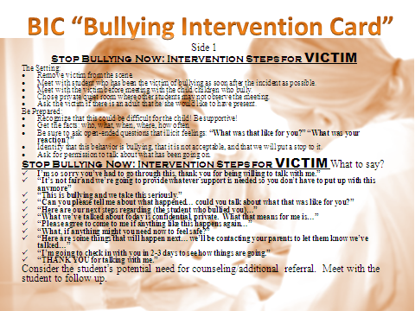

Slide 5
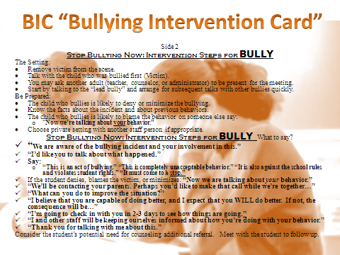

Slide 6

Cyber Bullying Interventions
Teachers’ Role = to EDUCATE
“The manner in which you represent yourself online should reflect who you
are now and who you want to be in the future.”
Most control over cyber security remains at home: EDUCATE the parents:
Follow suggested guidelines of website
Review with their child
Never give out personal information : i.e. passwords
Do not reply, forward, or send negative cyber messages
Google their child
Supervise their child’s time online
Computer in Family room or central location.
Store all electronic gadgets in parents’ bedroom before bed.
Know the law
Keep a detailed record of the event
Share the Online Experience: Parents, be their Facebook Friend
Notes:
Teach your students the harmful effects of cyber bullying for themselves and their peers.

