Slide 1
Radiological Assessment - of effects from - Fukushima Daiichi Nuclear Power Plant April 7, 2011

Slide 2
Operations Summary
Aerial Measuring Systems have totaled more than 262 flight hours in support of aerial monitoring operations
NNSA’s Consequence Management Response Teams have collected approximately 100,000 total field measurements taken by DOE, DoD, and Japanese monitoring assets
240 total air samples taken at US facilities throughout Japan undergoing lab analysis in the US

Slide 3
Guide to Interpretation
US radiological assessments are composed of aerial and ground measurements and indicate radiation levels from material that has settled on the ground
Each measurement corresponds to the radiation a person receives in one hour at that location. AMS data is presented as exposure rate 1 meter from the ground at the time the measurements occurred
All measurements outside the Fukushima power plant site boundary are below 0.013 REM per hour – a low but not insignificant level

Slide 4
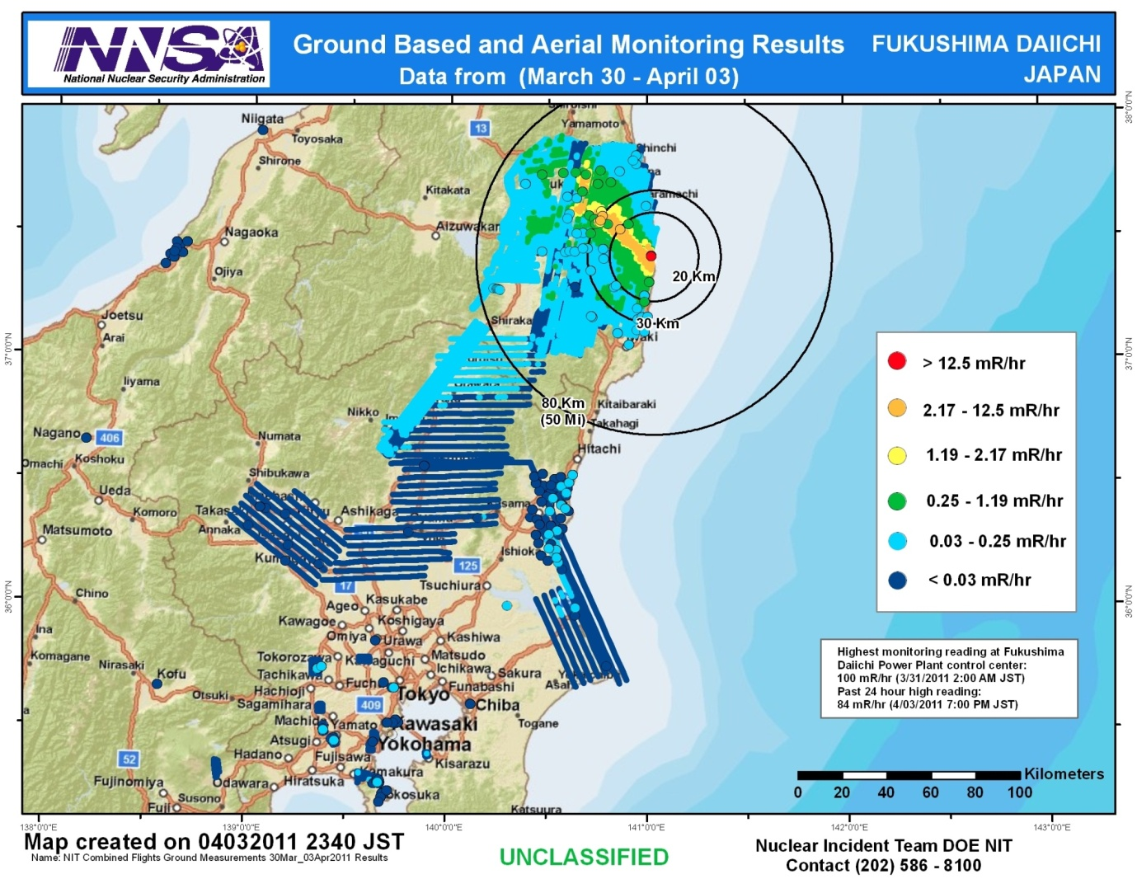
DOE/NNSA Monitoring

Slide 5
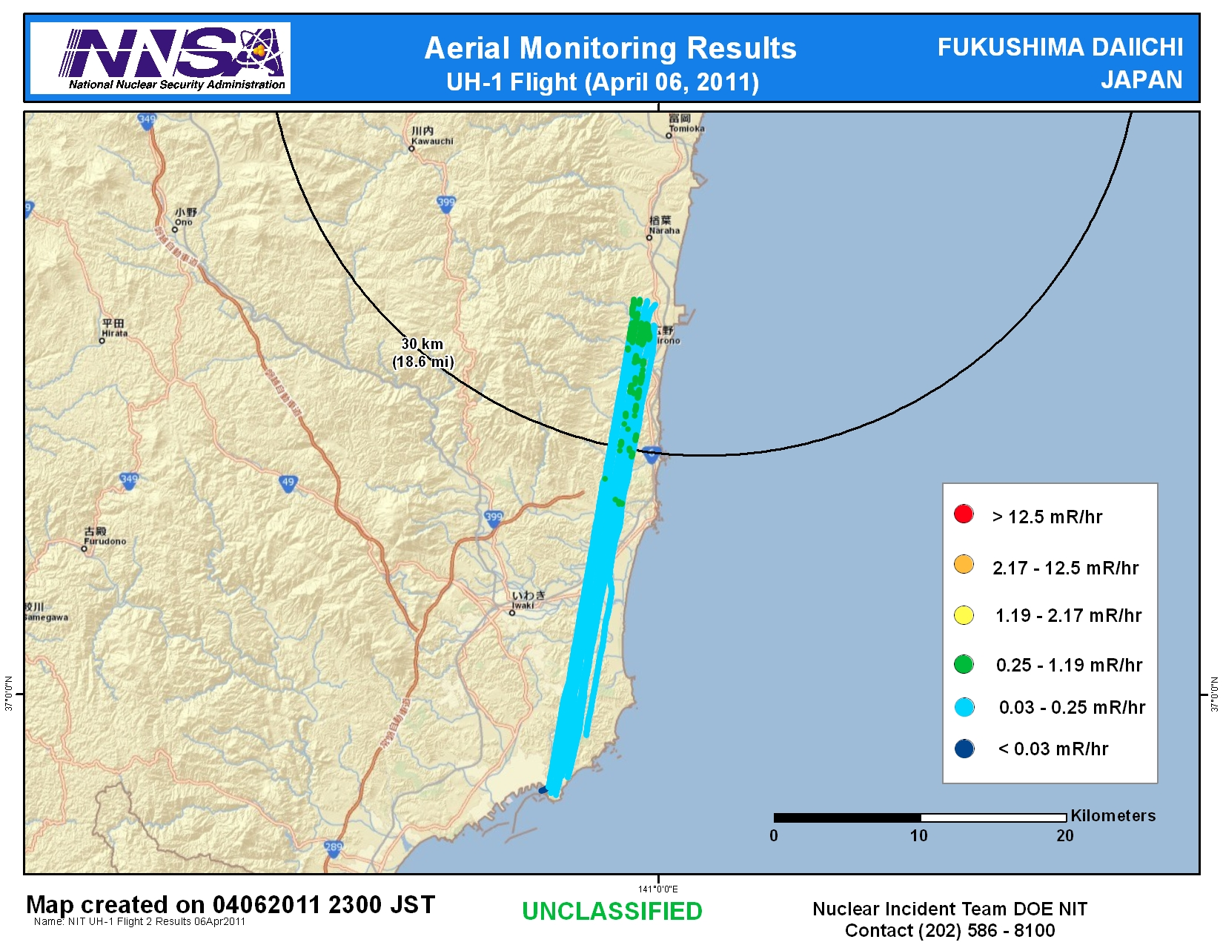

Slide 6
Assessment
An assessment of measurements gathered through April 6 continues to show:
Rapid decay of deposited radiological material indicating Radioiodine is the most significant component of dose
Radiation levels consistently below actionable levels for evacuation or relocation outside of 25 miles; and levels continue to decrease
No measurable deposit of radiological material since March 19
US bases and facilities all measure dose rates below 32 microrem/hr (32 millionths of a REM) – a level with no known health risks
Agricultural monitoring and possible intervention will be required for several hundred square kilometers surrounding the site:
Soil and water samples are the only definitive method to determine agricultural countermeasures
Ground monitoring can give better fidelity to identify areas that require agricultural sampling

Slide 7
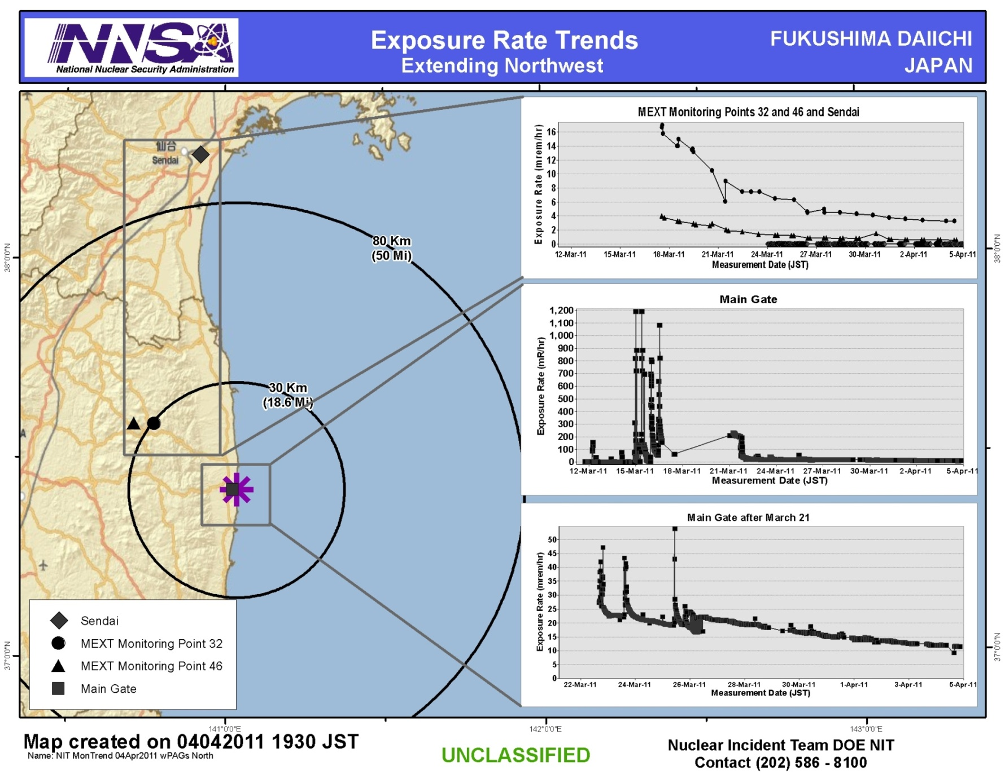

Slide 8
Context
The Nuclear Regulatory Commission estimates that the average American absorbs 620 mRem a year* (or 0.071 mRem/hour)
An average transatlantic flight produces an exposure of 2.5 mRem*
A typical chest x-ray produces 10 mRem per image
EPA guidelines call for public health actions if exposure exceeds 1000 mRem over 4 days
* Source: NRC: http://nrc.gov/images/about-nrc/radiation/factoid2-lrg.gif

Slide 9
