Slide 1
Radiological Assessment - of effects from - Fukushima Daiichi Nuclear Power Plant April 18, 2011

Slide 2
Operations Summary
Aerial Measuring Systems have totaled more than 334 flight hours in support of aerial monitoring operations
NNSA’s Consequence Management Response Teams have collected approximately 150,000 total field measurements taken by DOE, DoD, and Japanese monitoring assets
504 total air samples taken at US facilities throughout Japan undergoing lab analysis in the US

Slide 3
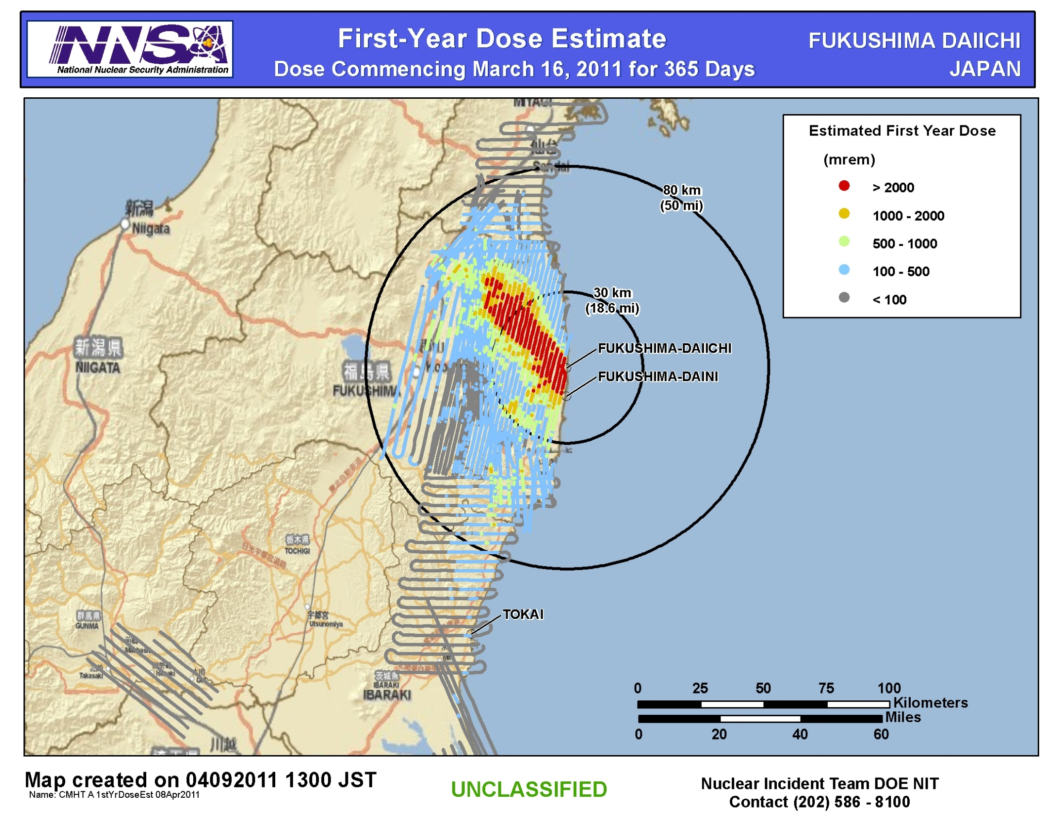
First Year Dose Estimate

Slide 4
Guide to Interpretation
First-Year Dose Estimate commencing March 16, 2011:
Map shows the radiation dose that would be received by people in the first year following the release of radioactive material from the Fukushima Daiichi plant.
First-Year 2 rem Threshold
People who did not evacuate this area before the releases occurred would be expected to receive 2 rem or greater dose if they remain in that area for one year following the release. This area is indicated by red. Those that did evacuate the red area prior to plant release (prior to 16 March) would be expected to receive less than a 2 rem dose.
First-Year 100 millirem Threshold
People who did not evacuate this area before the releases occurred would be expected to receive 100 millirem or greater dose if they remain in that area for one year following the release. This area is indicated by blue.
Assumptions
This dose estimate is conservative and assumes no dose reduction factor for spending time indoors.
This dose estimate takes into account radioactive decay of the source material.
This dose estimate includes the effects of external radiation due to material deposited on the ground and inhalation of re-suspended radioactive particles.
Notes
Based on 10 fixed-wing aerial surveys
Dose conversion factor (DCF) computed for each flight to account for decay
Computed dose based on NRC-supplied radionuclide mix, consistent with results to date for nuclides that have been measured
4

Slide 5
Assessment
An assessment of measurements gathered through April 17 continues to show:
Radiation levels continue to decrease
No measurable deposit of radiological material since March 19
US bases and facilities all measure dose rates below 32 microrem/hr (32 millionths of a REM) – a level with no known health risks
Agricultural monitoring and possible intervention will be required for several hundred square kilometers surrounding the site:
Soil and water samples are the only definitive method to determine agricultural countermeasures
Ground monitoring can give better fidelity to identify areas that require agricultural sampling

Slide 6
Context
The Nuclear Regulatory Commission estimates that the average American absorbs 620 mRem a year* (or 0.071 mRem/hour)
An average transatlantic flight produces an exposure of 2.5 mRem*
A typical chest x-ray produces 10 mRem per image
EPA guidelines call for public health actions if exposure exceeds 1000 mRem over 4 days
* Source: NRC: http://nrc.gov/images/about-nrc/radiation/factoid2-lrg.gif

Slide 7
