Slide 1
Radiological Assessment - of effects from - Fukushima Daiichi Nuclear Power Plant April 22, 2011

Slide 2
Operations Summary
Aerial Measuring Systems have totaled more than 400 flight hours in support of aerial monitoring operations
NNSA’s Consequence Management Response Teams have collected approximately 160,000 total field measurements taken by DOE, DoD, and Japanese monitoring assets
559 total air samples taken at U.S. facilities throughout Japan undergoing lab analysis in the United States

Slide 3
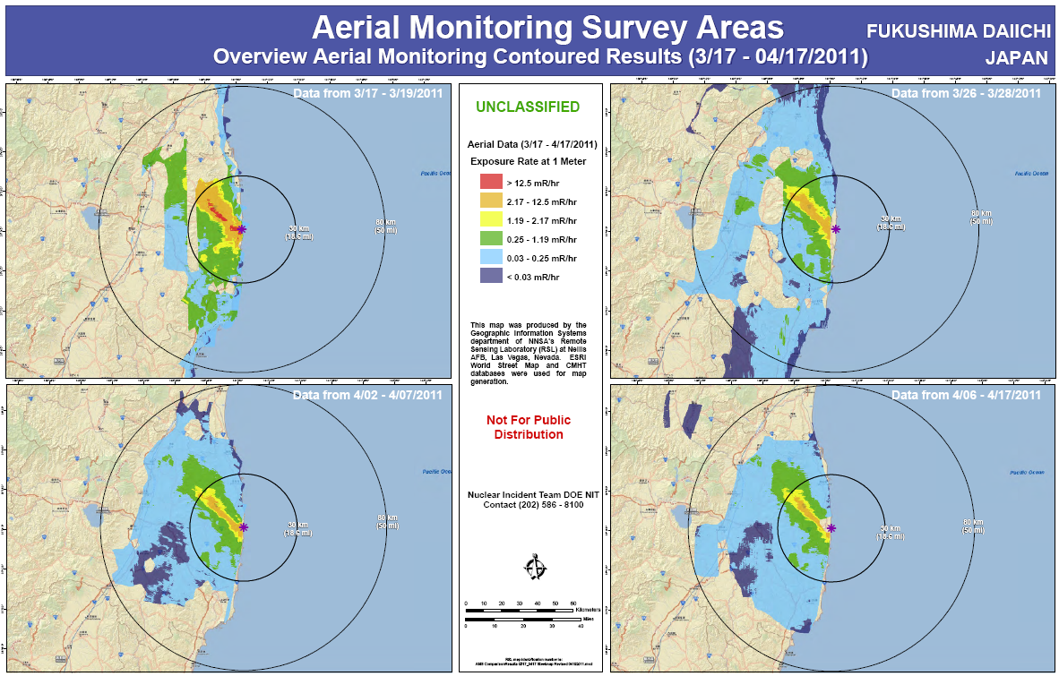
Survey Data Over Time

Slide 4
Assessment
An assessment of measurements gathered through April 20 continues to show:
Radiation levels continue to decrease
No measurable deposit of radiological material since March 19
US bases and facilities all measure dose rates below 32 microrem/hr (32 millionths of a REM) – a level with no known health risks
Agricultural monitoring and possible intervention will be required for several hundred square kilometers surrounding the site:
Soil and water samples are the only definitive method to determine agricultural countermeasures
Ground monitoring can give better fidelity to identify areas that require agricultural sampling

Slide 5
Context
The Nuclear Regulatory Commission estimates that the average American absorbs 620 mRem a year* (or 0.071 mRem/hour)
An average transatlantic flight produces an exposure of 2.5 mRem*
A typical chest x-ray produces 10 mRem per image
EPA guidelines call for public health actions if exposure exceeds 1000 mRem over 4 days
* Source: NRC: http://nrc.gov/images/about-nrc/radiation/factoid2-lrg.gif

Slide 6
