Slide 1
Radiological Assessment - of effects from - Fukushima Daiichi Nuclear Power Plant May 13, 2011

Slide 2
Monitoring Results: Sendai to Tokyo
Results show radiation levels along Tohoku Shinkansen Bullet Train
The integrated dose was measured with a calibrated electronic dosimeter by a field team member riding the train as a passenger, and includes external exposure but not inhalation.
The dose rate was recorded every 3 seconds with a calibrated scintillator.
All measurements were made inside the train.
The dose rate in some stations is significantly lower than along the tracks outside the station; possible evidence of decontamination.
The dose rate measured in the train is expected to be different from that measured by AMS because the train is often elevated (further from deposited activity) or in tunnels (unaffected by released activity).
The contamination on track beds may weather differently than on other surrounding ground material.

Slide 3
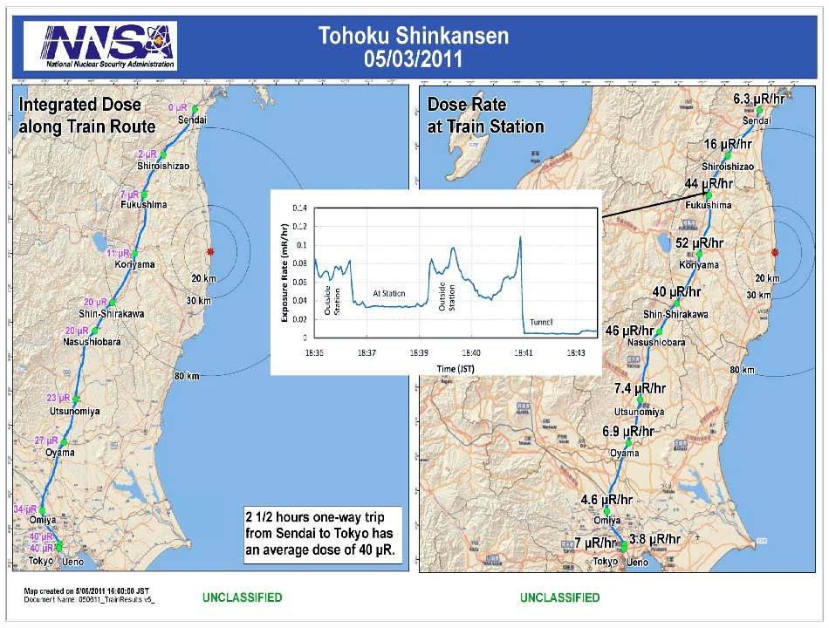
Monitoring Results: Sendai to Tokyo
Note: 1 milliRem (mRem) = 10 μ(micro)Sieverts; 1 milliRem (mRem) = 1000 μ(micro)rem

Slide 4
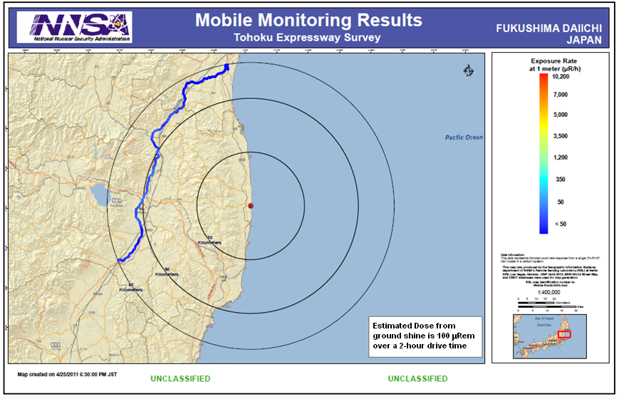

Slide 5
AMS Operations Summary
DOE/NNSA Aerial Measuring Systems have totaled more than 507 flight hours in support of aerial monitoring operations
NNSA’s Consequence Management Response Teams have collected over 269,500 total field measurements taken by DOE, DoD, and Japanese monitoring assets
More than 514 air samples taken at U.S. facilities throughout Japan undergoing lab analysis in the United States
148 total in situ ground spectra taken throughout Japan for lab analysis in US
115 Japan soil samples received, in-processed, and undergoing analysis

Slide 6
Joint US-Japan AMS Data
These results are from a joint MEXT, DOE/NNSA and USFJ survey
Data based on 42 fixed wing and helicopter survey flights at altitudes ranging from 150 to 700 meters between April 6 and April 29
Exposure rates are averaged over areas 300 m to 1500 m in diameter
There is no data near the Town of Inawashiro because it is mountainous and not easily accessible by low-flying aircraft
The cesium deposition was determined from aerial and ground-based measurements
The ratio of the amount of Cs-137 to Cs-134 is uniform across the survey region
There is no aerial survey data directly over the nuclear power plant itself
The survey boundary was chosen based on many preliminary measurement that showed the extent of the deposition

Slide 7
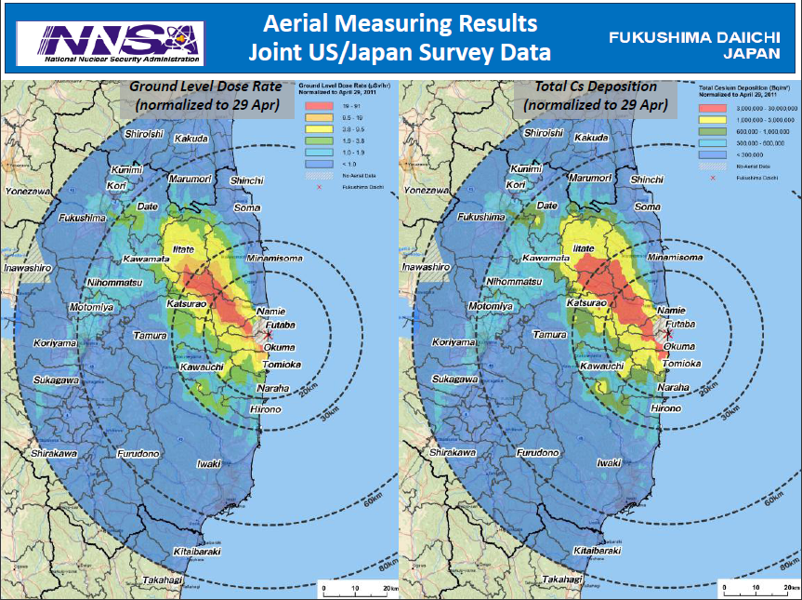
Joint US-Japan AMS Data

Slide 8
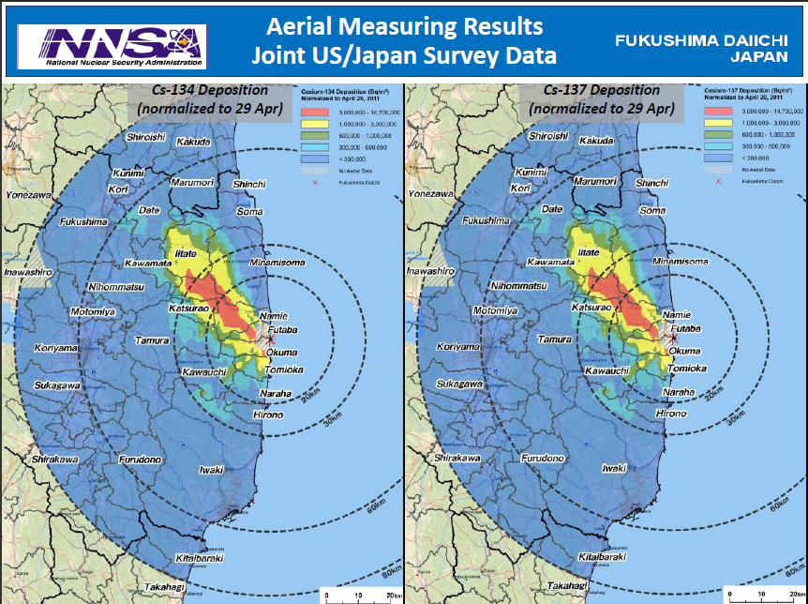
Joint US-Japan AMS Data

Slide 9
Assessment
An assessment of measurements gathered through May 13 continues to show:
Radiation levels continue to decrease
No measurable deposit of radiological material since March 19
US bases and facilities all measure dose rates below 32 microrem/hr (32 millionths of a REM)** – a level with no known health risks
Agricultural monitoring and possible intervention will be required for several hundred square kilometers surrounding the site:
Soil and water samples are the only definitive method to determine agricultural countermeasures
Ground monitoring can give better fidelity to identify areas that require agricultural sampling
** Note: 1 milliRem (mRem) = 10 μ(micro)Sieverts; 1 milliRem (mRem) = 1000 μ(micro)rem

Slide 10
Context
The Nuclear Regulatory Commission estimates that the average American absorbs 620 mRem a year* (or 0.071 mRem/hour)**
An average transatlantic flight produces an exposure of 2.5 mRem*
A typical chest x-ray produces 10 mRem per image
EPA guidelines call for public health actions if exposure exceeds 1000 mRem over 4 days
* Source: NRC: http://nrc.gov/images/about-nrc/radiation/factoid2-lrg.gif
** Note: 1 milliRem (mRem) = 10 μ(micro)Sieverts; 1 milliRem (mRem) = 1000 μ(micro)rem

Slide 11
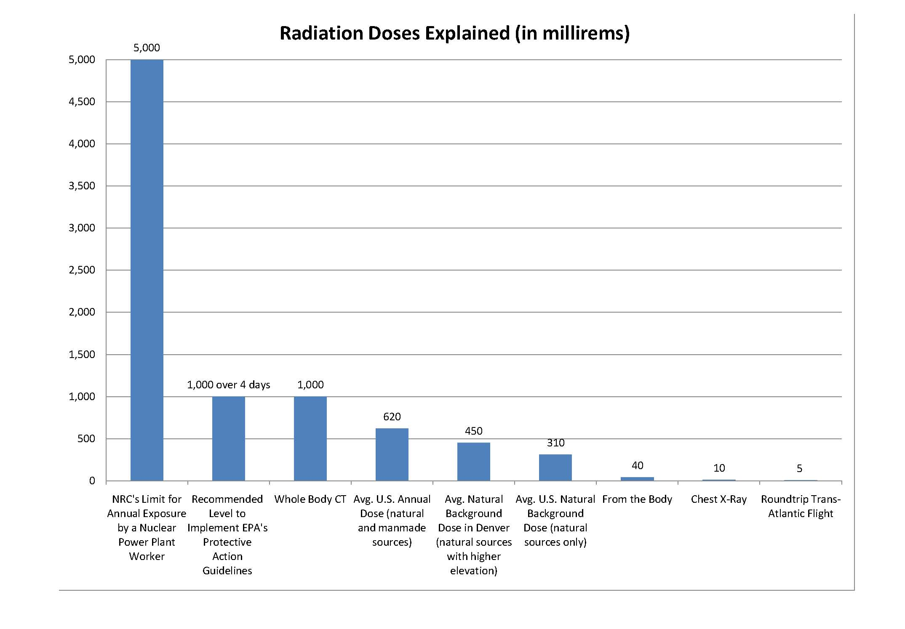
** Note: 1 milliRem (mRem) = 10 μ(micro)Sieverts; 1 milliRem (mRem) = 1000 μ(micro)rem

