Slide 1
Geothermal Play Fairway Analysis
FOA Webinar
DE-FOA-0000841 02/06/2014

Slide 2
Agenda
Registration Requirements
Award Information
FOA Information
Concept Paper
Full Application
Review Process
Technical Background on Play Fairway Analysis
Q&A
Notes:
Advise all potential applicants to have a copy of the FOA in front of them for reference. Submit questions through webinar chat box, to be answered at the end. All questions will be made public. Do not include proprietary information or PII

Slide 3
Disclaimer
All Applicants are strongly encouraged to carefully read the Funding Opportunity Announcement DE-FOA-0000841 (“FOA”) and adhere to the stated submission requirements. The content included in this presentation is intended to summarize the contents of FOA. If there are any inconsistencies between the content of this presentation and the information presented in the FOA please contact playfairway@go.doe.gov. In the event there is an inconsistency, the Funding Opportunity Announcement is the controlling document and applicants should rely on the FOA language.

Slide 4
DE-FOA0000841 Geothermal Play Fairway Analysis
Anticipated Schedule:
FOA Issue Date: | Friday 01/24/2014
FOA Informational Webinar: | Thursday 02/06/2014
Submission Deadline for Concept Papers: | Friday 02/21/2014 11:59PM EST
Submission Deadline for Full Applications: | Friday 04/11/2014 11:59PM EST
Submission Deadline for Replies to Reviewer Comments: | Wednesday 05/14/2014 11:59PM EST
Expected Date for EERE Selection Notifications: | Thursday 07/31/2014
Expected Timeframe for Award Negotiations: | Tuesday 09/30/2014
Notes:
Script:
Applicants must submit a Concept Paper by the due date listed above to be eligible to submit a Full Application
It is imperative that the Applicant/Selectee be responsive during award negotiations and meet negotiation deadlines. Failure to do so may result in cancelation of further award negotiations and rescission of the Selection.

Slide 5
Registration Requirements
To apply to this FOA, Applicants must register with and submit full application materials through EERE Exchange: https://eere-Exchange.energy.gov
Obtain a “control number” at least 24 hours before the first submission deadline eere-xhang.energy.gov
Although not required in order to submit an Application, the following registrations must be complete to received an award under this FOA:
Registration Requirement | Website
DUNS Number | http://fedgov.dnb.com/webform
SAM | https://www.sam.gov
FedConnect | https://www.fedconnect.net
Grants.gov | http://www.grants.gov
Notes:
There are several one-time actions before submitting an application in response to this FOA, and it is vital that applicants address these items as soon as possible. Some may take several weeks, and failure to complete them could interfere with an applicant’s ability to apply to this FOA, or to meet the negotiation deadlines and receive an award if the application is selected.
DUNS Number
Obtain a Dun and Bradstreet Data Universal Numbering System (DUNS) number.
System for Award Management
Register with the System for Award Management (SAM). Designating an Electronic Business Point of Contact (EBiz POC) and obtaining a special password called an MPIN are important steps in SAM registration. Please update your SAM registration annually.
Fedconnect
Register in FedConnect. To create an organization
account, your organization’s SAM MPIN is required. For more information about the SAM MPIN or other registration requirements, review the FedConnect Ready, Set, Go! Guide at https://www.fedconnect.net/FedConnect/PublicPages/FedConnect_Ready_Set_Go.pdf.
Grants.gov
Register in Grants.gov to receive automatic updates when Amendments to this FOA are posted. However, please note that [Delete if Letters of Intent are not applicable] Letters of Intent, Concept Papers, and Full Applications will not be accepted through Grants.gov.

Slide 6
Means of Submission
Concept Papers, Full Applications, and Replies to Reviewer Comments must be submitted through EERE Exchange at
https://eere-Exchange.energy.gov
EERE will not review or consider applications submitted through other means
The Users’ Guide for Applying to the Department of Energy EERE Funding Opportunity Announcements can be found at https://eere-Exchange.energy.gov/Manuals.aspx

Slide 7
Award Information
 | Phase 1 | Phase 2 | Phase 3
Anticipated Total Amount to be Awarded* | $3,000,000-$4,000,000 | $3,000,000-$5,000,000 | $3,000,000-$5,000,000
Anticipated Average Award Amount | $100,000 to $500,000 | $1,000,000 | $1,000,000
Types of Funding Agreements | Cooperative Agreements, Grants, Technology Investment Agreements, Work Authorizations, and Interagency Agreements
Period of Performance | 12 months | 12-24 months | 12-24 months
*Any future funding is contingent upon the availability of funds appropriated by Congress for the purpose of this program
Notes:
EERE will perform a down-select among Phase 1 recipients and provide additional Phase 2 funding only to a subset of recipients. This is described in the FOA in section VI-C.

Slide 8
Statement of Substantial Involvement
Substantial involvement includes, but is not limited to the following:
EERE has substantial involvement in work performed under Awards made following this FOA. EERE does not limit its involvement to the administrative requirements of the Award. Instead, EERE has substantial involvement in the direction and redirection of the technical aspects of the project as a whole. Substantial involvement includes, but is not limited to, the following:
EERE shares responsibility with the Recipient for the management, control, direction, and performance of the Project. To this end, the technology office will utilize a Technical Monitoring Team (TMT) composed of geothermal experts to provide periodic support in evaluating, reviewing, and guiding the project.
Notes:
There will be a substantial involvement between EERE and the Prime Recipient during the performance of a resultant cooperative agreement.
EERE has the right to intervene in the conduct or performance of project activities for programmatic reasons.
Intervention includes the interruption or modification of the conduct or performance of project activities. EERE does not limit its involvement to the administrative requirements of this Award. Instead, EERE has substantial involvement in the direction and redirection of the technical aspects of the project as a whole.

Slide 9
Statement of Substantial Involvement - Continued
EERE may intervene in the conduct or performance of work in this project for programmatic reasons. Intervention includes the interruption or modification of the conduct or performance of project activities.
EERE may redirect or discontinue funding the Project based on the outcome of EERE’s evaluation of the Project at the Go/No Go decision points or the competitive downselect reviews.
EERE participates in major project decision-making processes.

Slide 10
Multiple Applications
Applicants may submit more than one application to this FOA, provided that each application describes a unique, scientifically distinct project

Slide 11
Eligibility Requirements
Eligible applicants for this FOA include:
Individuals
Domestic Entities
Foreign Entities
If a foreign entity applies for funding as a Prime Recipient, it must designate in the Full Application a subsidiary or affiliate incorporated (or otherwise formed) under the laws of a State or territory of the United States to be the Prime Recipient.
Incorporated Consortia
Unincorporated Consortia
For more detail about each eligible applicant, please see Section III.A of the FOA for eligibility requirements

Slide 12
Prime Recipient Cost Sharing Requirements
Applicants must propose to contribute a minimum of 20% of the total project costs for R&D projects. Unless the project qualifies for the Cost Share Reduction.
Cost Share Reduction. EERE has reduced the Recipient Cost Share Requirement to 10% for R&D activities where:
The Prime Recipient is a domestic institution of higher education; domestic nonprofit entity; FFRDC; or U.S. State, local, or tribal government entity; and
The Prime Recipient performs more than 50% of the project work, as measured by the Total Project Cost.
Applicants who believe their project qualifies for the reduced recipient cost share must be able to provide verification that the above requirements are satisfied.

Slide 13
Allowable Cost Share
Cost Share must be allowable and must be verifiable upon submission of the Full Application
Refer to the following applicable Federal cost principles:
Entity | Cost Principles
Educational Institutions | 2 CFR Part 220
State, Local, and Indian Tribal Governments | 2 CFR Part 225
Non-profit Organizations | 2 CFR Part 230
For-profit Organizations | FAR Part 31

Slide 14
Allowable Cost Share
Cash Contributions
May be provided by the Prime Recipient, Subrecipients, or a Third Party
In-Kind Contributions
Can include, but are not limited to: personnel costs, indirect costs, facilities and administrative costs, rental value of buildings or equipment, and the value of a service, other resource, or third party in-kind contribution
Notes:
Basic definition: donation of personnel time, equipment, facilities, or other items that an organization will contribute to the project
Can take many forms, each of which must be assigned a dollar value to be included in the budget
Examples: donation of work hours, facility use, equipment use

Slide 15
Unallowable Cost Share
The Prime Recipient may not use the following sources to meet its cost share obligations including, but not limited to:
Revenues or royalties from the prospective operation of an activity beyond the project period
Proceeds from the prospective sale of an asset of an activity
Federal funding or property
Expenditures reimbursed under a separate Federal Technology Office
Independent research and development (IR&D) funds
The same cash or in-kind contributions for more than one project or program

Slide 16
Cost Share Contributions
Contributions must be:
Specified in the project budget
Verifiable from the Prime Recipient’s records
Necessary and reasonable for proper and efficient accomplishment of the project
Every cost share contribution must be reviewed and approved in advance by the Contracting Officer and incorporated into the project budget before the expenditures are incurred

Slide 17
Cost Share Payment
Prime Recipients must provide documentation of the cost share contribution, incrementally over the life of the award
The cumulative cost share percentage provided on each invoice must reflect, at a minimum, the cost sharing percentage negotiated

Slide 18
Cost Share Payment
In limited circumstances, the Prime Recipient may submit a waiver request to meet its cost share requirements on a less frequent basis, such as monthly or quarterly
Such waiver requests must be sent by email to the Contracting Officer during award negotiations and include:
(1) A detailed justification for the request;
(2) A proposed schedule of payments, including amounts and dates;
(3) A written commitment to meet that schedule; and
(4) Such evidence as necessary to demonstrate that the Prime Recipient has complied with its cost share obligations to date.
The Contracting Officer must approve all such requests before they may go into effect

Slide 19
Concept Papers
Applicants must submit a compliant Concept Paper by 02/21/2014 to be eligible to submit a Full Application
Concept Papers are deemed compliant if the Applicant successfully uploaded all required documents and clicked the “Submit” button in EERE Exchange by the deadline stated in the FOA
See Section IV.C of the FOA for information on the content requirements for Concept Papers

Slide 20
Concept Paper Review
Each eligible Concept Paper will be reviewed based on the criteria in Section V.A.1. of the FOA
Applicants will be notified of an Encourage/Discourage decision, and review comments on their Concept Paper will be available in EERE Exchange
Applicants will be provided approximately 30 days to prepare a Full Application
An Applicant who receives a “discouraged” notification may still submit a Full Application
By discouraging the submission of a Full Application, EERE intends to convey its lack of programmatic interest in the proposed project
Notes:
Regardless of the date the Applicant receives the Encourage/Discourage notification, the submission deadline for the Full Application remains the date stated on the FOA cover page

Slide 21
Full Applications
Applicants must submit a Full Application by 04/11/2014
Full Applications are deemed eligible if:
The Applicant is an eligible entity FOA, Section III.A;
The Applicant submitted an eligible Concept Paper;
The Cost Share requirement is satisfied FOA, Section III.B;
The Full Application is compliant FOA, Section III.C; and
The proposed project is responsive to the FOA FOA, Section III.D.

Slide 22
Merit Review and Selection Process - Overview
The evaluation and selection process consists of multiple phases that each include an initial eligibility review and a thorough technical review
Rigorous technical reviews are conducted by reviewers that are experts in the subject matter of the FOA
The Selection Official considers the recommendations of the Federal Consensus Board, along with other considerations such as program policy factors and available funding, to determine selections
See Section V.A.2 of the FOA for information on the technical review criteria for Full Applications

Slide 23
Merit Review and Selection Process - Overview
Pre-Selection Clarifications
Used solely for the purposes of clarifying the application, and will be limited to information already provided in the application
May occur before, during, or after the merit review evaluation process
Notes:
As part of the merit review process, EERE may invite one or more of the top ranked applicants to participate in a final phase of the merit review evaluation process: Pre-Selection Interviews.

Slide 24
Replies to Reviewer Comments
Applicants will have an opportunity to review the comments from Independent Reviewers and provide a Reply to Reviewer Comments.
Reply limited to 3 pages
Applicants will have approximately 2 business days to submit the Reply
Applicants are not required to submit a Reply
Please see FOA Sections IV.F. and V.A.3 for additional information regarding Replies to Reviewer Comments

Slide 25
Selection Factors
The Selection Official may consider the merit review recommendation, program policy factors, and the amount of funds available in arriving at selections for this FOA

Slide 26
Merit Review Criteria
Criterion 1: Technical Merit, Innovation, and Impact (50%)
Criterion 2: Project Research and Commercialization Plan (30%)
Criterion 3: Team and Resources (20%)

Slide 27
Program Policy Factors
The Selection Official may consider the following program policy factors in determining which Full Applications to select for award negotiations:
The degree to which the proposed project, including proposed cost share, optimizes the use of available EERE funding to achieve programmatic objectives
The level of industry involvement and demonstrated ability to commercialize energy or related technologies
Technical, market, organizational, and environmental risks associated with the project
Whether the proposed project is likely to lead to increased employment and manufacturing in the United States
Whether the proposed project will accelerate transformational technological advances in areas that industry by itself is not likely to undertake because of technical and financial uncertainty
The degree to which the proposed project directly addresses EERE’s statutory mission and strategic goals
The degree to which the proposed project will accelerate the development of geothermal exploration in under-explored regions

Slide 28
FOA Review Timeline
EERE
Concept Paper Review
EERE Full Application Review
EERE Review & Selection
Concept Paper Due
02/21/2014
Receive Encourage/ Discourage Notification
03/10/2014
Full Application Due
04/11/2014
Receive Reviewer Comments
05/09/2014
Reply to Reviewer Comments Due
05/14/2014
Receive notification of Selection/Non-Selection
07/31/2014
Pre-Selection Clarifications
05/27/2014 to 06/23/2014
EERE anticipates making awards by 9/30/2014

Slide 29
Key Submission Points
Check entries in EERE Exchange
Submissions could be deemed ineligible due to an incorrect entry
EERE strongly encourages Applicants to submit 1-2 days prior to the deadline to allow for full upload of application documents and to avoid any potential technical glitches with EERE Exchange
Make sure you hit the submit button
Any changes made after you hit submit will un-submit your application and you will need to hit the submit button again
For your records, print out the EERE Exchange Confirmation page at each step, which contains the application’s Control Number

Slide 30
Applicant Points-of-Contact
Applicants must designate primary and backup points-of-contact in EERE Exchange with whom EERE will communicate to conduct award negotiations
It is imperative that the Applicant/Selectee be responsive during award negotiations and meet negotiation deadlines
Failure to do so may result in cancelation of further award negotiations and rescission of the Selection

Slide 31
Play Fairway Analysis
The concept of play fairway analysis was developed in the petroleum industry in response to a need to:
Rapidly and accurately identify new areas that have the greatest potential for adding significant new reserves to a company’s portfolio
‘Sell’ the need to invest in further exploration of those areas to company management and/or investors

Slide 32
Play Fairway Analysis
A ‘play fairway’ is the area in a basin or region where examples of an individual type of resource concentration actually occur and/or are projected to exist based on the geologic characteristics of the basin and of the characteristics of the concentration.
Play fairway analysis is generally conducted during the early phases of resource exploration in order to highlight areas where more detailed exploration would be productive.

Slide 33
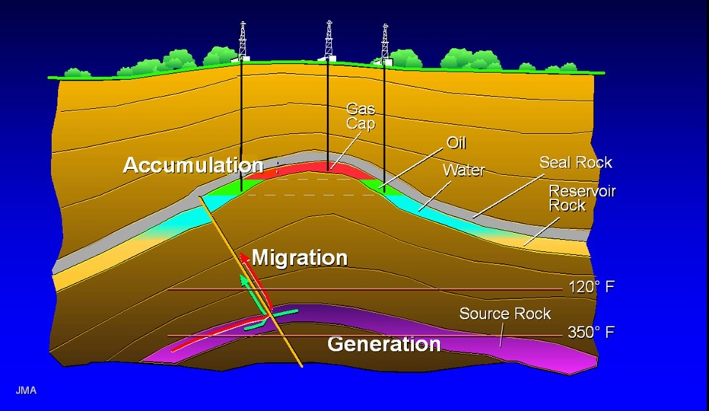
Focus is on the geologic conditions
For a resource concentration to exist, it has to have the coincidence of geologic factors.
A petroleum concentration, for example, has the following geologic elements:
source
reservoir
seal
trap
generation and migration
Note that in this
context, there is no
consideration of recoverability or engineering feasibility, just whether or not there is a concentration of the resource.
http://petroleumsupport.com

Slide 34
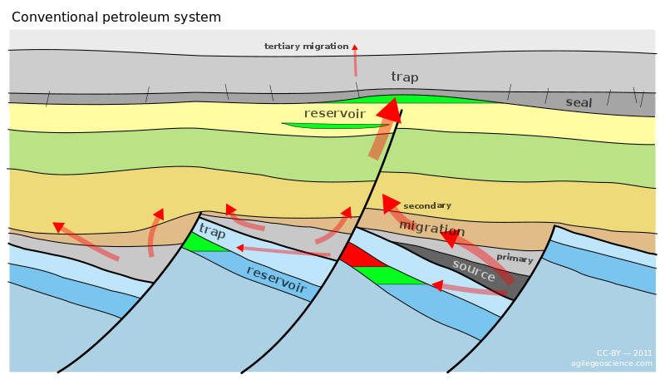
What is a ‘play?’
A combination of geologic factors that leads to the concentration of a desired resource
Can be based on the characteristics of a known accumulation or on a conceptual model or on a combination of the two.
http://subsurfwiki.org/wiki/Petroleum_system

Slide 35
Play ‘Risk’
Note that each play may have different several sources of geologic geologic ‘risks’ associated with it.
What is needed to make each play ‘work?
What is the natural geologic variability in each contributory factor?
How confident are you that those conditions exist in the area of interest?
http://subsurfwiki.org/wiki/Petroleum_system

Slide 36
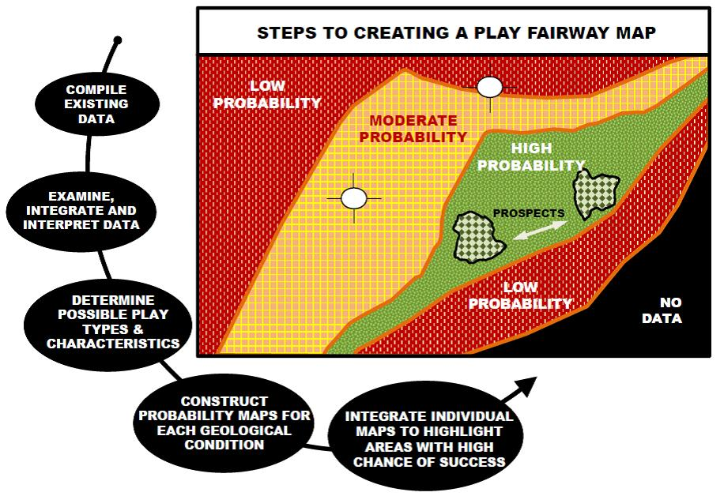
Identifying the play fairway
The Goal: To identify the locations in the area of study that have the highest probability of containing the geologic factors needed for this particular play

Slide 37
Identifying the play fairway
The Process:
1. Compilation of existing relevant geologic and geophysical data, including but not limited to:
Surface and subsurface geologic
Geophysical data
Remote sensing data
Geochemical data
2. Integration and interpretation of the data. This step may include modeling to project the data and interpretation into parts of the basin that is poorly sampled/explored.

Slide 38
Identifying the play fairway
3. Determination of the possible play types within the particular region and the necessary conditions required for each play type to occur.
4. Based on the data and on the play type, a probability map is constructed for each geologic factor that needs to exist for that play type. This step can include stochastic modeling of the natural variability of each geologic factor
5. These individual probability maps are then used to generate a composite probability map. This map should summarize the probability that a play exists given a specific set of causative factors as well as a quantitative measure of the likelihood of potential failure vs. size of the potential reward.

Slide 39
GTO is interested in projects that:
Focus on under or unexplored regions
Are at a basin or regional scale
Consider a wide range of possible geothermal resources, including traditional hydrothermal, blind hydrothermal, EGS, and low-temperature geothermal resources
Apply innovative analysis methods to extract new value from existing public and/or private data.
Develop methodologies that quantitatively couple multiple data types and incorporate a wide range of geologic and geophysical data in order to evaluate the risk of potential failure vs. size of the potential reward.
If an area looks prospective, will develop a clear plan to further characterize the geothermal resource.

Slide 40
Applications Specifically Not of Interest:
EERE performs a preliminary eligibility review of Full Applications. Applications that fall outside the parameters specified in Section I.B of the FOA are deemed non-responsive. This includes but is not limited to:
Applications for projects that begin with field collection of new data, instead of analysis of existing datasets. Proposals for Phase 1 should not include new field work.
Applications that propose work inside, or are extensions of, already-developed geothermal fields.
Applications for proposed technologies that are not based on sound scientific principles (e.g., violates the law of thermodynamics).

Slide 41
Questions
Questions about this FOA? Email playfairway@go.doe.gov
All Q&As related to this FOA will be posted on EERE Exchange
You must first select this specific FOA Number in order to view the Q&As (DE-FOA-000841)
EERE will attempt to respond to a question within 3 business days, unless a similar Q&A has already been posted on the website
Problems logging into EERE Exchange or uploading and submitting application documents with EERE Exchange? Email EERE- ExchangeSupport@hq.doe.gov.
Include FOA name and number in subject line
All questions asked during this presentation will be posted on EERE Exchange

