Slide 1
Radiological Assessment April 4, 2011

Slide 2
AMS Summary
Ops Summary
Aerial Measuring Systems have totaled more than 221 flight hours in support of aerial monitoring operations
NNSA’s Consequence Management Response Teams have collected thousands of ground measurements provided by DOE, DoD and the Japanese monitoring teams

Slide 3
Guide to Interpretation
US radiological assessments are composed of aerial and ground measurements and indicate the amounts of radiological material that has settled on the ground.
Each measurement corresponds to the radiation a person receives in one hour at that location. AMS data is presented as exposure rate 1 meter from the ground at the time the measurements occurred.
All measurements in this plot are below 0.03 Rem per hour – a low but not insignificant level.

Slide 4
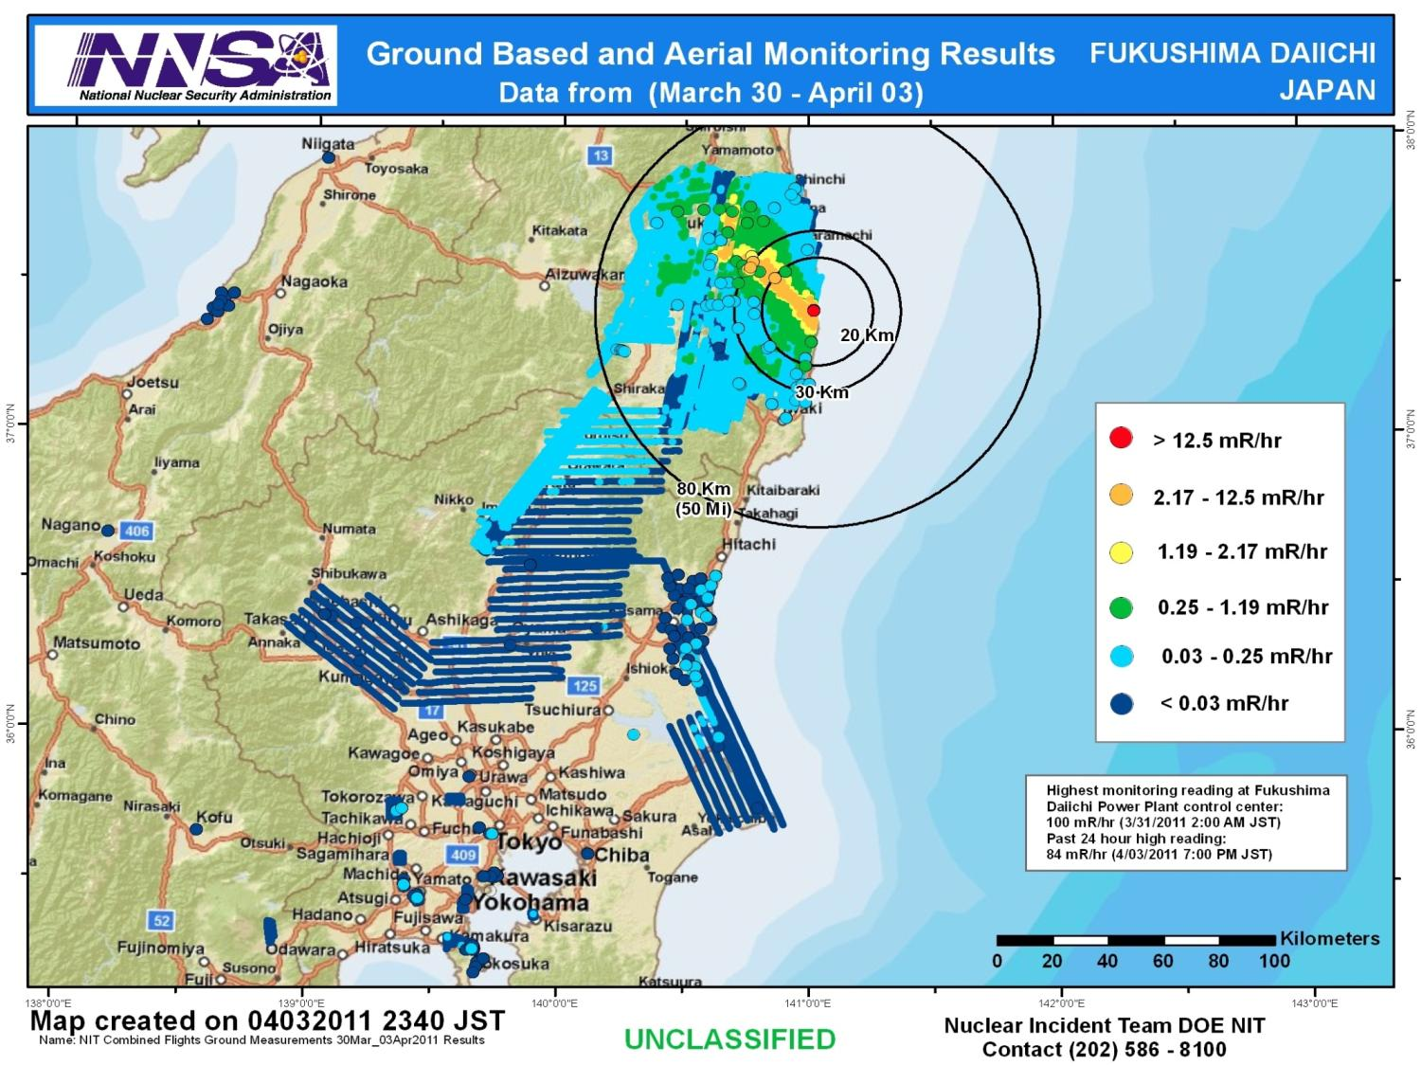

Slide 5
Assessment
An assessment of measurements gathered through April 3 continues to show:
Radiation levels consistently below actionable levels for evacuation or relocation outside of 25 miles
Radiological material has not deposited in significant quantities since March 19
An assessment of measurements gathered at US military installations in the Tokyo area through April 3 shows:
Radiation levels far below actionable levels for evacuation or relocation
All aerial measurements at US facilities were less than 32 microrem/hr - a level that poses no known health risk
Monitoring of these locations will continue although no increases in deposited radiation are anticipated

Slide 6
Context
The Nuclear Regulatory Commission estimates that the average American absorbs 620 mRem a year* (or 0.071 mRem/hour)
An average transatlantic flight produces an exposure of 2.5 mRem*
A typical chest x-ray produces 10 mRem per image
EPA guidelines call for public health actions if exposure exceed 1000 mRem over 4 days
* Source: NRC: http://nrc.gov/images/about-nrc/radiation/factoid2-lrg.gif

Slide 7
