Slide 1
Radiological Assessment March 22, 2011

Slide 2
AMS Summary
Ops Summary
Aerial Measurement Systems totaled more than 40 hours of flying
Plot interpretation
AMS data is presented as exposure rate 1 meter from the ground at the time the measurements occurred.

Slide 3
Guide to Interpretation
US radiological assessments are composed of aerial and ground measurements and indicate the amounts of radiological material that has settled on the ground.
Each measurement corresponds to the radiation a person receives in one hour at that location.
These calculations account for multiple variables. For instance, radiation is most intense in the first days following its release. Therefore, dose reduction may be achieved by evacuating early in the response.
All measurements in this plot are below 0.03 Rem per hour – a low level. And nearly all elevated readings are within 25 miles of Fukushima Daiichi.
Measurements also show an area of greater radiation extending northwest from the accident. This area may be of interest to public safety officials and responders.

Slide 4
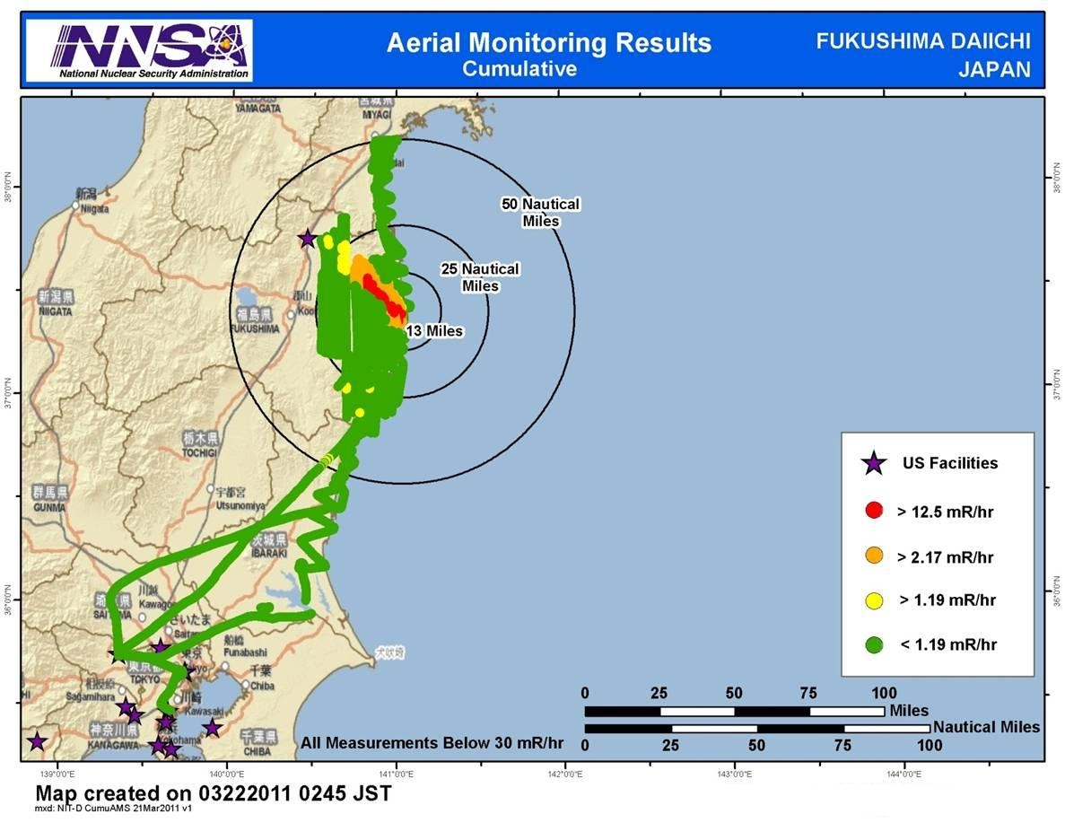

Slide 5


Slide 6
Context
The Nuclear Regulatory Commission estimates that the average American absorbs 620 mRem a year* (or 0.071 mRem/hour)
An average transatlantic flight produces an exposure of 2.5 mRem*
A typical chest x-ray produces 10 mRem per image
EPA guidelines call for public health actions if exposure exceed 1000 mRem over 4 days
* Source: NRC: http://nrc.gov/images/about-nrc/radiation/factoid2-lrg.gif
6

Slide 7
