Slide 1
Radiological Assessment March 25, 2011

Slide 2
AMS Summary
Ops Summary
Aerial Measurement Systems totaled more than 70 hours of flying
Flight operations were curtailed on March 20-22 due to weather
NNSA’s Consequence Management Response Teams have collected thousands of ground measurements that were provided by DOE, DoD and the Japanese

Slide 3
Guide to Interpretation
US radiological assessments are composed of aerial and ground measurements and indicate the amounts of radiological material that has settled on the ground.
Each measurement corresponds to the radiation a person receives in one hour at that location. AMS data is presented as exposure rate 1 meter from the ground at the time the measurements occurred.
All measurements in this plot are below 0.03 Rem per hour – a low but not insignificant level. And nearly all elevated readings are within 25 miles of Fukushima Daiichi.
Measurements also show an area of greater radiation extending northwest from the accident. This area may be of interest to public safety officials and responders.

Slide 4
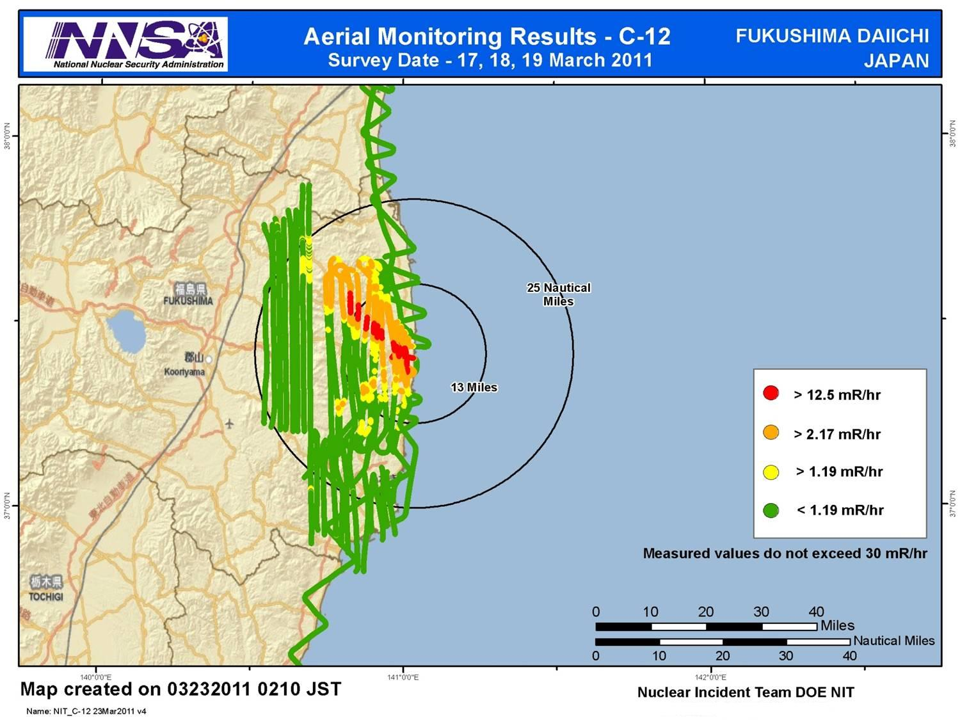

Slide 5
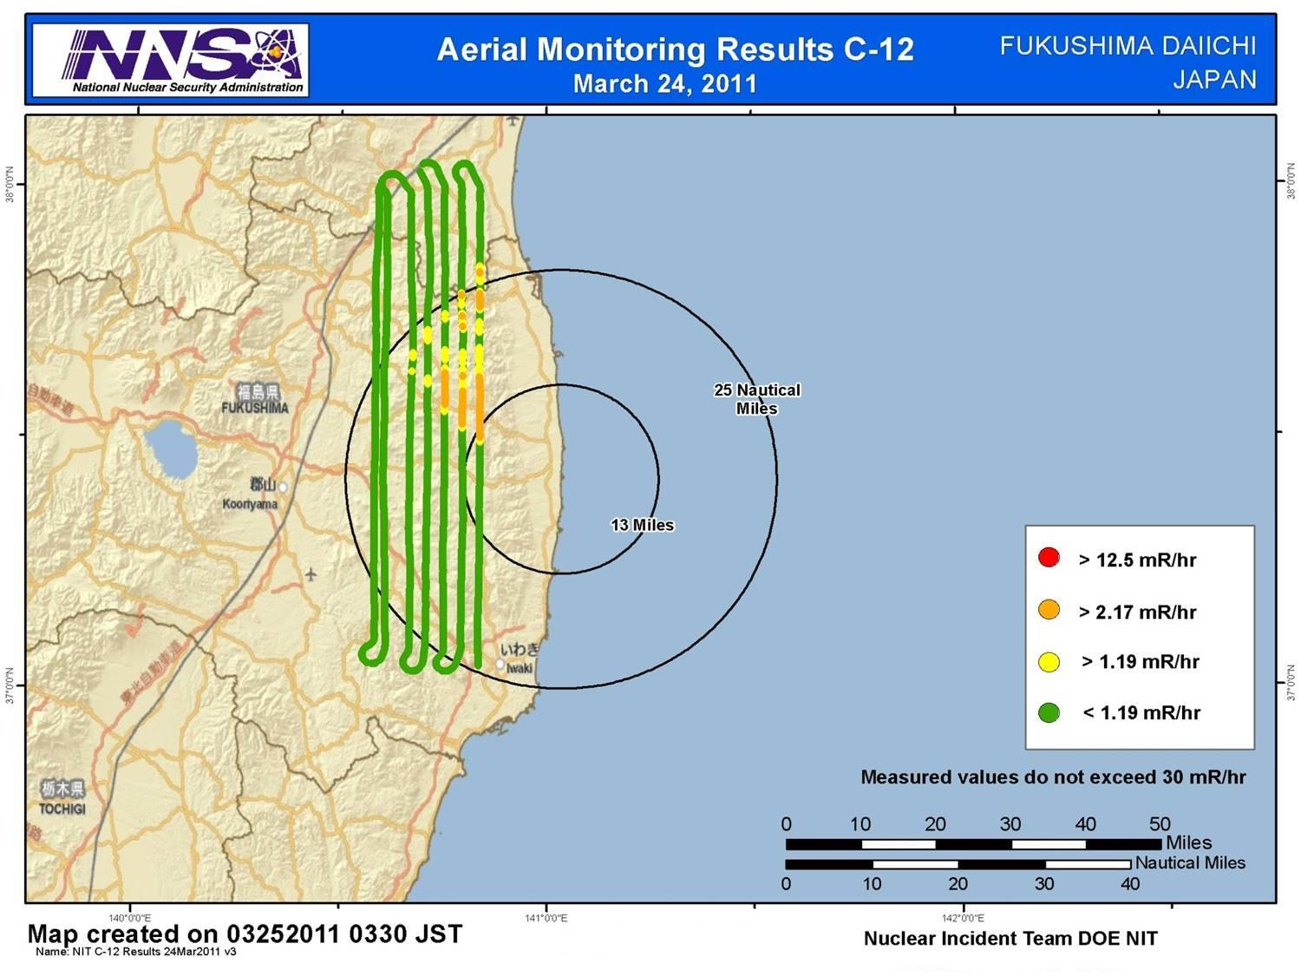

Slide 6
Assessment
By comparing data from March 24th to previous measurements, the data indicate:
Peak exposure rates are lower in comparable areas (Note: reduction in exposure rate is expected as a result of radioactive decay);
No new areas of deposition are apparent although winds since March 19th have crossed the area measured.
Conclusion:
In the area measured, radiological material has not deposited in significant quantities since March 19th
Path Forward:
These conclusions are preliminary. Additional measurements will refine our knowledge of radiological conditions in the area surrounding Fukushima Dai-ichi.

Slide 7
Context
The Nuclear Regulatory Commission estimates that the average American absorbs 620 mRem a year* (or 0.071 mRem/hour)
An average transatlantic flight produces an exposure of 2.5 mRem*
A typical chest x-ray produces 10 mRem per image
EPA guidelines call for public health actions if exposure exceed 1000 mRem over 4 days
* Source: NRC: http://nrc.gov/images/about-nrc/radiation/factoid2-lrg.gif
7

Slide 8
