Slide 1
Radiological Assessment March 29, 2011

Slide 2
AMS Summary
Ops Summary
Aerial Measuring Systems totaled more than 130 hours of flying
Flight operations were curtailed on March 20-22 and March 25 due to weather
Flight operations conducted March 27 and 28 focused on areas outside of a 25 mile radius from the incident site
NNSA’s Consequence Management Response Teams have collected thousands of ground measurements provided by DOE, DoD and the Japanese monitoring teams

Slide 3
Guide to Interpretation
US radiological assessments are composed of aerial and ground measurements and indicate the amounts of radiological material that has settled on the ground.
Each measurement corresponds to the radiation a person receives in one hour at that location. AMS data is presented as exposure rate 1 meter from the ground at the time the measurements occurred.
All measurements in this plot are below 0.03 Rem per hour – a low but not insignificant level.

Slide 4
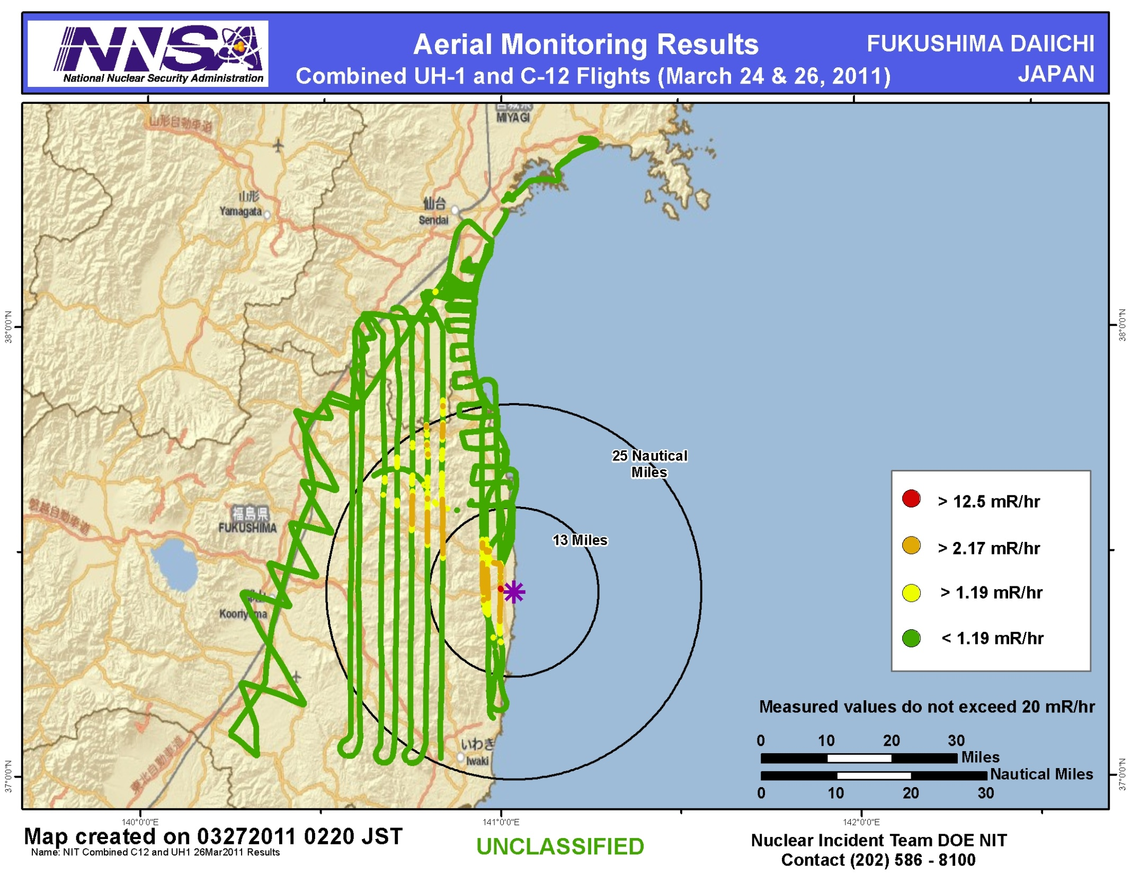

Slide 5
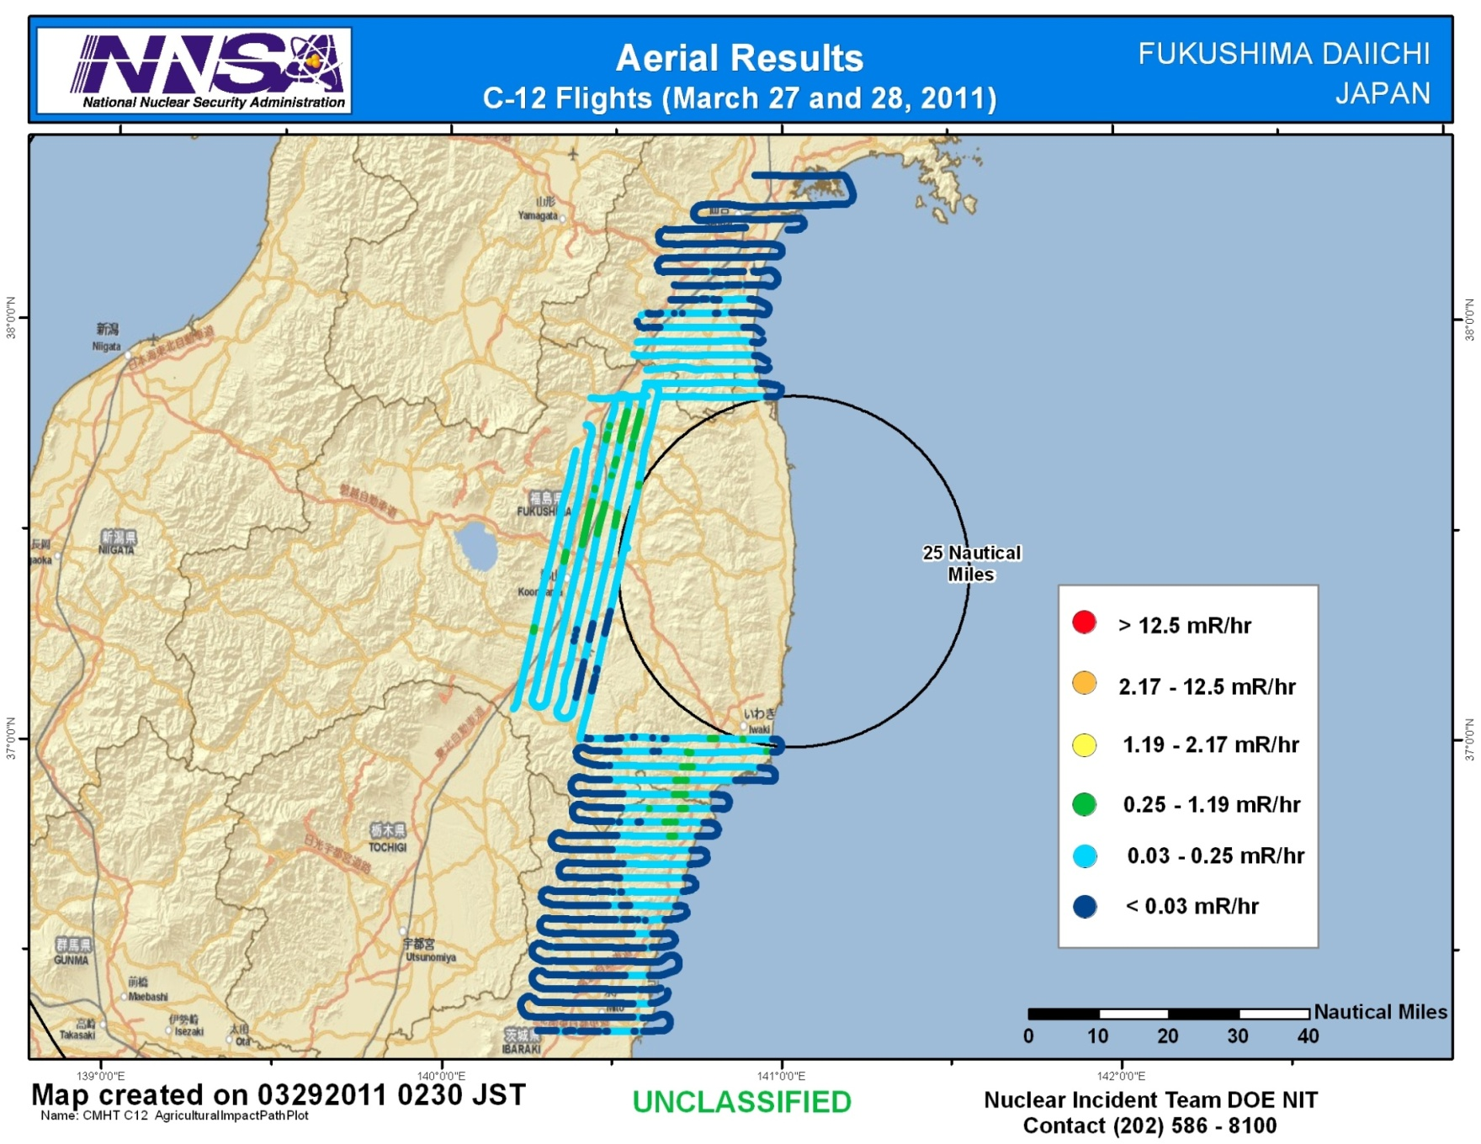

Slide 6
Assessment
Assessment:
The dose rates measured by AMS have decreased since last week. This is expected due to radioactive decay of the material deposited on the ground
AMS monitoring results in areas beyond 25 miles from the Fukushima Daiichi reactors show areas where dose rates are many times higher than historical background.
The measured external dose rates in these areas are not high enough to warrant evacuation or relocation of the population, however, lower levels of radioactive contamination in food provide more of a risk because the radioactive material can be ingested into the body. Agricultural monitoring in these areas may be warranted.
Radiological material has not deposited in significant quantities in the areas measured since March 19.

Slide 7
Context
The Nuclear Regulatory Commission estimates that the average American absorbs 620 mRem a year* (or 0.071 mRem/hour)
An average transatlantic flight produces an exposure of 2.5 mRem*
A typical chest x-ray produces 10 mRem per image
EPA guidelines call for public health actions if exposure exceed 1000 mRem over 4 days
* Source: NRC: http://nrc.gov/images/about-nrc/radiation/factoid2-lrg.gif

Slide 8
