Slide 1
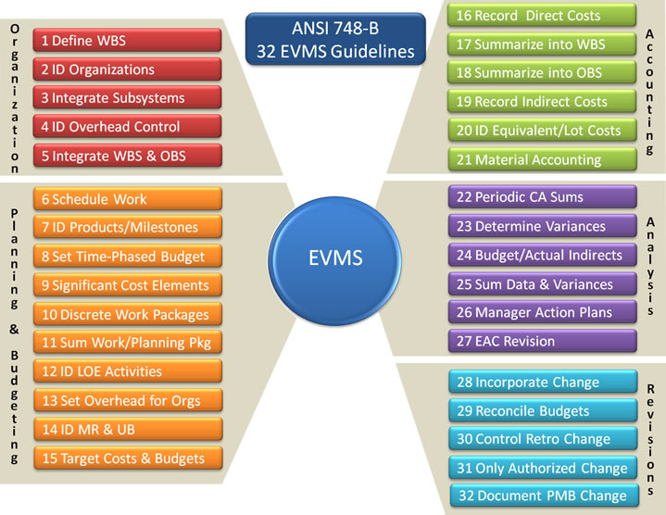
EIA-748C EVMS Guidelines Reference
EIA-748C

