Slide 1
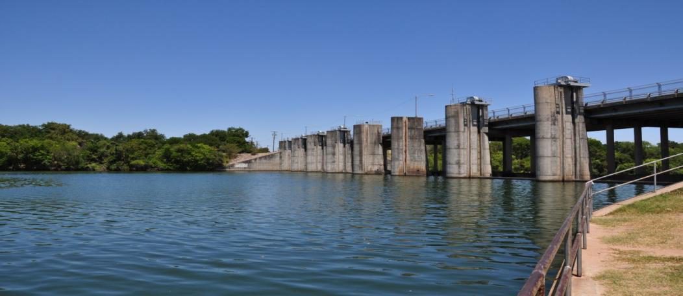
Water Power Peer Review
Real World Demonstration of a New American Low-Head Hydropower Turbine
Hydro Green Energy, LLC
In partnership with:
Mechanical Solutions, Inc.
HDR|DTA and
Alden Research Laboratory
  Sustainable Small Hydropower
  Innovative System Testing (1.2)
Department of Energy, Wind and Water Power
November 2011
DE-FOA-0000486

Slide 2
Purpose, Objectives, & Integration
Purpose:
Reduce the LCOE of low-head hydropower generation with a new modular turbine design
Test turbine performance at an actual low-head hydropower site
  The civil engineering and licensing costs associated with installing and maintaining typical hydropower projects do not scale down for low-head projects.
  Typical project designs can require river damming or riverbed excavation and therefore costly licensing processes.
  Off-the-shelf foreign-made low-head turbines cannot be easily integrated into more efficient modular turbine systems.
Objectives:
The project addresses WPP’s goals of developing new hydropower technologies that have better energy and environmental performance and bringing them to commercial readiness.
  HGE‘s turbine system is cost-effective, modular, and uses low-impact installation methods. This project includes stress testing and performance evaluation of HGE’s turbine system during a real world deployment.
Integration:
Proposed design deployment at Longhorn Dam (TX) will build off lab-based stress testing and validation of the turbine system under HGE’s Subtopic 1.1 project.

Slide 3
Technical Approach
Technical Approach:
HGE’s modular turbine design and its Longhorn Dam installation site will be modeled and stress tested using CFD and FEA.
HGE and its partners will then fabricate, install, and operate the turbine system at Longhorn Dam and collect performance data
Stress analyses conducted by MSI using 3D finite-element analysis (FEA) will ensure that the system performs under normal and severe operating conditions before the installation is carried out.
The design reduces head loss at the turbine inlet because the generator is out of the water flow path, increasing the system’s efficiency.
The system works at the existing water depth on the tail water side of an impoundment and therefore does not require river damming or riverbed excavation.

Slide 4
Plan, Schedule, & Budget
Schedule
Initiation date: June 2011
Planned completion date: July 2013
[Milestones for FY10 and FY11]
[Go/no-go decision points for FY12 and FY13]
Budget:
Total DOE Award Amount approximately $1,500,000
Approximately $3,645,000 in cost share
Budget History
FY2009 |  | FY2010 |  | FY2011
DOE | Cost-share | DOE | Cost-share | DOE | Cost-share

Slide 5
Additional Slides
The following slides are for information purposes only

Slide 6
Guidelines for number of slides
(Not a template slide – for information purposes only)
Slides may include pictures, graphics, or information that is additional to what is requested in the template (above), however, slides must include all information that is indicated in the template.
Project PIs will also be available for Q&A with the Peer Reviewers (via teleconference) during the timeslot allotted for the lower TRL level projects.

Slide 7
Preparation Instructions
(Not a template slide – for information purposes only)
Do not include any proprietary, copyrighted, or confidential information. Do not mark any slide with “Official Use Only” or any similar restriction used by your organization.
Please name your electronic MS PowerPoint presentation file as follows (use the first 4 letters of your title):
  [Title_Organization_LastName.ppt].
Do not incorporate animations or special effects since all presentations will be saved as PDF files for presentation and for posting on the web. Animations critical to describing the project may be presented as separate files, however they must be approved by the Program and presented within your allotted time.

Slide 8
Final Instructions
(Not a template slide – for information purposes only)
Your presentation, in MS PowerPoint format, is due to Ed Eugeni at Edward_Eugeni@sra.com. If your presentation is too large to email, contact Ed Eugeni at 240-223-5552 for alternative delivery options.

Slide 9
Questions?
(Not a template slide – for information purposes only)
Contact:
  Hoyt Battey at Hoyt.Battey@ee.doe.gov,
  202-586-0143
  or Ed Eugeni at Edward_Eugeni@sra.com, 240-223-5552

