Slide 1
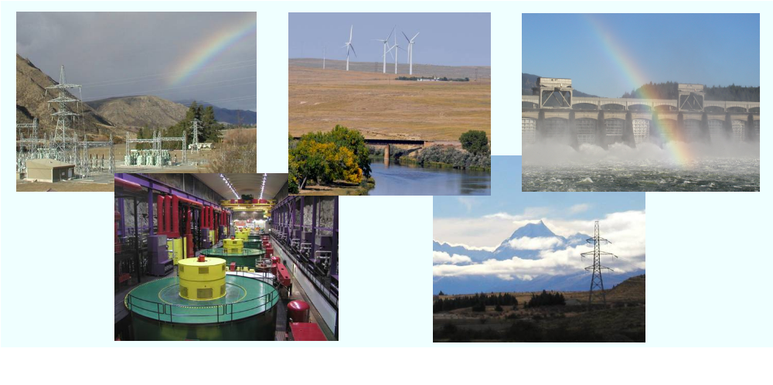
Water Power Peer Review
  Quantifying the Value of Hydropower in the Electric Grid
Tom Key
Electric Power Research Institute
tkey@epri.com
November 3, 2011

Slide 2
Purpose, Objectives, & Integration
Purpose: Quantify the potential value of increased hydropower use
Objective: Data and methods to value grid services from Hydropower
Participants:
  Researchers include EPRI, Oak Ridge National Lab, Sandia National Lab
  Consultants include HDR-DTA, HPPi, LCG Consulting, Kirby Consulting
  Industry sponsors include Case Study plant owners and Cost Share Partners

Slide 3
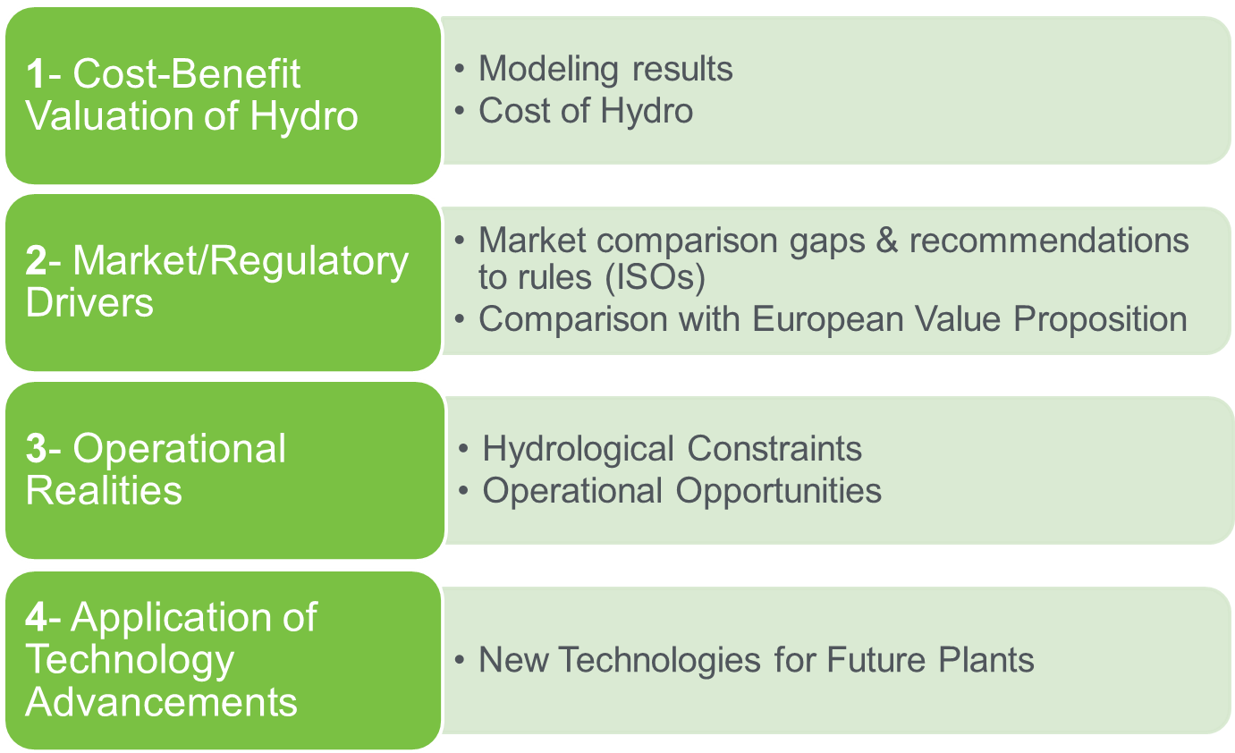
Project Approach for Defining Hydropower Value
Notes:
Year One:
Conduct specific plant studies to determine operation (HPPi)
Model WECC electric sector to determine value of (LCG):
Energy arbitrage value with LMP
Ancillary Services
Consider CO2, RPS, and future generation mix
Determine cost of future hydro technology/assets (HDR|DTA)
Evaluate today’s market rules (Sandia)
Year Two:
Run scenarios to determine future value (LCG)
Consider other values e.g. freq. regulation, reliability energy security (All)
Factor in systemic constraints and ways to minimize (ORNL)
Synthesis into valuing/methods report comparing alternatives (All)

Slide 4
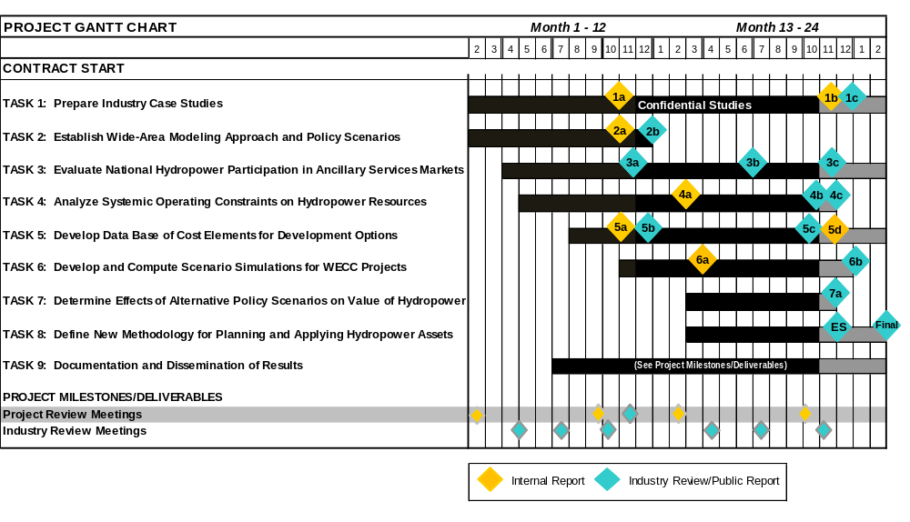
Project Schedule/ Budget
Budget: $3.2 M, Spending as of Sept 2011: $2.1 M

Slide 5

Project Technical Transfer Updatewww.epri.com/hydrogrid
Reports
3 of 7 – EPRI, ORNL and Sandia web sites linked.
Industry Workshops
2 of 3
Industry Reviews
4 of 5
Webcasts
10 so far
Papers
3 of 7

Slide 6
1. Cost-Benefit Valuation of Hydro Overview
Modeling to Determine Value
  Developed reference cases for 2010, 2020
  Defined energy future scenarios
  Obtained input from pumped storage/conventional plant operators (in WECC)
  Described Model and Approach in a public report
Estimating Hydro Plant Costs (new/upgraded plants)
  Cost elements compiled (pumped storage & conventional)
  Cost comparison with available data
  Report is complete and in publication

Slide 7
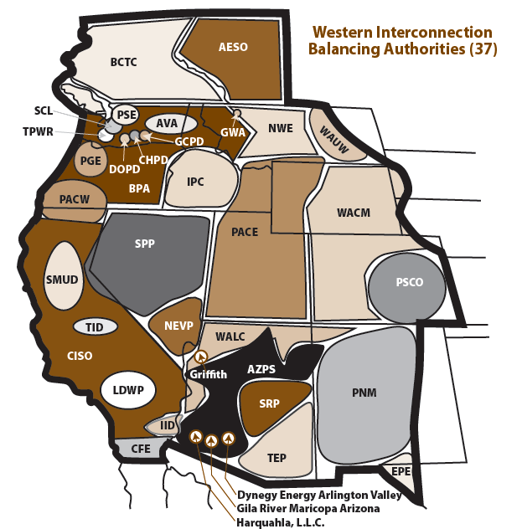
1. Modeling: WECC Breakdown
WECC includes 37 Balancing Authorities
WECC includes 4 Subregions:
CA-MX US
AZ-NM-SNV
NWPP
RMPA

Slide 8
1. Modeling: Data Sent to Plant Owners/Operators in WECC
Conventional:
Pumped Storage:
Idaho Power
Pacific Gas & Electric
Chelan County PUD
Sacramento Municipal Utility District
US Bureau of Reclamation
Avista Corp
Pacific Corp
Portland General Electric
Southern California Edison
Seattle City Light
US Corps of Engineers
California Dept. of Water Resources
Salt River Project
Central Arizona Project
LA Dept. of Water & Power/CDWR
Xcel Energy
US Bureau of Reclamation
Southern California Edison Co
Pacific Gas & Electric Co

Slide 9
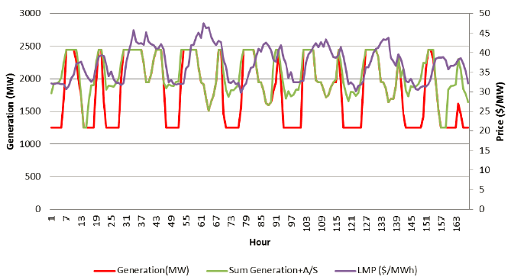
1. Modeling: Plant Owner/Operator Feedback
Are plant parameters properly modeled?
Is operation characterized
correctly in markets or utility
Do plant drivers and interaction
with other plants look right
Input/new learnings incorporated into the model

Slide 10
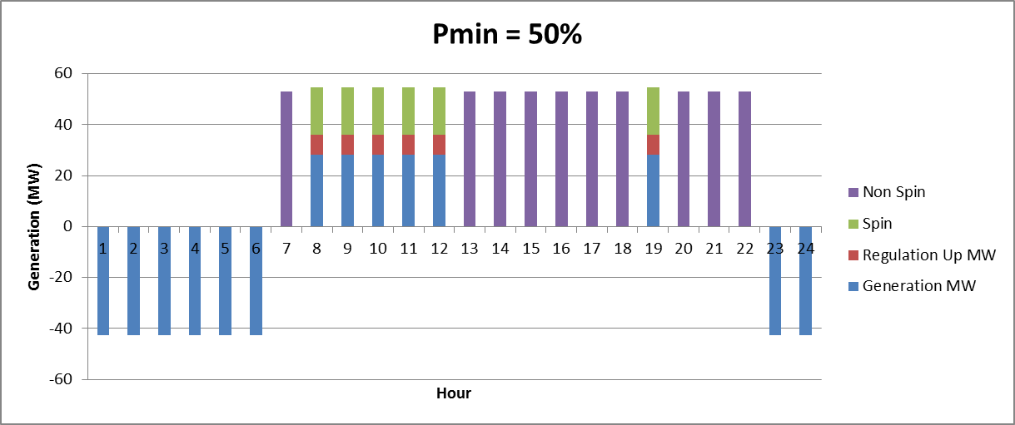
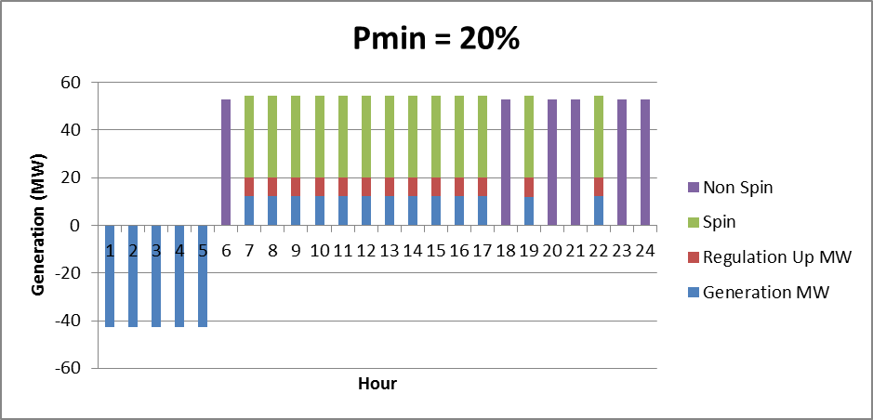
1. Modeling: Pumped Storage Operations
Dramatic shifts in operations occur when the minimum loading constrained is altered to allow a very low set point.

Slide 11
1. Modeling: Primary Energy Future Scenarios
Timeframes
Energy Futures
Sensitivities
Hydro Conditions
Carbon Costs
2010
PS Expansion
Load Growth
2020
Gas Prices
Technology Upgrades
Energy Future | Emission Costs | Demand | Generation Expansion
Future 1 | None | Average | TEPPC (WECCs plan)
Future 2 | None | Average | EPRI Estimate (NESSIE)
Future 3 | Medium | Average | EPRI Estimate (NESSIE)
Future 4 | Medium | High | NESSIE w/ High Gas price

Slide 12
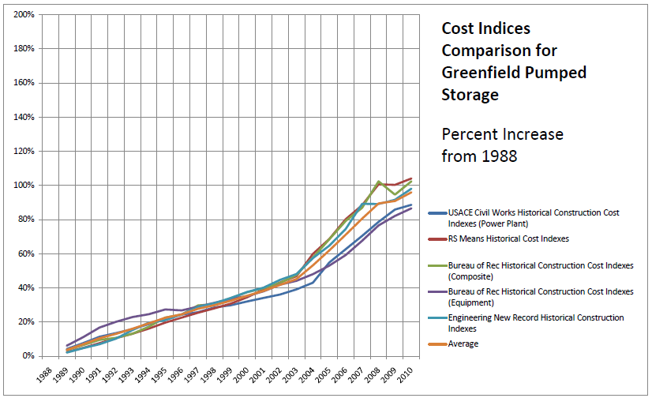
1. Cost: Average Compared to Expected Plant Costs
Industry trends indicate actual 2010 escalation is higher than 2.0

Slide 13
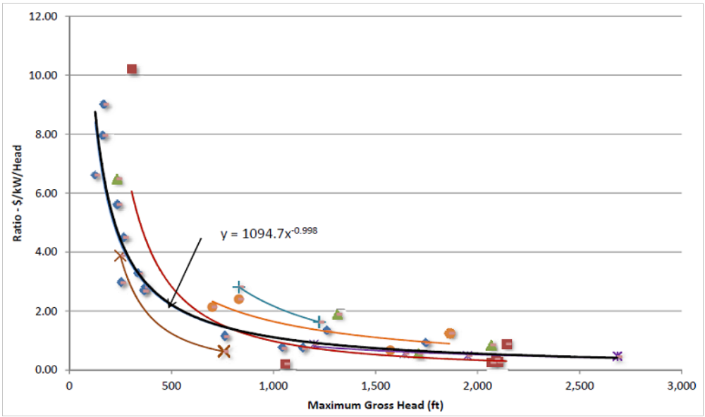
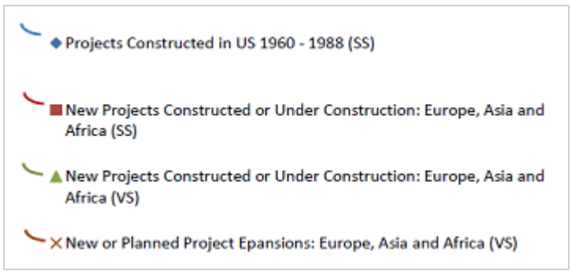
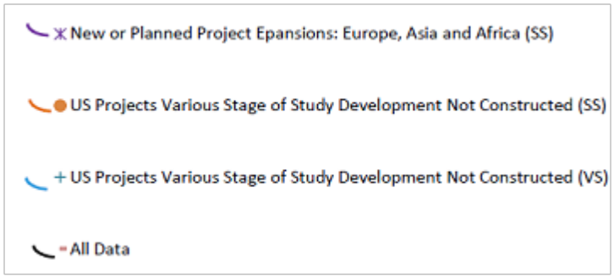
1. Cost: Importance of Head in Pumped Storage Economy

Slide 14
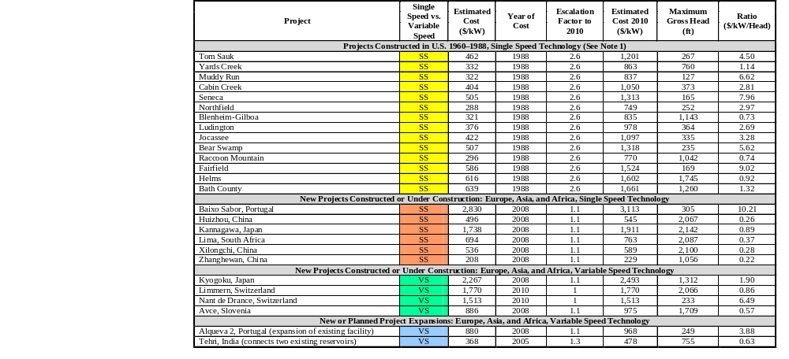
Pumped Storage Construction Cost Data

Slide 15
2. Market/Regulatory Drivers
Market comparisons considering specific plant case studies, (ISOs)
  Completed report on market treatment of hydro power energy and ancillary services
  Conducted workshops with WECC/CAISO and at MISO
  Will report on gaps with recommendations in final report , paper proposed for HydroVision 2012
Comparison with European Value Proposition
  Input from stakeholders on pumped storage (final report and paper proposed for HydroVision 2012) primarily from Voith

Slide 16
2. Markets: Characteristics of well-functioning markets
Ease of market entry and exit
  Limit requirements for market participation
Absence of significant monopoly power
  No dominant firms
Widespread availability of information
  All participants should simultaneously have the same information
Absence of market externalities
  No uncompensated services
Achievement of public interest objectives
  More competition leads to lower energy prices

Slide 17
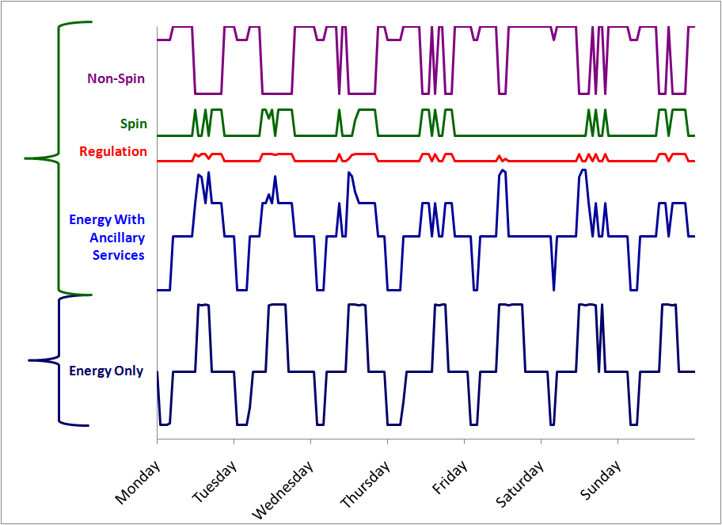
2. Markets: Benefits of Optimizing single PS Plant Ancillary Services in CAISO (no VSD)
Total profits increased 133%
Energy profits reduced -48%
Regulation profits added +41%
Spinning profits added +89%
Non-Spin profits added +50%
Plant Capabilities 320MW pump, 200-400MW gen, 40MW reg, 200MW spin, 400MW non)
Notes:
It may be appropriate for ISOs to consider managing Pumped Storage energy and AS, like they do for conventional and are starting to do for batteries

Slide 18
3. Operational Realities Overview
Hydrological Constraints
  Published Metrics for Hydropower Grid Services
  Published Whitepaper on the Research Needed to Enable Regional and National Modeling of Water Availability and Policy Impacts on Water Power Grid Services
  Final Report Systemic Plant Operating Constraints is under review
Operational Opportunities
  Continue work on 7 case studies to identify operational drivers
  Each case include a report to owner
  All cases will be summarized in a public report

Slide 19
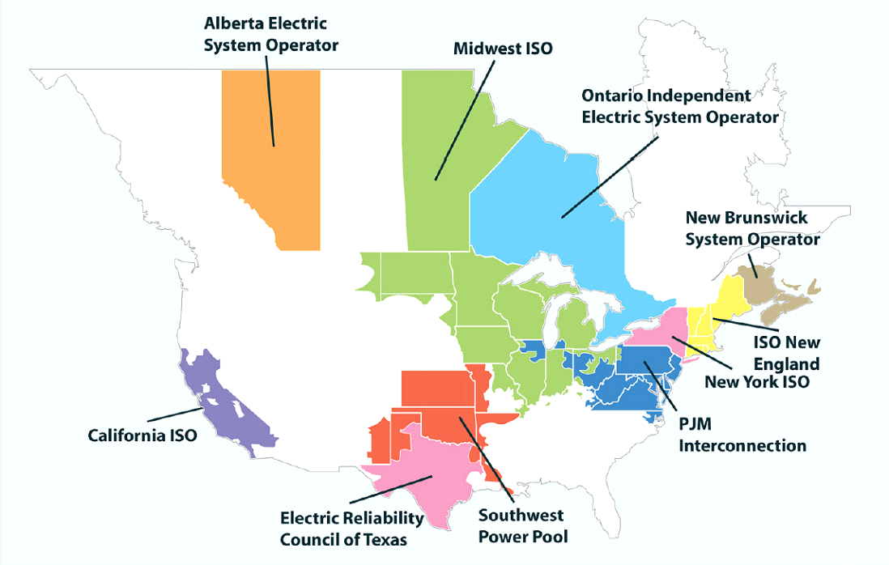
3. Operational Opportunities: Case Study Locations
New York Power Auth.
New York Power Auth.
New York Power Auth.
New York Power Auth.
Blenheim
Blenheim
-
-
Gilboa
Blenheim
Gilboa
Blenheim
-
-
Gilboa
NYISO
Gilboa
NYISO
NYISO
NYISO
AmerenUE
AmerenUE
AmerenUE
Chelan County PUD
AmerenUE
Chelan County PUD
Chelan County PUD
Chelan County PUD
Osage
Osage
Osage
Rocky Reach
Osage
Rocky Reach
Rocky Reach
Rocky Reach
MISO
MISO
MISO
WECC
MISO
WECC
AmerenUE
WECC
AmerenUE
WECC
AmerenUE
AmerenUE
Taum Sauk
Taum Sauk
Taum Sauk
Taum Sauk
MISO
USACE
MISO
MISO
USACE
MISO
Harry S. Truman
Exelon Generation
New York Power Auth.
New York Power Auth.
New York Power Auth.
Muddy Run
Blenheim
-
SWPA, MISO
-
Gilboa
Blenheim
Blenheim
-
-
Gilboa
NYISO
Gilboa
PJM
NYISO
NYISO
Exelon Generation
Chelan County PUD
Chelan County PUD
Chelan County PUD
Conowingo
Rocky Reach
Rocky Reach
Rocky Reach
PJM
WECC
WECC
WECC
Pacific Gas & Electric
Duke Energy
Pacific Gas & Electric
Duke Energy
Duke Energy
Helms
Duke Energy
Bad Creek
Helms
Bad Creek
Bad Creek
CAISO, WECC
Bad Creek
Southeast
CAISO, WECC
Southeast
Southeast
Southeast
New York Power Auth.
TVA
New York Power Auth.
Conventional Hydro
New York Power Auth.
Blenheim
Raccoon Mountain
-
-
Gilboa
Blenheim
Blenheim
-
-
Gilboa
NYISO
Gilboa
Southeast
NYISO
Pumped-Storage
NYISO

Slide 20
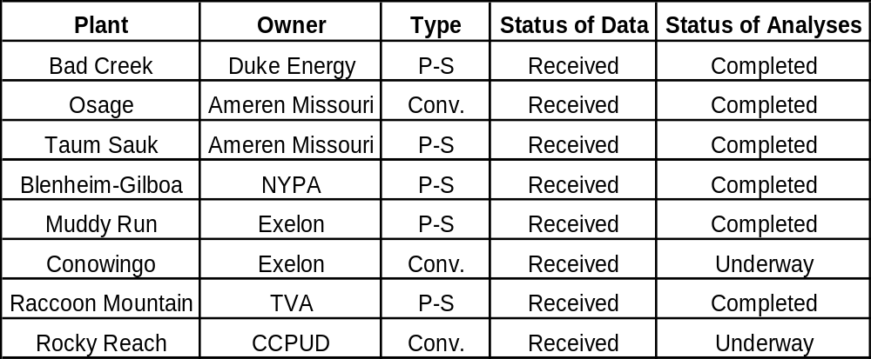
3. Operational Opportunities: Status of Case Studies

Slide 21
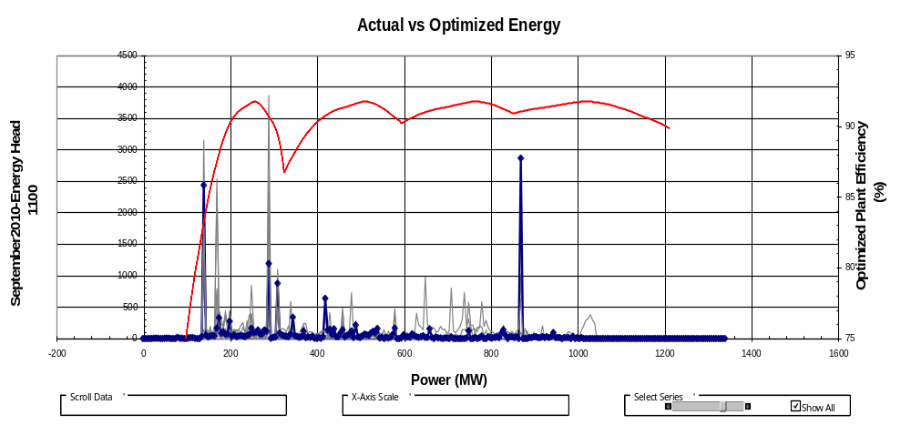
3. Operational Opportunities: Scheduling Analysis

Slide 22
4. Application of Technology Advancements Overview
New Technologies for Future Plants
  Investigate options for plant upgrades
        Provide more generation capacity
        Provide more ancillary services (min/max operating points)
        Adding a turbine to existing dam
  Investigate new plant technologies
        Incorporating Variable speed
        New turbine generator configurations
        Chapter in final report and a paper proposed for
        HydroVision 2012
Notes:
Upgrades- provide more energy, more services, or add turbine

Slide 23
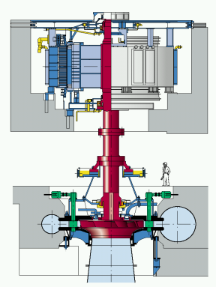
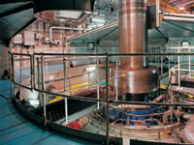
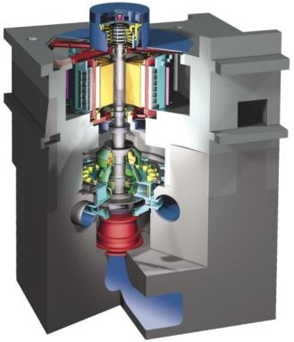
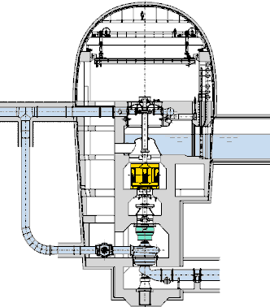
4: Technology Advancements: Possible PS Unit Configurations
  Conventional reversible unit
  Fast & frequent response reversible unit
  Conventional units with water short
  circuit arrangement
  Variable Speed reversible unit
  Ternary unit arrangement (Francis or Pelton)
Slower
Less Flexible
Faster
More Flexible

Slide 24
Plan for Project Final Report
Executive Summary
  Value calculations – EPRI
    Energy and Ancillary Services – LCG Modeling
    Costs – HDR|DTA Estimating
  Market comparison gaps & recommendations to rules (ISOs)- Sandia National Lab and Kirby Consulting
  Hydrological Constraints- Oak Ridge National Lab
  Operational Opportunities - HPPi
  New Technologies for Future Plants - Voith/HDR|DTA
  Comparison with European Value Proposition- Voith
  Conclusions & Future Research

Slide 25
Next Steps
Q4 2011
Run scenarios to determine future value
Finalize Case Studies
Consider other values e.g. freq. regulation, reliability energy security
Report on systemic water constraints
Synthesis into valuing/methods report comparing alternatives
Q1 2012
Draft final report
Stakeholders workshop (in CA)
Publish Final Report
3 papers submitted for July 2012 HydroVision

