Slide 1
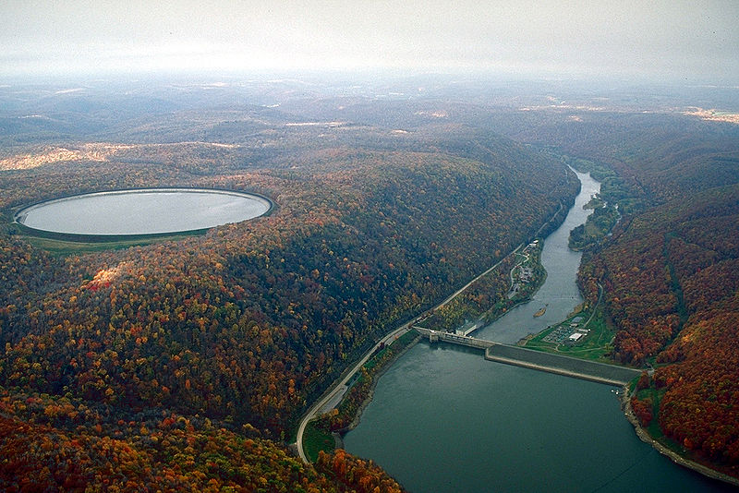
Water Power Peer Review
Modeling and Analysis of Advanced Pumped-Storage Hydro
Project Team: Argonne National Laboratory, Siemens PTI, Alstom, MWH, National Renewable Energy Laboratory
  Modeling and Analysis of Value of Advanced Pumped Storage Hydropower in the U.S.
Presenter: Vladimir Koritarov
Organization: Argonne National Laboratory
Contact Info: Email: koritarov@anl.gov
Phone: 630-252-6711
Date: November 3, 2011

Slide 2
Purpose, Objectives, & Integration
Purpose: Develop detailed models of advanced pumped-storage hydro (PSH) plants to analyze their technical capabilities to provide various grid services and to assess the value of these services under different market structures
Challenges:
New models are needed to simulate the operation of PSH and conventional hydro (CH) plants with a fine granularity (time steps on the order of seconds are required for accurate modeling of certain ancillary services)
New models are also needed for the modeling of advanced PSH technologies, such as adjustable speed units, and capturing the value of their flexibility in operation and for provision of various grid services
Different timescales (varying from seconds to minutes to hours) are needed for modeling different grid services
Lack of effective grid services market for valuing various grid services
Main Project Objectives:
Improve the modeling representation of advanced PSH and CH plants in power system and electricity market simulation models
Quantify their technical capabilities to provide various grid services
Analyze the value of these services under different market conditions and for different levels of variable renewable generation (wind and solar) in the system
Provide information about the full range of benefits and value of PSH and CH plants

Slide 3
Purpose, Objectives, & Integration
The project supports DOE Water Power Program mission and objectives in several ways by:
Developing a modeling capability to simulate the advanced and innovative PSH and CH technologies at timescales necessary to capture the full range of benefits that these facilities are capable of providing
Improving the methods for valuing these benefits and ensuring that hydropower technologies are properly incorporated into electricity sector deployment and benefit models
Characterizing the value of hydropower storage in integrating increasing amounts of variable renewable generation and in providing reliability and stability to the grid
Addressing some of the barriers and impediments for development of hydropower in the U.S., such as the lack of effective grid services market, by providing simulation capabilities to accurately assess the current and potential future value of PSH and CH ancillary services
Developing publicly available models and disseminating the information that may stimulate hydropower industry and strengthen business models for the development of PSH and CH facilities

Slide 4
Technical Approach
ADVANCED TECHNOLOGY MODELING
Develop vendor-neutral models of advanced PSH and CH plants, including adjustable (variable) speed PSH units
Test prototype models using:
  Actual operation data for plants in the WECC region
  For technologies that do not exist in WECC:
    Operation data from other countries
    Manufacturers’ design data
Integrate models of advanced PSH and CH into available software tools (e.g., PSS/E, CHEERS, FESTIV)
Verify and validate integrated models by simulating actual utility systems within the WECC region
Publish and make available vendor-neutral models (equations and transfer functions) for integration into other software packages

Slide 5
Technical Approach
PRODUCTION COST & REVENUE MODELING
Simulate different balancing authorities within the WECC region to:
  Quantify technical capability of PSH and CH plants to provide dynamic response and various grid services
  Quantify the economic value and financial revenues of PSH and CH plants if they are co-optimized for energy and ancillary services
  Assess other benefits that these plants bring to the system (lower system production cost, better integration of variable renewable resources, reduced cycling of thermal units, etc.)
Impacts of different market structures:
  Regulated utilities (cost-based approach)
  Competitive electricity markets (market-based approach)
Impacts of different penetration levels of variable renewable resources (e.g., wind and solar)
Besides PSS/E, FESTIV, e-terra, and CHEERS, other software tools (e.g., PLEXOS, PROMOD, GTMax, etc.) will be used if necessary to capture certain operational aspects or specific grid services

Slide 6
Plan, Schedule, & Budget
Schedule
Initiation date: TBD
Planned completion date: 18 months from project start
FY12 Milestones
  Develop and test prototype models of advanced PSH and CH plants
  Integrate prototype models into available software tools and perform testing and validation on power systems within the WECC region
Budget:
The project was awarded in FY11, but the funding will be received in FY12.
No project expenses as of yet.
Budget History
FY2009 |  | FY2010 |  | FY2011/12
DOE | Cost-share | DOE | Cost-share | DOE | Cost-share
$0 | $0 | $0 | $0 | $1.875M | $0

