Slide 1
Leadership Attributes and Cultural Traps and Leadership Gaps for Asian Americans and Pacific Islanders May 15th, 2014
Outline of Presentation
Leadership Attributes, Do We have them?
Asian Americans are Not Viewed as Ideal Leaders
Glass Ceiling is Reality
Sources of Misperception
Cultural Traps Leads to Leadership Perception Gaps
How I Overcame Cultural Traps
By
James C Meng
Deputy Assistant Secretary of the Navy

Slide 2
Collin Powell’s definitions of Leader It Worked for Me: In Life and Leadership Collin Powell with Tony Koltz 2012
Someone unafraid to take charge. Someone people respond to and are willing to follow.
Leader must be agile in thought and action. (Not be blinded by the brilliance of his Plan or investment in it)
Leader must watch the execution from beginning to end and do what it tells.
Leader must relentlessly cross-examine the reports until fully satisfied. (UN in 2003 about Iraqi WMD)

Slide 3
Code of Leadership that Inspires Confidence, Trust, and Admiration the “Powell Way” Colin Powell’s 7 Laws of Power (Modern Maturity Jan/Feb 2002)
Dare to be the Skunk.
Tolerate rebels who tell the emperor he has no clothes.
Being responsible sometimes means pissing people off.
To get the real dirt, head for the trenches.
The people in the field are closest to the problem.
Powell came around his vase desk and welcome to a smaller round table that sends a message of intimacy and trust.
Share the Power.
Plan don’t accomplish work, Everybody has a vital role to play.
Letter from the Chief of Staff of the Army, if in 2 years you have not been offered a new position or promotion to fours stars, I expect you to resign.
Know when to ignore your advisers.
Experts often possess more data than judgment.
Develop selective amnesia.
Leaders are trapped in fixed ways of seeing things.
Mikhail Gorbachev said to Powell in spring of 1988, “I am ending the Cold War; you are going to have to find a new enemy”. Collin’s initial mental reaction was “but I don’t want to”.
Come up for Air.
Do not prove to anybody that I can work 16 hours a day if I can get it done in 8.
Declare victory and quit.
Leadership is not rank, privilege titles or money, it is responsibility.

Slide 4
Stereotypes of Asian American Executives DiversityInc Jan 2013
“You must be the IT person.” In America, the leadership skill is defined by how confrontational, direct and aggressive you are,” Asian values respect authority and come from a hierarchical culture. “Asian Americans are not risk takers.”
“You aren’t like them” or “You don’t act very Asian.” Asian do not spend time organizing a regular tennis outing with a group of white executives.
“Where are you from? No, where are you really from?” all Asian-Americans are recent immigrants.
“Oh, you speak English good!” or “Do you speak your language?” Asian has difficulty communicating. Then boss couldn’t hear the words because the boss only heard the accent.
“You’re not a minority because all Asians are rich and successful.” Asian-American executives should be last to receive a raise because they don’t need money.

Slide 5
Glass Ceiling: Number of APA by Pay Grade By Dr. J. Meng @ CNP APA Employee Resource Group, 10 December, 2008

Slide 6
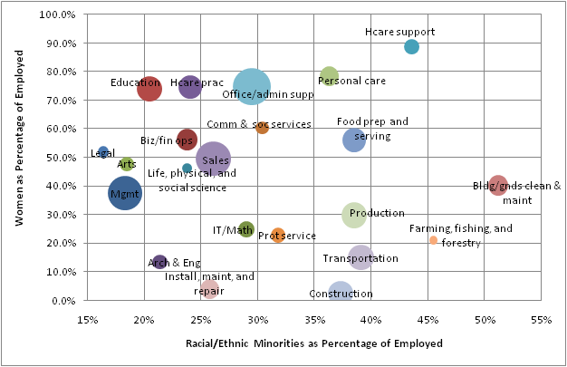
Workforce Composition by Major Occupational Categories Presented by Steve Pemberton, CFO, Monster.com, Mar 2010
₆

Slide 7



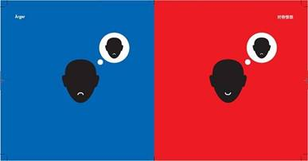
Eastern/Western Cultural Differences Cultural Comparisons by Chinese-born German Designer Yang Liu
Opinion
B: Talk to the point
R: Talk around the circle, especially if different opinions
Way of Life
B: Individualism, think of himself or herself.
R: Enjoy gathering with family and friends, solving their problems, and know each other's business (keh poh).
Contacts
B: Contact to related person only
R: Contact everyone everywhere, business very successful.
Anger
B: Show that I am angry.
R: I am angry, but still smiling... (beware!)
Blue -> Western Red -> Asian/Chinese

Slide 8


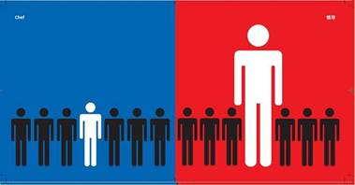

Eastern/Western Cultural Differences Cultural Comparisons by Chinese-born German Designer Yang Liu
Party
B: Only gather with their own group.
R: All focus on the one activity that is hosted by the CEO.
Handling of Problems
B: Take any steps to solve the problems.
R: Try to avoid conflicts, and if can, don't leave any trail.
The Boss
B: The boss is part of the team.
R: The boss is a Fierce god.
The Child
B: The kid is going to be independent and make his/her own living.
R: Work, live and all for the kids, the centre of life.
Blue -> Western Red -> Asian/Chinese

Slide 9
Root Causes? (ASIAN AMERICAN AND PACIFIC ISLANDER WORK GROUP REPORT TO THE CHAIR OF THE EEO COMMISSION, Dec 21, 2008)
Multiple Sources of Discrimination
Perceptions as a Model Minority & Excessive Competence
Language/Accent Discrimination
Perceptions of Foreignness
Perceptions of Social Deficiency
Perceptions of Leadership (or the lack thereof)
End Results
Low representation across the board
Root Causes?
b.c. Lack of mid-level development and management opportunities

Slide 10
Leverage Free Tutoring
The 7 Habits of Highly Effective People® Signature Edition 4.0 is the foundational framework and operation system for creating an effective winning culture.
http://www.enablegreatness.com/templates/7H/q3_tour/join_morn_prospect.png
Tuition is waived for federal government. Please use promo code "guest" to register. It is a promotional program from FranklinCovey Co. 2200 West Parkway Blvd. Salt Lake City, Utah 84119
Civilian Agencies: jennifer.grange@franklincovey.com.
Defense: amy.cima@franklincovey.com.
Preview 7 Habits 4.0.
Join other government leaders in Washington DC at the Partnership for Public Service facility on May 28, 2014. Tuition is waived for federal employees.

Slide 11
Take Aways
How to Inspires Confidence, Trust, and Admiration?
Being humble and respectful are good attributes but are many times mis-interpretated.
Focus on “how to temper our virtues from our culture and engage to prove values of inclusivity of diversities”
History Says It Takes 100 Years to Realize Real Changes There are no superior and inferior races on our planet.
Leverage all opportunities to improve yourself.
You Have To Engage

