Slide 1

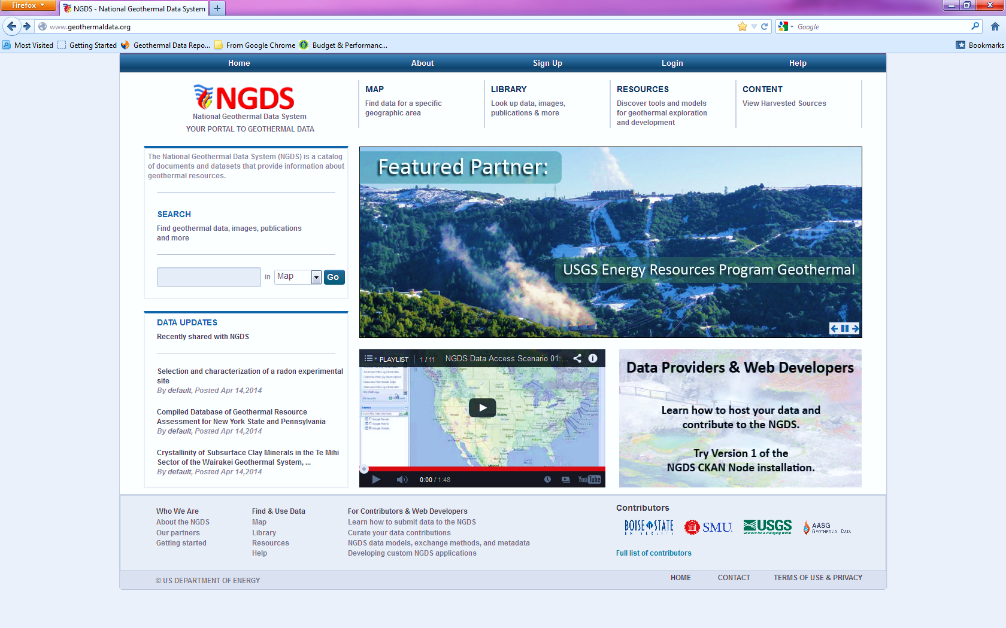
National Geothermal Data System (NGDS)
Access to 9 million datapoints
Tools and Models
NGDS is a catalog of documents and datasets that provide information about geothermal resources within the United States, including information from other parts of the world, used to:
Determine geothermal potential;
Guide exploration and development;
Make data-driven policy decisions;
Minimize development risks;
Understand how geothermal activities affect your community and the environment;
Guide investments.
Newest
Submissions
Featured
Node
Training
Free software for data providers
http://geothermaldata.org/
Notes:
The National Geothermal Data System (NGDS) is a catalog of documents and datasets that provide information about geothermal resources located primarily within the United States (although information from other parts of the world is also included).
This complete and current catalog of available data, which is funded by the Department of Energy’s Geothermal Technology Office, is designed to accelerate the development of U.S. geothermal resources, and can be used to in a variety of ways, such as:
Determine geothermal potential
Guide exploration and development
Make data-driven policy decisions
Minimize development risks
Understand how geothermal activities affect your community and the environment
Guide investments.
In addition the system:
Is the result of a “Best-in-class” data collection and usability effort, aggregating data from all 50 state geological surveys and DOE-funded projects
Addresses a significant obstacle to geothermal development: lack of quantifiable data
Has nine million inter-operable GIS data points in 340 separate web feature and map services
Supports the Energy Department’s efforts to reduce cost and risks associated with widespread adoption of geothermal energy
What Tools are Available to Access NGDS Data?
NGDS supports the popular ESRI Map Service protocol, so people may access the data through a variety of proprietary and free/open-source applications and software. See our Resources section for a listing of resources, models, and tools you can use to interact with NGDS data.
Developing a Custom Application Using NGDS Data
NGDS is built on United States Geoscience Information Network (USGIN) standards, which allows Web developers to easily build innovative custom applications that use NGDS data. Some examples of third party applications might include data gap analysis, financial analysis, and other useful data manipulation.

Slide 2
Federal Open Data Policy How Does NGDS Stack Up?
Open Data Policy Requirements | NGDS Capabilities
Domain: all federal agency data; all research data funded by federal agencies | Works for all digital data
Legal Status: Executive Order | DOE-GTO funded
Public access at no cost | þ
Searchable/ discoverable | þ
Interoperability | þ
Scalability | þ
Metadata core requirements | þ
Open Source | þ
Assistance/Education for data creators and end users | þ
Community building efforts | þ
Description Requirements (What info, access requirements) | þ
Notes:
Does NIAB comply with US Open Data Policy?

Slide 3

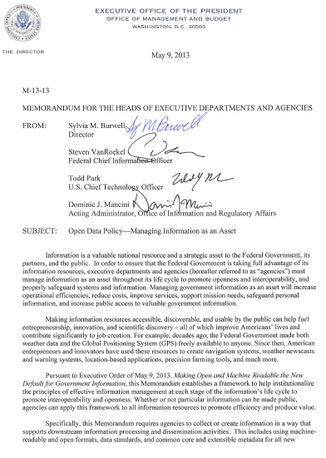
Federal Guidance – Open Data Policy Managing Information as an Asset
“Information is a valuable national resource and a strategic asset to the Federal Government, its partners, and the public. . . Departments must manage information as an asset throughout its life cycle to promote openness and interoperability. . . “
“Specifically, this memorandum requires agencies to collect or create information in a way that supports downstream information processing and dissemination activities. . . Using machine readable and open formats, data standards, and common core and extensible metadata for all new information creation and collection efforts . . . “
Notes:
Managing Open Data – Data as an Asset
The DOE-GDR is a free searchable repository application that allows users to discover and download content. The submitters of the uploaded content are solely GTO funded projects. The projects data submissions are placed through security safeguards and data curation processes before they are slated to be made publicly available.
The NGDS promotes interoperability by utilizing common standards and protocols like those put forth by the Open Geospatial Consortium CSW

