Slide 1
EERE Communications
EERE Web Coordinators Meeting
01/21/2016

Slide 2
Agenda
Web Coordinators Meeting
Around the room – Carolyn
EERE’s new template coordinator, process for application template approvals, site map status – Leslie Gardner
Graphics for landing pages – Billie Bates, Nate Shelter
Template redesign feedback for HUGE – Carolyn Hinkley
Newly available energy.gov features – Atiq Warraich
Updating Energy Basics – Elizabeth Spencer
FY15 Digital Media Report – Leslie Gardner, Ken Dykes, Alexis Powers

Slide 3
Agenda
Web Coordinators Meeting
Around the room – Carolyn
EERE’s new template coordinator, process for application template approvals, site map status – Leslie Gardner
Graphics for landing pages – Billie Bates, Nate Shelter
Template redesign feedback for HUGE – Carolyn Hinkley
Newly available energy.gov features – Atiq Warraich
Updating Energy Basics – Elizabeth Spencer
FY15 Digital Media Report – Leslie Gardner, Ken Dykes, Alexis Powers

Slide 4
Agenda
Web Coordinators Meeting
Around the room – Carolyn
EERE’s new template coordinator, process for application template approvals, site map status – Leslie Gardner
Graphics for landing pages – Billie Bates, Nate Shelter
Template redesign feedback for HUGE – Carolyn Hinkley
Newly available energy.gov features – Atiq Warraich
Updating Energy Basics – Elizabeth Spencer
FY15 Digital Media Report – Leslie Gardner, Ken Dykes, Alexis Powers

Slide 5
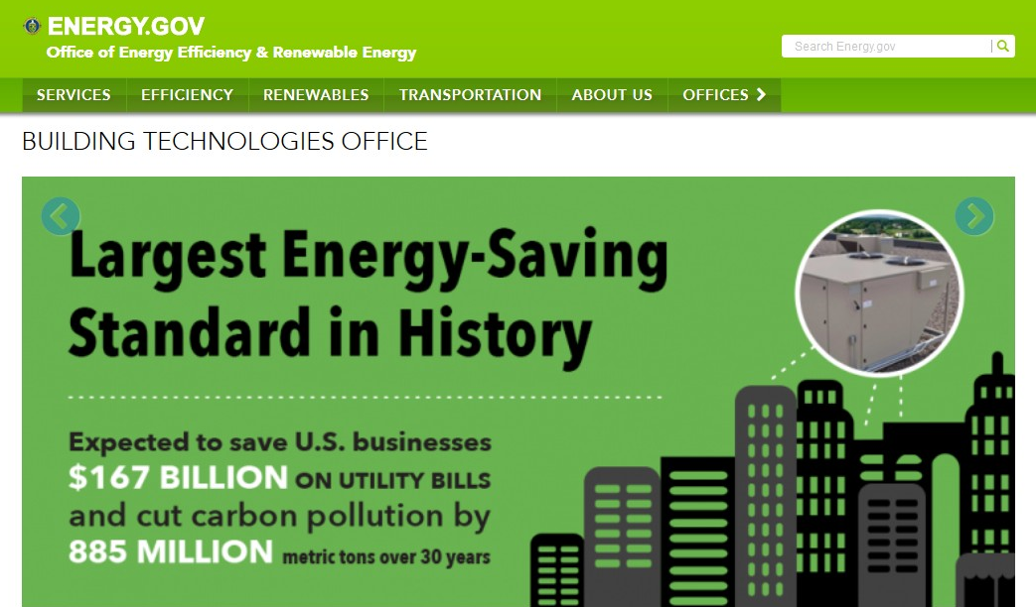
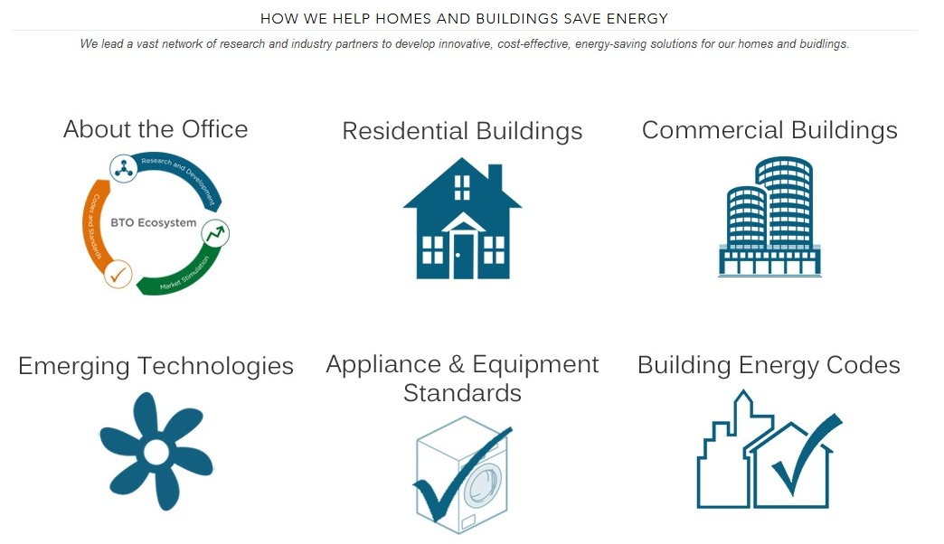
Graphics for Landing Pages
http://energy.gov/eere/buildings

Slide 6
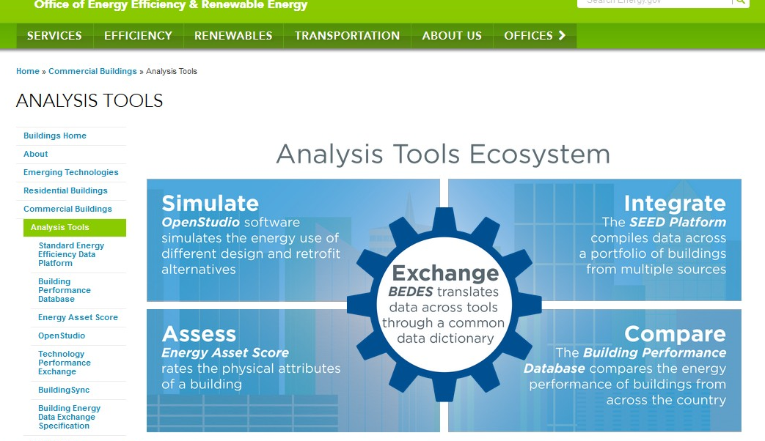
Graphics for Landing Pages
Example 1:
Analysis Tools Ecosystem, http://energy.gov/eere/buildings/analysis-tools

Slide 7
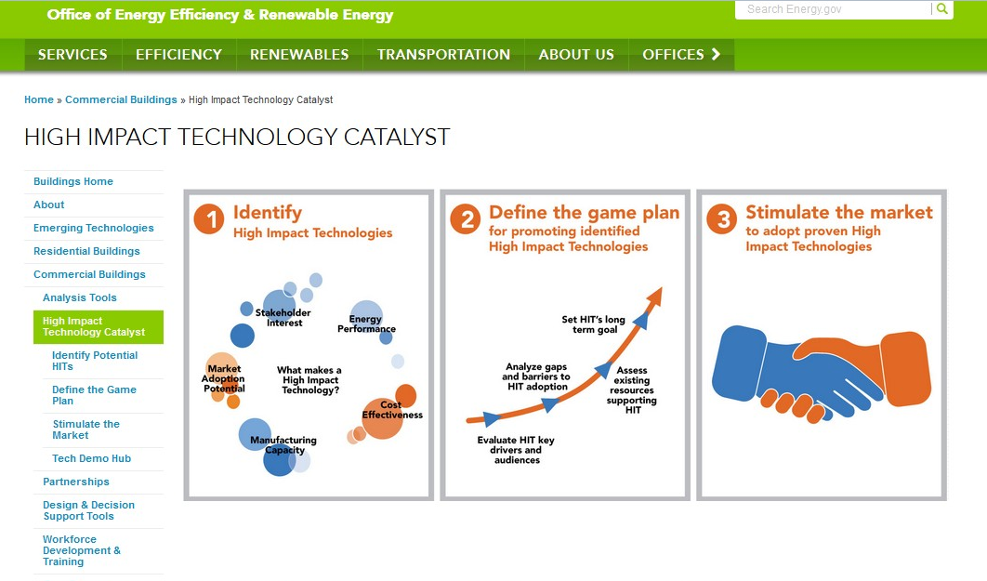
Graphics for Landing Pages
Example 2:
High Impact Technology Catalyst, http://www.energy.gov/eere/buildings/high-impact-technology-catalyst

Slide 8
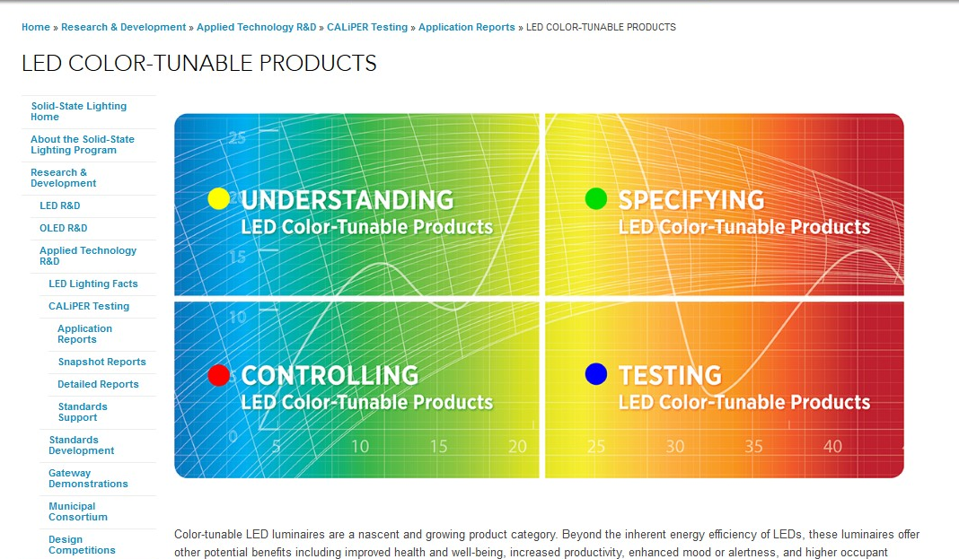
Graphics for Landing Pages
Example 3:
Solid-State Lighting, LED Color-Tunable Products, http://energy.gov/eere/ssl/led-color-tunable-products

Slide 9
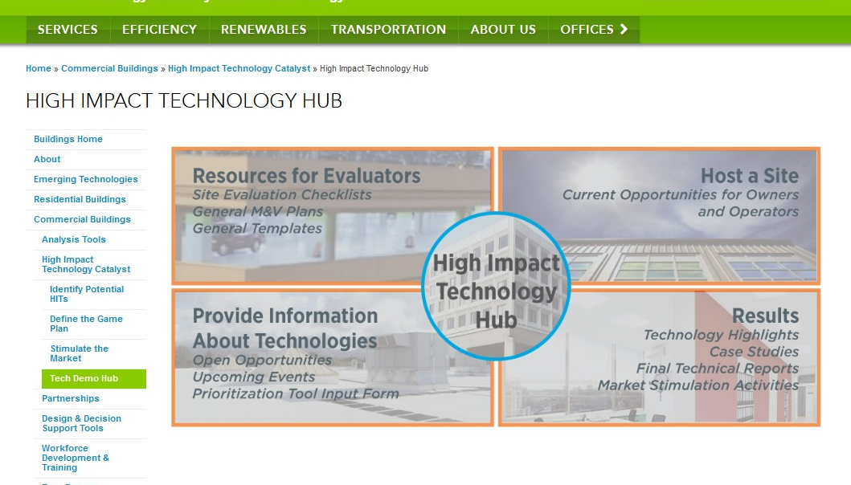
Graphics for Landing Pages
Example x:
High Impact Technology Hub, http://www.energy.gov/eere/buildings/high-impact-technology-hub

Slide 10
Agenda
Web Coordinators Meeting
Around the room – Carolyn
EERE’s new template coordinator, process for application template approvals, site map status – Leslie Gardner
Graphics for landing pages – Billie Bates, Nate Shelter
Template redesign feedback for HUGE – Carolyn Hinkley
Newly available energy.gov features – Atiq Warraich
Updating Energy Basics – Elizabeth Spencer
FY15 Digital Media Report – Leslie Gardner, Ken Dykes, Alexis Powers

Slide 11
Redesign Feedback for HUGE Team
Interviewed in December 2015 by HUGE team reps
Feedback:
EERE’s top concern is navigation, ticket request streamlining, content analysis
Other feedback:
Section 508, hero images, mobile, site branding
Minimize use of right rail
Create I/A for entire enterprise
More options for content blocks
Test home page for usability

Slide 12
Agenda
Web Coordinators Meeting
Around the room – Carolyn
EERE’s new template coordinator, process for application template approvals, site map status – Leslie Gardner
Graphics for landing pages – Billie Bates, Nate Shelter
Template redesign feedback for HUGE – Carolyn Hinkley
Newly available energy.gov features – Atiq Warraich
Updating Energy Basics – Elizabeth Spencer
FY15 Digital Media Report – Leslie Gardner, Ken Dykes, Alexis Powers

Slide 13
Agenda
Web Coordinators Meeting
Around the room – Carolyn
EERE’s new template coordinator, process for application template approvals, site map status – Leslie Gardner
Graphics for landing pages – Billie Bates, Nate Shelter
Template redesign feedback for HUGE – Carolyn Hinkley
Newly available energy.gov features – Atiq Warraich
Updating Energy Basics – Elizabeth Spencer
FY15 Digital Media Report – Leslie Gardner, Ken Dykes, Alexis Powers

Slide 14
Updating the Energy Basics Website
Help us update Energy Basics!
energy.gov/eere/energybasics/energy-basics
Background:
Energy Basics was created to host general information about how EE & RE technologies work.
Around 2010, most office-level “basic science” information was moved from offices’ websites to create Energy Basics.
All offices still own their content—it’s just hosted somewhere else.
And it’s out of date!

Slide 15
Updating the Energy Basics Website
We need your help.
Your office can decide the best way to update your content.
We’re working on an inventory that shows all the pages you own on the site, and we’ll share it in the next few weeks.
We’d love if you could update this content in FY16. Just tell us what schedule works for you, and we’ll work with you to get it done.
We’ll post your content when you’ve approved it.

Slide 16
Agenda
Web Coordinators Meeting
Around the room – Carolyn
EERE’s new template coordinator, process for application template approvals, site map status – Leslie Gardner
Graphics for landing pages – Billie Bates, Nate Shelter
Template redesign feedback for HUGE – Carolyn Hinkley
Newly available energy.gov features – Atiq Warraich
Updating Energy Basics – Elizabeth Spencer
FY15 Digital Media Report – Leslie Gardner, Ken Dykes, Alexis Powers

Slide 17
EERE FY15 Digital Media Report
Platforms
EERE website, EERE Facebook, @energy.gov Twitter
Energy Saver website, Energy Saver Facebook, Energy Saver Twitter
DOE You Tube, Vimeo
EERE Blog
GovDelivery

Slide 18
EERE FY15 Digital Media Report
EERE Website, Facebook, @energy.gov Twitter
EERE website had nearly 28 million pageviews
EERE Success Stories pageviews increased 145%
EERE Facebook increased “Likes” to 111,000 up from 11,000 two years ago
EERE Facebook posts have a cumulative reach of nearly five million users in FY15
In Q3 and Q4, 73% of @energy tweets were related to clean energy
Campaigns: Wind Vision and National Drive Electric Week.

Slide 19
EERE FY15 Digital Media Report
EERE Top Pages
How Do Wind Turbines Work?
EERE Home Page
Animation: How a Wind Turbine Works
Alternative Fuels Data Center: Alternative Fueling Station Locator
Alternative Fuels Data Center Home Page
Building Technologies Office: EnergyPlus Energy Simulation Software
COMcheck | Building Energy Codes Program
Advantages and Challenges of Wind Energy
Alternative Fuels Data Center: Alternative Fuels and Advanced Vehicles
Alternative Fuels Data Center: Ethanol Fueling Station Locations

Slide 20
EERE FY15 Digital Media Report
Energy Saver Website, Facebook, Twitter
Redesigned home page and new site architecture
Launched new appliance energy calculator
Energy Saver generated 28% of energy.gov pageviews
Energy Saver pages had four of the 10 most viewed pages in energy.gov
Launched Twitter account
Energy Saver mobile/tablet use = 35% vs 12% for EERE.

Slide 21
EERE FY15 Digital Media Report
Videos
22 Energy 101 videos
101 videos have 1.75 million cumulative views
13 of 15 most viewed videos on DOE’s YouTube channel
B-roll library on Vimeo
Produced as part of 101 process
Testimonial videos
Produced as part of 101 process
EERE Comms also produces testimonial videos.

Slide 22
EERE FY15 Digital Media Report
Email Lists
238 lists in GovDelivery
Total 335K subscribers
EERE News = 58K subscribers
EERE Network News = 60K subscribers

Slide 23
EERE FY15 Digital Media Report
Report posted on EERE Communication Standards
Websites & Digital Media > Web Governance > Website Reports
http://energy.gov/eere/communicationstandards/downloads/eere-annual-website-reports
FY16
Develop success indicators that align with EERE’s Strategic Plan and dashboards

Slide 24
Next meeting: February 18, 1:00-2:00 EST
11:00-12:00 MST
Golden: X300 & HQ: 5E-069

