Slide 1
WEATHERIZATION ASSISTANCE PROGRAM
Procurement Management
March 2015

Slide 2
Federal Procurement Regulations
RULES:
2 CFR PART 200
200.317 through 200.326

Slide 3
Federal Procurement Regulations
Standards:
Recipient is responsible for all procurement contractual and administrative issues.
Maintain Code of Conduct.
All procurement transactions must provide for open and free competition.

Slide 4
Federal Procurement Regulations, cont.
Grantees & Subgrantees must have procurement procedures that include:
Documented procurement procedures.
Procedure to maintain oversight to ensure the contractor performs in accordance with contract or purchase order.
Written standards of conduct.
Methods to avoid the purchase of unnecessary or duplicative items.
Analysis of lease and purchase alternatives.
Grantees are encouraged to enter into State and local inter-governmental agreements for purchasing common goods and services.
Grantees are encouraged to use Federal excess and surplus property.
Procedures to ensure awards are only to responsible contractors.
Records that detail the significant history of a procurement.
Methods for settlement of all contractual and administrative issues, including but not limited to protests.

Slide 5
Federal Procurement Regulations, cont.
All procurement transactions will be conducted in a manner providing full and open competition.
There must be written selection procedures. Also, the solicitation must include a clear and accurate description of the service or material being procured.

Slide 6
Methods of Procurement
Micro purchase procedures for items which do not exceed the micro purchase threshold of $3,000 in the aggregate.
Small purchase procedures for services and goods that do not exceed the Simplified Acquisition threshold of $150,000 in the aggregate.
Sealed bids (formal advertising).
Competitive proposals.
Non-competitive proposals may only be used when the item is available from one source, emergency situations, the awarding agency authorizes, or competition is determined inadequate. Pre-award review may be required.

Slide 7

Methods of Procurement – Sealed Bid Proposals
Sealed Bid Proposals:
Made early in the procurement cycle:
Allows vendors time to prepare their bids to meet the specification of the solicitation.
Solicitation information includes:
What is being purchased.
Terms & conditions the vendors must meet.
Where & when sealed bids will be opened.

Slide 8
Methods of Procurement – Sealed Bid Proposals, cont.
Sealed Bid Proposals:
Awards are made to the lowest priced responsible vendor:
Capable of compliance will all bid specification.
Capability of performing the work.
Has administrative capacity.
Award becomes – a firm, fixed price contract.

Slide 9
Methods of Procurement – Sealed Bid Proposals
Sealed Bid Proposals:
Vendor’s payments:
Lump sum - paid for successful performance.
Unit price - paid for each deliverable unit is completed in the contract.
Must have at least 2 responsive suppliers competing for contract.

Slide 10

Methods of Procurement – Competitive Proposal
Competitive Proposal Procurements:
Proposal types:
Request for Proposal (RFP).
Request for Qualifications (RFQ).
Request for Information.

Slide 11
Methods of Procurement – Competitive Proposal
Competitive Proposal Procurements:
Publicized method same as sealed competitive process (invitation for bids).
All evaluation factor publicized & their importance.
All vendor submittals received and evaluated.
Proposals must be solicited from a number of qualified sources.
Organization must have a method for conducting technical evaluation of all proposals & for selecting awardees.

Slide 12

Methods of Procurement
Competitive Proposal Procurements:
Award made to the most responsive firm whose proposal is most advantageous to the program.
Price and other factors considered to determine most advantageous offer.
Must have at least 2 responsive suppliers competing for contract.

Slide 13
Methods of Procurement
Non Competitive Procurements:
Non competitive procurements must be approved by funding agency before awarding.
Organization must devise & document its own analysis process to ensure fair prices are being charged.
Non competitive contracts become negotiated contracts.
Organization determines what level of organizational leadership is required to approve this method.

Slide 14
Methods of Procurement
Non Competitive Procurements:
May be used only when it is not feasible for:
Small purchase procedures.
Sealed bid or competitive proposals.
and one of the following conditions applies:
Item only available from a single source.
Emergency exist that will not permit a delay resulting from completive biding.

Slide 15
Methods of Procurement
Non Competitive Procurements:
Organization authorized noncompetitive proposals.
After solicitation of a number of sources, competitive is determined as inadequate.
Cost analysis is required which verifies:
Proposed cost data.
Projection of the data.
Evaluation of costs and profits.

Slide 16


Procurement
Grantees are to encourage minority firms, women’s business enterprises, and labor surplus area firms.

Slide 17

Procurement
There must be a cost price analysis in connection with every procurement.

Slide 18
Procurement
Grantees must make available proposed procurement technical specifications upon request by the awarding agency.

Slide 19
Methods of Procurement
The bonding requirements of a recipient will be accepted if the awarding agency’s interest is adequately protected.

Slide 20
Contracts
The regulations require a number of provisions that must be included in all contracts awarded with Federal government funds.
Appendix II of 2 CFR Part 200 lists all the required provisions.

Slide 21
12 Steps to Procurement
Determine what you will be purchasing.
Establish the timeframe for the purchase.
Identify the lead individual to handle the purchase.
Prepare the general instructions.
Prepare the specifications and price quote sheets.
Advertise the solicitation.

Slide 22
12 Steps to Procurement
Conduct bidder’s conference.
Receive bids/proposals/quotations.
Evaluate the bids/proposals/quotations.
Select the contractor(s)/vendor(s)
Establish the solicitation file.
Enter into agreements with contractor(s)/vendor(s).

Slide 23

Procurement Procedures
Procedures are administrative communications.
Written
Prescribed
Standing

Slide 24
Procurement Procedures
Procedures assure that:
Staff know what is expected of them.
Staff know what is expected of others.
Staff interact properly.
Policies can be complied with.
Practices are uniform and fair.
Operating errors are reduced.
Oral instructions minimized.
Knowledge does not leave with a staff person.

Slide 25
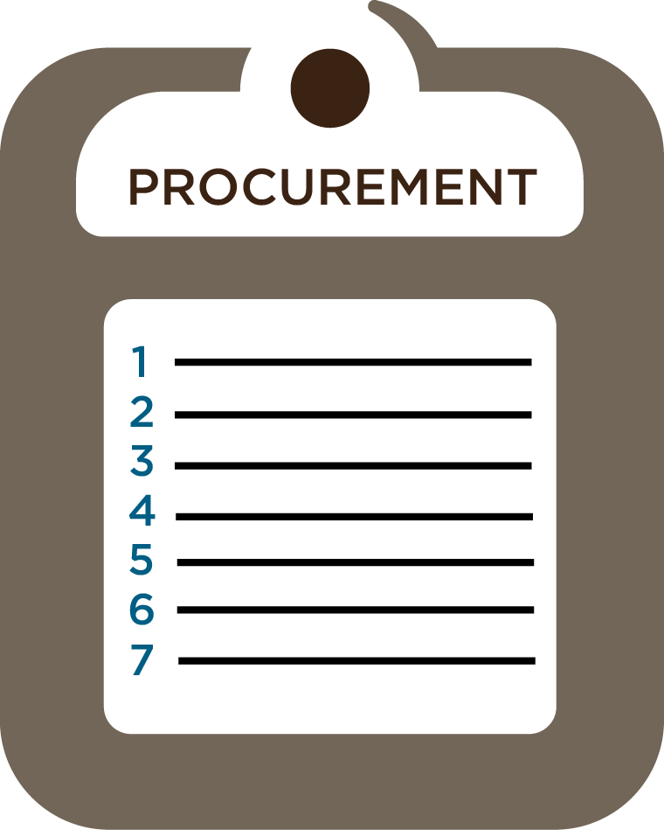
Procurement Procedures
Good procedures are:
Understandable.
Unambiguous.
Unequivocal.
Uncluttered.
Detailed.
Logical.
Consistent.

Slide 26
Sample Procedure Structure
Purpose
Specific Procedure with Staff Assignments
Additional Information
Mandated Forms

Slide 27
Determination of Procurement Methods
Purpose:
The purpose is to establish the appropriate procurement method to be used for the goods or services to be purchased. The methods allowable comply with agency, state and federal regulation requirements.

Slide 28
Determination of Procurement Methods
Activities:
Establish cost estimate for the purchase in the aggregate and submit to Contract Officer.
Select the appropriate method for the procurement.
$_______in the aggregate, and lower will follow micro purchase procedures.
$_______ in the aggregate to $3,000 will follow small purchase procedures.
$_______ in the aggregate, and over will follow large purchase procedures.
Submit description and cost estimate for approval.
Authorize purchases over $_______ and Program Director will authorize purchases under $______.

Slide 29
Small Purchase Procedures
Purpose:
To provide guidance to Program Directors making small purchases. Small purchase procedures are those relatively simple and informal procurement methods for securing services, supplies, or other property that do not cost more than $_______ in the aggregate.
Small Purchase Procedures Fall under Agency Requirements.

Slide 30
Bid/Proposal Package
Purpose:
To establish the process for development of a standard bid package for goods and services.

Slide 31
Bid/Proposal Package Development
Activities:
Prepare the scope of work statement and/or specifications of materials/services to be solicited.
Establish the solicitation timeframe which includes:
Date and time period for advertisement.
Closing date for receipt of bids/proposals.
Opening date of bids/proposals.
Establish minimum requirements.
Establish evaluation criteria, if applicable.

Slide 32
Bid/Proposal Package Development
Activities:
Prepare the bid package which includes:
Cover sheet (closing and opening date)
Statement of work specifications or materials to be purchased.
Minimum requirements
Evaluation criteria
Work quality standards
Proposal format
Sample contract
Date of bidder's conference
Right of the agency to accept or reject all bids
Period of contract

Slide 33

Solicitation of Bids/Proposals
Purpose:
To establish a standard method of advertising procurement activities to assure maximum open and free competition.

Slide 34
Solicitation of Bids/Proposals
Activities:
Prepare the advertisement for newspaper.
Prepare notice to be posted.
Submit to Contracts.
Submit advertisement to newspaper and post advertisement.
Secure documentation of advertisement, i.e. newspaper - tear sheet, posting signed statement from the office where it was posted.
Notify all individuals on the bidders list of solicitation, if applicable.

Slide 35
Solicitation of Bids/Proposals
Activities:
Record the name of the individuals or firms requesting bid packages, the date the request was received, and the date the bid package was sent.
Prepare technical information for bidder’s conference.
Facilitate bidder's conference.
Provide sign-in sheet for bidder’s conference and ensure all individuals sign.
Record minutes of bidder’s conference.

Slide 36
Receipt of Bids/Proposals
Purpose:
To establish procedures that will be followed to assure equal treatment to all prospective bidders.

Slide 37
Receipt of Bids/Proposals
Activities:
Log all sealed bids/proposal into the bid/proposal control sheet.
Stamp each bid with the date and time received and initial the date and time stamp.
Store bids/proposals in a locked location unopened until the time of opening.
Return all bids/proposals received/submitted after the closing date unopened to bidder including a letter of explanation as to the reason it was returned.

Slide 38
Evaluation of Bids/Proposals and Contract Awards
Purpose:
To evaluate the bids/proposals submitted, select the contractor and award the contract.

Slide 39
Evaluation of Bids/Proposals and Contractor Selection
1. Conduct bid opening (public or private).
2. For public bid openings (IFB's) the bid amounts will be announced at the opening.
3. Schedule meeting of evaluation panel.
4. Evaluate bids/proposals for compliance with all requirements.
5. Evaluate the responsive bids/proposals based on cost of criteria established in the bid package.
6. Prepare summary of points/costs for all of the responsive bidders.

Slide 40
Evaluation of Bids/Proposals and Contractor Selection
Submit the name, the bid amount and justification for selection of the individual/firm selected for contract award to administration for approval.
8. Send the notice to contract to select contractor and secure the following information.
a. Certification of insurance, if applicable.
b. Review and approve suppliers list, if applicable.
c. Secure a copy of all required licenses, if applicable.
d. Certification regarding suspension and debarment from suppliers and subcontractors.

Slide 41
Evaluation of Bids/Proposals and Contractor Selection
9. Verify that the insurance meets requirements, if applicable.
10. Secure fully executed contract.
11. Provide written notification to unsuccessful bidders.
12. Schedule debriefing conference for bidders based on individuals requests.

Slide 42
Protest Procedures
Purpose:
To provide specific actions which will be taken should a protest be filed by an unsuccessful bidder.

Slide 43
Protest Procedures
Activities:
Notify contractor that a complaint of protest has been filed.
Schedule the meeting of protest committee to review complaint.
Conduct meeting to evaluate protest within ten (10) working days of the filing of the receipt of protest.
a. Record minutes of evaluation of protest committee meeting.
Issue a decision to agency administration within five (5) working days of the meeting of the protest committee.
Notify protester of the decision of the protest committee.

Slide 44
Records Management
Purpose:
To detail the required information that must be maintained in the bid process, contract, and protest (if applicable) to ensure proper documentation.

Slide 45

Records Management
Activities:
Establish and maintain the bid file(s) which includes:
Cost estimated and approval to proceed with the procurement.
Documentation of advertisement.
Bid/proposal package.
d. List of individuals attending the bidders conference (sign-in sheet).

Slide 46
Records Management
Activities:
Establish and maintain the bid file(s) which includes:
e. Minutes of the bidders conference.
f. List of evaluation panel members.
g. Bids received.
h. Summary sheet and work papers.
i. Rejection letters.

Slide 47

Records Management
Activities:
Establish and maintain contractor files which include the following information:
a. Bid/Proposal
b. Notice to Contract
c. Certificate of Insurance
d. Licenses, if applicable
e. Payment Requests
f. Performance Evaluations

Slide 48
Records Management
Activities:
Establish and maintain contractor files which include the following information:
g. Change Order, if applicable
h. Contract
i. Certifications
Suspension and Debarment
Lobbying
Drug Free Workplace

Slide 49
Records Management
Activities:
Protest File
List of protest committee members.
Copy of the protest committee correspondence, meeting minutes, and work papers.

