Slide 1
ENGINEERING REVIEW
PCD RF回路設計
9枚で読む検証結果
問題設定から工学判定まで
PCD 0.16.0 凍結ベンチマーク 2026-09-15 ngspice_cli
TECHNICAL DESIGN REVIEW
01
Notes:
Sources:
- docs/technical-specification-ja.md
- runs/benchmark_suite/benchmark_result.json
Design reference:
- PCD_RF_Circuit_Design_Engineering_Review_JA_v6.pptx
- Public Tokyo Electron IR presentation visual language only. No logo or proprietary master is used.

Slide 2
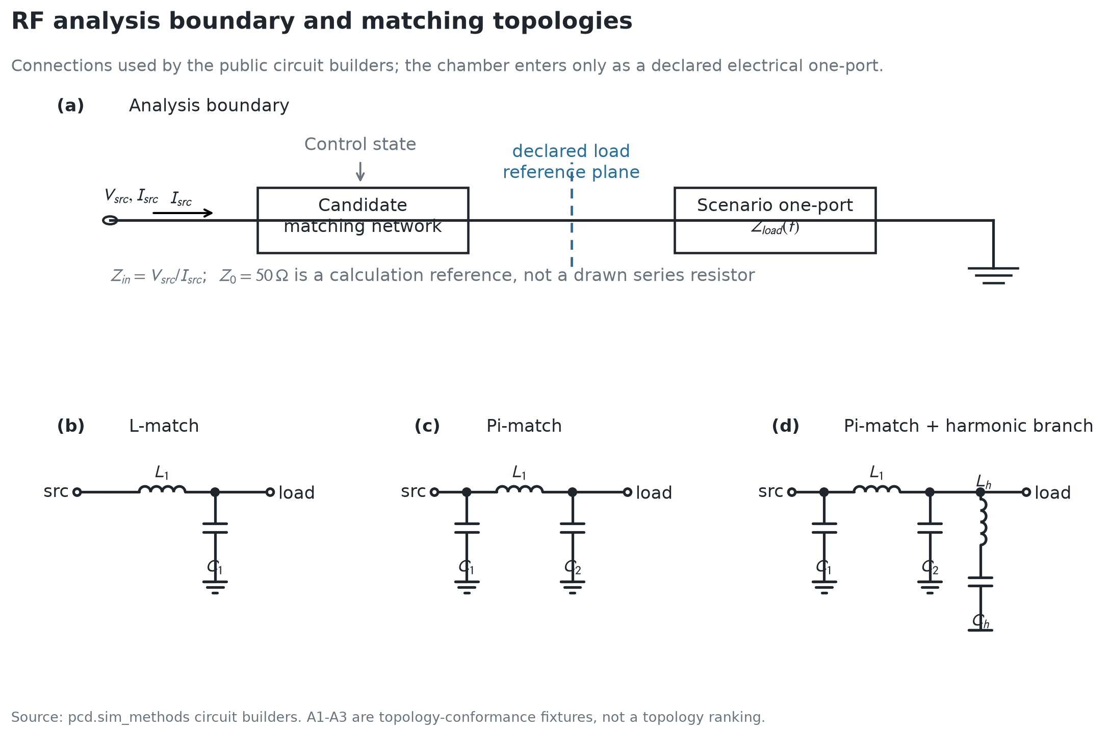
02 PROBLEM BACKGROUND
課題背景
整合点だけでは
装置可否を決められない
負荷・周波数
Zload は運転条件で変わる
調整権限
可動域と余裕が有限
装置制約
電流・損失・基準面が判定を変える
Γ = (Zin − Z0)/(Zin + Z0)
Prefl / Pinc = |Γ|²
本ベンチマークの上限 |Γ| ≤ √0.1 = 0.3162
RF boundary and topology figure / technical specification
PCD
2
Notes:
Sources:
- bench/figures/generated/01-analysis-boundary-and-topologies.png
- docs/technical-specification-ja.md §§3, 4, 11
Acceptance: reflected-power fraction <= 0.10, equivalent to |Gamma| <= 0.31622776601683794.
Physical boundary: the chamber enters as a declared electrical one-port at a named reference plane.

Slide 3
03 CODE PROCESSING ARCHITECTURE
コードの処理構成
入力を一度だけ実行形式へ解決し、全評価を同じ Case から生成する
1
入力と検査
2
実行計画
3
評価格子
4
回路計算
5
工学判定
6
成果物
YAML / JSON
case.py
Resolved Case
plan.py
Candidate × Scenario
× ControlState
netlist.py
ngspice
Γ・V・I・P・loss
metrics.py
study_result.json
evaluations.csv
PLAN
EVALUATE
DECIDE & PUBLISH
入力解釈を一箇所に固定
各評価を独立実行し、失敗も保存
feasibility-first 集約と原子的公開
Neval = Ncand × Σs Ncontrol(s)
各電気評価の状態・入力指紋・成果物を保持してから候補を集約
docs/architecture.md / public numerical path
PCD
3
Notes:
Sources:
- docs/architecture.md
- docs/technical-specification-ja.md §8.1
- pcd/case.py, pcd/plan.py, pcd/study_config.py, pcd/netlist.py, pcd/solver.py, pcd/metrics.py, pcd/results/
The diagram shows the numerical data path, not every Python import.

Slide 4
04 FROZEN BENCHMARK DESIGN
ベンチマークの問題設定
A1–A5 回路式・有効負荷
5 cases / 9 eval
B1–B8 調整・探索・ストレス
8 cases / 399 eval
D1–D3 基準面
3 cases / 3 eval
Benchmark PASS
Candidate × Scenario
ngspice
電気量
制約
期待した数値・分類
× ControlState
実回路計算
Γ・V・I・P・loss
限界値と余裕
Engineering feasible
受入上限 |Γ| ≤ √0.1 = 0.3162
全制約を満足
16
19
411
0
cases
candidates
ngspice evaluations
solver failures
6 feasible / 10 diagnostic infeasible
runs/benchmark_suite/benchmark_result.json
PCD
4
Notes:
Sources:
- runs/benchmark_suite/benchmark_result.json
- bench/figures/generated/figure_data.json
Frozen suite: 16 cases, 19 candidates, 411 evaluations, 0 failed evaluations.
Evaluation counts: A=9, B=399, D=3.
Benchmark PASS means the declared expectation was reproduced. It does not mean the candidate is engineering-feasible.

Slide 5
05 RESULTS 1/4 CONTROL AUTHORITY
調整権限で運転窓の成立率は20%から100%へ
全5負荷条件に対する feasible fraction
最悪反射振幅
上限 0.3162
B2は worst |Γ|=0.302 でも不合格
3 / 5 条件で調整余裕が不足
B3 min margin = 0.233
Frozen B1–B3 results
PCD
5
Notes:
Sources:
- bench/figures/generated/figure_data.json control_cases.B1/B2/B3
- runs/benchmark_suite/benchmark_result.json
B1 feasible_fraction=0.2, worst |Gamma|=0.7672066486794401.
B2 feasible_fraction=0.4, worst |Gamma|=0.30200504425254665, control_margin=0; three scenarios fail min_control_margin.
B3 feasible_fraction=1, worst |Gamma|=0.038844448497050175, control_margin=0.23255813953488372.

Slide 6
06 RESULTS 2/4 FREQUENCY CONFORMANCE
13.56 MHzの一点整合は周波数外挿できない
周波数点別の反射振幅
1 / 3
周波数点が合格
Γ = (Zin − 50)/(Zin + 50)
10.00 MHz 16.75 + j865.46 Ω
13.56 MHz 50.00 + j0.00 Ω
20.00 MHz 0.78 + j957.87 Ω
上限 0.3162
離散3点の検証。
点間の連続帯域は未評価。
Frozen A5 ICP-transformer result
PCD
6
Notes:
Sources:
- bench/figures/generated/figure_data.json a5
- runs/benchmark_suite/benchmark_result.json A5_icp_transformer_frequency_conformance
Data: |Gamma|=0.9977743741208945, 4.787813681571927e-12, 0.999914993914838 at 10, 13.56, and 20 MHz.
The three frequencies are independent discrete scenarios; no continuous-band interpolation is claimed.

Slide 7
07 RESULTS 3/4 HIGH-DRIVE STRESS
低反射でも100 Vpkでは電流と損失が定格超過
25 Vpkを1としたスケーリング
100 Vpk時の limit 比
limit = 1
V・I
P・loss
|Γ| = 0.0110 で両駆動点とも不変
振幅4倍で V・I は4倍、P・loss は16倍
Frozen B5 high-drive result
PCD
7
Notes:
Sources:
- bench/figures/generated/figure_data.json b5
- runs/benchmark_suite/benchmark_result.json B5_high_drive_stress
Low drive: 25 Vpk, |Gamma|=0.011035382019418111. High drive: 100 Vpk, |Gamma|=0.011035382019418161.
High-drive limit ratios: 2.083876455159899, 4.342541080369787, 1.4232793495772509, 2.0128209592177053.
Linear AC scaling preserves reflection while voltage/current scale with amplitude and power/loss scale with amplitude squared.
Source apparent power is a terminal quantity, not a claim of forward generator power.

Slide 8
08 RESULTS 4/4 ROBUSTNESS BOUNDARIES
公差と基準面の扱いが判定を反転させる
B8 ±15% 完全コーナー
D1–D3 基準面
上限 0.3162
上限 0.3162
記号順 C1 / L1 / C2 − = 0.85 + = 1.15
B8 3 / 8 PASS
治具二重計上で |Γ| 0.0383 から 0.3418
Frozen B8 and D1–D3 results
PCD
8
Notes:
Sources:
- bench/figures/generated/figure_data.json b8 and reference_plane
- runs/benchmark_suite/benchmark_result.json B8_component_value_corner_stress and D1–D3
B8 reflection values: 0.3138060449485408, 0.3033133703168062, 0.29261084516467445, 0.31731383100605454, 0.35106614999425845, 0.3324299127343038, 0.350880419346502, 0.3724936145006189; 3 of 8 deterministic corners pass.
Reference-plane values: D1=0.03829679687789924, D2=0.038296796877719114, D3=0.3418282828657569.
The B8 corner spread is a deterministic scenario envelope, not a probability distribution or yield estimate.

Slide 9
09 ENGINEERING CONCLUSIONS
まとめ
観測事実
設計判断
20% → 100%
調整器の可動域と余裕を回路仕様に含める
1 / 3
周波数点を独立条件として判定し、点間を外挿しない
4× → 16×
整合と同時に部品電流・損失・source VAを判定する
3 / 8 + D3 FAIL
部品コーナーと基準面表現を入力契約として固定する
PCDで判断する範囲
装置実験で閉じる範囲
回路候補・運転窓・電気ストレス
測定校正・熱寿命・プラズマ工程
Frozen benchmark interpretation and scope boundary
PCD
9
Notes:
Sources:
- bench/figures/generated/figure_data.json
- runs/benchmark_suite/benchmark_result.json
- docs/technical-specification-ja.md §§2, 19, 20, 21
Conclusion scope: the platform supports electrical circuit decisions within the declared models and limits. It does not qualify plasma chemistry, thermal lifetime, safety, or process yield.

