Slide 1
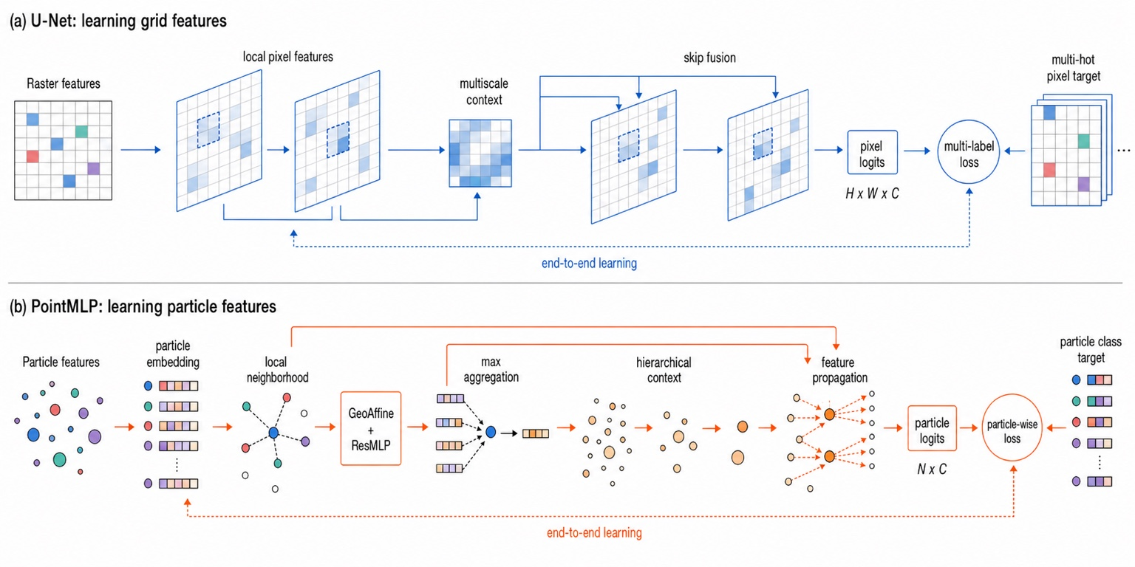
Notes:
Pixel-faithful version of the approved reference image. Use this slide when visual identity is the priority.

Slide 2
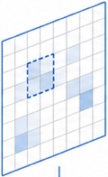
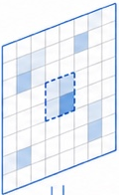
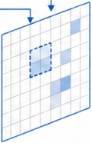
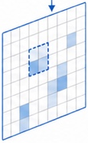
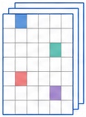
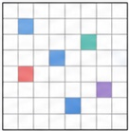

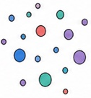






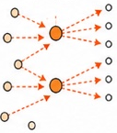

(a) U-Net: learning grid features
local pixel features
skip fusion
multi-hot
pixel target
Raster features
multiscale
context
pixel
logits
multi-label
loss
⋯
H × W × C
end-to-end learning
(b) PointMLP: learning particle features
particle
embedding
particle class
target
Particle features
local
neighborhood
max
aggregation
hierarchical
context
feature
propagation
GeoAffine
+
ResMLP
particle-wise
loss
particle
logits
N × C
⋮
end-to-end learning
Notes:
Editable reconstruction of the reference figure. Titles, labels, major arrows, supervision loops, output/loss blocks, and the lane separator are native PowerPoint objects. Fine scientific glyphs are independent raster layers cropped from the approved reference to preserve their exact appearance.

