Slide 1
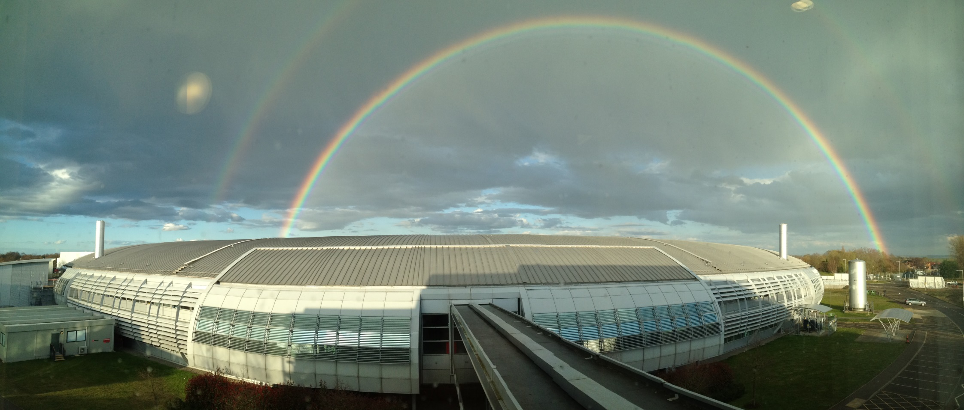
Imaging Challenges at Diamond
Annual Review Launch
Paul Quinn, Daniil Kazantsev, Diamond Light Source
Bath 28th Jan – 1st Feb 2019
Notes:
Talk – 30 mins, including 5 for questions
Aims: (i) Outline strong commitment at Diamond to imaging – 10 beamlines (out of 33 total)
(ii) Part of strong environment for imaging at Harwell – EM, neutrons ,lasers…
(iii) Imaging activities set to expand further – Diamond II, XFEL, University partnerships
Q for CR – ‘what is microscopy’ (in this context ???)

Slide 2
Drift, alignment and other problems...
Science focus:
Sources
In-situ experiments
Imaging Experiments at Diamond:
Overview of a scanning experiment
Overview of a 3D and 4D tomography experiment
Challenge - how can make experiments faster with sampling.

Slide 3
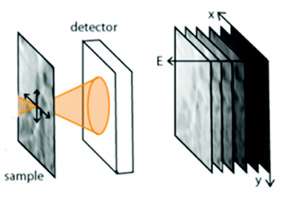
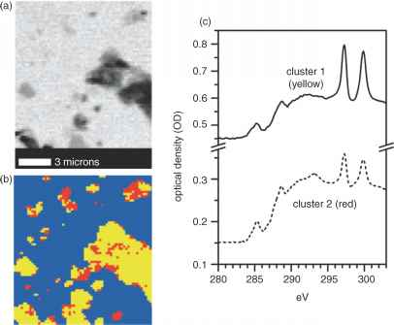
Hyper-spectral data
Take 2D map
Change energy
Stack and align
PCA/Cluster analysis

Slide 4
Data quality…
The result depends on the alignment of the stack
Image alignment ?
FFT
Depends on structure
Never really works for small images - e.g. 30x30 pixels ?
Intensity
Sum sq diff ?
Mutual information - implementation?

Slide 5
Data quality…
We know if the alignment is good by the PCA result
Can we align data based on reducing the number of PCA components found or reducing noise?
Producing best result rather than relative image comparisons ?
Dealing with motion drift…

Slide 6
X-ray scanning experiment :
Current experiment….
Slow drifts
Image offset
Fast scanning direction
Row shift horizontally
Slow scanning direction ?
Compress or vertical row shift?

Slide 7
In-situ corrections
If the sample is going to drift I have to make the scan area big enough to compensate - wasted time !
How can I track/compensate the drift during the experiment ?
Most reliable way to track and correct motion to minimize scan area and post experiment corrections ?
Prediction method ?

Slide 8
Data Live Example Drift data set 1

Slide 9
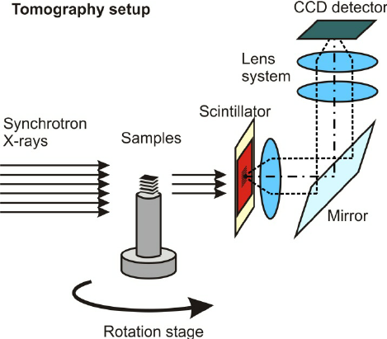
Nano-tomography
Conventional tomography
10’s micron resolutions
Rotate the object about centre of rotation
Alignment issues around wobble slight movements
Most rotation stages have eccentricity or wobble by 1-5um.
Nano-tomography
Scan range at each angle is 10um
Uncertainty in stage position is a few um
Alignment of all images to a centre of rotation is more challenging….

Slide 10
Data Live Example Drift data set 2

