Slide 1
Decentralized Web
April 13, 2018
The Third Generation Internet or Web 3.0

Slide 2
So what’s Web 3.0 ?
To understand this, let’s try to understand WEB 1.0 and Web 2.0 in brief.

Slide 3
What’s in Web 1.0?
In web 1.0 → small number of writers created web pages for a large number of readers over the Internet.
HTML was then used to display those documents so that any connected computer with a browser could access and read a web page.
Content creators were few, with the vast majority of users simply acting as consumers of content.
Web 1.0 can also be said as “read-only web”.

Slide 4
What’s in Web 2.0 ?
In Web 2.0, websites allowed users to interact, collaborate and become the creators of content
It can be said as “read-write web”.
Server-side scripting technologies emerged in market.
Enabled developers to easily build applications where people could write information to a database.
It gave us blogging, social networking, video sharing, eBay, Youtube, Facebook and all the large platforms that dominate the web today.

Slide 5
What’s the issue with Web 2.0 then?
Web 2.0 has evolved to become highly centralized around profit tech companies (G-A-F-A).
These large enterprises are creating many issues such as security, privacy, and control and concentration of power.
Harder for startups, creators to grow their internet presence without worrying about centralized platforms.
Your free data is more valuable than the free services that these giants provide since you are the product.

Slide 6
What’s there in Web 3.0 ?
The idea -> Reconfigure the internet into a distributed global computer.
Web 3.0
A web where the concept of website or webpage disappears,
Where data isn’t owned by GAFA but instead shared,
Where services (browsers) show different views for the same data.
In the decentralized version, the database doesn't belong to its creators, it belongs to its community.

Slide 7
Current Running services using Web 3.0 ?
There are already a lot of services which are using Web 3.0 capabilities.
dBrowsers : Blockstack, Beaker.
dApps: BitTorrent, Tor, OpenBazaar, Steemit.
dFileSystems: IPFS, FileCoin, Storj.

Slide 8
What are dApps?
Decentralized applications (dApps) are applications that run on a P2P network of computers rather than a single computer.

Slide 9
Difference between traditional web app and dApps?
Traditional websites: Front End → API → Database.
dApps : The front end uses the exact same technology to render the page.
The one critical difference is that instead of an API connecting to a Database, you have a Smart Contract connecting to a blockchain.
dApp enabled website: Front End → Smart Contract → Blockchain.

Slide 10
How do you make your dApp?
Centralized applications → where the backend code is running on centralized servers
dApps → their backend code running on a decentralized P2P network.
Create a dApp on a smart contract system → Combine several smart contracts → use 3rd party systems for the front-end.
However, its frontend can be hosted on decentralized storage such as Swarm or IPFS.

Slide 11
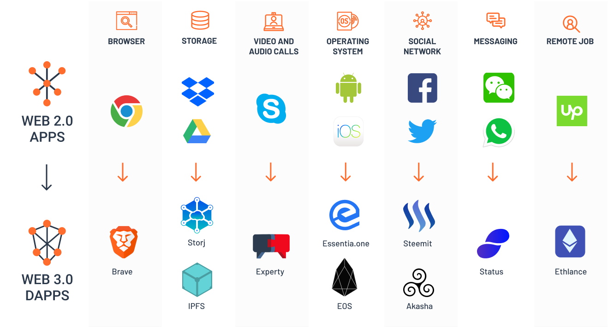
Web 2.0 vs Web 3.0 services

Slide 12
Conclusion
Centralized platforms have been dominant for so long that many people have forgotten there is a better way to build internet services. Crypto-networks are a powerful way to develop community-owned networks and provide a level playing field for 3rd-party developers, creators, and businesses.

Slide 13
Questions & Discussion

