Slide 1
An RL agent that re-tunes a PID controller live, on a real heater rig
CHE381 · PROCESS DYNAMICS & CONTROL PROJECT
TD3 actor–critic on a low-cost Arduino temperature testbed, trained on a digital twin of our own step-test data and benchmarked against Ziegler–Nichols, Cohen–Coon, SIMC, AMIGO, IMC and MATLAB pidtune on three real-rig runs.
≈ SIMC
−51 to −87 %
±0.03 °C
10×
error on the same disturbances, like-for-like (0.97 · 1.15 · 1.00 × SIMC in runs 1–3)
real-rig error vs MATLAB pidtune's fixed gains
RMS error at the end of runs 1 and 3 on the real rig
less heater switching than Ziegler–Nichols / Cohen–Coon
Deepak Kumar Chauhan · Azaad Katiyar · Divy Kumar Pandey · Kuldip
Notes:
One line: we trained a TD3 agent on a digital twin of our heater and it re-tunes the Arduino PID every 10 s on the real rig. Across three real runs with supply disturbances it matches SIMC, beats IMC and MATLAB pidtune by a wide margin, and switches the heater ten times less than Ziegler–Nichols or Cohen–Coon.

Slide 2
Most industrial PID loops are badly tuned
WHY THIS MATTERS
97 %
Why re-tuning gets postponed
of regulatory controllers use PID (survey of 11,000+ controllers in refining, chemicals, pulp & paper)
Every re-tune needs a step test: the process is disturbed on purpose and runs off-spec while it settles.
Slow thermal loops take hours per test and a skilled engineer to supervise.
Processes drift (fouling, wear, ambient, supply), so gains tuned at commissioning go stale.
Desborough & Miller, Honeywell, 2002
> 95 %
of industrial control loops are PID, mostly PI; their tuning decides plant performance
Åström & Hägglund, ISA, 2006
Our own rig shows it
30·30·20 %
of loops ran in manual · had more variability from poor tuning · used factory defaults
8.7 hours of step tests to characterise the heater at 4 supply voltages.
τ ≈ 15 min, so each test needs 1–1.5 h to settle.
MATLAB pidtune gives a 5× different Kp at 2 V than at 5 V: one fixed tuning is right at one point only.
Ender, Control Engineering, 1993
Notes:
Motivation: PID is everywhere, tuning is done once and goes stale. Re-tuning means a step test, which is slow and costly. On our own heater one characterisation took 8.7 h, and the right gains change 5x with supply voltage. Goal: an agent that keeps the loop tuned without new step tests.

Slide 3
Tune once, then let the agent keep it tuned
THE IDEA
Classical workflow (ZN, Cohen–Coon, SIMC, MATLAB pidtune)
Step test
Fit model
Fixed gains
Supply or process changes? Repeat everything.
1–1.5 h per operating point on our rig
K, τ, θ
right only near that point
Our workflow
A few step tests, once
Train agent
Agent re-tunes live
Supply or process changes? The agent adapts the gains.
we used 4 (2, 3, 4, 5 V)
in a randomised digital twin, ~1 h CPU
every 10 s on the rig, no new tests
Illustration only, not measured: 500 loops × 20 % needing a re-tune per year × 4 engineer-hours each = 400 engineer-hours a year, plus off-spec product during every step test.
Notes:
Contrast the two workflows. Classical: every change needs a new step test and new gains. Ours: step tests once, train in a randomised twin, then the agent adapts online every 10 seconds.

Slide 4
Six standard tunings from the same identified model (4 V)
THE METHODS WE COMPETE AGAINST
Method | Kp | Ki | Kd
Ziegler–Nichols (open loop) | 93.96 | 1.1745 | 1879.2
Cohen–Coon | 105.22 | 1.0878 | 1518.9
SIMC (Skogestad) | 39.15 | 0.1223 | 522.0
AMIGO | 35.89 | 0.1561 | 708.9
IMC (λ tuning) | 12.43 | 0.0128 | 243.4
MATLAB pidtune (chose PI) | 4.700 | 0.00906 | 0
MATLAB pidtune per supply
Supply | Kp | Ki
2 V | 16.379 | 0.02824
3 V | 7.752 | 0.01407
4 V | 4.700 | 0.00906
5 V | 3.261 | 0.00671
5× different Kp across the supply range: fixed gains need a new step test for every voltage.
All controllers run as Arduino PID_v1 (0–100 % PWM, anti-windup, derivative on measurement): the same code as the rig. Classical gains are commissioned once at 4 V, as an engineer would.
Notes:
These are the baselines. All tuned once from the 4 V step test. Note how MATLAB's own tuning changes 5x across supply voltage, which is exactly the problem the agent addresses.

Slide 5
Trained once on a twin, then tunes the real PID live
THE AGENT
Offline: training
4 step tests
Nonlinear plant model
Randomised twin
TD3, 2 × 300 k steps
2, 3, 4, 5 V at 1 Hz on our rig, 8.7 h of data
τ·dΔT/dt = K₀·P(t−θ) − ΔT(1+βΔT)
K₀ 8.51 °C/W · τ 1141 s · θ 40 s
K₀, β, τ, θ, R, ambient, noise, supply and setpoint changes drawn each episode
best model picked on a fixed 24-run suite scored against SIMC (0.88)
Online: on the rig
Arduino Nano, PID_v1
Observation (10 values)
Actor MLP 256–256
Gains = SIMC(V, SP) × m
every 1 s: NTC (A0), current (A1), supply V (A2) → heater PWM (D6)
error, slope, mean PWM, PWM chatter, gain multipliers, supply V, headroom, ΔT
action ∈ [−1, 1]³ every 10 s
Kp, Ki × 0.25–4 · Kd × 0.05–2 → sent as K:Kp,Ki,Kd
Reward −|e| − 2·overshoot − λ·|Δu| − small gain-change cost: track tightly, don't overshoot, don't hammer the heater.
Why TD3 Twin critics (no Q over-estimation), delayed actor, target smoothing. γ 0.99, batch 256, lr 3·10⁻⁴.
Why anchored gains Zero action = SIMC at the measured voltage: the agent refines the tuning and can never switch integral action off.
Notes:
Offline we fit a nonlinear first-order-plus-dead-time model to our step tests and randomise it heavily, so the agent sees many plants. TD3 learns a policy that nudges gain multipliers around SIMC. Online the Nano runs the PID every second and the Python tuner queries the actor every 10 seconds.

Slide 6
v1 failed on the rig; v2 fixes each cause
WHAT THE FIRST RIG TEST TAUGHT US
Cause in v1 | Fix in v2
Gains could roam 2.5 decades; agent found a corner with Ki ≈ 0 | Anchored gains: SIMC(V, SP) × 0.25–4; integral can't be switched off
Episodes started from absurd random gains | 40 % start near SIMC, 60 % up to 4× wrong (learns to repair)
γ 0.98 looks ~500 s ahead; plant needs ~1000 s | γ 0.99
Best model picked on 8 noisy random episodes | Picked on a fixed 24-run suite scored against SIMC
Ambient fixed at the step-test value (29.2 °C) | Tuner measures room temperature at start (run 2 onward)
v1 on the rig
±0.85 °C
permanent oscillation at 40 °C
Gains drifted to Kp 300, Ki 0.002: an on/off controller with no integral action.
Training data unchanged: the same four step tests, fetched from data/raw on GitHub. Hardware fixes: heater gate rewired to D6 (100 Ω); the tuner freezes the agent if the heater stops obeying.
Notes:
Short slide on what went wrong first time and how v2 fixes it. Key fix: anchoring gains to SIMC so the agent cannot turn the integral off.

Slide 7
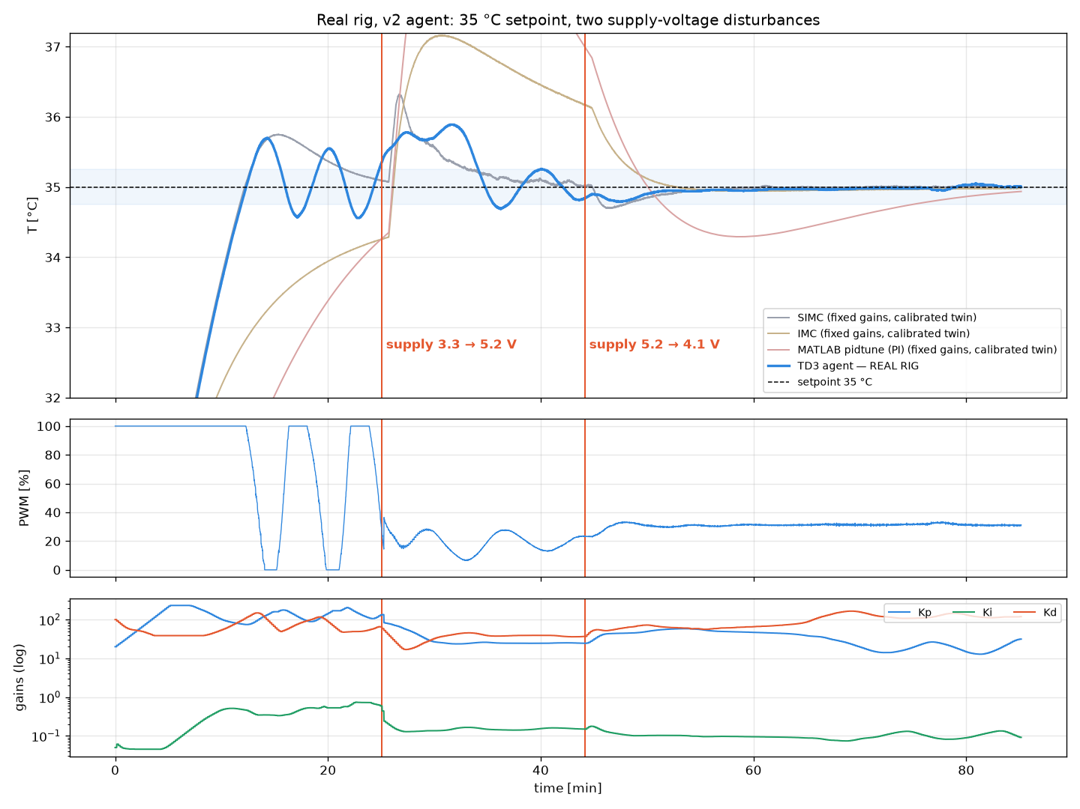
Run 1: 35 °C, supply raised then lowered
REAL RIG · RUN 1 · 10 NOV 2026
Phase | Agent on the real rig
Cold start 24.9 → 35 °C (3.3 V) | reached in 12.2 min; overshoot 0.70 °C
Dist. 1: heater 2.9 → 9.3 W | peak 0.89 °C; back in ±0.25 °C in 15.1 min
Dist. 2: heater 9.3 → 5.5 W | peak 0.21 °C; never left ±0.25 °C
Last 5 min | RMS error 0.03 °C
508 gain updates, all in the right direction: more supply → lower gains (Kp 130 → 25).
Rig ≠ training plant: 26 % less gain, 27 % faster than the step-test model. It still held 35 °C.
Weak spot: ±0.5 °C limit cycle at 3.3 V, caused by a wrong ambient in the tuner (fixed for runs 2–3).
Blue: agent on the real rig. Grey/purple/pink: fixed classical gains on a twin calibrated to this run (RMSE 0.19 °C), same supply changes.
Notes:
Run 1: cold start then two supply changes made by hand. The agent lowered its gains when supply rose and raised them when it fell. The final 5 minutes are within 0.03 °C RMS.

Slide 8
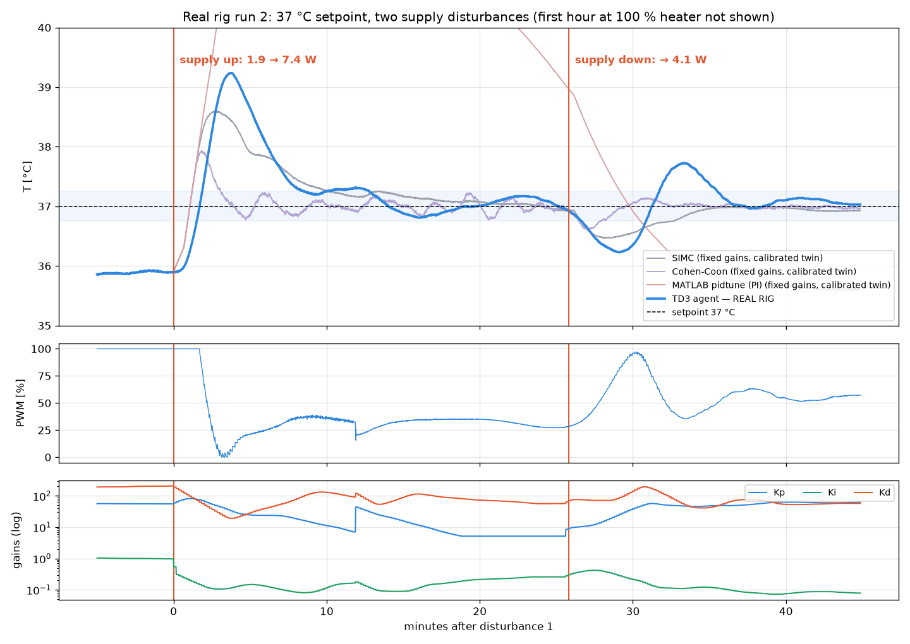
Run 2: 37 °C, supply raised then lowered
REAL RIG · RUN 2 · 11 NOV 2026
Phase | Agent on the real rig
First 59 min, ~2.1 V | 37 °C unreachable (max 35.9 °C): not scored
Dist. 1: heater 1.9 → 7.4 W | overshoot 2.24 °C; back in ±0.25 °C in 12.8 min
Dist. 2: heater 7.4 → 4.1 W | peak 0.77 °C; back in ±0.25 °C in 9.7 min
Last 5 min | RMS error 0.10 °C
Gains followed the supply: after the rise Kp 59 → 5, Ki 1.0 → 0.1; after the drop Kp back to ~60.
Ambient fix worked: tuner read 24.8 °C; no limit cycle.
Weak spot: while 37 °C was unreachable the agent inflated Kp (370) and Ki, giving the 2.24 °C overshoot.
Time 0 = disturbance 1. Classical gains on a twin calibrated to this run (RMSE 0.38 °C), started from the rig's real state at disturbance 1.
Notes:
Run 2: first hour the supply was too low to reach 37 C, so we score only the two disturbances. Gains moved correctly; the overshoot after the first disturbance came from gain inflation while saturated. Fix: freeze gain increases while PWM is pinned at 100 percent.

Slide 9
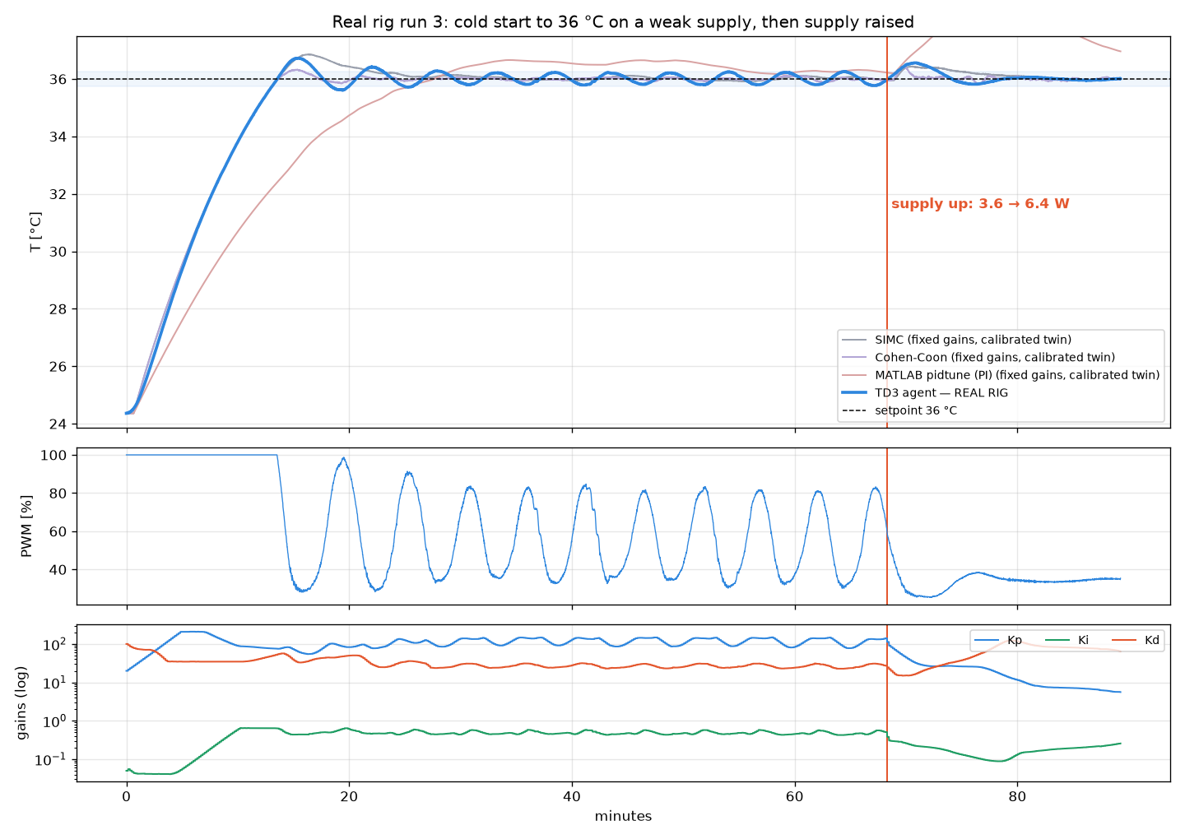
Run 3: 36 °C cold start, then supply raised
REAL RIG · RUN 3 · 11 NOV 2026 (NEW)
Phase | Agent on the real rig
Cold start 24.4 → 36 °C (3.6 W) | reached in 13.4 min; overshoot 0.72 °C
Hold, 25–68 min | within −0.29 / +0.28 °C (RMS 0.16 °C)
Dist.: heater 3.6 → 6.4 W (×1.8) | peak 0.56 °C; back in ±0.25 °C in 4.7 min, ±0.1 °C in 9.3 min
Last 5 min | RMS error 0.03 °C
533 gain updates. After the rise: Kp 115 → 6, Ki 0.47 → 0.26, Kd 27 → 64.
Calmest end of all three runs: ±0.05 °C band, heater steady at ~35 %.
Weak spot: slow ±0.25 °C swing on the weak supply; SIMC and AMIGO swing as much on the twin.
Classical gains on a twin calibrated to this whole run (K₀ 6.18 °C/W, τ 856 s, θ 40 s, RMSE 0.26 °C), same cold start and same heater power profile.
Notes:
Run 3: a full cold start to 36 C on a weak supply, then the supply was raised. The agent cut Kp by 20x within minutes and settled to 0.03 C RMS. During the weak-supply hold it swung about plus or minus 0.25 C, about the same as SIMC and AMIGO would.

Slide 10
Level with SIMC and AMIGO, far ahead of IMC and MATLAB
THREE RIG RUNS VS STANDARD METHODS
0.97 · 1.15 · 1.00
agent ÷ SIMC error per run, like-for-like on the calibrated twin
−51 to −87 %
real-rig error vs MATLAB pidtune (runs 3 and 2); −26 to −79 % vs IMC
3.6 vs 40 %/s
heater switching: agent vs Ziegler–Nichols / Cohen–Coon, which win on IAE only by hammering the heater
IAE in °C·s. Run 1: whole run; run 2: from disturbance 1; run 3: whole run. Classical gains (fixed, tuned at 4 V) run on a twin calibrated to each run with the same heater power; the agent shown on the twin (like-for-like) and on the real rig.
Notes:
Average over three runs, error relative to SIMC. Agent is level with SIMC and AMIGO, far better than IMC and MATLAB. ZN and Cohen-Coon get lower error on this slow lag-dominant loop, but they switch the heater about ten times more.

Slide 11
Every controller, every run, same disturbances
THE NUMBERS
Controller | Run 1 IAE 35 °C | Run 2 IAE 37 °C | Run 3 IAE 36 °C | Mean ÷ SIMC | Run 3 dist.: peak (°C) | Run 3 dist.: back ±0.1 °C | Final RMS run 3 (°C) | Switching (%/s)
TD3 agent · real rig | 4,322 | 1,037 | 5,096 | 1.12 | 0.56 | 9.3 min | 0.031 | 0.4*
TD3 agent · twin | 4,038 | 937 | 4,926 | 1.04 | 0.50 | 7.5 min | 0.076 | 3.6
Cohen–Coon | 3,728 | 301 | 4,505 | 0.73 | 0.43 | 11.7 min | 0.035 | 38.6
Ziegler–Nichols | 3,837 | 342 | 4,550 | 0.76 | 0.44 | 19.9 min | 0.058 | 41.2
AMIGO | 4,072 | 712 | 4,857 | 0.95 | 0.43 | 9.2 min | 0.056 | 23.8
SIMC | 4,161 | 813 | 4,917 | 1.00 | 0.44 | 12.3 min | 0.036 | 18.2
IMC | 6,982 | 4,913 | 6,869 | 3.04 | 1.45 | never | 0.809 | 8.5
MATLAB pidtune (PI) | 11,779 | 8,106 | 10,325 | 4.97 | 2.33 | never | 1.324 | 0.1
Fastest back inside ±0.1 °C after the run-3 disturbance (7.5 min on the twin) of every controller; 9.3 min on the real rig.
The only adaptive controller: same policy in all three runs, no re-tuning, no step tests.
Switching = mean |ΔPWM| per second, runs 1 and 3 on the twin. *Real-rig value comes from the logged (averaged) PWM, so it is not comparable with the twin values.
Notes:
Full table for reference. Highlight: after the run 3 disturbance, the agent was the fastest of all controllers to get back within 0.1 C, and its final error matches the best classical rules.

Slide 12
The agent gives SIMC-level accuracy with 5× less switching
ACCURACY VS ACTUATOR EFFORT
How to read it
Same error as SIMC and AMIGO (within 1.5 %), far below IMC, with 2.4–6.6× less heater switching than all three.
ZN and Cohen–Coon buy ~8 % lower error (runs 1 and 3) with ~11× more switching: more heater wear and supply ripple.
MATLAB pidtune is smooth but 2.5× SIMC's error: too sluggish for disturbances.
No fixed tuning sits where the agent does: low effort and SIMC-level accuracy at every supply.
Notes:
This is the key proficiency slide. X axis is how hard the controller works the heater, Y is error relative to SIMC. The agent dominates SIMC, AMIGO and IMC. Only ZN and Cohen-Coon have lower error, and they pay with about eleven times more switching.

Slide 13
On unseen plants the agent has the lowest error of all
SIMULATION · 40 RANDOM PLANTS
Controller | Mean IAE | Median IAE | Not settled | Switching %/s
TD3 agent v2 (from bad gains) | 5,673 | 3,942 | 1/40 | 14.3
TD3 agent v2 (from ZN gains) | 5,723 | 3,890 | 0/40 | 14.0
Cohen–Coon (best classical) | 6,032 | 4,317 | 3/40 | 36.1
SIMC | 6,162 | 4,740 | 1/40 | 31.3
Ziegler–Nichols | 6,206 | 4,521 | 3/40 | 37.1
AMIGO | 6,518 | 4,874 | 2/40 | 34.6
IMC | 6,969 | 5,349 | 2/40 | 22.3
MATLAB pidtune | 7,085 | 5,586 | 0/40 | 4.3
−6 %
mean error vs the best classical rule (Cohen–Coon), with 2.5× less heater switching
87–99 %
of the best rule's accuracy in each of 7 fixed scenarios; beats MATLAB in all 7, SIMC in 6
1.42 °C
lowest peak deviation of all controllers on a 3 → 5 V supply rise (others 1.64–3.86 °C)
Same plant, scenario and sensor noise for every controller. Random K₀, τ, θ, β, ambient, supply and setpoint changes. Classical gains tuned once at 4 V.
Notes:
Simulation backs up the rig: on 40 random unseen plants with supply and setpoint changes, the agent has the lowest mean error, settles in 39 or 40 of 40, and switches much less than the aggressive rules.

Slide 14
Classical tuning is right at one point. Our agent stays right as the process changes.
CONCLUSION
≈ SIMC
−51 to −87 %
5–11×
8.7 h → 0
accuracy on the real rig in 3 runs (1.04× SIMC mean, like-for-like)
error vs MATLAB pidtune's fixed gains
less heater switching than SIMC, AMIGO, ZN, Cohen–Coon
step testing for new supply voltages once trained
Honest limitations and next steps
On this slow, lag-dominant loop ZN and Cohen–Coon reach lower error (~8 % in runs 1 and 3, more in run 2), at ~11× the switching.
Gain inflation while saturated (run 2 overshoot); fix: freeze gain increases at 100 % PWM.
Classical rules compared on twins calibrated to each run, not re-run on the rig. Next: run SIMC and Cohen–Coon on the rig, retrain with the rig's measured K₀ and τ.
github.com/dkchauhan2006/rl-pid-autotuner · Desborough & Miller (2002) · Ender (1993) · Åström & Hägglund (2006) · Fujimoto et al., TD3 (ICML 2018)
Notes:
Close: across three real runs the agent matches SIMC accuracy, is far ahead of IMC and MATLAB, and uses much less actuator effort, with no new step tests. Be upfront about the limitations.

