Slide 1
ThermoTune-RL
CHE381 INNOVATION PROJECT
A reinforcement-learning agent that keeps a PID controller tuned, live, on a real heater rig
TD3 actor–critic trained on a digital twin of our own step tests; benchmarked on three real-rig runs against Ziegler–Nichols, Cohen–Coon, SIMC, AMIGO, IMC and MATLAB pidtune.
≈ SIMC
−51 to −87 %
±0.03 °C
5–11×
accuracy, like-for-like, across three rig runs
real-rig error vs MATLAB pidtune's fixed gains
RMS error at the end of runs 1 and 3
less heater switching than SIMC, AMIGO, ZN, Cohen–Coon
Azaad Katiyar
240249
Deepak Kumar Chauhan
240330
Divy Kumar Pandey
240368
Kuldip
Notes:
ThermoTune-RL: a TD3 agent that re-tunes the Arduino PID every 10 s on our heater rig. Across three real runs with supply disturbances it matches SIMC, beats IMC and MATLAB pidtune by a wide margin, and works the heater 5 to 11 times less than the classical rules.

Slide 2
Most industrial PID loops are badly tuned
WHY THIS MATTERS
97 %
Why re-tuning gets postponed
of regulatory controllers use PID (survey of 11,000+ controllers in refining, chemicals, pulp & paper)
Every re-tune needs a step test: the process is disturbed on purpose and runs off-spec while it settles.
Slow thermal loops take hours per test and a skilled engineer to supervise.
Processes drift (fouling, wear, ambient, supply), so gains tuned at commissioning go stale.
Desborough & Miller, Honeywell, 2002
> 95 %
of industrial control loops are PID, mostly PI; their tuning decides plant performance
Åström & Hägglund, ISA, 2006
Our own rig shows it
30·30·20 %
of loops ran in manual · had more variability from poor tuning · used factory defaults
8.7 hours of step tests to characterise the heater at 4 supply voltages.
τ ≈ 15 min, so each test needs 1–1.5 h to settle.
MATLAB pidtune gives a 5× different Kp at 2 V than at 5 V: one fixed tuning is right at one point only.
Ender, Control Engineering, 1993
Notes:
PID is everywhere, tuning is done once and goes stale. Re-tuning means a step test, which is slow and costly. On our heater one characterisation took 8.7 h, and the right gains change 5x with supply voltage.

Slide 3
Tune once, then let the agent keep it tuned
THE IDEA
Classical workflow (ZN, Cohen–Coon, SIMC, MATLAB pidtune)
Step test
Fit model
Fixed gains
Supply or process changes? Repeat everything.
1–1.5 h per operating point on our rig
K, τ, θ
right only near that point
Our workflow
A few step tests, once
Train agent
Agent re-tunes live
Supply or process changes? The agent adapts the gains.
we used 4 (2, 3, 4, 5 V)
in a randomised digital twin, ~1 h CPU
every 10 s on the rig, no new tests
Illustration only, not measured: 500 loops × 20 % needing a re-tune per year × 4 engineer-hours each = 400 engineer-hours a year, plus off-spec product during every step test.
Notes:
Classical: every change needs a new step test and new gains. Ours: step tests once, train in a randomised twin, then the agent adapts online every 10 seconds.

Slide 4
Six standard tunings from the same identified model
THE METHODS WE COMPETE AGAINST, AND WHERE THEIR GAINS COME FROM
Method and source | Kp rule | Ti rule | Td rule | Kp | Ki | Kd
Ziegler–Nichols (open loop) Ziegler & Nichols, Trans. ASME 1942 | 1.2τ / (Kθ) | 2θ | θ/2 | 93.96 | 1.1745 | 1879
Cohen–Coon Cohen & Coon, Trans. ASME 1953 | (τ/Kθ)(4/3 + θ/4τ) | θ(32+6r)/(13+8r) | 4θ/(11+2r) | 105.22 | 1.0878 | 1519
SIMC, τc = θ Skogestad, J. Process Control 2003 | τ / (K(τc+θ)) | min(τ, 4(τc+θ)) | θ/3 | 39.15 | 0.1223 | 522
AMIGO Åström & Hägglund, J. Process Control 2004 | (0.2 + 0.45τ/θ) / K | θ(0.4θ+0.8τ)/(θ+0.1τ) | 0.5θτ/(0.3θ+τ) | 35.89 | 0.1561 | 709
IMC, λ = max(τ/4, 1.5θ) Rivera, Morari & Skogestad, I&EC 1986 | (τ+θ/2) / (K(λ+θ/2)) | τ + θ/2 | τθ/(2τ+θ) | 12.43 | 0.0128 | 243
MATLAB pidtune Control System Toolbox, default 60° phase margin | numerical (loop shaping) | chose PI | 0 | 4.700 | 0.00906 | 0
Model all rules are applied to: FOPDT G(s) = K e^(−θs)/(τs+1), linearised from our step tests at 4 V, 35 °C: K = 0.343 °C per % PWM, τ = 1074 s, θ = 40 s. Gains in PID_v1 parallel form: Ki = Kp/Ti, Kd = Kp·Td; r = θ/τ.
Notes:
Each method's gains come from a published rule applied to the same first-order-plus-dead-time model identified from our step test at 4 V. MATLAB pidtune is the Control System Toolbox tuner with its default 60 degree phase margin; it chose a PI controller. These gains are fixed for the whole run, as they would be after commissioning.

Slide 5
Trained once on a twin, then tunes the real PID live
THE PIPELINE
Offline: training
4 step tests
Nonlinear plant model
Randomised twin
TD3, 2 seeds × 300 k steps
2, 3, 4, 5 V at 1 Hz on our rig, 8.7 h of data
τ·dΔT/dt = K₀·P(t−θ) − ΔT(1+βΔT), P = u·V²/R
K₀ 8.51 °C/W · τ 1141 s · θ 40 s
K₀, β, τ, θ, R, ambient, sensor noise, supply and setpoint changes drawn each episode
best checkpoint picked on a fixed 24-run test suite
Online: on the rig
Arduino Nano, PID_v1
Observation (10 values)
Actor MLP 256–256
New Kp, Ki, Kd
every 1 s: NTC (A0), current (A1), supply V (A2) → heater PWM (D6)
error, slope, mean PWM, PWM chatter, gain multipliers, supply V, headroom, ΔT
action ∈ [−1, 1]³ every 10 s
sent to the Nano as K:Kp,Ki,Kd; clamped by the firmware
Two speeds: the PID reacts every second (fast loop); the agent only changes the PID's gains every 10 s (slow loop). If the agent or the laptop stops, the Nano keeps controlling with the last gains, so the plant is never left without a controller.
Notes:
Offline we fit a nonlinear first-order-plus-dead-time model to our step tests and randomise it heavily, so the agent sees many different plants. Online the Nano runs the PID every second and the Python tuner queries the actor every 10 seconds.

Slide 6
Gain tuning as a Markov decision process, solved with TD3
THE MATHS OF THE AGENT
State, action, reward
TD3 learning rule
Initial gain map (first agent)
State (10 values, every 10 s)
s = [ e/10, ΔT(10 s), ū/100 − ½, |Δu|/50, z(Kp), z(Ki), z(Kd), (V − 3.5)/2, h, (T − T₀)/50 ]
Action and gain update
a ∈ [−1, 1]³, z ← clip(z + 0.06 a, −1, 1)
Reward (averaged over the 10 PID steps)
r = (1/10) Σ [ −|e|/2 − max(0, T − SP) − |Δu|/100 ] − 0.02 Σ|a|
track tightly · punish overshoot · don't hammer the heater · move gains gently
Critic target (twin critics, smoothed target)
y = r + γ · min( Q′₁, Q′₂ )(s′, π′(s′) + ε)
ε = clip( N(0, 0.2²), −0.5, 0.5 )
Critic loss
L(θᵢ) = E[ (Qᵢ(s, a) − y)² ], i = 1, 2
Actor update (every 2nd critic step)
∇J(φ) = E[ ∂Q₁(s, a)/∂a · ∂π(s)/∂φ ], a = π(s)
Soft targets, exploration
θ′ ← 0.005 θ + 0.995 θ′
explore: a = π(s) + N(0, 0.3²)
Adam, lr 3·10⁻⁴, batch 256, MLP 256–256 (Fujimoto et al., 2018)
Gains free over fixed log ranges
K = Kmin · (Kmax / Kmin)^((z + 1)/2)
Kp ∈ [1, 300], Ki ∈ [0.002, 3], Kd ∈ [1, 3000]
Training set-up
γ = 0.98 (horizon 1/(1−γ) = 50 steps ≈ 500 s)
200 k steps, one seed; every episode started from random gains; best model = highest mean reward over 8 random episodes; thermocouple sensor model.
Notes:
The agent sees a 10-number state every 10 s and outputs three numbers that nudge the log-scaled gains. Reward: absolute error, an extra penalty for overshoot, a penalty on PWM changes, and a small cost for moving the gains. TD3 trains two critics on the Bellman target using the smaller of the two, adds noise to the target action, and updates the actor less often: this stops the Q over-estimation that makes DDPG unstable. On the right is how our first agent mapped actions to gains: free over fixed ranges. The next slide shows what that led to and what we changed.

Slide 7
What the first agent did, what we added, and the result
FROM THE FIRST AGENT TO THE FINAL ONE
What the first agent did | So we added | Result
Drove its gains into a corner (Kp → 300, Ki → 0.002): on/off control, no integral action; ±0.85 °C oscillation on the rig | Anchored gains: K = K(SIMC at measured V, SP) × m(z), m ∈ [0.25, 4] for Kp, Ki and [0.05, 2] for Kd | Integral action can never vanish; zero action = SIMC, so the agent refines a sound tuning
Started every episode from absurd random gains, so it rarely saw a well-tuned loop | 40 % of episodes start near SIMC, 60 % start up to 4× wrong | Learns both to refine good gains and to repair bad ones
γ = 0.98 looked ~500 s ahead, but the heater needs ~1000 s to show the effect of a gain change | γ = 0.99 (horizon ≈ 1000 s) | Credit for a gain change reaches the decision that caused it
Best model picked on 8 random episodes; reward noise ±100–250 hid real differences | Fixed 24-run test suite, scored as IAE ÷ IAE of SIMC; 2 seeds × 300 k steps | Final model 0.88 × SIMC's error on the suite (12 % better)
Sensor model was a 0.25 °C thermocouple; ambient taken from the step tests (29.2 °C) | Sensor noise 0.01–0.12 °C and resolution 0.01–0.25 °C randomised; tuner measures room temperature at start | Removed the 3.3 V limit cycle; ±0.03 °C RMS at the end of rig runs 1 and 3
Notes:
Tell it as a story: the first agent found a loophole, pushing gains to the edges, which is on/off control with no integral action, and on the rig that oscillated by 0.85 C. Each change on this slide fixed one cause. The biggest one is anchoring the gains to SIMC: the agent now outputs a correction to a sound engineering tuning, so it can only make it better or repair it.

Slide 8
Training is stable, and the best model beats SIMC by 12 %
TRAINING CURVES
No divergence
-502 → -400
0.88 × SIMC
critic loss stays bounded; its spikes follow shifts in the policy (the data the critic fits keeps changing)
training episode return (+20 %), with exploration noise, first 20 k → last 20 k steps
best checkpoint (seed 0, 60 k steps) on the 24-run test suite; used on the rig
Losses and returns: seed 0 re-trained with identical code, seed and settings (the test-suite scores reproduce the original run exactly, e.g. 1.100 × SIMC at 20 k steps); the original run did not save loss logs. Test-suite curves: models/td3_seed*/suite_log.csv on GitHub.
Notes:
Left: the critic's squared Bellman error falls as the Q-function fits. Middle: the actor maximises the critic's Q estimate; it settles once the critic has learnt the true scale of the (negative) returns. Right: the score we used to pick the model, error relative to SIMC on 24 fixed test runs; seed 0 reached 0.88 at 60 k steps, and that is the model on the rig. In RL the score is not monotonic, which is why we keep the best checkpoint rather than the last.

Slide 9
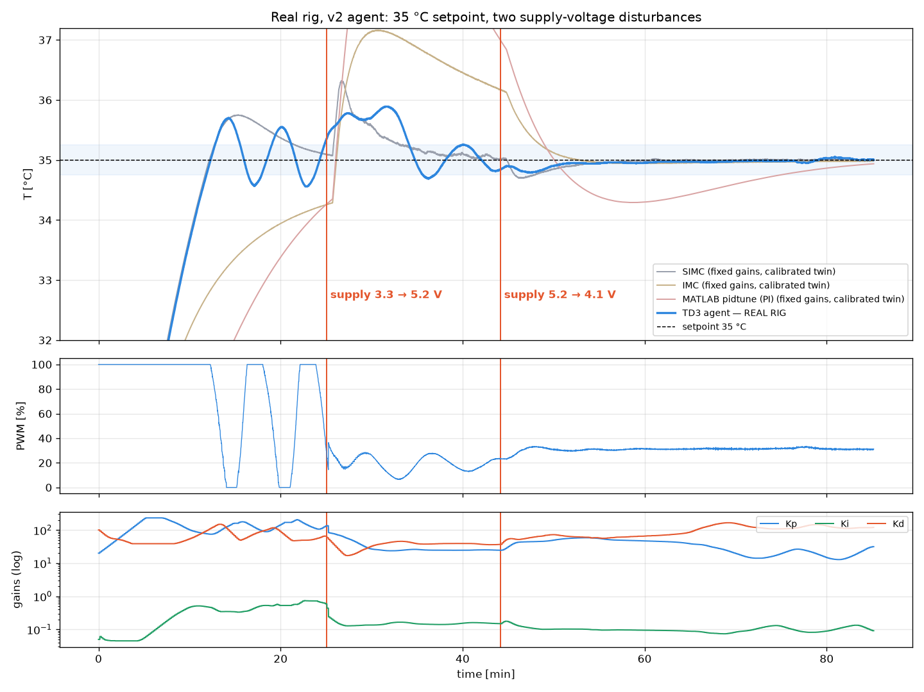
Run 1: 35 °C, supply raised then lowered
REAL RIG · RUN 1 · 10 NOV 2026
Phase | Agent on the real rig
Cold start 24.9 → 35 °C (3.3 V) | reached in 12.2 min; overshoot 0.70 °C
Dist. 1: heater 2.9 → 9.3 W | peak 0.89 °C; back in ±0.25 °C in 15.1 min
Dist. 2: heater 9.3 → 5.5 W | peak 0.21 °C; never left ±0.25 °C
Last 5 min | RMS error 0.03 °C
508 gain updates, all in the right direction: more supply → lower gains (Kp 130 → 25).
Rig ≠ training plant: 26 % less gain, 27 % faster than the step-test model. It still held 35 °C.
Early swing at 3.3 V came from a wrong ambient value in the tuner; fixed before runs 2 and 3.
Blue: agent on the real rig. Grey/purple/pink: fixed classical gains on a twin calibrated to this run (RMSE 0.19 °C), same supply changes.
Notes:
Run 1: cold start then two supply changes made by hand. The agent lowered its gains when supply rose and raised them when it fell. The final 5 minutes are within 0.03 C RMS.

Slide 10
Run 1: smallest disturbance peak of every controller
RUN 1 VS STANDARD METHODS
Controller | IAE | Reach SP (min) | Overshoot (°C) | Dist. 1 peak (°C) | Dist. 1 back ±0.25 | Dist. 2 peak (°C) | Switching (%/s)
TD3 agent · real rig | 4,322 | 12.2 | 0.70 | 0.89 | 15.1 min | 0.21 | 0.3*
TD3 agent · twin | 4,038 | 12.1 | 0.56 | 1.20 | 8.9 min | 0.33 | 3.7
Cohen–Coon | 3,728 | 12.1 | 0.31 | 1.24 | 9.2 min | 0.27 | 35.6
Ziegler–Nichols | 3,837 | 12.3 | 0.25 | 1.26 | 18.1 min | 0.24 | 37.8
AMIGO | 4,072 | 12.1 | 0.74 | 1.22 | 6.8 min | 0.36 | 23.2
SIMC | 4,161 | 12.1 | 0.75 | 1.32 | 8.7 min | 0.30 | 18.0
IMC | 6,982 | never | 0.00 | 2.16 | never | 1.17 | 8.6
MATLAB pidtune | 11,779 | never | 0.00 | 4.94 | never | 1.99 | 0.1
Lowest peak after the supply jump: 1.20 °C on the twin (0.89 °C on the rig) vs 1.22–4.94 °C for every fixed tuning.
Lower total error than SIMC, AMIGO, IMC and MATLAB (−3 %, −1 %, −42 %, −66 %); within 8 % of Cohen–Coon with 10× less heater switching.
Classical gains: fixed, tuned once at 4 V (previous slide's rules), run on a digital twin calibrated to this run with the same heater power changes. TD3 agent shown on the real rig and on the same twin (like-for-like). Twin RMSE 0.19 °C. *Real-rig switching is from the logged (averaged) PWM, not comparable with twin values.
Notes:
Same disturbances, every controller. The agent had the smallest temperature excursion after the supply jump, and beat SIMC, AMIGO, IMC and MATLAB on total error. Cohen-Coon and ZN are slightly better on IAE but switch the heater ten times more.

Slide 11
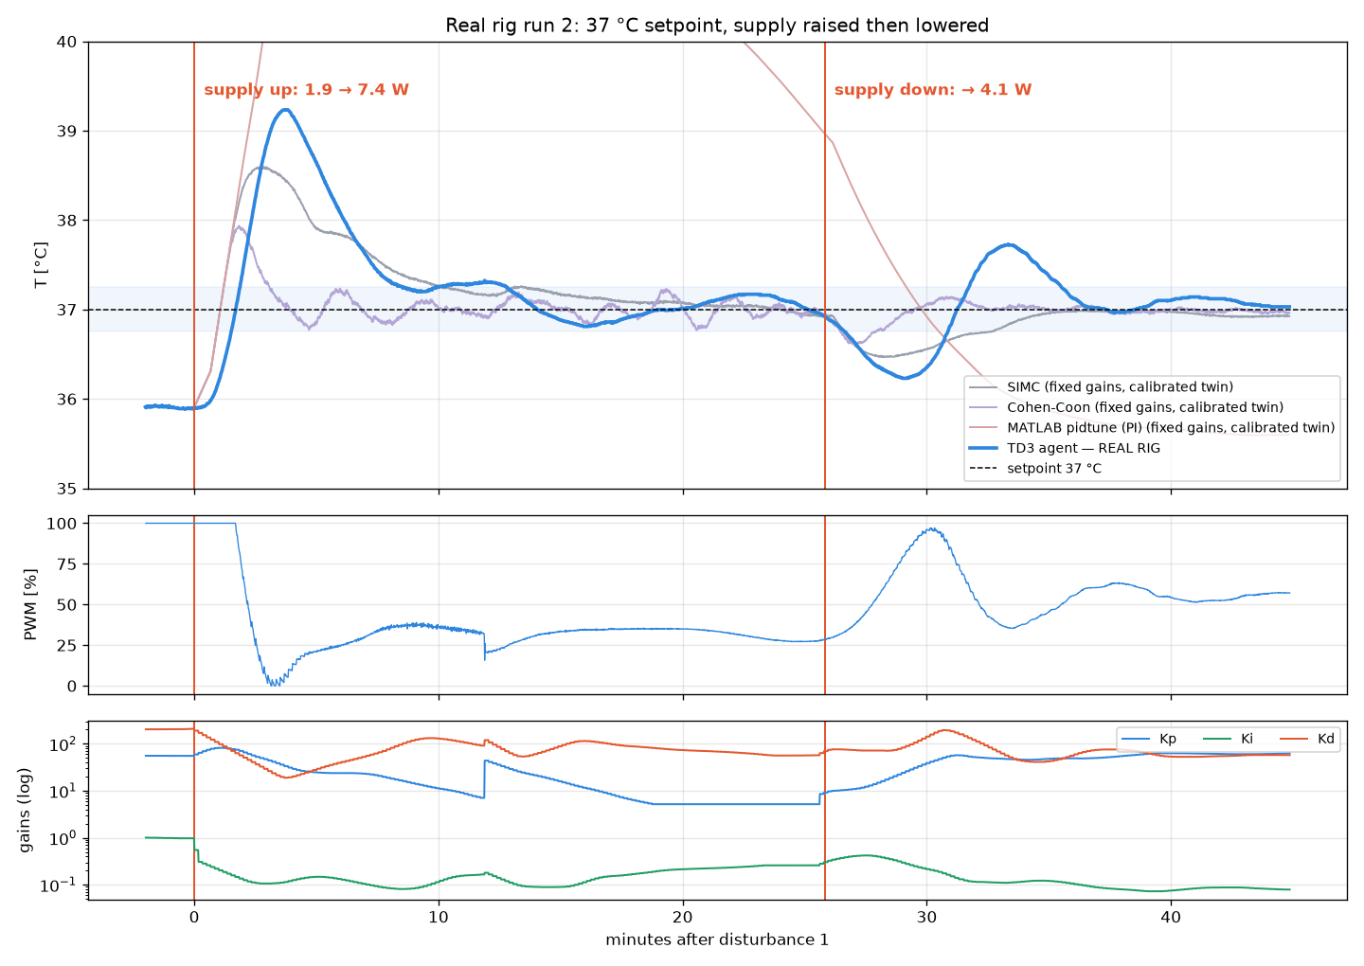
Run 2: 37 °C, supply raised then lowered
REAL RIG · RUN 2 · 11 NOV 2026
Phase | Agent on the real rig
Dist. 1: heater 1.9 → 7.4 W (×3.9) | overshoot 2.24 °C; back in ±0.25 °C in 12.8 min
Dist. 2: heater 7.4 → 4.1 W | peak 0.77 °C; back in ±0.25 °C in 9.7 min
Last 5 min | RMS error 0.10 °C
Gains followed the supply: after the rise Kp 59 → 5 and Ki 1.0 → 0.1; after the drop Kp back up to ~60.
Ambient measured correctly (24.8 °C): no limit cycle.
Biggest jump of the three runs (×3.9 power). The gains it carried into the jump were high, hence the overshoot; next step: freeze gain growth while PWM is at 100 %.
Time 0 = disturbance 1. Classical gains on a twin calibrated to this run (RMSE 0.38 °C), started from the rig's real state at disturbance 1.
Notes:
Run 2: two supply changes at 37 C. The power jump here was the largest, almost four times. The gains moved the right way, and after the second disturbance the loop recovered faster than SIMC and AMIGO on the twin.

Slide 12
Run 2: faster recovery from the drop than SIMC and AMIGO
RUN 2 VS STANDARD METHODS
Controller | IAE | Dist. 1 overshoot (°C) | Dist. 1 back ±0.25 | Dist. 2 peak (°C) | Dist. 2 back ±0.25 | Final RMS (°C)
TD3 agent · real rig | 1,037 | 2.24 | 12.8 min | 0.77 | 9.7 min | 0.097
TD3 agent · twin | 937 | 1.52 | 22.5 min | 0.58 | 4.3 min | 0.053
Cohen–Coon | 301 | 0.94 | 3.1 min | 0.40 | 2.1 min | 0.022
Ziegler–Nichols | 342 | 0.78 | 5.0 min | 0.48 | 2.8 min | 0.024
AMIGO | 712 | 1.61 | 8.3 min | 0.56 | 6.0 min | 0.052
SIMC | 813 | 1.60 | 13.6 min | 0.53 | 6.8 min | 0.066
IMC | 4,913 | 4.28 | never | 1.76 | never | 0.247
MATLAB pidtune | 8,106 | 6.75 | never | 1.97 | never | 1.384
After the supply drop: 30 % less error than SIMC (137 vs 196 °C·s), back in ±0.25 °C in 4.3 min vs 6.0 (AMIGO) and 6.8 (SIMC); IMC and MATLAB never get back.
5–9× lower error than IMC and MATLAB pidtune. Hardest run for the agent: 15 % more error than SIMC, almost all of it from the ×3.9 power jump.
Classical gains: fixed, tuned once at 4 V (previous slide's rules), run on a digital twin calibrated to this run with the same heater power changes. TD3 agent shown on the real rig and on the same twin (like-for-like). Twin RMSE 0.38 °C. IAE from disturbance 1 to the end.
Notes:
Run 2 comparison. After the second disturbance the agent recovered faster than SIMC and AMIGO. Overall it was 15 percent behind SIMC here because of the very large first power jump. IMC and MATLAB's fixed gains never recovered within the run.

Slide 13
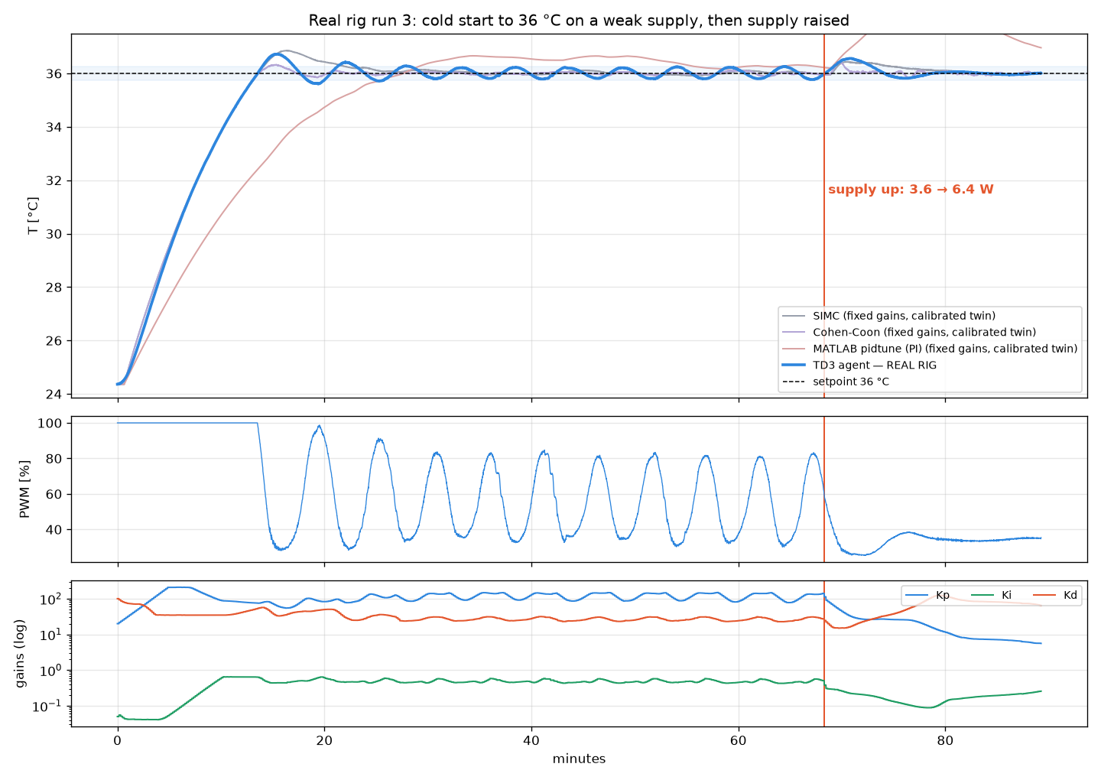
Run 3: 36 °C cold start, then supply raised
REAL RIG · RUN 3 · 11 NOV 2026
Phase | Agent on the real rig
Cold start 24.4 → 36 °C (3.6 W) | reached in 13.4 min; overshoot 0.72 °C
Hold, 25–68 min | within −0.29 / +0.28 °C (RMS 0.16 °C)
Dist.: heater 3.6 → 6.4 W (×1.8) | peak 0.56 °C; back in ±0.25 °C in 4.7 min, ±0.1 °C in 9.3 min
Last 5 min | RMS error 0.03 °C
533 gain updates. After the rise: Kp 115 → 6, Ki 0.47 → 0.26, Kd 27 → 64.
Calmest end of all three runs: ±0.05 °C band, heater steady at ~35 %.
On the weak supply a slow ±0.25 °C swing; SIMC and AMIGO swing as much on the twin.
Classical gains on a twin calibrated to this whole run (K₀ 6.18 °C/W, τ 856 s, θ 40 s, RMSE 0.26 °C), same cold start and same heater power profile.
Notes:
Run 3: a full cold start to 36 C on a weak supply, then the supply was raised. The agent cut Kp by 20x within minutes and settled to 0.03 C RMS.

Slide 14
Run 3: fastest back to ±0.1 °C of every controller
RUN 3 VS STANDARD METHODS
Controller | IAE | Reach SP (min) | Overshoot (°C) | Dist. peak (°C) | Back ±0.1 °C | Final RMS (°C) | Switching (%/s)
TD3 agent · real rig | 5,096 | 13.4 | 0.72 | 0.56 | 9.3 min | 0.031 | 0.4*
TD3 agent · twin | 4,926 | 13.3 | 0.61 | 0.50 | 7.5 min | 0.076 | 3.6
Cohen–Coon | 4,505 | 13.4 | 0.33 | 0.43 | 11.7 min | 0.035 | 41.6
Ziegler–Nichols | 4,550 | 13.6 | 0.32 | 0.44 | 19.9 min | 0.058 | 44.7
AMIGO | 4,857 | 13.4 | 0.85 | 0.43 | 9.2 min | 0.056 | 24.3
SIMC | 4,917 | 13.4 | 0.86 | 0.44 | 12.3 min | 0.036 | 18.3
IMC | 6,869 | 32.0 | 0.16 | 1.45 | never | 0.809 | 8.4
MATLAB pidtune | 10,325 | 26.8 | 0.66 | 2.33 | never | 1.324 | 0.1
Back inside ±0.1 °C in 7.5 min after the supply jump: faster than AMIGO (9.2), Cohen–Coon (11.7), SIMC (12.3), ZN (19.9); IMC and MATLAB never.
Same total error as SIMC (4,926 vs 4,917), 28–52 % below IMC and MATLAB, and 5–12× less heater switching than SIMC, AMIGO, ZN and Cohen–Coon.
Classical gains: fixed, tuned once at 4 V (previous slide's rules), run on a digital twin calibrated to this run with the same heater power changes. TD3 agent shown on the real rig and on the same twin (like-for-like). Twin RMSE 0.26 °C. *Real-rig switching is from the logged (averaged) PWM.
Notes:
Run 3 comparison: the agent matched SIMC on total error, recovered to within 0.1 C faster than any fixed tuning, and switched the heater far less.

Slide 15
Level with SIMC and AMIGO, far ahead of IMC and MATLAB
THREE RIG RUNS TOGETHER
0.97 · 1.15 · 1.00
agent ÷ SIMC error in runs 1, 2, 3, like-for-like on the calibrated twins
−51 to −87 %
real-rig error vs MATLAB pidtune; −26 to −79 % vs IMC
3.6 vs 40 %/s
heater switching: agent vs Ziegler–Nichols / Cohen–Coon, which win on IAE only by hammering the heater
IAE in °C·s. Run 1: whole run; run 2: from disturbance 1; run 3: whole run. Classical gains fixed (tuned at 4 V) on twins calibrated to each run with the same heater power.
Notes:
Average over the three runs, error relative to SIMC. The agent is level with SIMC and AMIGO and far better than IMC and MATLAB. ZN and Cohen-Coon get lower error on this slow loop, but switch the heater about ten times more.

Slide 16
SIMC-level accuracy with 5× less heater switching
ACCURACY VS ACTUATOR EFFORT
How to read it
Same error as SIMC and AMIGO (within 1.5 %), far below IMC, with 2.4–6.6× less heater switching than all three.
ZN and Cohen–Coon buy ~8 % lower error (runs 1 and 3) with ~11× more switching: more heater wear and supply ripple.
MATLAB pidtune is smooth but has 2.5× SIMC's error: too sluggish for disturbances.
No fixed tuning sits where the agent does: low effort and SIMC-level accuracy at every supply.
Notes:
X axis: how hard the controller works the heater. Y: error relative to SIMC. The agent matches SIMC and AMIGO at a fraction of the switching, and dominates IMC.

Slide 17
On unseen plants the agent has the lowest error of all
SIMULATION · 40 RANDOM PLANTS
Controller | Mean IAE | Median IAE | Not settled | Switching %/s
TD3 agent (from bad gains) | 5,673 | 3,942 | 1/40 | 14.3
TD3 agent (from ZN gains) | 5,723 | 3,890 | 0/40 | 14.0
Cohen–Coon (best classical) | 6,032 | 4,317 | 3/40 | 36.1
SIMC | 6,162 | 4,740 | 1/40 | 31.3
Ziegler–Nichols | 6,206 | 4,521 | 3/40 | 37.1
AMIGO | 6,518 | 4,874 | 2/40 | 34.6
IMC | 6,969 | 5,349 | 2/40 | 22.3
MATLAB pidtune | 7,085 | 5,586 | 0/40 | 4.3
−6 %
mean error vs the best classical rule (Cohen–Coon), with 2.5× less heater switching
87–99 %
of the best rule's accuracy in each of 7 fixed scenarios; beats MATLAB in all 7, SIMC in 6
1.42 °C
lowest peak deviation of all controllers on a 3 → 5 V supply rise (others 1.64–3.86 °C)
Same plant, scenario and sensor noise for every controller. Random K₀, τ, θ, β, ambient, supply and setpoint changes. Classical gains tuned once at 4 V.
Notes:
On 40 random unseen plants with supply and setpoint changes the agent has the lowest mean error and switches much less than the aggressive rules.

Slide 18
Fixed gains are right at one point. ThermoTune-RL stays right.
CONCLUSION
≈ SIMC
−51 to −87 %
7.5 min
8.7 h → 0
accuracy on the real rig in 3 runs (1.04× SIMC mean, like-for-like)
error vs MATLAB pidtune's fixed gains
back to ±0.1 °C after the run-3 supply jump: fastest of all controllers
step testing for new supply voltages once trained
Limitations and next steps
On this slow, lag-dominant loop ZN and Cohen–Coon reach lower IAE, at ~11× the heater switching.
Large power jumps after a long saturated stretch cause overshoot; next: freeze gain growth while PWM is at 100 %.
Classical rules compared on twins calibrated to each run. Next: run SIMC and Cohen–Coon on the rig, retrain with the rig's measured K₀ and τ.
github.com/dkchauhan2006/rl-pid-autotuner · Fujimoto et al., TD3 (ICML 2018) · Skogestad (2003) · Åström & Hägglund (2004, 2006) · Ziegler & Nichols (1942) · Cohen & Coon (1953) · Rivera et al. (1986) · Desborough & Miller (2002) · Ender (1993)
Notes:
Close: across three real runs the agent matches SIMC accuracy, is far ahead of IMC and MATLAB, recovers fastest in two of the disturbance tests, and uses much less actuator effort, with no new step tests.

