Slide 1
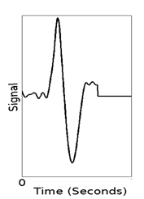
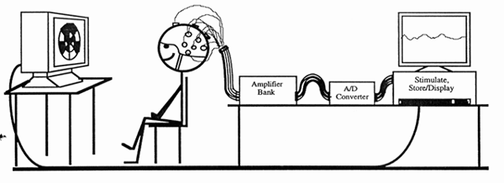
Visual Experiment
Patch #3
V(5, 3 ,1:250) =
Electrode #5
V(e,p,t)

Slide 2
Methods (Revisited)
f/MRI per patch
Sensor Config.
Typical Inverse
Generator

Slide 3
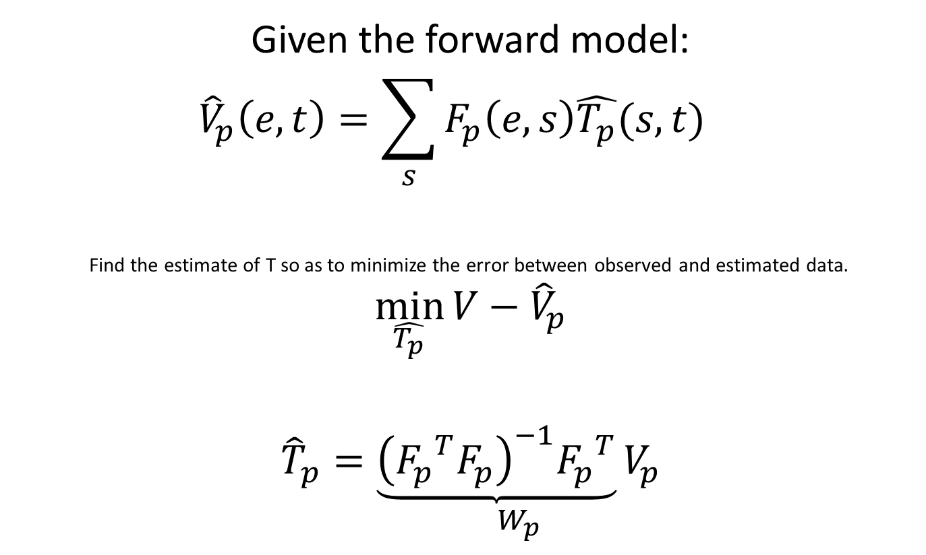
Inverse Operator for a Single Patch
Given the forward model:
$${\hat{V}}_{p}\left(e,t\right)=\sum_{s}{F_{p}\left(e,s\right)\hat{T_{p}}(s,t)}$$
Find the estimate of T so as to minimize the error between observed and estimated data$.$
$$\min_{\hat{T_{p}}}{V−{\hat{V}}_{p}}$$
$${\hat{T}}_{p}=\underset{W_{p}}{\underbrace{{\left({F_{p}}^{T}F_{p}\right)}^{−1}{F_{p}}^{T}}V_{p}}$$

Slide 4
Methods (Revisited)
Empirical Inverse
Generator
f/MRI per patch
Sensor Config.
96 patch Multifocal VEP

Slide 5
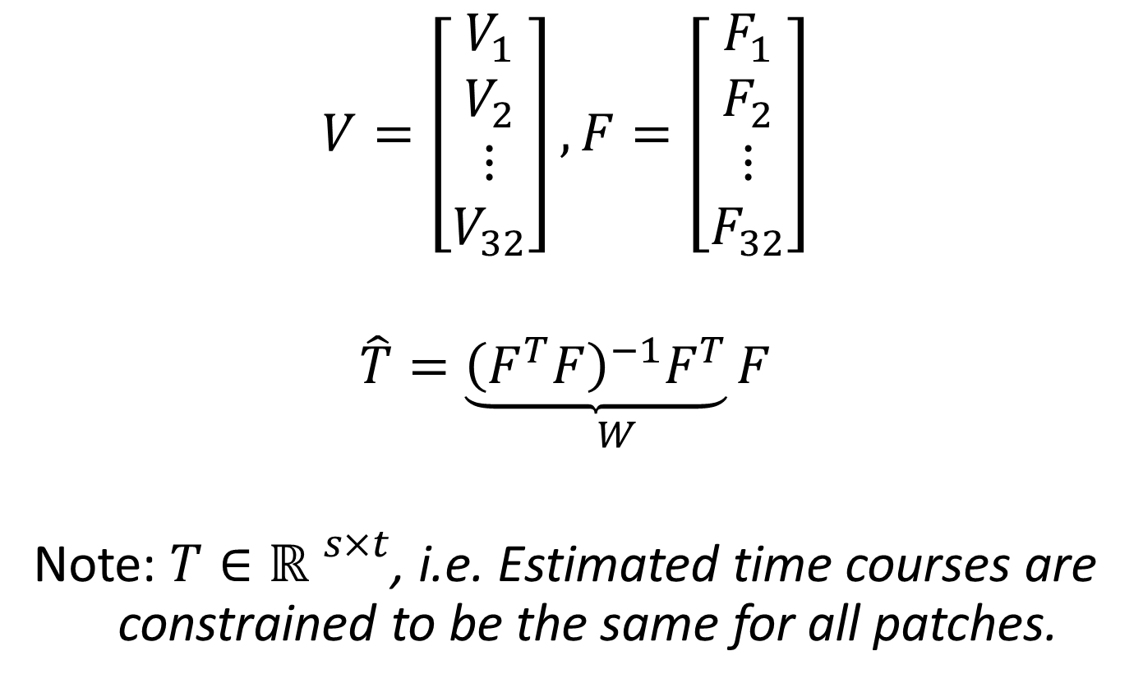
Inverse Operator for the Ensemble Set
$$V=\left[\begin{aligned}V_{1} \\ V_{2} \\ ⋮ \\ V_{32}\end{aligned}\right], F=\left[\begin{aligned}F_{1} \\ F_{2} \\ ⋮ \\ F_{32}\end{aligned}\right]$$
$$\hat{T}=\underset{W}{\underbrace{{\left(F^{T}F\right)}^{−1}F^{T}}F}$$
Note: $T∈{\text{ℝ} }^{s×t}$, i.e. Estimated time courses are constrained to be the same for all patches.

Slide 6
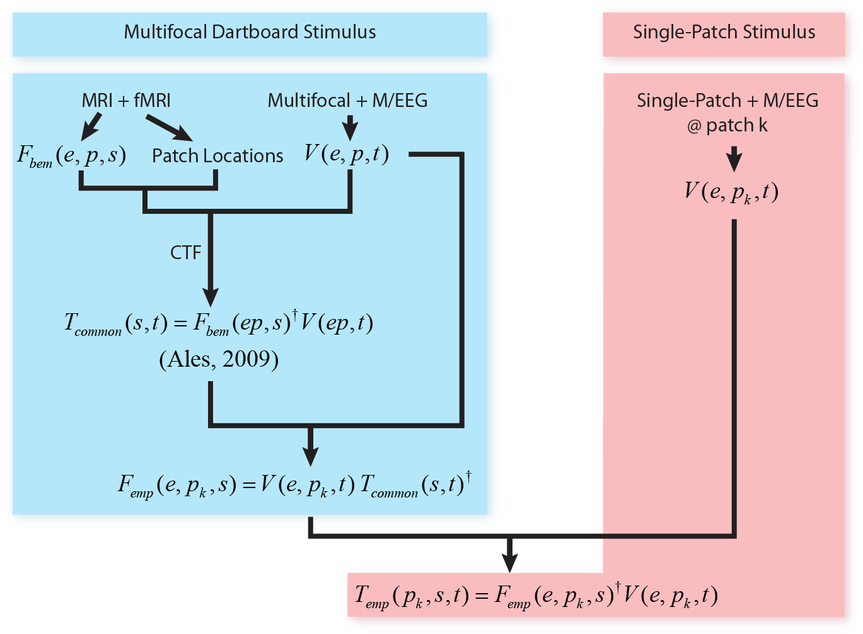
Overview of Methods

Slide 7
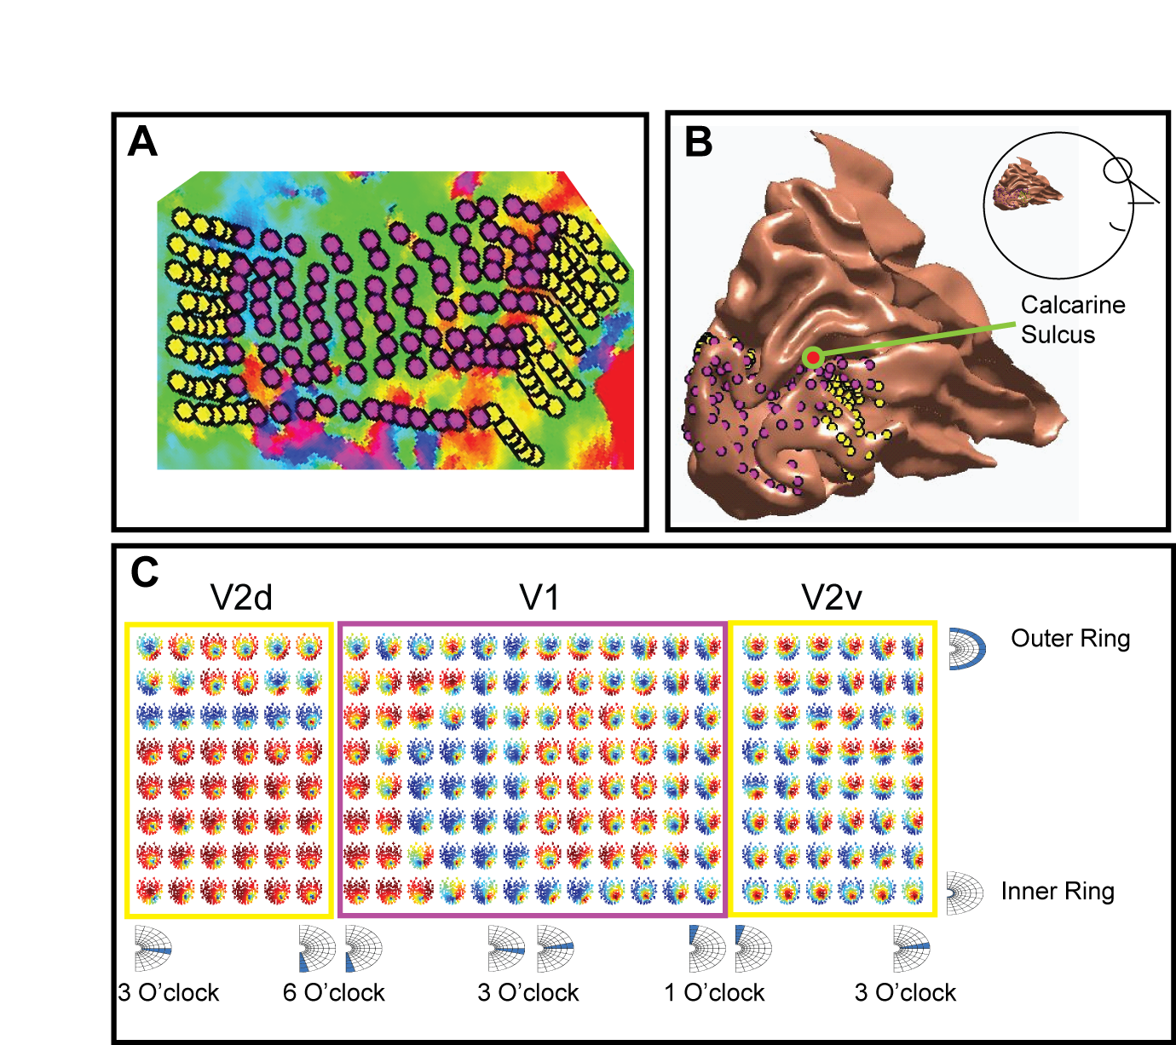
Background – Visual Experiments

Slide 8
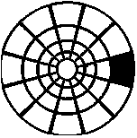
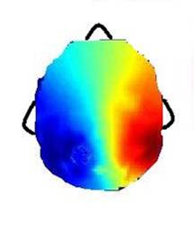
Common Topography
Common Topography Assumption
We make the assumption that a given patch always gives identical sensor weighting, regardless of the content.
E.g. F(s, t, contrast_task) = F(s, t, color_task)

Slide 9
Equations & Notations

