Slide 1
Digital Portfolio
STUDENT NAME: DEEPIKA K
REGISTER NO AND NMID:astvu24924924u18004
DEPARTMENT: BSc COMPUTER SCIENCE
COLLEGE: SSS COLLEGE FOR WOMEN,ARNI
THIRUVALLUVAR UNIVERSITY

Slide 2
PROJECT TITLE
    The student Digital Portfolio is a personal web-based platform created to showcase my skills, achievements, and projects . It is developed using basic web technologies: HTML, CSS, and JavaScript. The portfolio reflects my identity as a Computer Science student.

Slide 3


AGENDA
Project statement
Project overview
End Users
Tools and Technologies
Portfolio design and Layout
Features and Functionality
Results and Screenshots
Conclusion
Github Link
3/21/2024 Annual Review

Slide 4

PROBLEM STATEMENT
In today's digital age, individuals—especially students and athletes—often struggle to present their skills, achievements, and career highlights in a structured, accessible, and professional format. Traditional resumes or paper portfolios are limited, static, and often fail to showcase one's full potential, especially when it comes to multi-disciplinary profiles.
There is a need for a digital platform that allows individuals to create a personal brand, highlight both academic and
extracurricular achievements, and provide contact options for opportunities in employment, sports, or collaboration.

Slide 5

PROJECT OVERVIEW
summary:
The Online Quiz Application is a web-based platform built with HTML, CSS, and JavaScript. It allows users to take quizzes and receive instant feedback. The project demonstrates basic front-end skills like navigation, form handling, and interactive design.
What your portfolio contain(Home,About me,project,skills,contect).
Main idea:
showcase personal achievement,skills and project.

Slide 6
WHO ARE THE END USERS?
Recruiters and Employers:
Why they use it: To assess your technical skills, personal qualities, and achievements before
offering a job or internship.
What they look for: Skills section, education, personal introduction, and overall presentation
General Public / Online Visitors:
Anyone curious to know more about my profile.
Can reach out through the contact form for queries or opportunities.
Students – Attempt quizzes, get scores
Admins – Manage quiz content
Visitors (optional) – Preview or demo access

Slide 7

TOOLS AND TECHNIQUES
HTML (Hyper Text Markup Language):
Used to structure the content of the webpage.
CSS (Cascading Style Sheets):
Used to style the webpage (colors, layout, fonts, spacing, responsiveness).
JavaScript (Basic):
.Used for:
  .Navigation between sections
  .Handling form submission
  .Showing success messages

Slide 8
POTFOLIO DESIGN AND LAYOUT
Header Section:
.Displays your name, profile photo, and professional tagline.
.Uses a center-aligned layout with a colored background for visual impact.
. Profile picture is styled to be circular using:
Navigation Bar (Navbar):
.Horizontal menu with links: About Me, Projects, Contact.
.Implemented using Flexbox (display: flex; justify-content: center;) for alignment.
.Color-coded: dark background (#333) and hover effect (#990073).
Main Content Area (Container):
.Uses <section> elements for different pages (Home ,About ,skills, Projects, Contact).
.Only one section is visible at a time, toggled by JavaScript function show Section(id) the using visual studio code.
8

Slide 9
About Me Section
Split into two subsections:
.Personal introduction
.Skills listing (structured with <p> tags)
Projects Section
.Each project is placed inside a .project div:
.Background: white Border & shadow: creates a card-like appearance
.Rounded corners using:
Contact Section
Clean layout with:
.Input fields and text area stacked using flex-direction
.column A submit button styled with hover effects
Footer:
.Simple, center-aligned footer with consistent brand color.
Response layout is desktop view

Slide 10
FEATURES AND FUNCTIONALITY
Features:
Responsive Design:
The portfolio is optimized for various devices and screen sizes.
Project Showcase:
I have a section to display your projects with descriptions.
Skills Section:
I listed your technical skills and proficiencies.
About Me:
A brief bio and introduction to who you are and what you do.
Contact Form:
A way for visitors to get in touch with you.

Slide 11
Functionality:
Navigation Menu:
A functional navigation menu to switch between sections.
Section Display:
Sections are displayed and hidden dynamically using JavaScript.
Form Submission:
The contact form submits successfully and displays a confirmation message.
Smooth User Experience:
The portfolio provides a smooth and engaging user experience.
Additional Features:
Image Display:
I included images in your portfolio.
Footer:
A footer with copyright information.

Slide 12

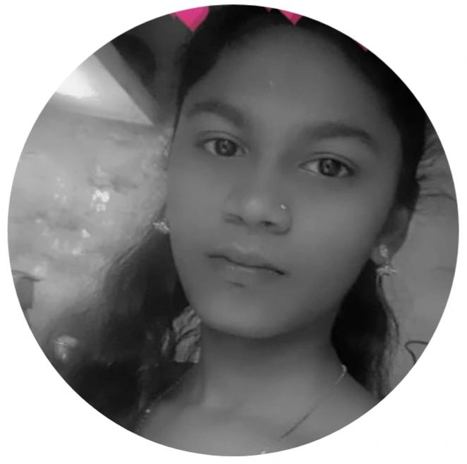
RESULTS AND SCREENSHOTS
Screenshots of each section
Hence vs After HTML- > with CSS & JS
Hello and welcome! I’m Deepika K — a passionate web developer, creative designer, and a dedicated state-level handball player. This portfolio is a reflection of my journey in both technology and sports. Here, I find information about my background, technical skills, academic projects, and my achievements in handball. Whether you’re here to explore my development work, discuss collaboration, or learn more about my experience as a sportsperson, I’m glad you stopped by!
12

Slide 13
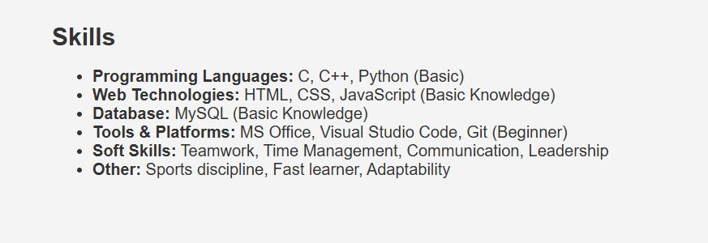
About Me Hello! I’m K. Deepika, a Bachelor of Science in Computer Science student with a strong passion for technology, innovation, and continuous learning. Throughout my academic journey, I’ve developed a solid foundation in programming, web development, databases, and software design. I enjoy solving real-world problems through logical thinking and creative solutions. Alongside my studies, I actively build projects to apply my knowledge in practical ways — from web-based applications to simple games. I’m eager to learn new technologies, collaborate with others, and contribute to impactful projects in the tech space. As a tech enthusiast and a team player, I strive to improve my technical and interpersonal skills every day, preparing myself for a dynamic career in the software and IT industry.

Slide 14
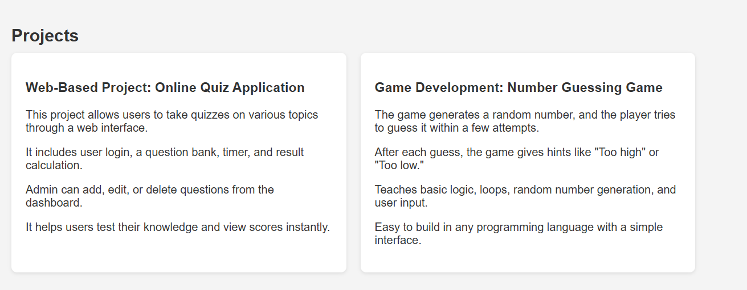

Slide 15
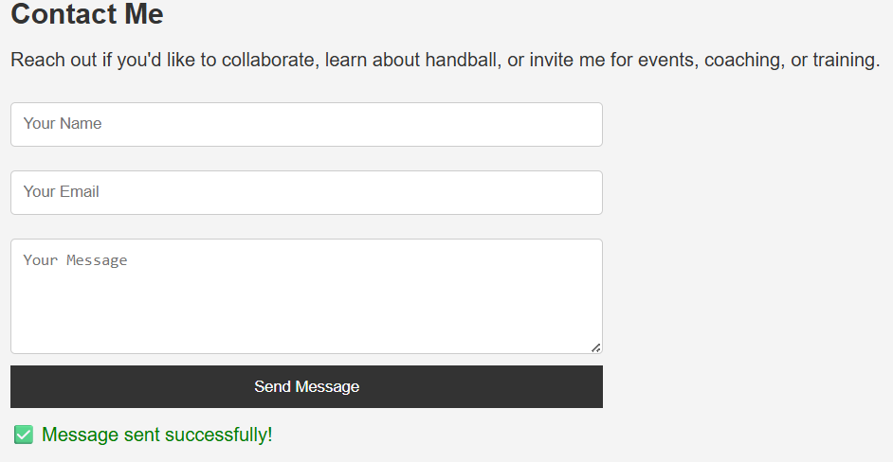

Slide 16
CONCLUSION
My digital portfolio effectively showcases your skills and experience in web development, with a clean design and functional features. By highlighting your projects, skills, and contact information, you've created a valuable resource for potential employers or collaborators. With some minor enhancements, your portfolio can continue to grow and showcase your expertise in the field.
This portfolio showcases my journey, achievements, and dedication in both sports
and technology, reflecting my passion for growth and excellence.
16

