Slide 1
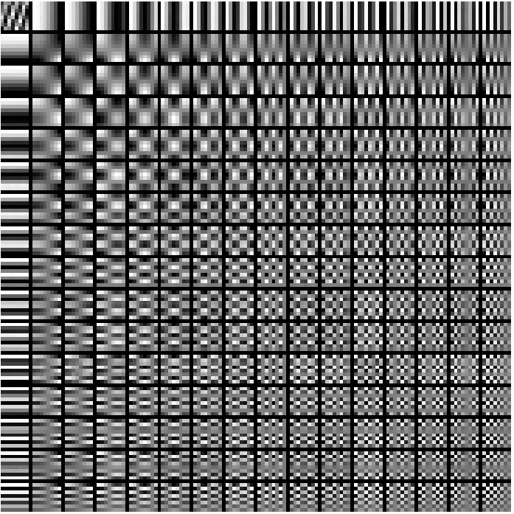
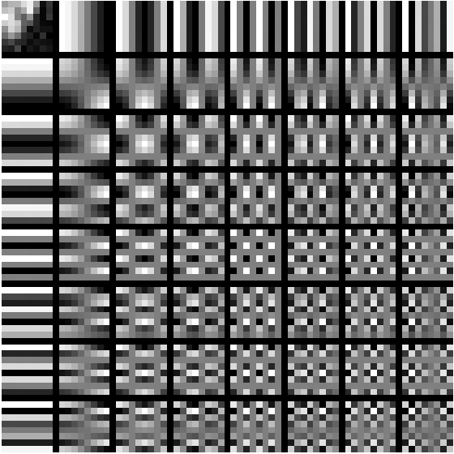
Advanced Machine Learning

Slide 2
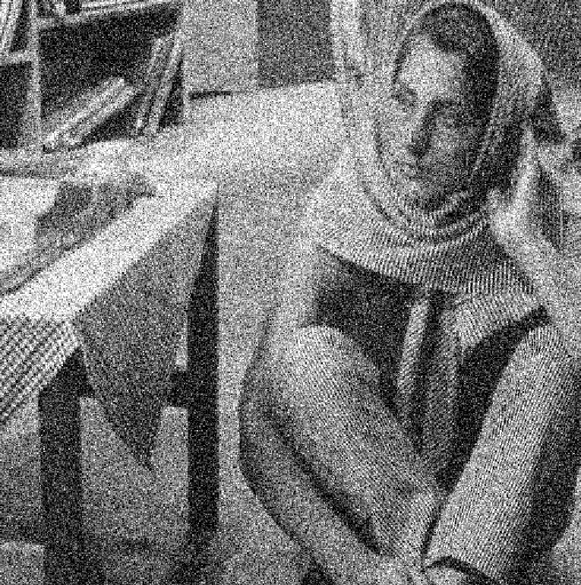
Noisy Image

Slide 3
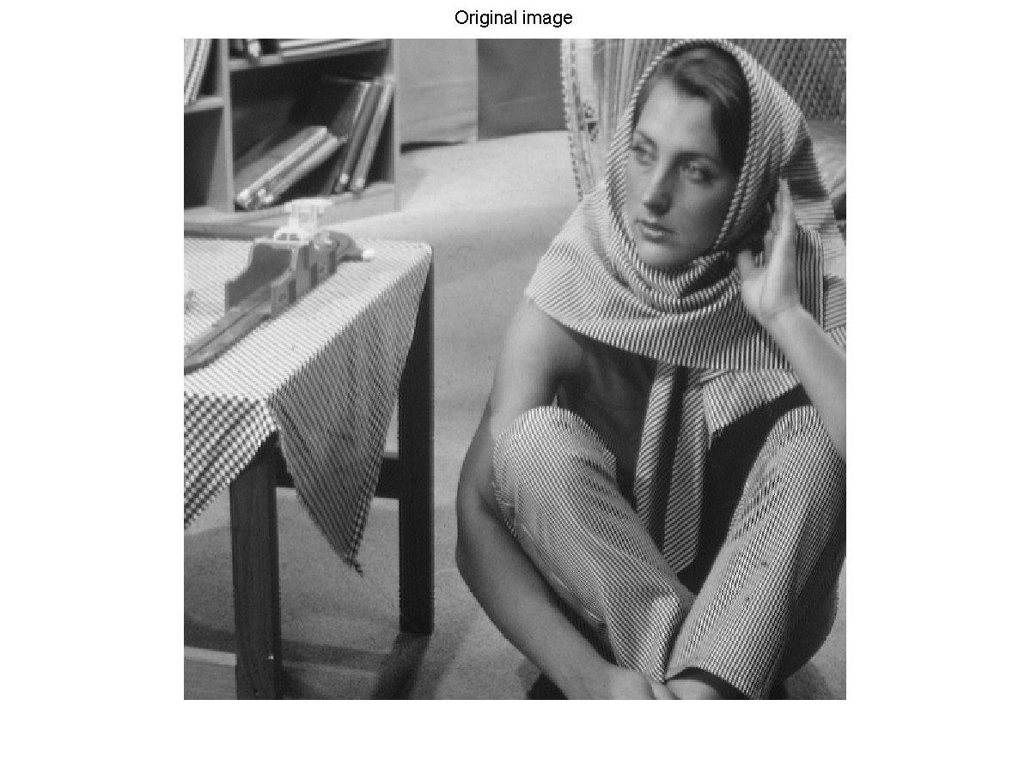
De-noised

Slide 4
How do you go from noisy to de-noised?

Slide 5

Dictionary and Sparse Codes
$$x_{1}$$
$$0$$
$$0$$
0
$$x_{5}$$
0
$$x_{7}$$
0
=
+
+

Slide 6
Sparse Coding Techniques for Dictionary Learning in Context of Image De-noising
Sarah Panda (sp3206)
Dhaivat Shah (ds3267)
Gaurav Ahuja (ga2371)

Slide 7
Dictionary and Sparse Codes
A dictionary, D is an N X k matrix that contains k prototype signals called ATOMS as columns, such that any given signal y can be represented as a linear combination of a small number of these atoms.
For any signal y and dictionary D, there must exist a vector x in R^{K}, such that,
y = D*x
=
Signal, y N x 1
Dictionary, D N x K
Sparse Vector, x Kx1
Notes:
Each of the atoms in the dictionary is a vector of length N which in itself is a potential signal.
x contains the representation coefficients of signal y.

Slide 8
OK, where do we get the dictionary from?
Use pre-calculated dictionaries built from a huge dataset of natural images over time.
OR
Learn a dictionary from the given set of training signals : Has proven to dramatically improve signal reconstruction.
So, here comes the problem of Dictionary Learning!!

Slide 9

Dictionary Learning
Classical dictionary learning techniques try to optimize the following empirical cost function, for a training set of signals Y = [y1, y2,…., yn]
$${L\left(D\right)}^{}=\frac{1}{n}\sum_{i=1}^{n}{l(y,D)}$$
$l(y,D)$ is a loss function that assumes a low value if the dictionary D is good at representing signal y

Slide 10
K-SVD
Initialize D
Sounds Good?
But x and D are unkown…
Sparse Coding
Dictionary Update
Dictionary update Step uses standard K-SVD
We focus our attention on Sparse Coding

Slide 11

Sparsity
min${\left\|x\right\|}_{0}$
Subject to y = D*x
This is the exact representation of the problem.
But as it turns out, solving the above equation is NP-Hard.
Notes:
The idea is to represent the signal in the terms of the dictionary and x, where x is a sparse vector.
Here we use the $l_{0}$ norm of x which is th number of nn-zero elements in the vector.

Slide 12

Relaxation
min${\left\|x\right\|}_{0}$
Subject to ${\left\|y−Dx\right\|}^{2}$ < ε
But still solving this is hard.
So what do we do?
Get Greedy and more Relaxation

Slide 13
Greedy Approach (Matching Pursuit)
min${\left\|x\right\|}_{0}$
Subject to ${\left\|y−Dx\right\|}^{2}$ < ε
Sequentially selects best Dictionary atoms
Example Solvers: MP, OMP

Slide 14
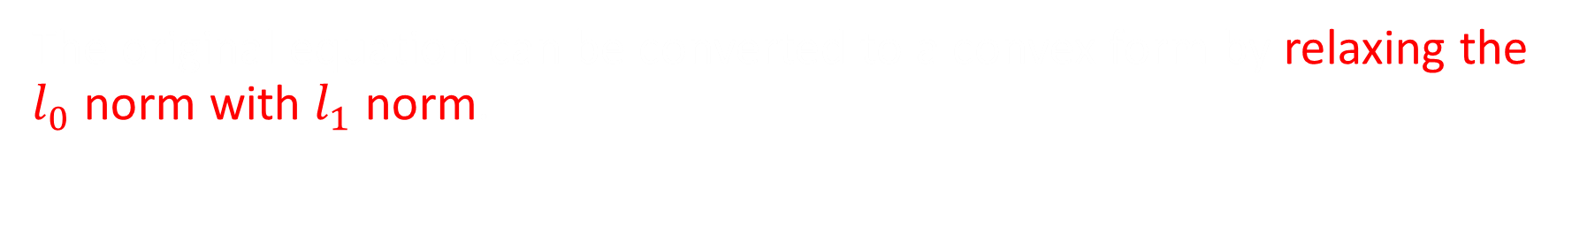
Basis Pursuit
$$\min_{x}{{\left\|y−Dx\right\|}^{2}\text{ + }\text{λ}{\left\|x\right\|}_{1}}{}$$
The original equation can be converted to a convex form by relaxing the $l_{0}$ norm with $l_{1}$ norm.

Slide 15
Sparse Coding Techniques Used
Matching Pursuit (MP)
Orthogonal Matching Pursuit (OMP)
FISTA
Augmented Langrangian Method (ALM)
Feature Sign
Truncated Newton Interior Point Method (L1LS)

Slide 16
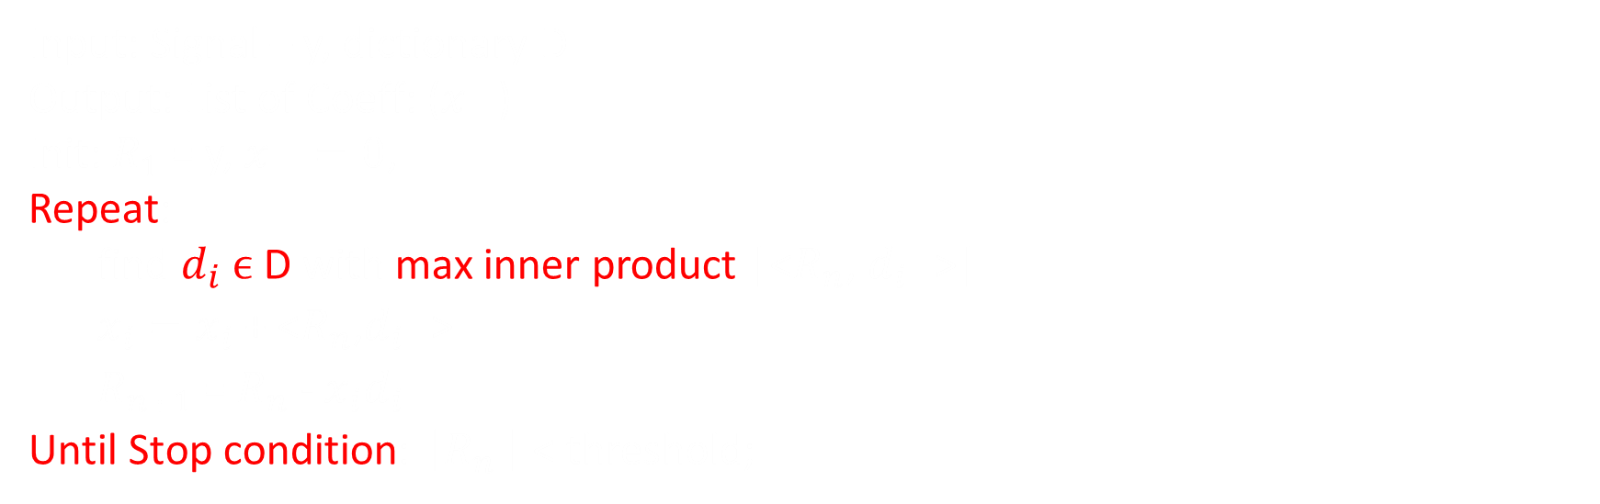

Matching Pursuit
$$y^{}=\sum_{i}{x_{i}}d_{i_{}}$$
Input: Signal – y, dictionary D
Output: List of Coeff: ($x_{}$)
Init: $R_{1}$ = y, $x_{}=0$,
Repeat:
find $d_{i}$ $ϵ$ D with max inner product |<$R_{n}$, $d_{i_{}}$>|
$x_{i}=x_{i}$ + <$R_{n}$,$d_{i_{}}$>
$R_{n+1}$ = $R_{n}$ - $x_{i}d_{i_{}}$
Until Stop condition:$\left\|R_{n}\right\|$ < threshold;

Slide 17

Orthogonal Matching Pursuit
Extension to MP.
Orthogonal Projection of signal onto already selected set of atoms
Input: $y$, $D_{0}$
Init: $Γ←ϕ$, r = y
while$\left\|r\right\| \text{>} \text{threshold}$
$i←{argmax}_{\left\{p=1,…,k\right\}}\left| d_{p}^{T}r\right|$
$$Γ←Γ∪\{i\}$$
Solve for z: ${(d}_{i}^{′}∗d_{i}) z_{i}={(D}^{′}∗r)[i] ∀i∈Γ$
$$x_{i}=x_{i}+z_{i} ∀ i∈Γ$$
$$r=y −D{\left(:,Γ\right)}^{′}∗x(Γ)$$

Slide 18


Feature Sign
$$\min_{x,D}{\sum_{i=1}^{n}{\left({\left\|y^{i} − \sum_{j=1}^{k}{x_{j}^{i} D_{j}}\right\|}^{2}+\text{λ}\sum_{j=1}^{k}{\left|x_{j}^{i}\right|}\right)}}$$
Input: Signal- Y = [$y_{1,}y_{2}$,…$,y_{n}$], dictionary D
Output: List of Coeff: ($x_{j}$)
Init: x := 0, $θ$=0, active set ={};
Repeat:
Activate a co-efficient $x_{i}$ from non-zero co-efficient of $x_{}$, if it locally improved the objective($\frac{∂{\left\|y−D∗x\right\|}^{2}}{∂x_{i}}$)
Repeat:
Let D be the submatrix of D that include columns corresponding to active set
Given a and $θ$,
$x_{new}= {(D^{T}D)}^{−1} (D^{T}y −\text{λ}\frac{θ}{2})$ ….(unconstrained optimization problem, solved analytically )
Perform a discrete line search from $x$ to${ x}_{new}$and check for points where co-effient changes sign.
Update a with the point with the least objective value.
Until $\frac{∂{\left\|y−D∗x\right\|}^{2}}{∂x_{i}}+\text{λ}sign(x_{i})$=0, $∀x_{i}=0$ , not satisfied
Until $\left|\frac{∂{\left\|y−D∗x\right\|}^{2}}{∂x_{i}}\right| ≤\text{λ},∀x_{i}≠0$ not satisfied

Slide 19
Primal ALM

Slide 20
Dual ALM

Slide 21
Experimental Setting
K-SVD for Dictionary Learning
Parameters experimented with
Image Noise Level
Dictionary Size
Sparse Coding Techniques
Evaluation metric
Execution Time
SNR of de-noised image

Slide 22
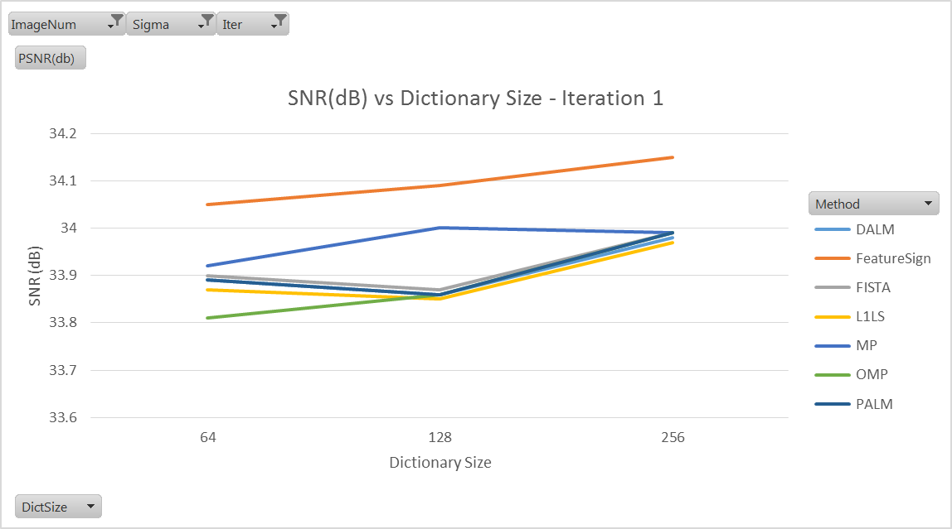
Observations – Variations With Dictionary Size

Slide 23
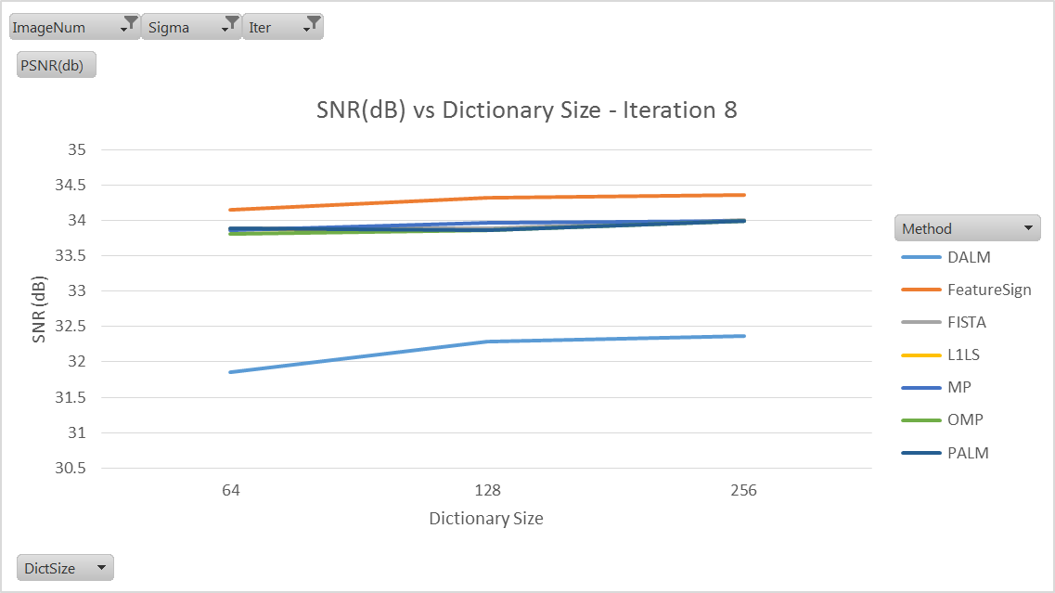
Observations – Variations With Dictionary Size

Slide 24
Observations – Execution Time

Slide 25
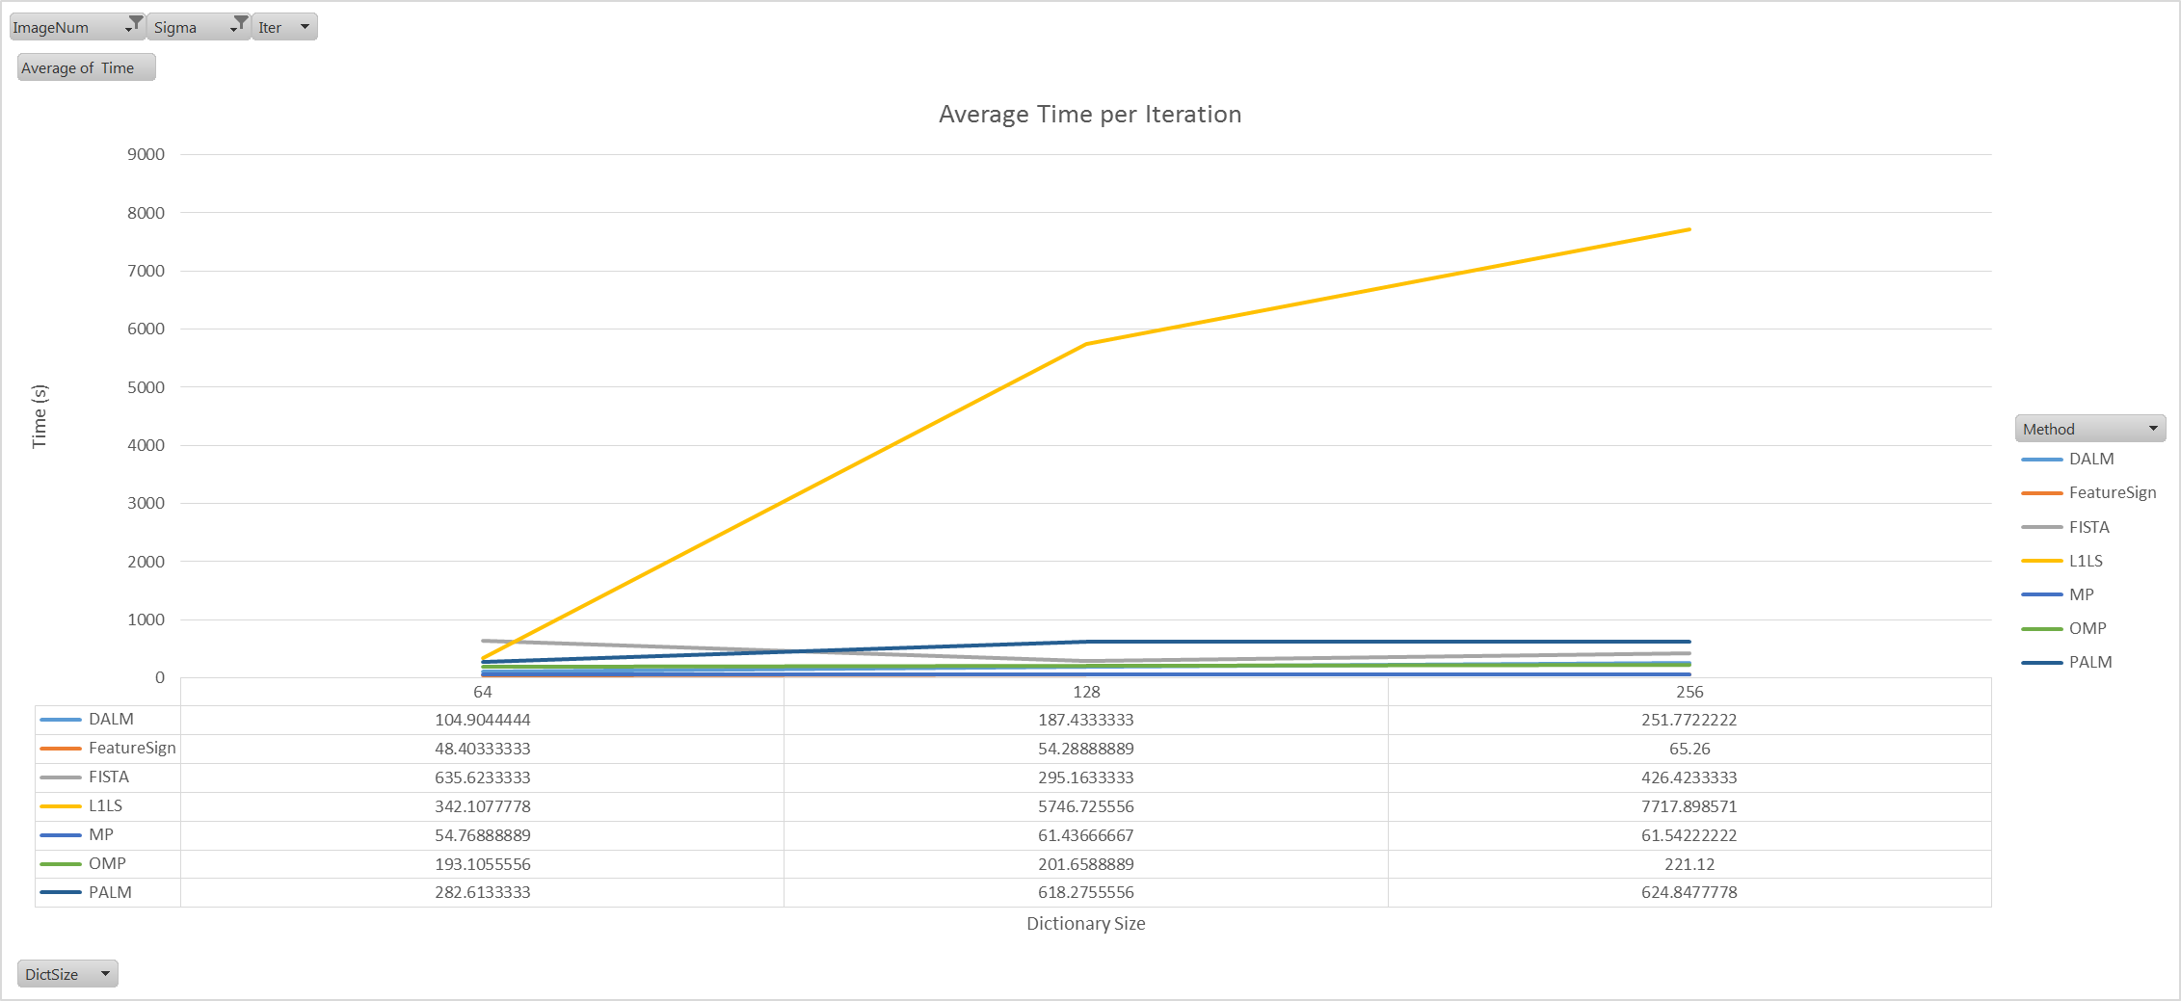

Slide 26
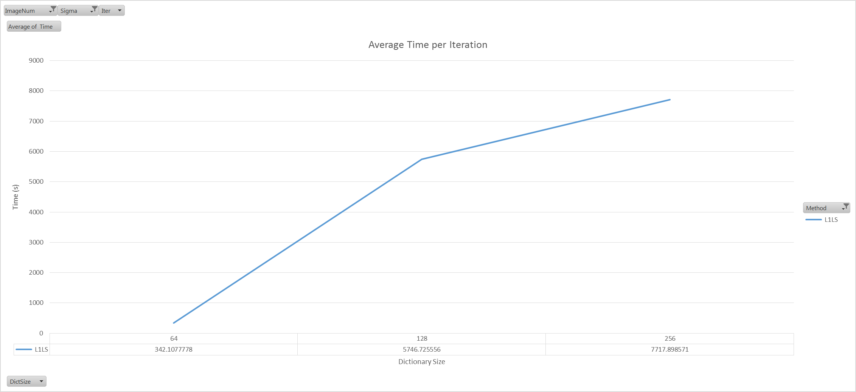

Slide 27
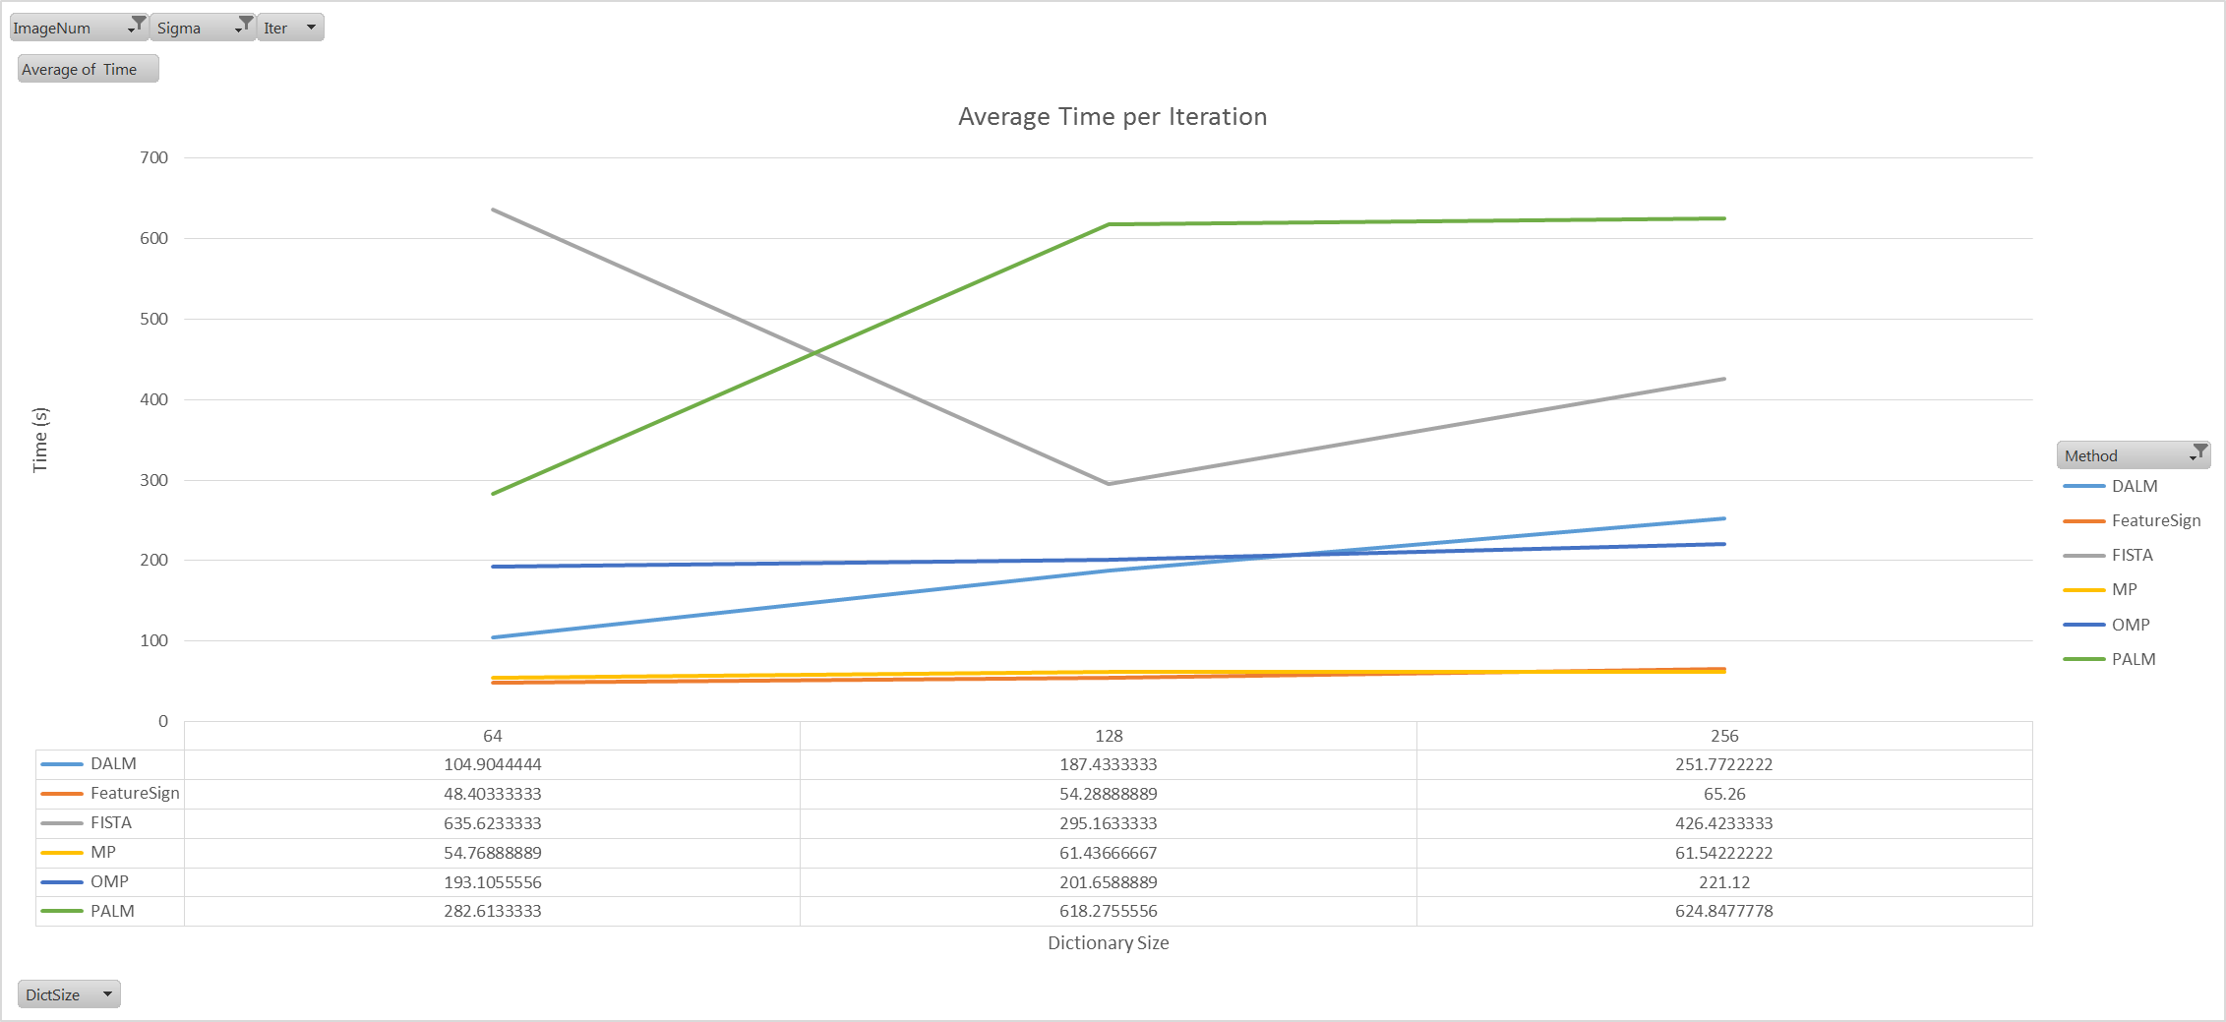

Slide 28
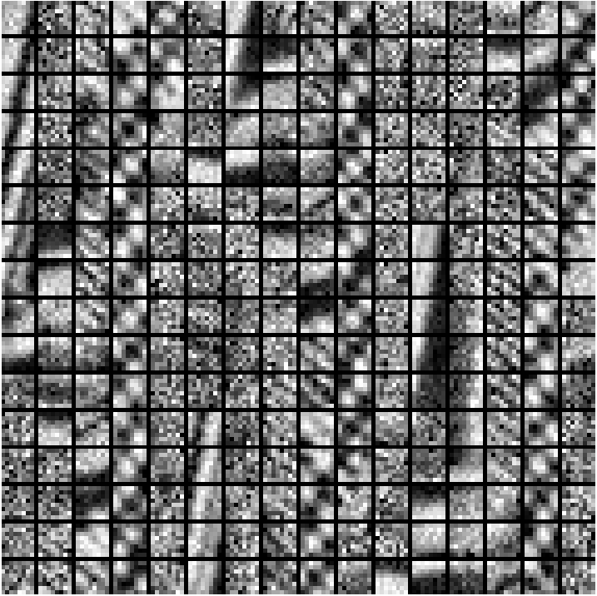
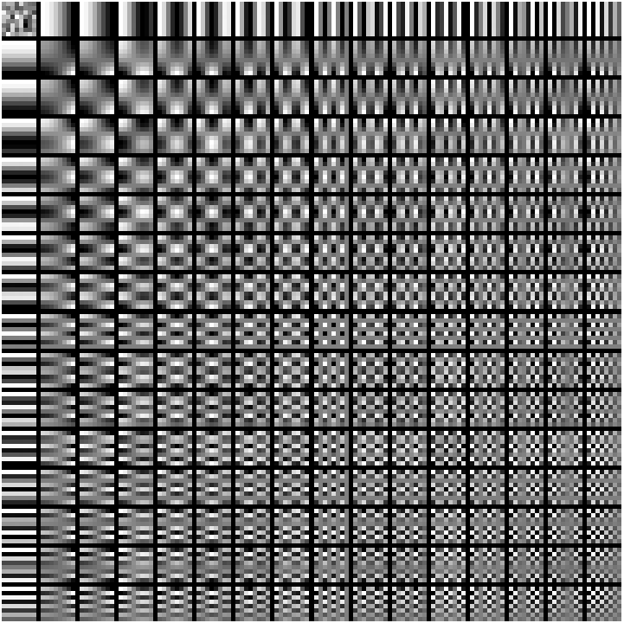
Trained Dictionaries
DALM – Sigma -10
De-noised Image PSNR = 32.36 (dB)
PALM– Sigma -10
De-noised Image PSNR = 33.99 (dB)

Slide 29
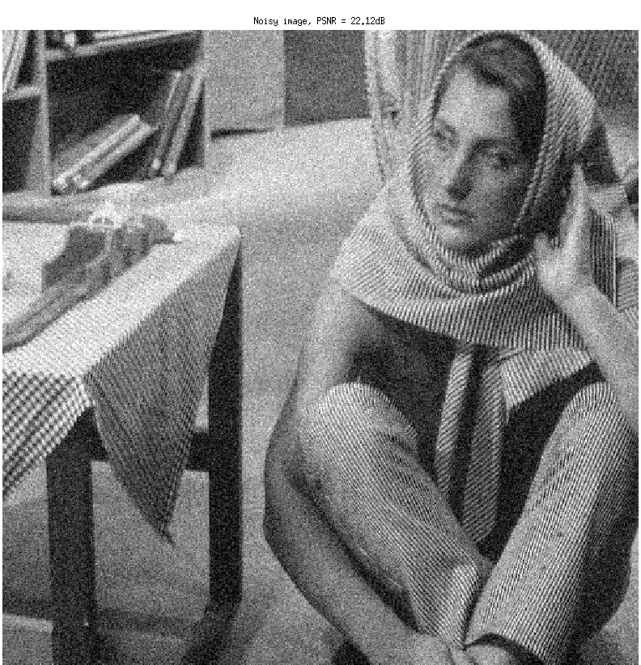
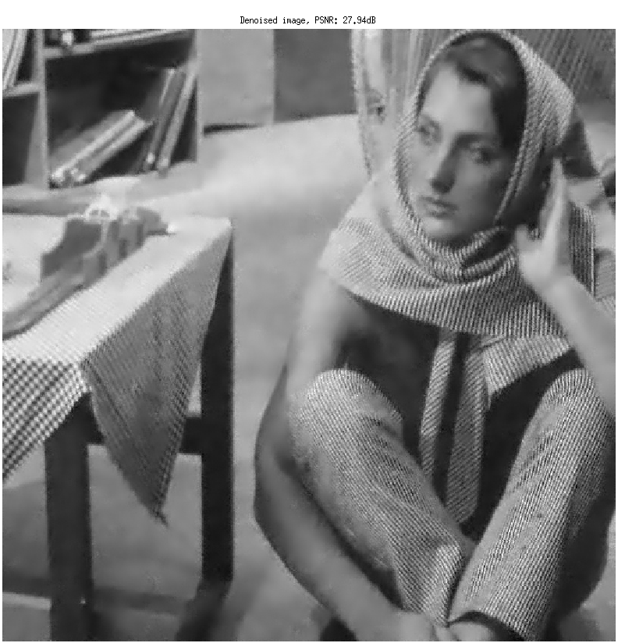
De-noised Images –DALM, Sigma=20
PSNR = 22.12 dB
PSNR = 27.94 dB

Slide 30

De-noised Images –Feature Sign, Sigma=20
PSNR = 22.12 dB
PSNR = 30.50 dB

Slide 31
Conclusion
Performs better as dictionary size increases
Feature-sign gives best results and converges quicker
L1LS takes the maximum time per iteration
DALM learns a poor dictionary

Slide 32
For more results
https://github.com/dkdfirefly/aml

Slide 33
References
Yang, Allen Y., et al. "Fast l1-minimization algorithms for robust face recognition." arXiv preprint arXiv:1007.3753 (2010).
Lee, Honglak, et al. "Efficient sparse coding algorithms." Advances in neural information processing systems 19 (2007): 801.
Mallat, Stéphane G., and Zhifeng Zhang. "Matching pursuits with time-frequency dictionaries." Signal Processing, IEEE Transactions on 41.12 (1993): 3397-3415.
Pati, Yagyensh Chandra, Ramin Rezaiifar, and P. S. Krishnaprasad. "Orthogonal matching pursuit: Recursive function approximation with applications to wavelet decomposition." Signals, Systems and Computers, 1993. 1993 Conference Record of The Twenty-Seventh Asilomar Conference on. IEEE, 1993.
Aharon, Michal, Michael Elad, and Alfred Bruckstein. "-svd: An algorithm for designing overcomplete dictionaries for sparse representation." Signal Processing, IEEE Transactions on 54.11 (2006): 4311-4322.

Slide 34
Thank You

