Slide 1

BANKING WEB PAGE
NAME:DINESH KUMAR.D

Slide 2

FRONTEND DEVELOPMENT
It is a mix of programming and layout the process that power the visuals and interaction of the web . It comprises of 3 basic tools
HTML(HYPER TEXT MARK UP LANGUAGE):Describe the content of a file .It describe the structure of the page . It is a backbone of any website development process.
CSS(CASCADING STYLE SHEET)Describe how the page look ,It is used to style the page ,It is responsible for appearance .It is coexist in html in three forms :inline, embedded and external.
JAVASCRIPT : It basically deals with deals with how the page behave or how it function.
JavaScript is the Programming Language for the Web.
JavaScript can update and change both HTML and CSS.
JavaScript can calculate, manipulate and validate data.

Slide 3

SIMPLE HTML CODE
<!DOCTYPE html>
<html lang=“en”>
<head>
<meta charset=“UTF-8”>
<title>my first project</title>
</head>
<body>
</body>
</html>

Slide 4

SIMPLE CSS CODE
<style>
Body{
margin:10px;
padding:20px;
text-align :center ;
height:50%;
}
</style>

Slide 5

SIMPLE JAVASCRIPT
<script language=“javascript”>
or
<script type=“text/javascript”>
<!—
document.write(“hello world”);
//-- >
</script>

Slide 6
BANKING HOME PAGE
HEADER:
Image src=“ “ is float left
<h1> is float left
FLOAT PROPERTY is used to align Img and header in straight line.

Slide 7
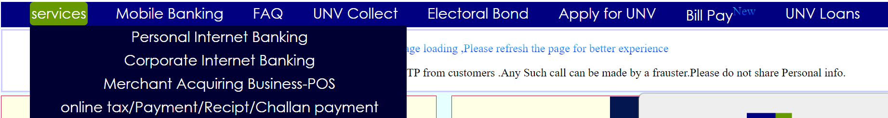
BODY CONTENT
→NAV bar with dropdown list
→BLINKING TEXT
ANIMATION PROPERTY used to change the text color automatically with every second.

Slide 8
BODY CONTENT
→2 COLUMN LAYOUT:
* personal and corporate banking.
*<a href=“ “ >link</a> are added .
*LOGIN button is used in both personal and corporate banking column.
*select and option tag used for drop down menu.
→SCROLLING TEXT:
*<marquee> tag used for scrolling text.

Slide 9
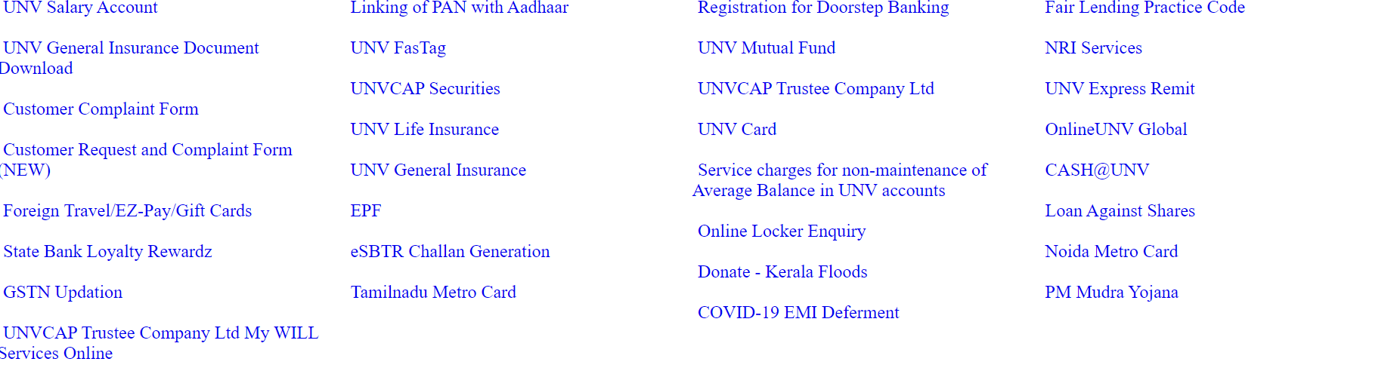
BODY CONTENT
→DIVISION OF LINK:
4 column division of link ,equal separated by width .

Slide 10
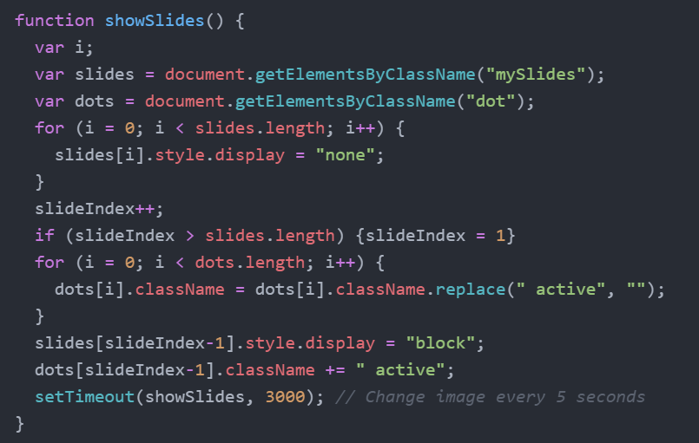
BODY CONTENT
→AUTOMATIC IMAGE SLIDER:
FOOTER
The footer in HTML defines a footer for a document or a section of a web page. Footers usually contain the author of a document, contact information, and important links.

Slide 11

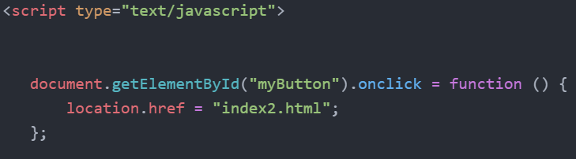
PERSONAL BANKING PAGE
BODY CONTENT
2 column layout
left side image float and right side login button and content with link.
JAVASCRIPT

Slide 12
END

