Slide 1
Project
Presentation
Dineshkumar N
Company Name
Month Year

Slide 2
Digital Portfolio
STUDENT NAME : DINESHKUMAR N
REGISTER NO AND NMID : 2422K1868
NMID : 1E952132CE3A26A97AC46C1BF31CFC21
DEPARTMENT : COMPUTER SCIENCE
COLLEGE : CHIKKANNA GOVT ARTS AND SCIENCE
COLLEGE . BHARATHIAR UNIVERSITY,
TIRUPUR
Company Name
Month Year

Slide 3
PROJECT TITLE
portfolio Website
My personal website
Company Name
Month Year

Slide 4
AGENDA
1.Problem Statement
2.Project Overview
3.End Users
4 .Tools and technologies
5.Portfolio design and layout
6. Futures' and functionality
7.Results and screen shots
8. Conclusion
9.Github link
Month Year

Slide 5
PROBLEM STATEMENT
Many developers struggle to showcase their skills, projects, and experience in a professional and interactive way. A well-structured portfolio website is essential to demonstrate technical expertise, creativity, and communication ability to recruiters, clients, and collaborators.

Slide 6
Project Overview
This project is a personal portfolio website built using HTML and CSS. It allows me to present:
My bio & introduction
Projects I have worked on
Contact details for opportunities
The website design is responsive, modern, and easy to navigate
Company Name
Month Year

Slide 7
End Users
Recruiters/HR professionals – to evaluate technical skills
Clients – to review past work before collaboration
Peers/colleagues – to connect and share knowledge
Myself – as a digital resume to track projects
Company Name
Month Year

Slide 8
Tools and technologies
Frontend: HTML5, CSS3
Fonts: Google Fonts (Archivo Black, Merriweather)
Styling Features: Flexbox, Box-shadow, Hover effects
Hosting (future): GitHub Pages / Netlify
Company Name
Month Year

Slide 9
Portfolio design and layout
Header: Title + welcome text
Navigation Bar: Sticky links (About, Projects, Contact)
About Section: Profile image + introduction
Projects Section: List of sample projects
Contact Section: Email & phone information
Footer: Copyright notice
Company Name
Month Year

Slide 10
Futures' and functionality
1. Responsive layout (works on different screen sizes)
2.Profile image with shadow styling
3.Hover effects on navigation links
4.Clean and simple card-based sections
5.Centralized Google Fonts integration
Company Name
Month Year

Slide 11
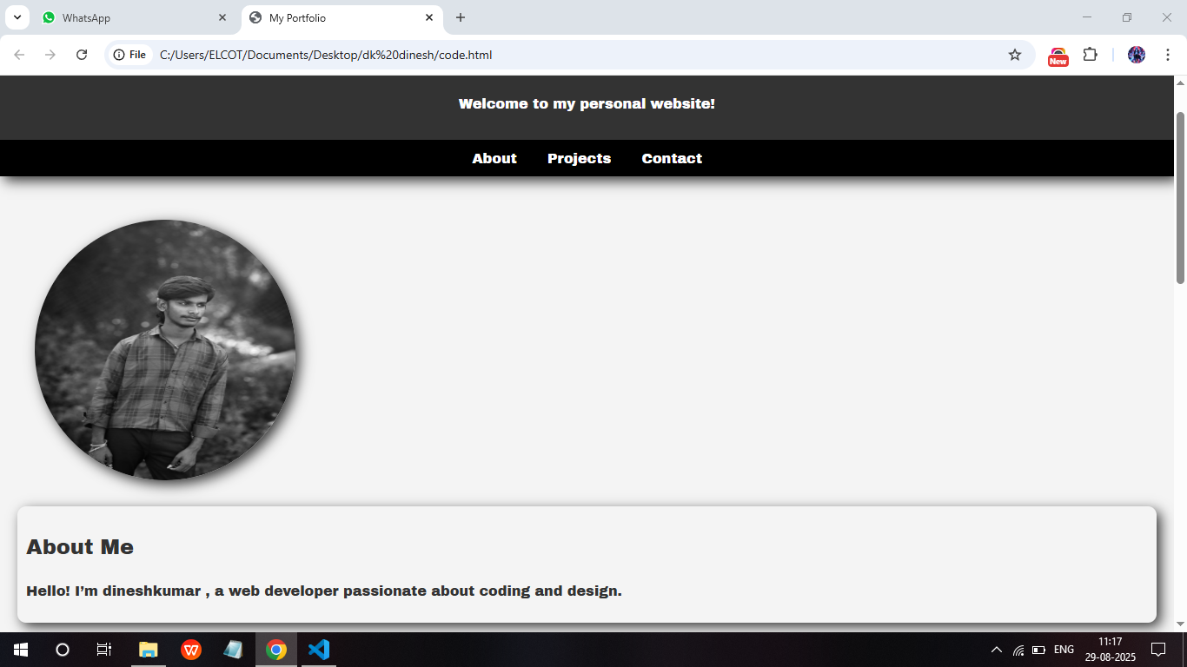
Results and screen shots
Company Name
Month Year

Slide 12
Conclusion
This portfolio website serves as my digital identity and demonstrates my ability to build clean, structured web pages. It can be enhanced with JavaScript for interactivity and deployed for public access. Continuous updates will include more projects and styling improvements.
Company Name
Month Year

Slide 13
Github link
https://github.com/dkdon11345-png/Dineshkumar.N-TNSDC-FWD-DP.git
Company Name
Month Year

Slide 14
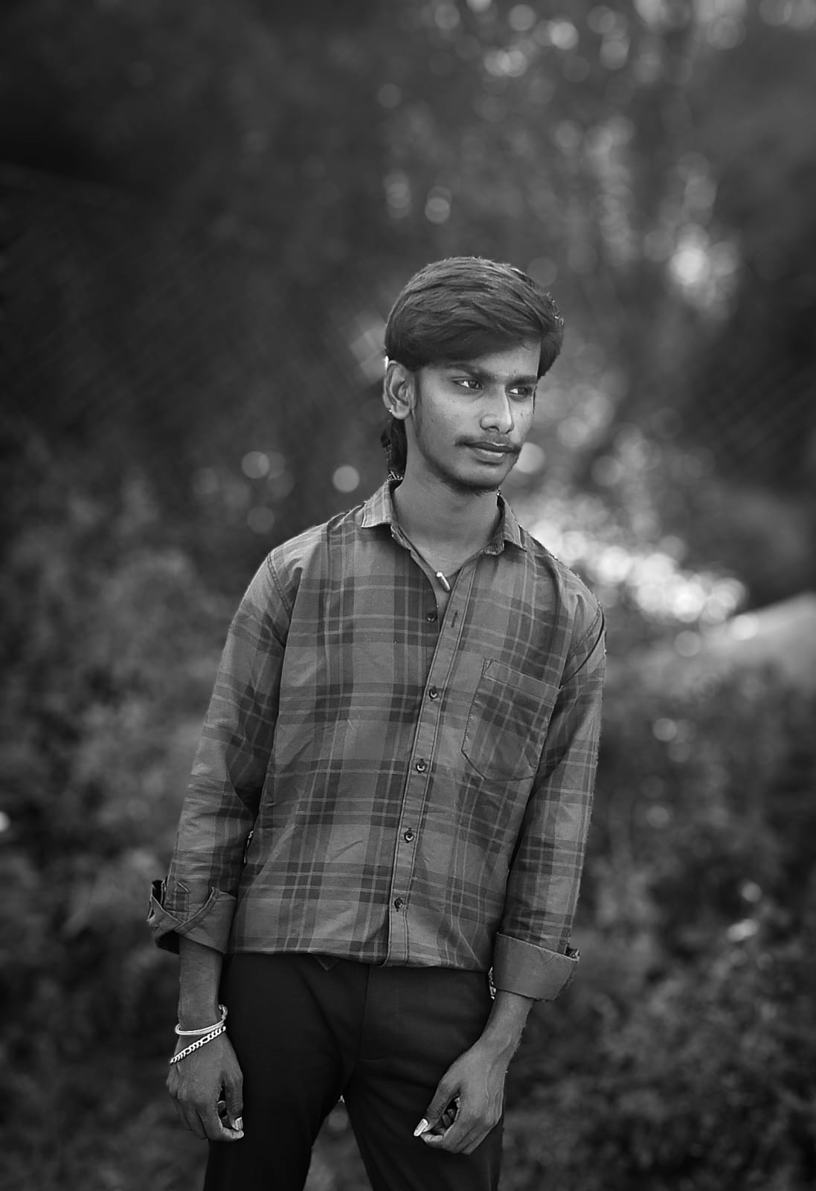
Thank you
Encourage your audience to ask questions or give feedback about your presentation.
Full Name | Title
:poondi,
Tirupur
641654
dkdon11345@gmail.com
8220358144
Company Name
Month Year

