Slide 1
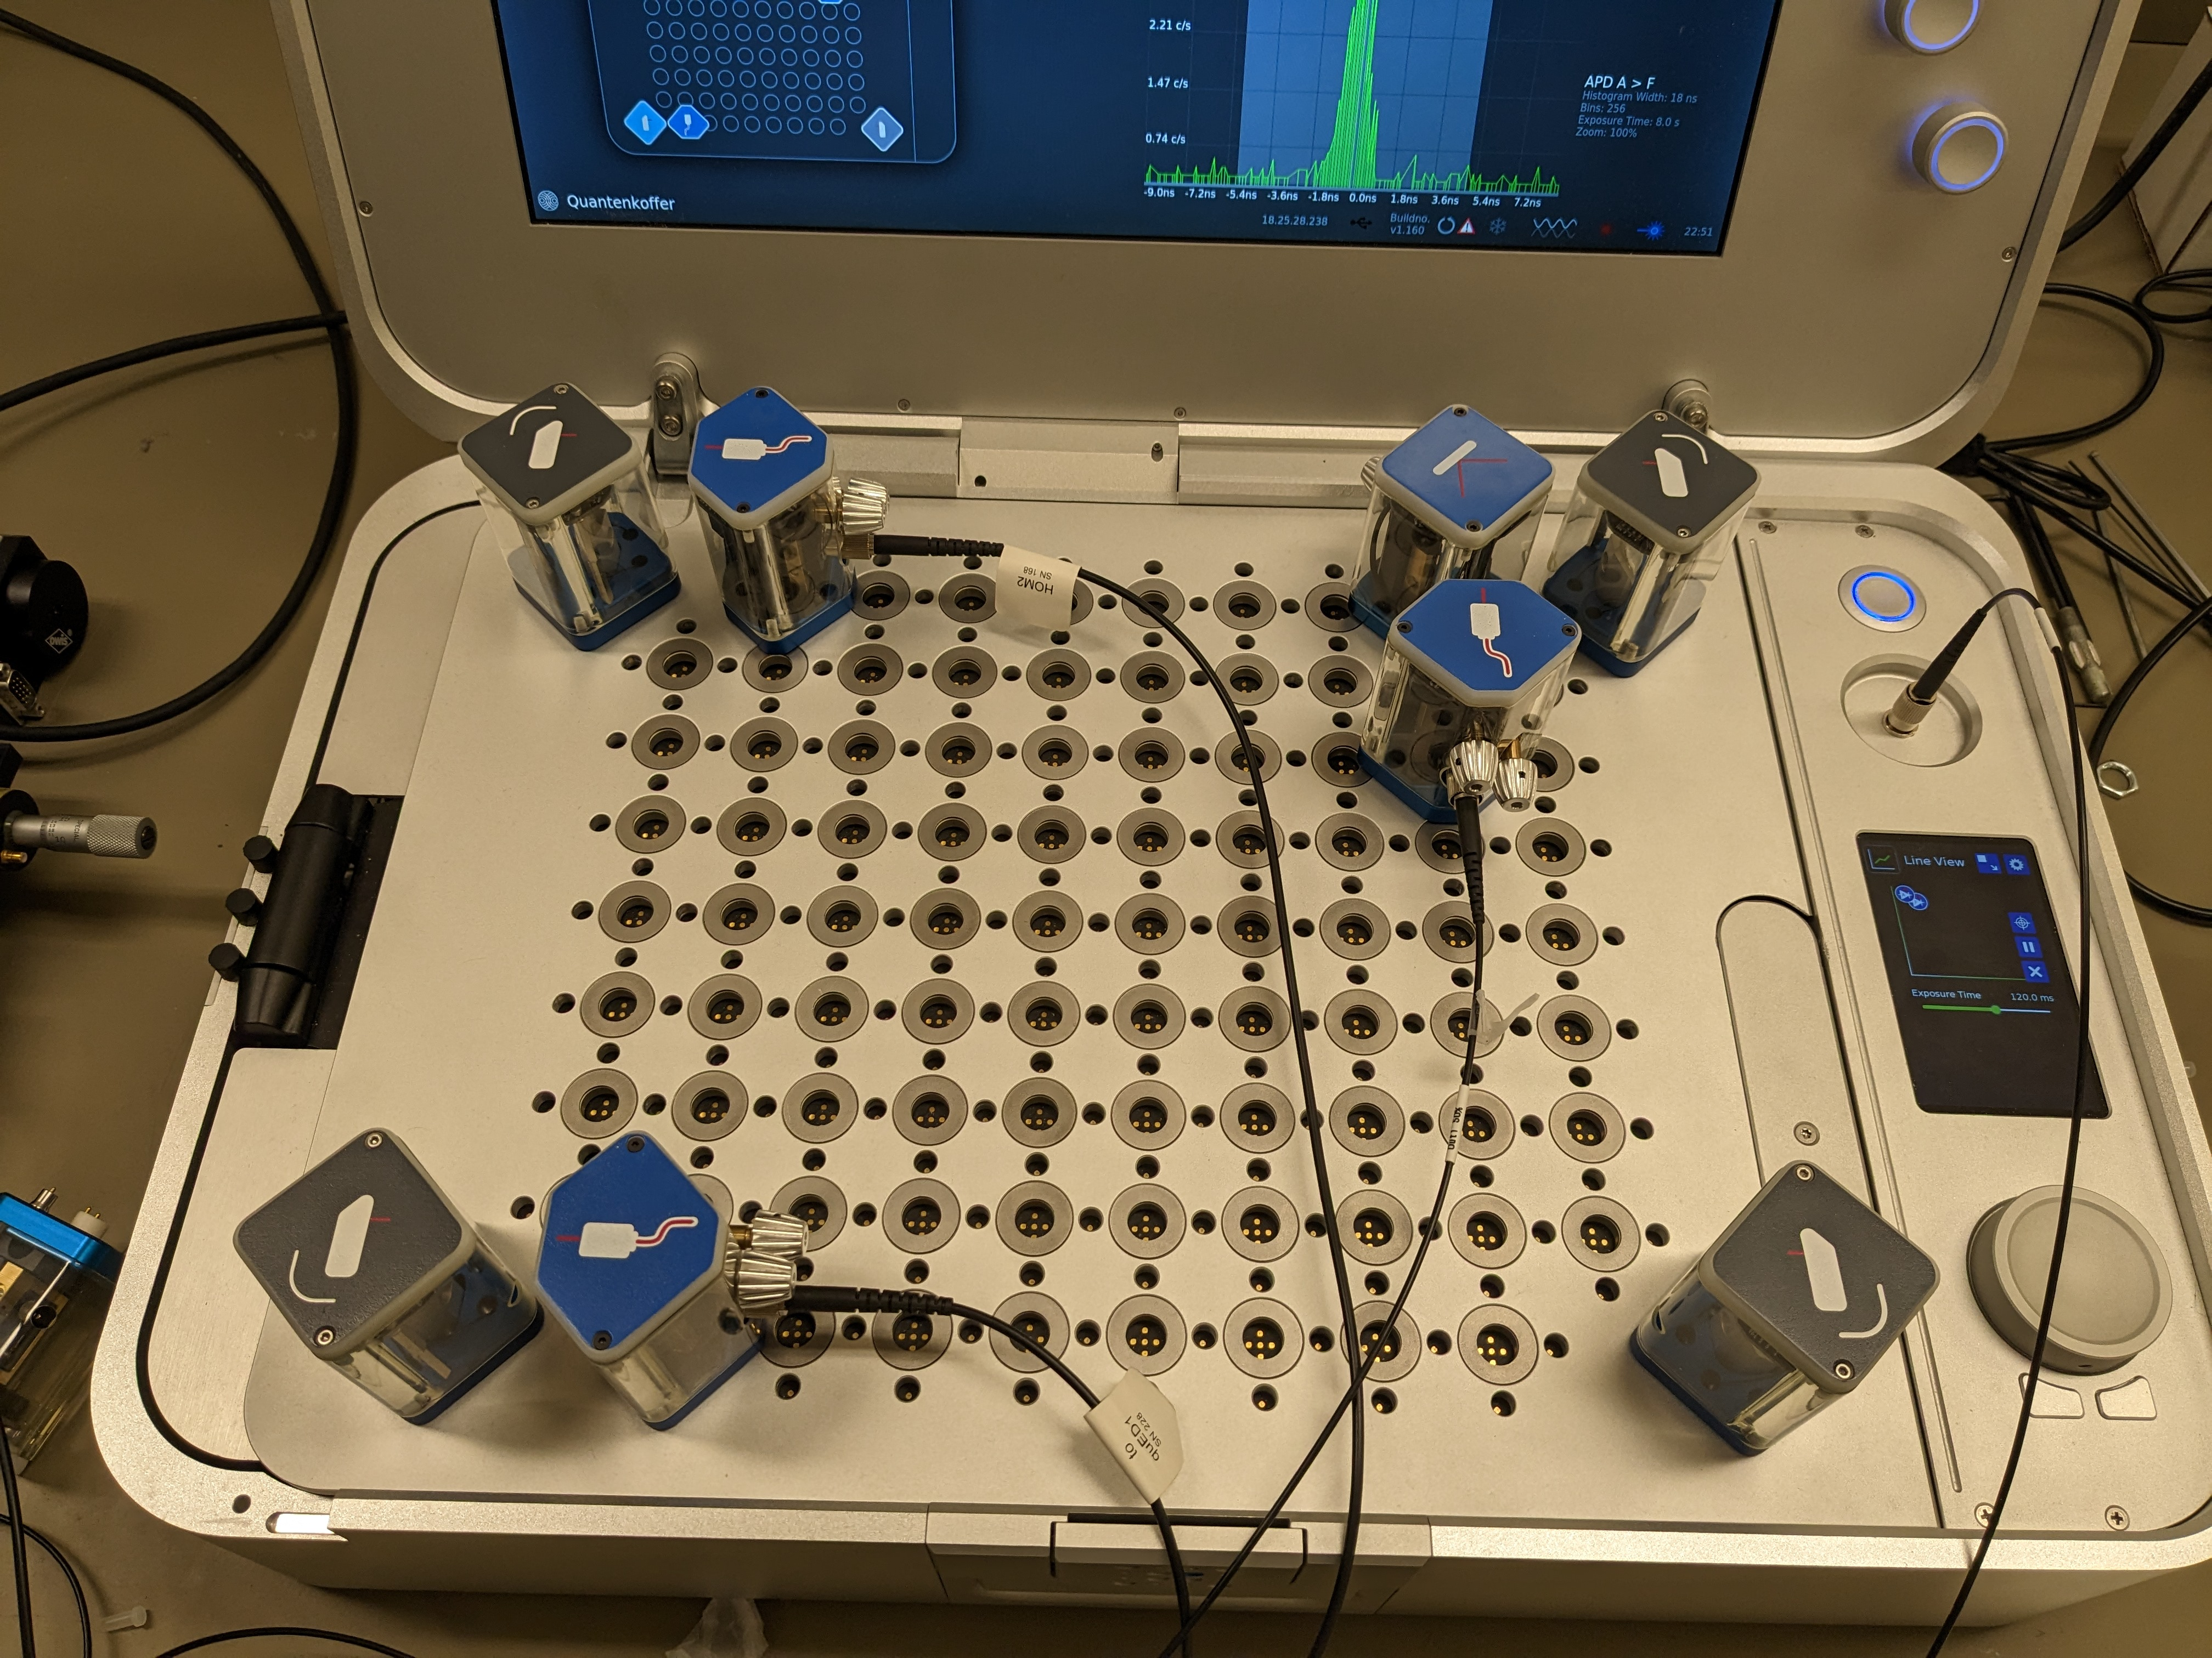
Port A Input
To Fiber Setup
Port F Input
To Fiber Setup

Slide 2
To Fiber Setup
To Fiber Setup

Slide 3
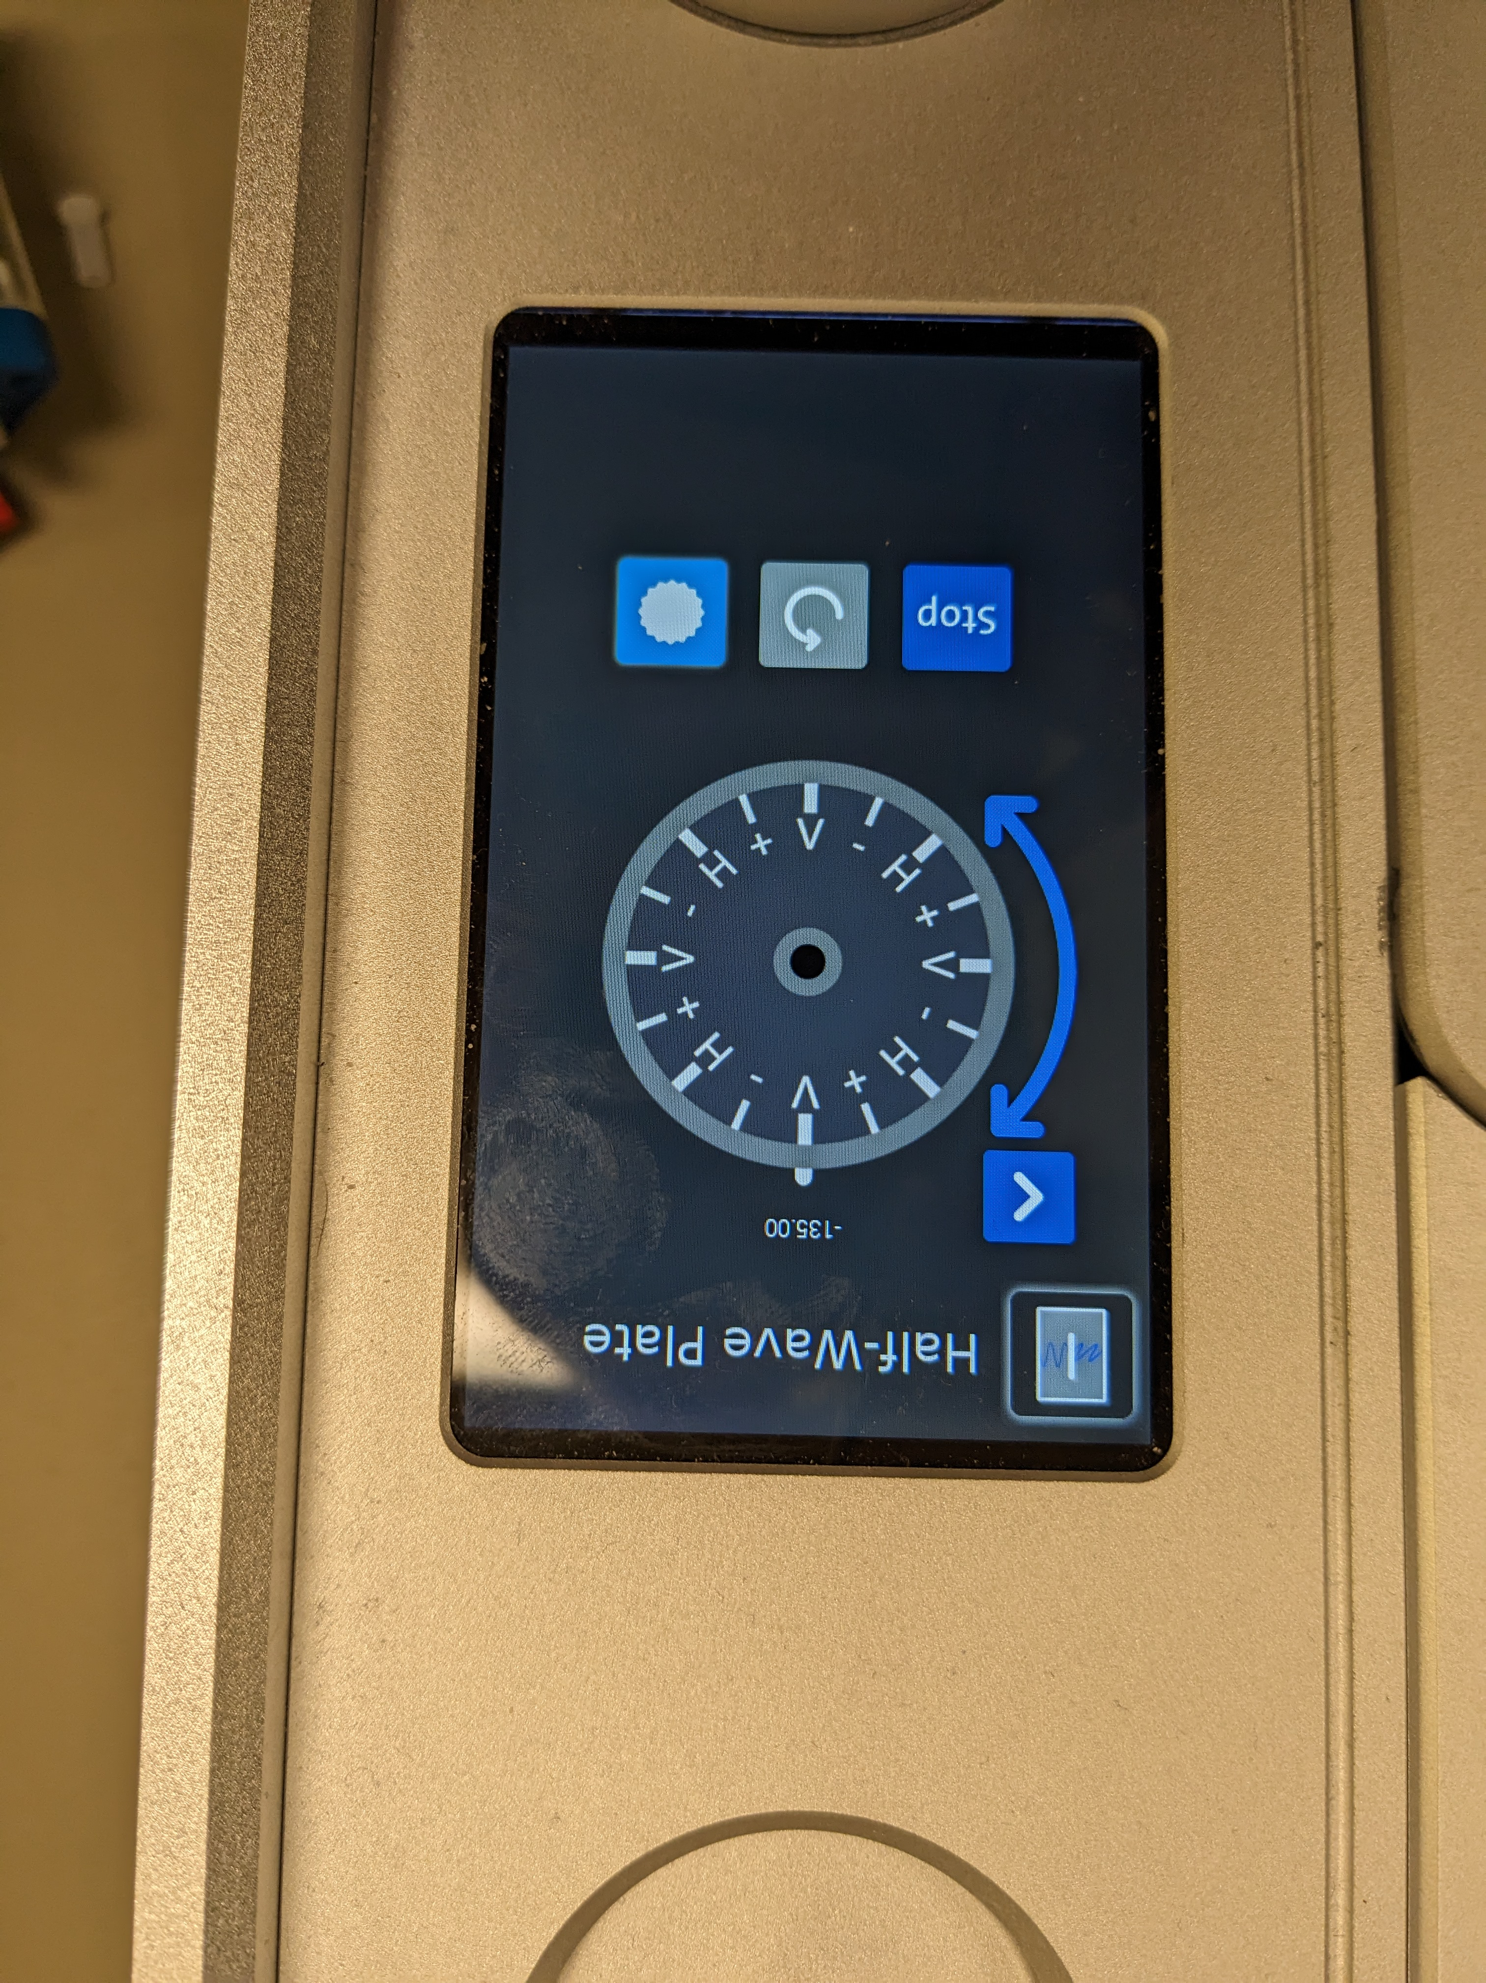

Slide 4
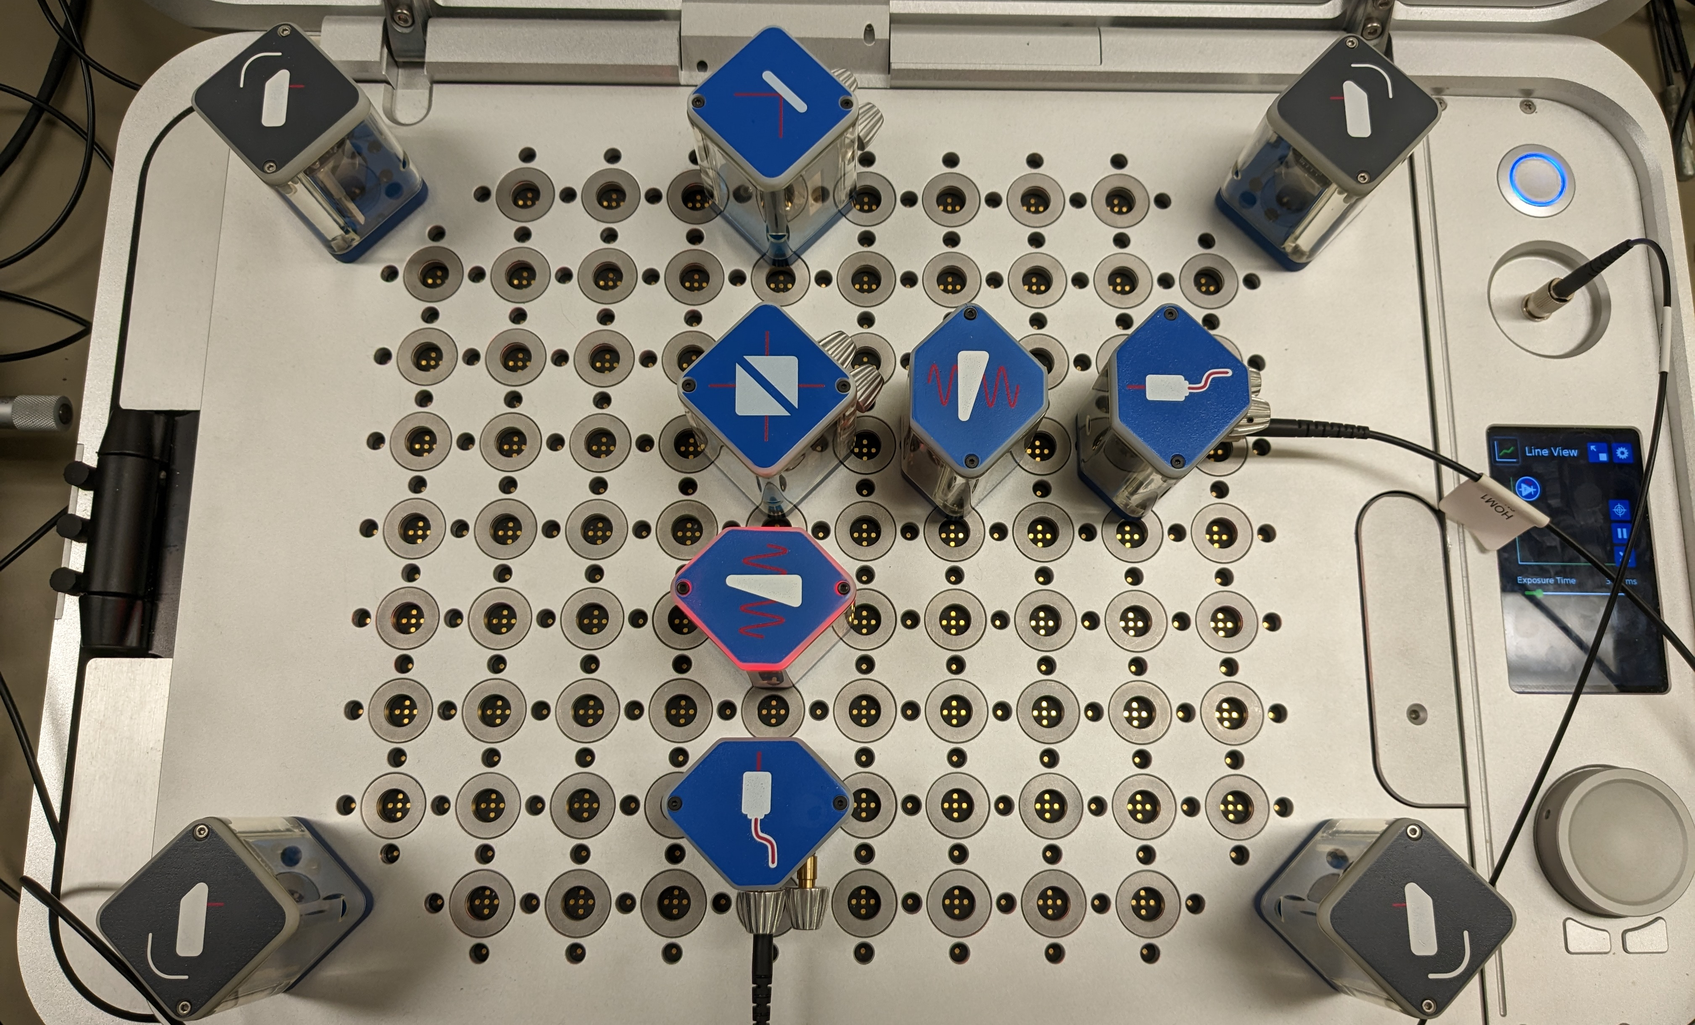
Port F Input
To Fiber Interferometer
To Fiber Interferometer

Slide 5
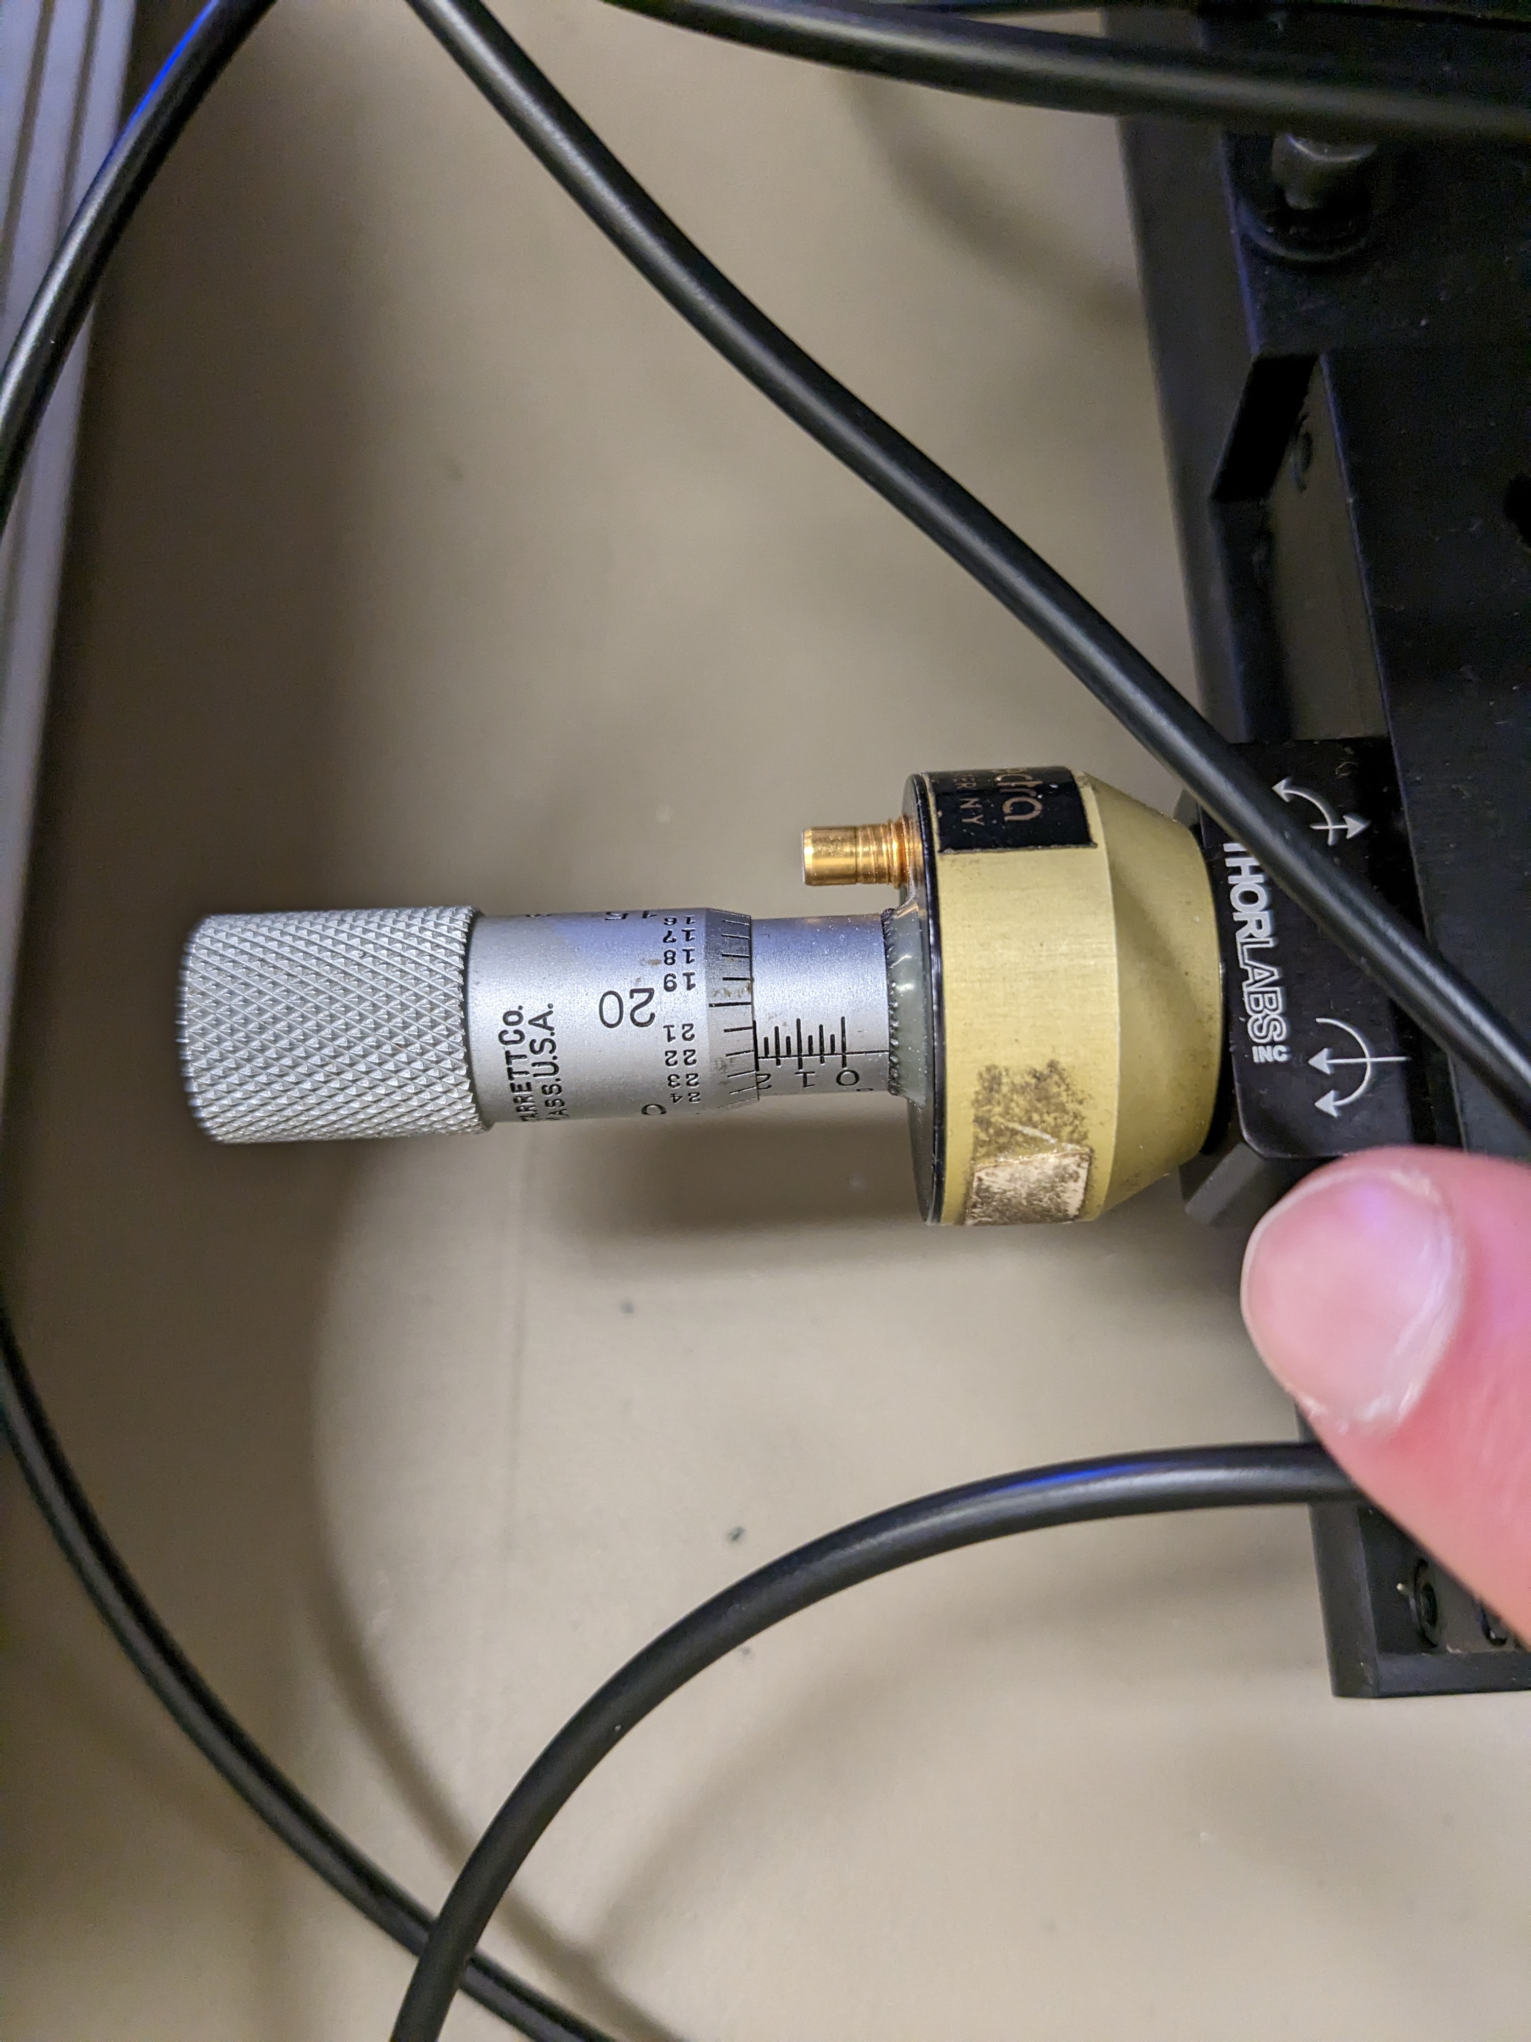

Slide 6
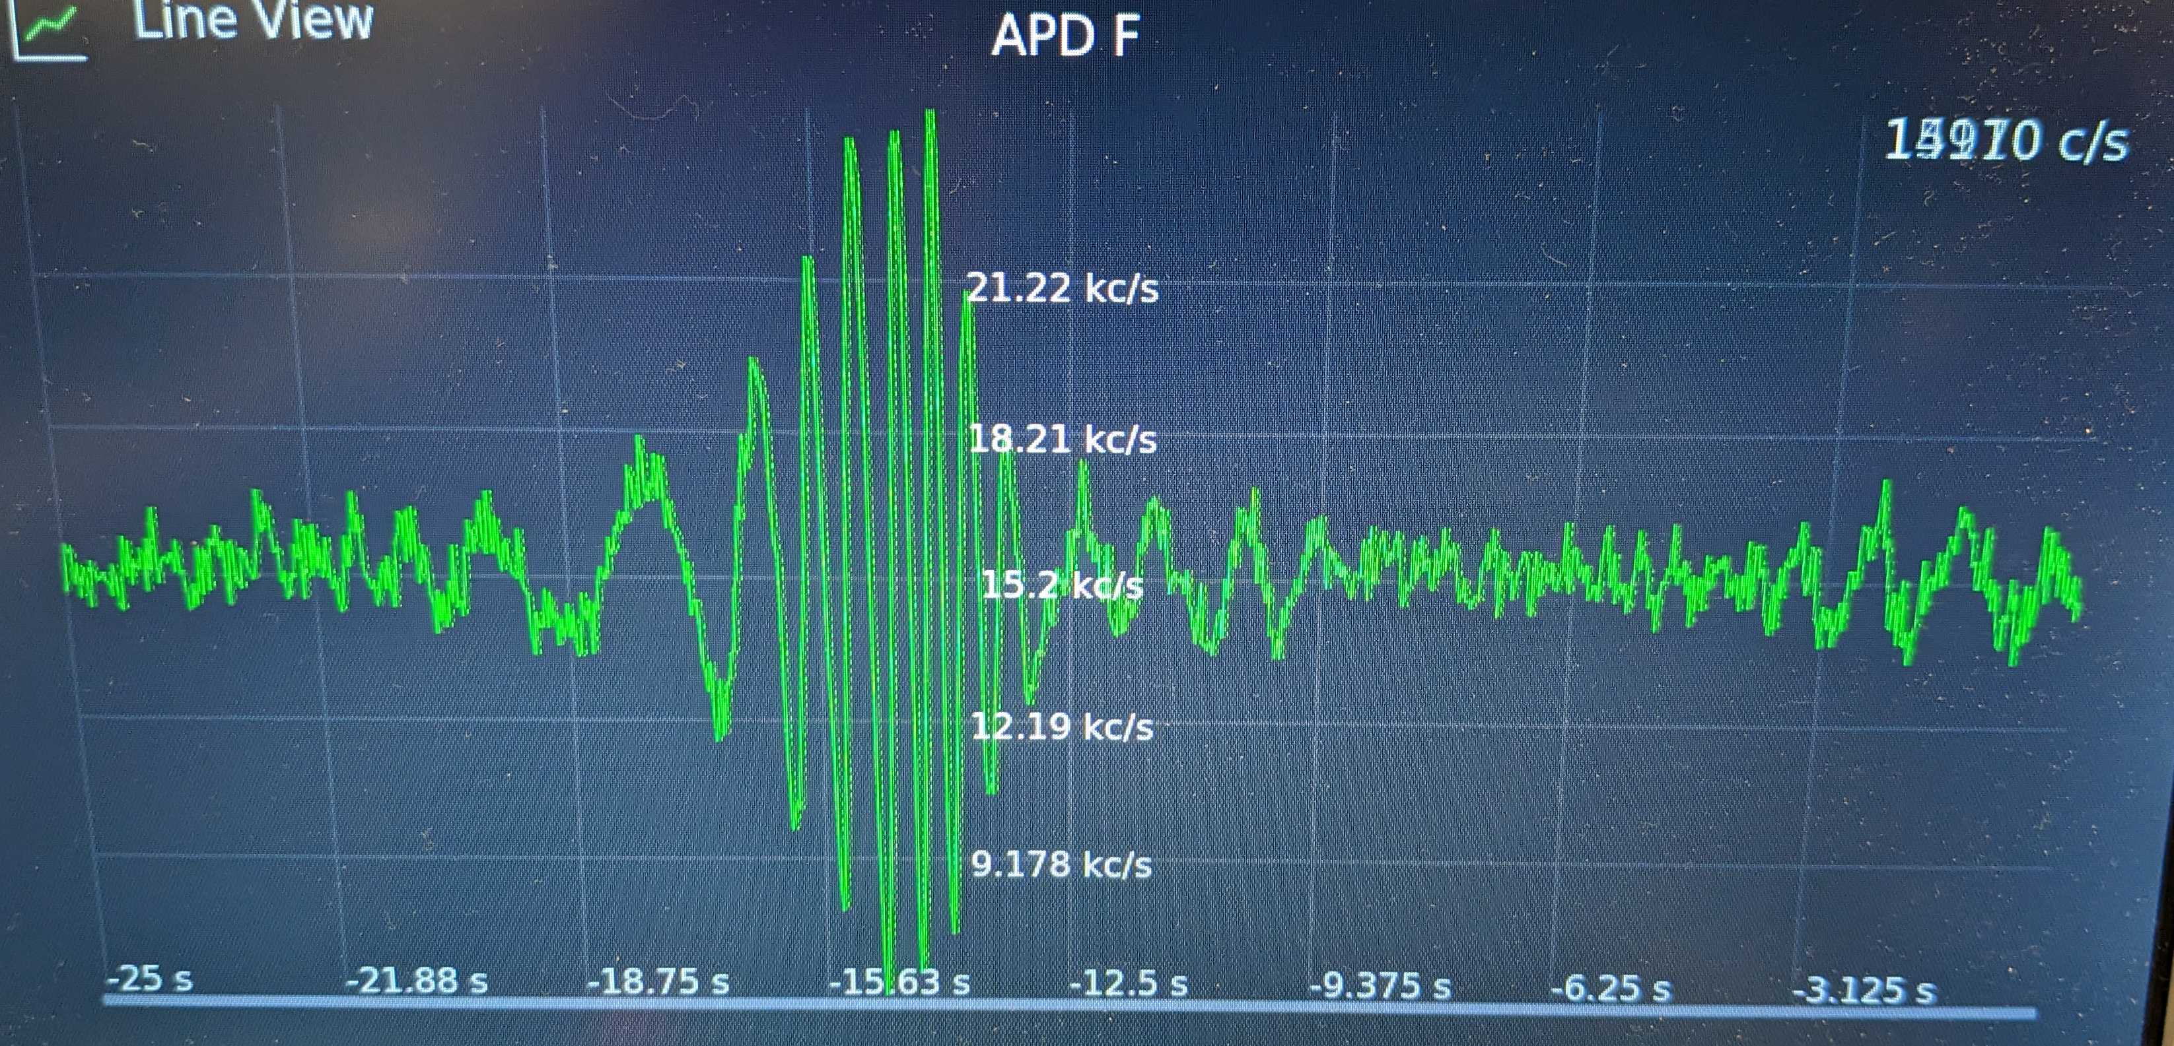

Slide 7


