Slide 1
Grid Wars
A Game AI Coding Competition
Benjamin Wolff (CERN/AIS)

Slide 2
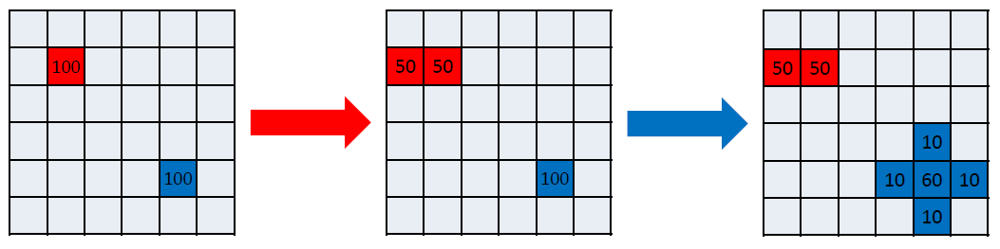
Game Setup
Universe: 50x50 cells board
1vs1 matches between 2 „bots“
Bots start at a random cell with 100 units (population)
Bots take alternating turns to move units (2 turns = 1 round)
Start
Turn 1 (red)
Turn 2 (blue)

Slide 3
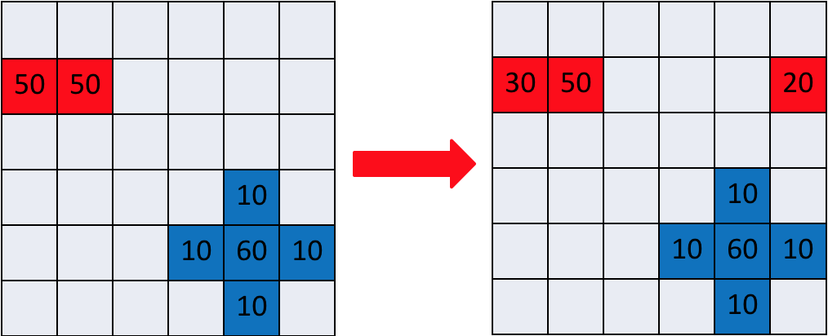
Movements
Units can be moved into directly neighbouring cells
Up, down, left, right (no diagonals)
The board is a torus (the edges wrap around)

Slide 4
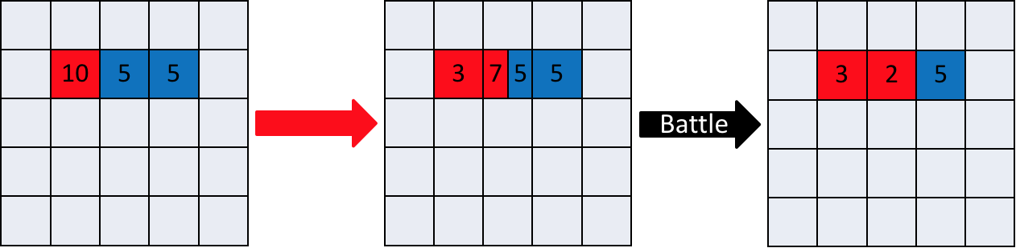
Battle
If two bots meet in a cell? Fight!
Simple comparison (more units will win)
Surviving units = attacking – defending units (can result in 0)
Battles occur after every turn (not round)

Slide 5
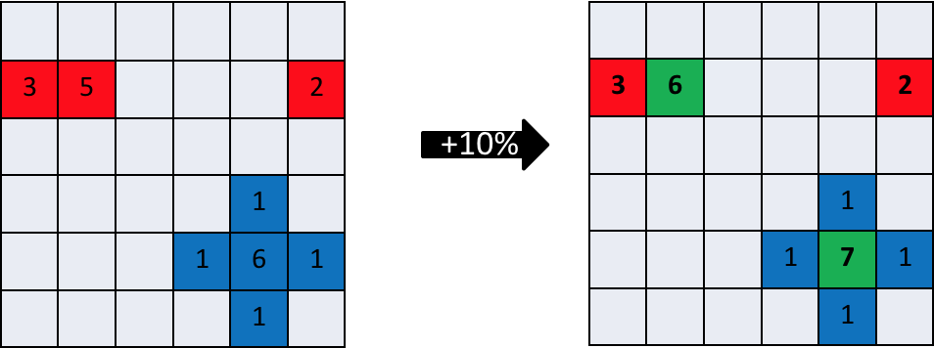
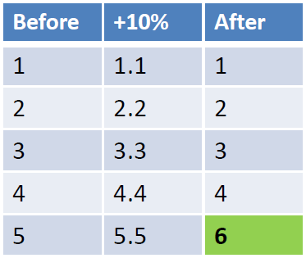
Population Growth
After every round (2 turns = one turn per bot)
Population increased by 10% (growth rate)
Rounding to nearest integer (e.g. 4.4 = 4, 5.5 = 6)
Maximum population per cell = 100

Slide 6
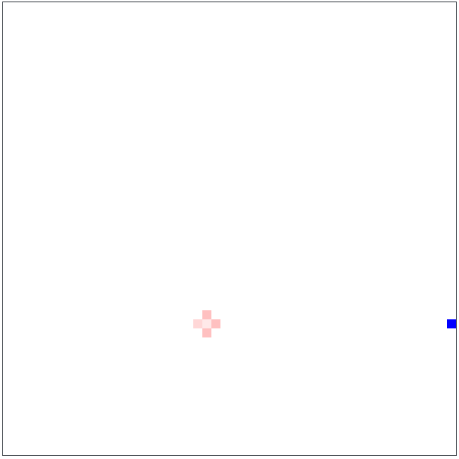
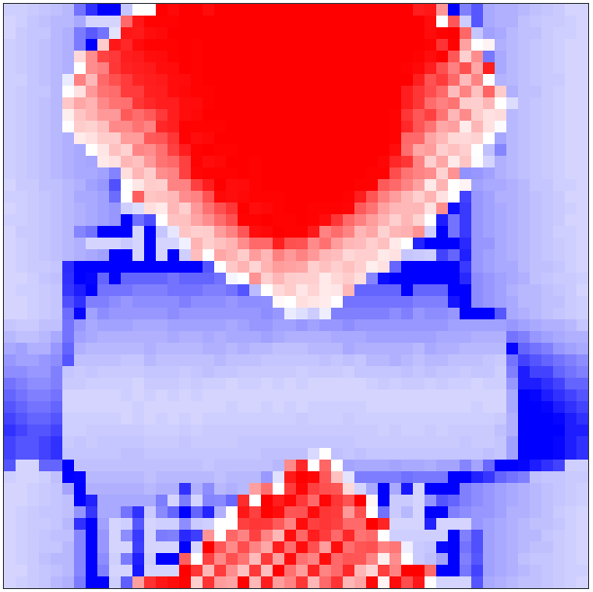
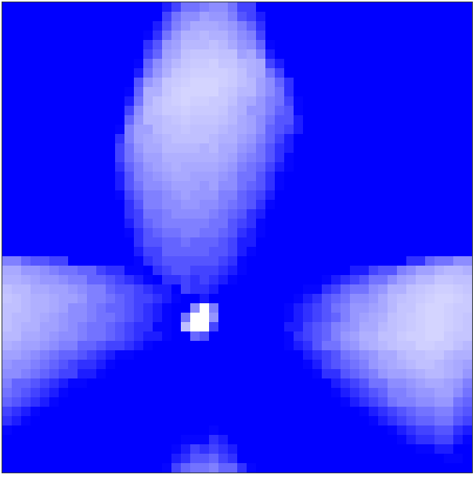
Winning
Last surviving bot
Or highest total population after 2000 rounds

Slide 7
Coding Competition
Form small teams (team == more than 1 person ;))
Register on the GridWars platform: https://gridwars.cern.ch/
1 user account per team
Registration password: !SpringCampus2018!
Please provide a valid e-mail address
Develop your bot locally and upload it to compete against the bots of other teams

Slide 8
Bot Development
Getting Started guide: https://gridwars.cern.ch/docs/getting-started
Programming language: Java 8
Bots are packaged and uploaded as Java jar files
Server will generate and play matches against all other bots on upload
Only one active bot at a time, will be replace with new upload
You can upload new versions your bot as often as you want
Final bot upload deadline at the end of the competition

Slide 9
Bot Development
Do I need awesome programming skills?
Basic programming knowledge is enough
Simple examples are provided
Opportunity to learn
What if I can‘t programm at all?
Find team with someone who knows how to
Programming is only one part, it‘s also important to come up with a good strategy and algorithms, can also be done with pen & paper

Slide 10
Bot Development
Demo

Slide 11
Some more rules
Illegal move = all moves for the turn are ignored
Timeout on bot initialisation (3s)
If the bot fails to initialise in time, it will idle for the whole match.
Timeout getting the next moves for a turn (50ms)
All moves added after the timeout are ignored
Stateful bots are allowed
Use of 3rd party libraries is not allowed
Java reflection & file access etc. is not allowed
More infos in the FAQ: https://gridwars.cern.ch/docs/getting-started

Slide 12
Schedule
When | What
Today, at lunch break | Registrations will open
Tuesday, 18h45 – 19h45 | Hackathon
Wednesday, 18h45 – 19h45 | Hackathon
Thursday, around lunch time | Closing of bot upload, playoffs
Thursday, 16h15 | Results & price ceremony
Hackathons will take place in the scientific library (rooms on 2nd floor)

Slide 13
Questions?
Talk to me
Join the hackathons
grid.wars@cern.ch

