Slide 1
Grid Wars
A Game AI Coding Competition
Benjamin Wolff (CERN/AIS)

Slide 2
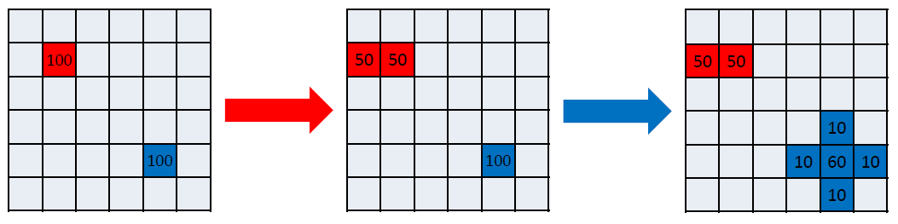
Game Setup
Universe: 50x50 cells board
1vs1 matches between 2 „bots“
Bots start at a random cell with 100 units (population)
Bots take alternating turns to move units (2 turns = 1 round)
Start
Turn 1 (red)
Turn 2 (blue)

Slide 3
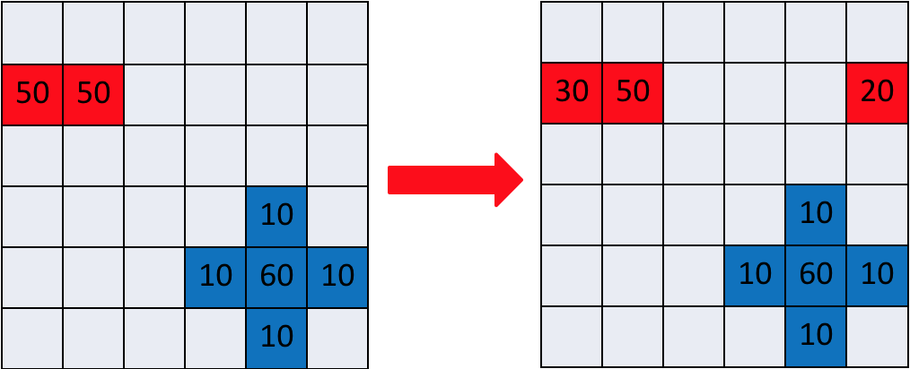
Movements
Units can be moved into directly neighbouring cells
Up, down, left, right (no diagonals)
The board is a torus (the edges wrap around)

Slide 4
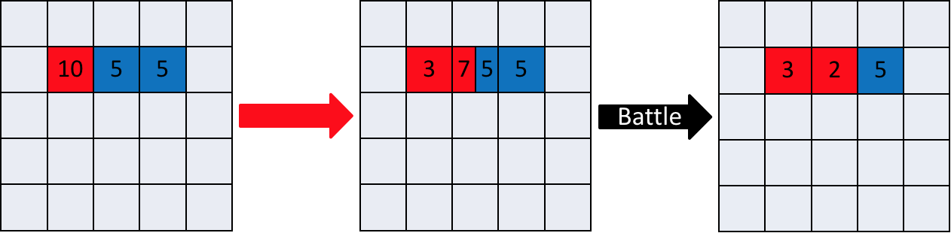
Battle
If two bots meet in a cell? Fight!
Simple comparison (more units will win)
Surviving units = attacking – defending units (can be 0)
Battles occur after every turn (not round)

Slide 5
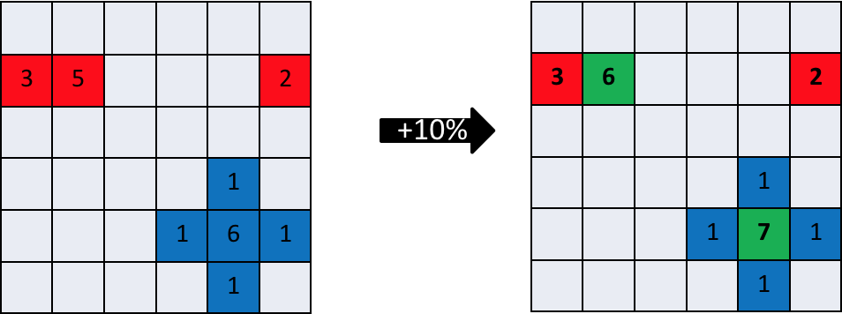
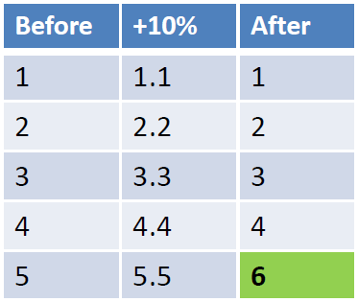
Population Growth
After every round (2 turns = one turn per bot)
Population increased by 10% (growth rate)
Rounding to nearest integer (e.g. 4.4 = 4, 5.5 = 6)
Maximum population per cell = 100

Slide 6
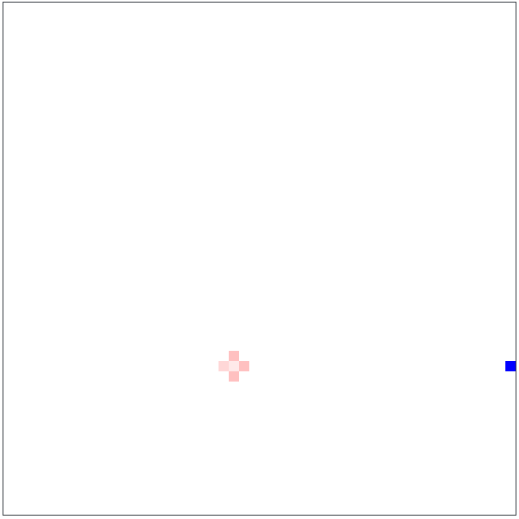
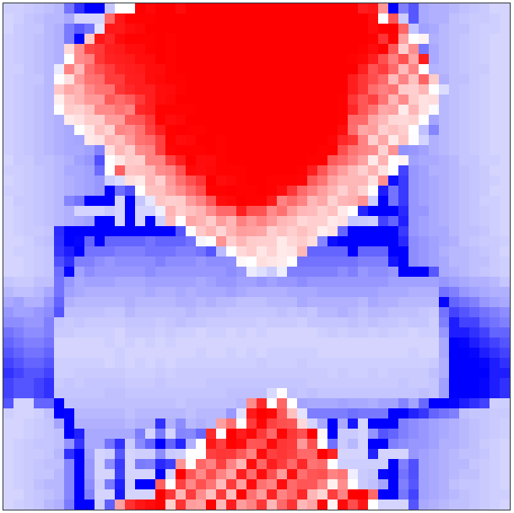
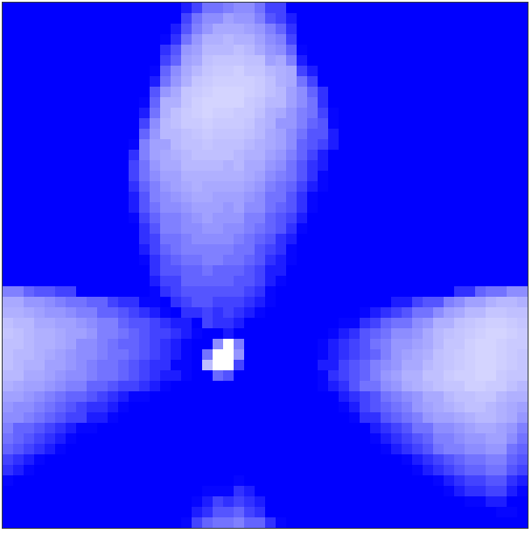
Winning
Last surviving bot
Or highest total population after 2000 rounds

Slide 7
Coding Competition
Form small teams (team == more than 1 person ;))
Register on the GridWars platform: https://gridwars.cern.ch/
1 user account per team
Registration password: 5pr1ngC4mpu52018!
Please provide a valid e-mail address
Develop your bot locally an upload it to compete against the bots of other teams

Slide 8
Bot Development
Getting Started guide: https://gridwars.cern.ch/docs/getting-started
Programming language: Java 8
Bots are packaged and uploaded as Java jar files
1 bot = 1 jar file
Server will generate and play matches against all other bots on upload
Only one active bot per team, will be replace with new upload
You can upload new versions your bot as often as you want
Final bot upload deadline at the end of the competition

Slide 9
Schedule
FILL me

Slide 10
Questions?
Talk to me
Join the hackathons
grid.wars@cern.ch

