Slide 1
Home CalorieCulate MyMacros Meal-Plans
CalorieCalculator (Initial Home Page wireframe)
What, Why & How
Done
What
Three step process for users:
Input personal information
Calculates calorie goals
Specify macro-nutrient mix
Sets target macros
Select Favourite Foods
Generates meal ideas
Results:
Daily Calorie targets
Macro nutrient mixes
Sample meal plans generated
Why
Benefits of planning
1. Structure/ accountability.
Counting calories lets you know exactly how much food you should eat and plan meals accordingly.
2. motivational.
When your diet improves, the immediate health benefits – weight loss, increased energy, etc. – can lead to positive behavioral changes and healthy habits.
3. better food choices.
Counting calories can help you identify which foods are more nutrient dense and which foods lack nutritional value.
4. encourage exercise.
Knowing that exercise helps burn calories can inspire you to get up off the couch and move.
(Also include cons/risks – time required, effort, behaviour, disconnects etc)
How
Harris-Benedict formula for BMR
Dieticians for Macro mixes
Science for Food content (P/F/C)
User choice for available foods/menu
Follow 3-step process ->
Facebook Twitter Instagram Youtube

Slide 2
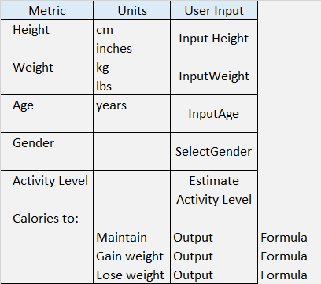
Home CalorieCulate MyMacros Meal-Plans
CalorieCalculator (Calorie Calculation page)
Step 1 - Populate the input fields below to calculate your calorie goals
Done
Facebook Twitter Instagram Youtube

Slide 3

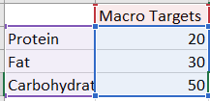
Home CalorieCulate MyMacros Meal-Plans
CalorieCalculator (Macro-Nutrient mix Calculation page)
Step 2 - Select your goals below to calculate your macro-nutrient splits:
Done
Standard
High Protein
Low Carb
Facebook Twitter Instagram Youtube

Slide 4
Home CalorieCulate MyMacros Meal-Plans
CalorieCalculator (Custom Meal-Planner page)
Step 3 - Tick/check boxes for foods you like from each category below to generate sample meal-plan ideas which fit your caloric goals & macro-nutrient targets
Protein
Chicken
Eggs
Turkey
Salmon
Cod
Steak
Pork
Haddock
Whiting
Mackerel
Click to generate sample Meal-plan Idea
Breakfast
Set Calories = Daily Calories * 0.30
Select Random Protein + random Carb + random Fat
Lunch
Set Calories = Daily Calories * 0.30
Dinner
Set Calories = Daily Calories * 0.30
Set protein, carb, fats to Macros * 0.3 each / per gram
Set protein, carb, fats to Macros * 0.3 each / per gram
Select Random Protein + random Carb + random Fat
Set protein, carb, fats to Macros * 0.3 each / per gram
Select Random Protein + random Carb + random Fat
Carbohydrate
Bread
Pasta
Rice
Oats
Cereal
Bananas
Oranges
Apples
Potatoes
Sweet Potatoes
Beans/Pulses
Quinoa
Fats
Coconut Oil
Olive Oil
Butter
Bacon
Cheese
Cream
Almonds
Walnuts
Brazil Nuts
Seeds
Click to share this meal plan on Twitter / Instagram
Click to export to CSV
Facebook Twitter Instagram Youtube

Slide 5
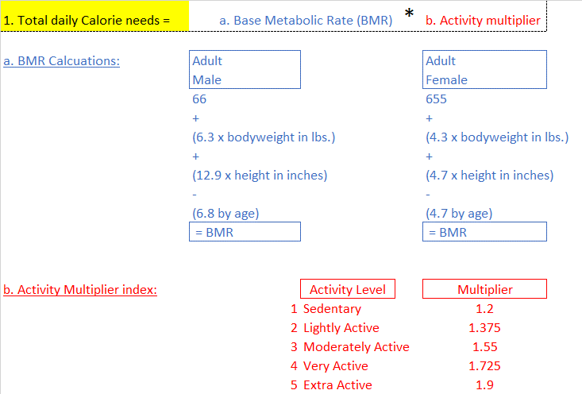
Formulas & Logic (For Javascript)
Populate the input fields below to calculate your calorie goals
Checks & controls (examples)
Age check
If <18 – throw a warning to come back when old enough
Calorie check
If calories fall below recommended minimums - warning

Slide 6
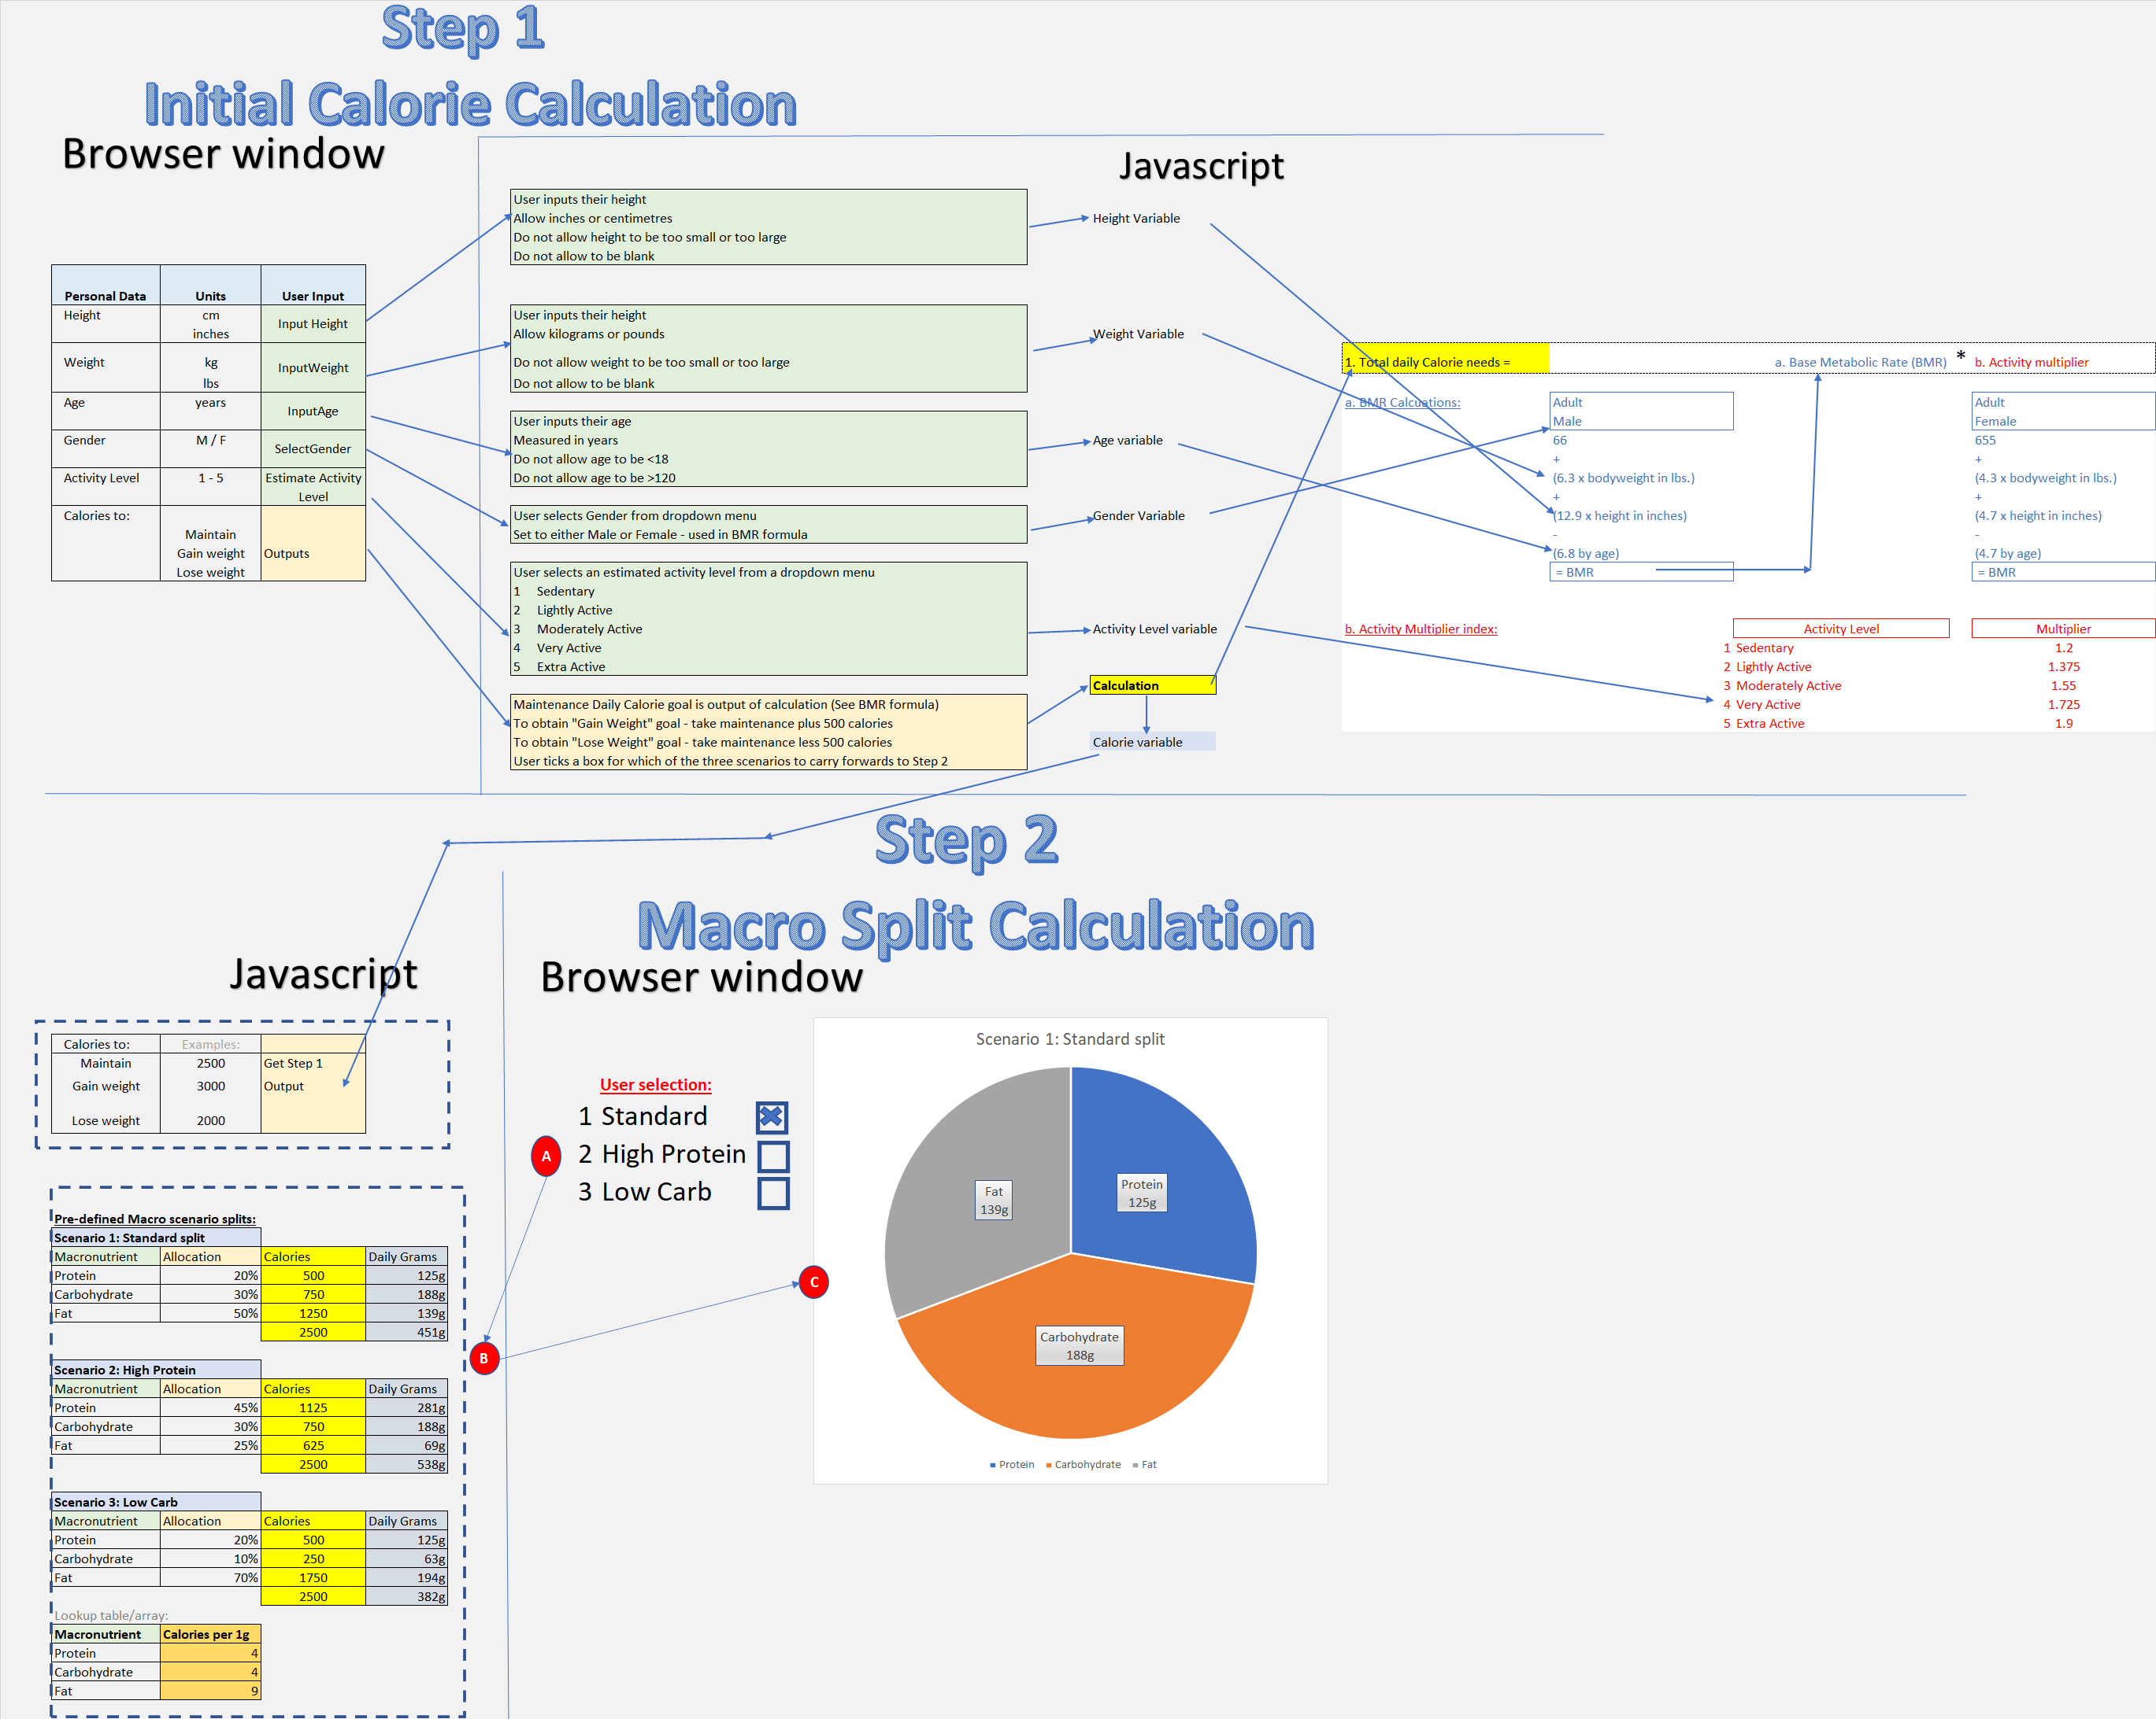

Slide 7
Checks & controls
Age check
If <18 – throw a warning to come back when old enough
Calorie check
If calories fall below recommended minimums – warning
Gender
Male or Female

Slide 8
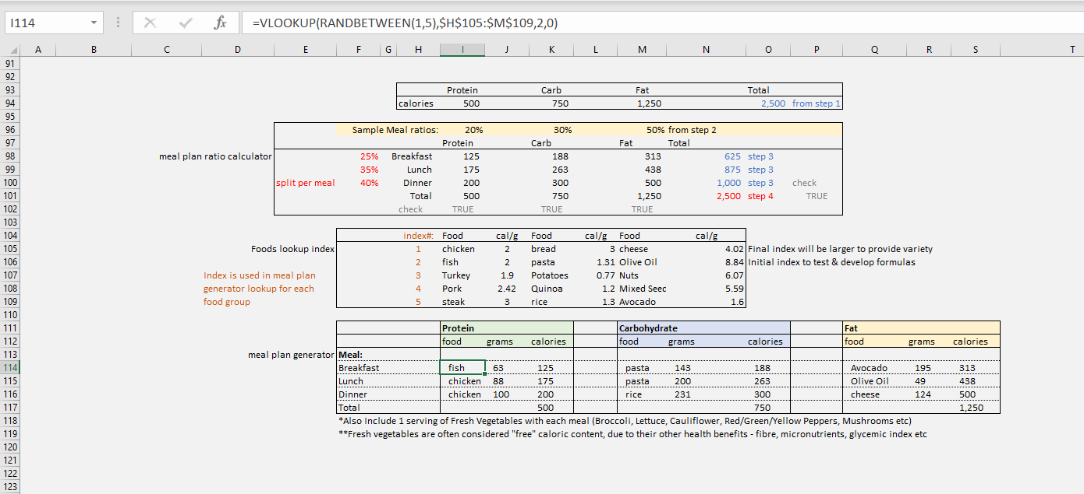
Random Number generated to select random foods from macro nutrient arrays
Start with PDCT
Standard static % split per meal
Use Macro Mix (selected by user in step 2) to allocate %’s across macronutrients (prot/carb/fat)
Use meal splits (pre-determined/static %) to allocate calories by macronutrient by meal
Food lookup index – cross referenced by meal plan generator

Slide 9
CalorieCulator

