Slide 1


Terminal Velocity: Galactica
Scrumdog Millionaires
Scrum master: Andrew Gray,
Project owner: Dan Kershner
Developers: John Piermatteo, Dylan Zucker

Slide 2
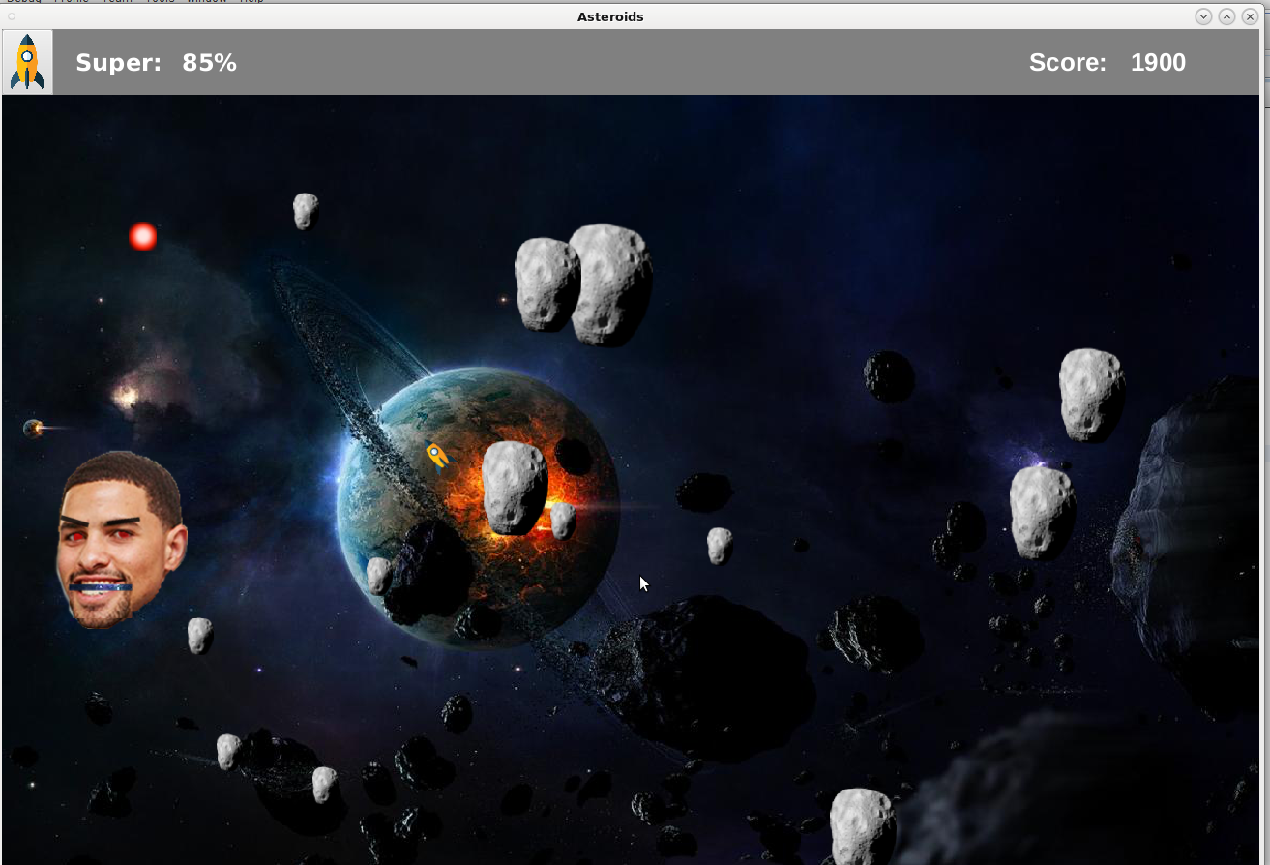
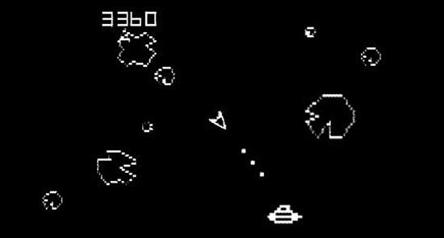
Our Purpose
Make a fun game that we would like to play
Improve an old game
Very accurate space travel simulation

Slide 3
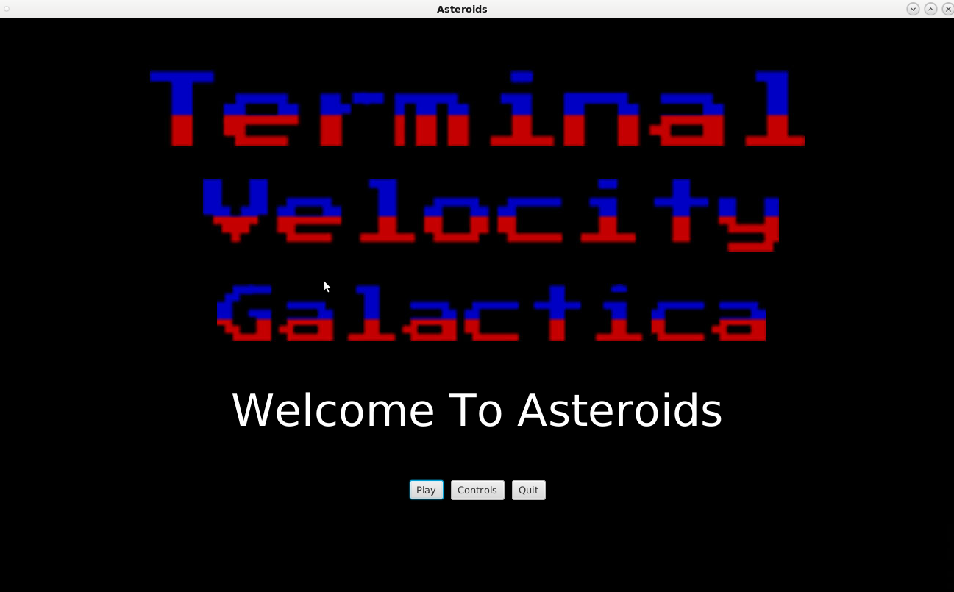
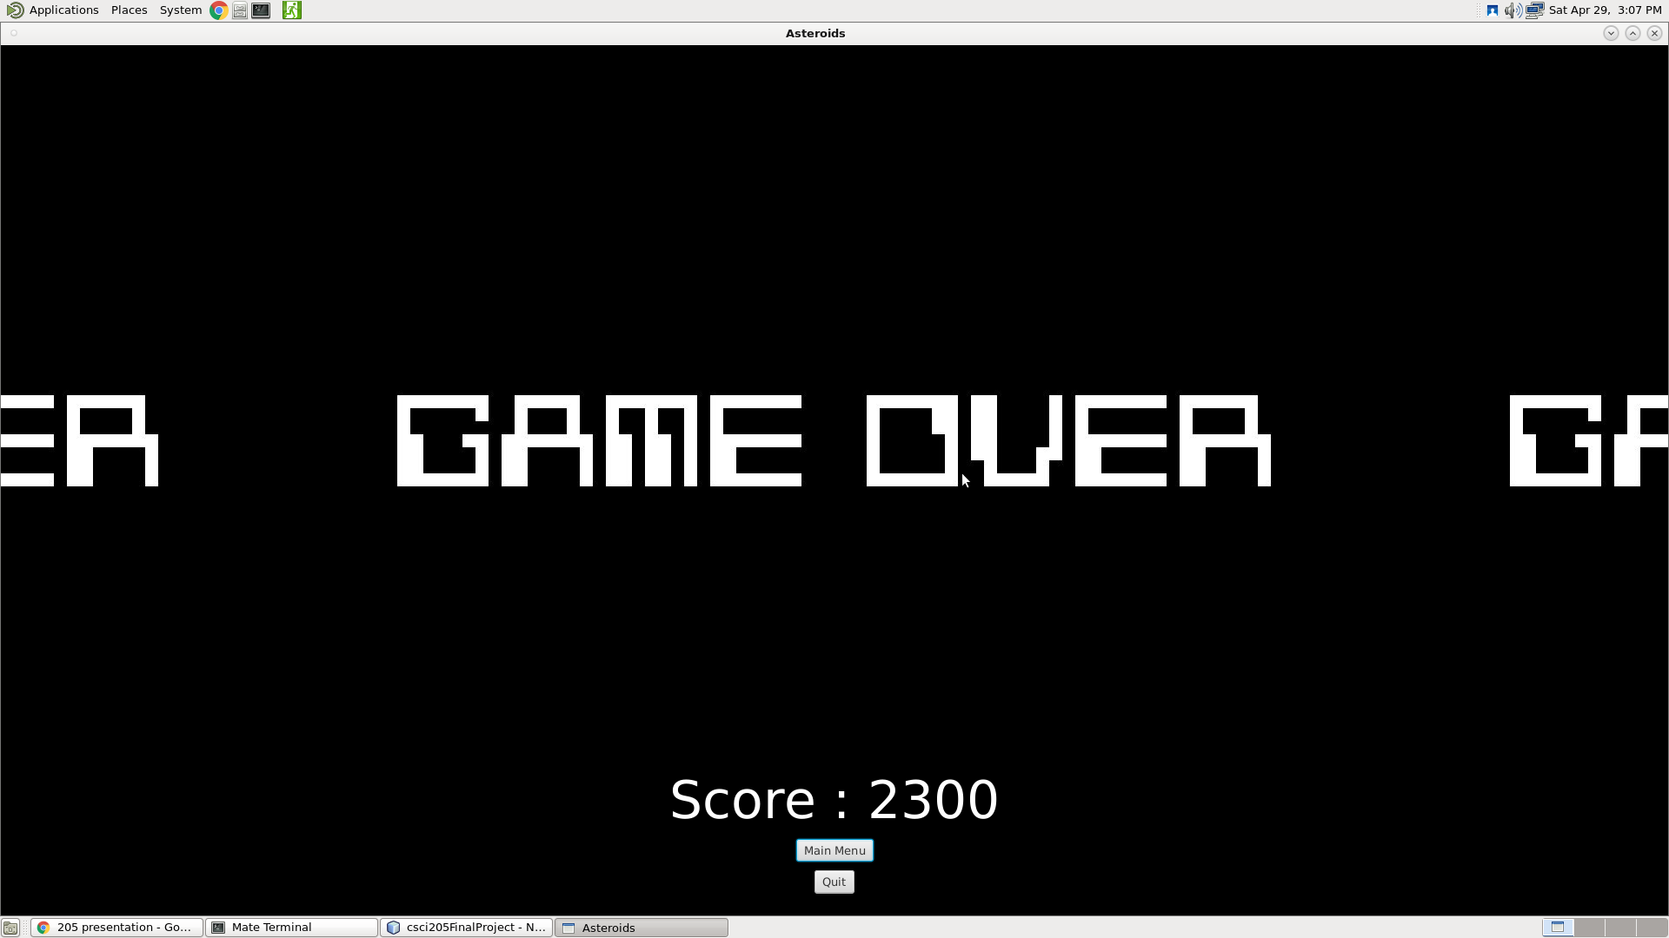

Slide 4
The Game
Travel to faraway galaxies on a space expedition
Destroy incoming asteroids before they destroy you
Larger asteroids split into smaller ones
You can shoot or dodge them
Defeat bosses
Evil alien asteroids named Ben and Professor Dancy

Slide 5
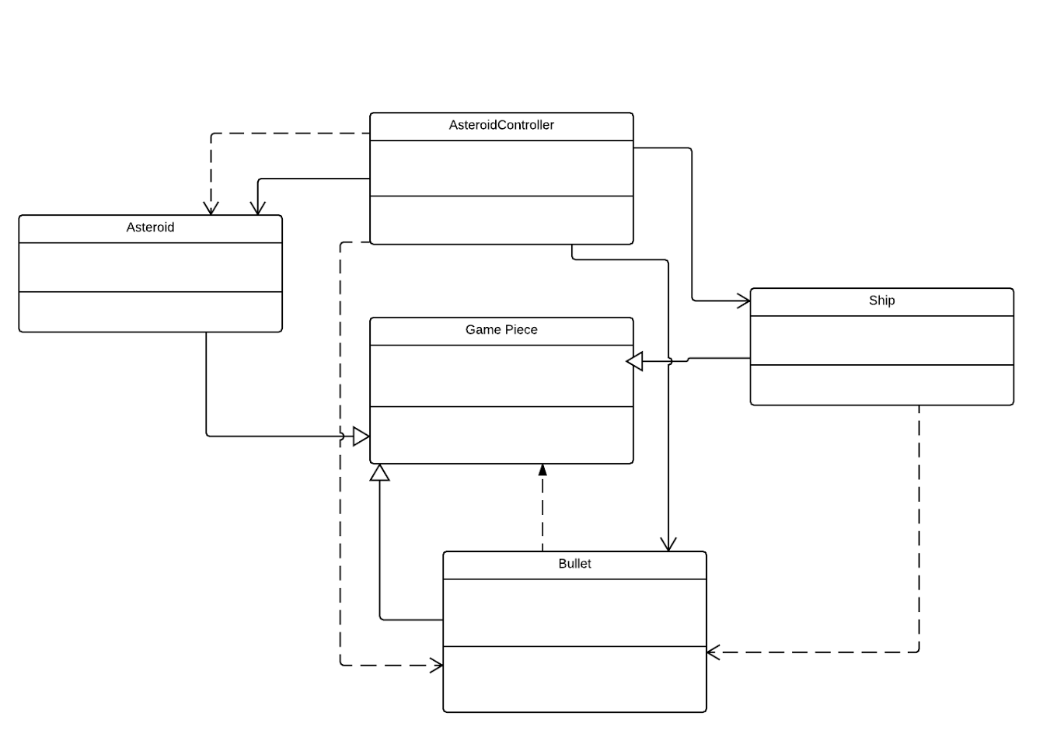
UML

Slide 6
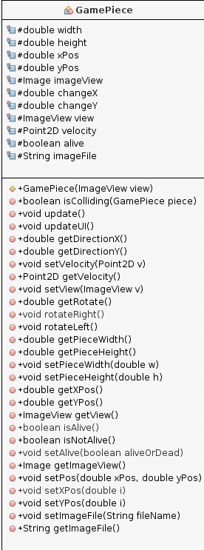
UML

Slide 7
Scrum
ScrumDesk
Strengths:
Generated burndown charts and other graphs instantly
Aesthetically pleasing and organized interface
Weaknesses:
More of a hassle than helpful because of the size of the project
Must update hours in real time (can’t enter all hours at one time)
Key user stories:
As a user, I would like a pause button, live updating score, main menu, etc...
Notes:
Put a picture of the burndown chart on here

Slide 8
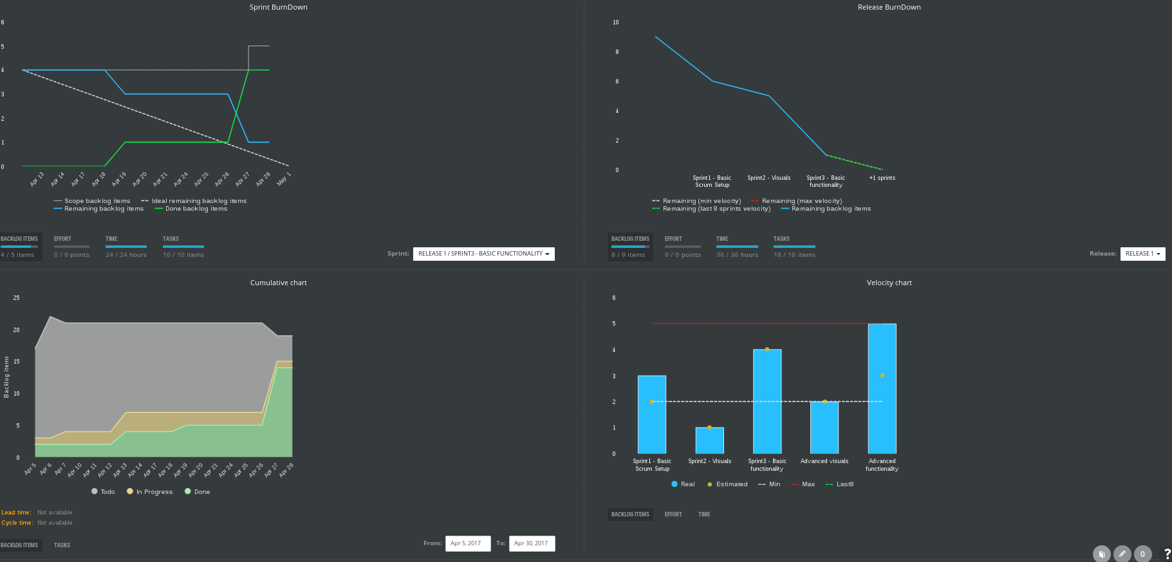

Slide 9
Challenges
Scene Builder
Caused problems with collisions
Caused problems with movement and rotations
Problems with frame rate
We overcame this with tasks and better pictures
Images behaving as rectangles

Slide 10
What we learned
Scrum
Time management
How to tackle a fairly large project on our own
How to make a video game
JavaFX
Animations - drawing all the images and having them move
Handlers for combinations of keys

Slide 11
For Terminal Velocity Galactica 2.0
Change themes
Ability to pick how your ship, the bullets, and the asteroids look
Add a store
In the pause menu, be able to spend your points on powerups, skins, and secret levels
Keeping track of highscores
Music
Round based gamemode
All of these would make the game more enjoyable to play

