Slide 1








Slide 3
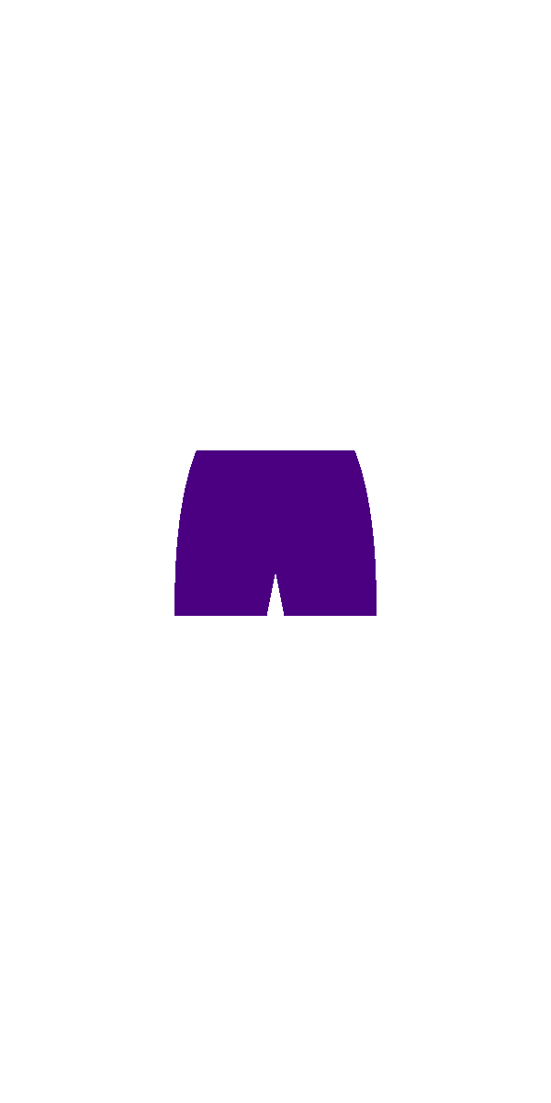





Slide 7


Slide 8
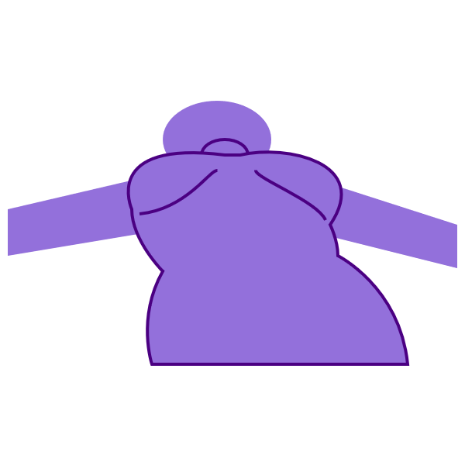

Slide 11

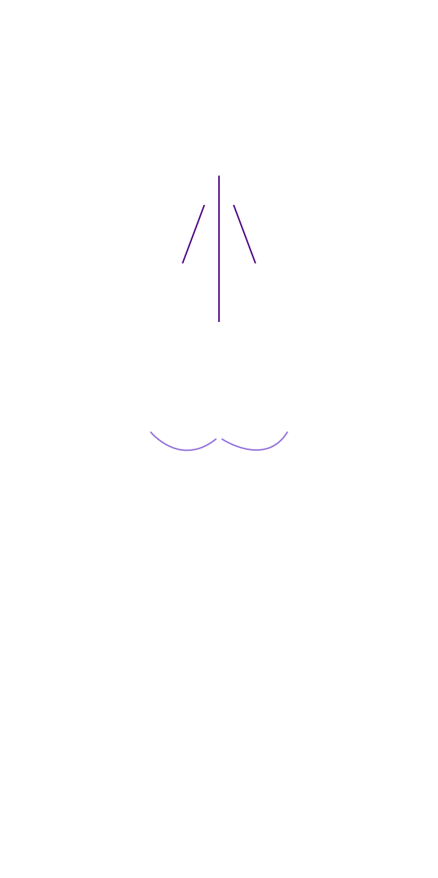


Slide 12


Slide 14


apex
apex
apex

Slide 15




Slide 19


Slide 23
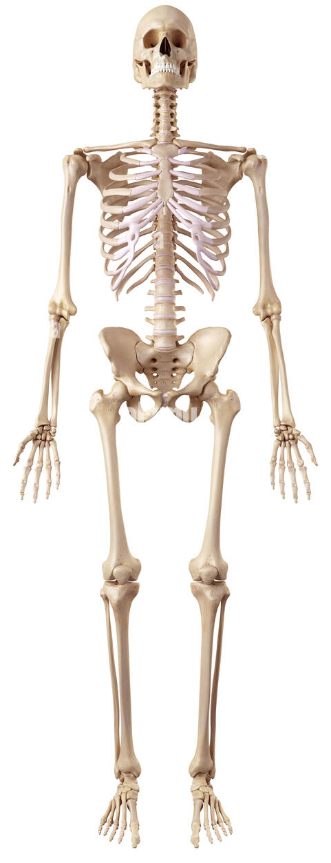

Slide 37
if volume & bust point
if very flat/ no bust point

Slide 56


