Slide 1
Developing a Contact Portal for Local Steel Works Co.
By: Dakota Fulp

Slide 2

Requirements
Customer Contact Form:
Gather customer information.
Gather question and newsletter decision.
Administrative Front End:
View all information.
View customer-specific information/questions.
Edit customer/question information.
Add new customers.
Bonus: Login.
Database Backend:
Store all user data.

Slide 3



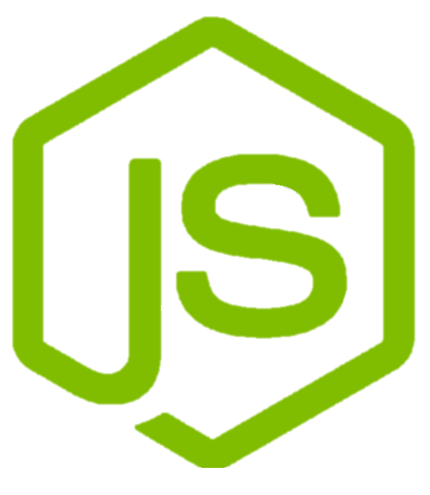
MERN Fullstack Framework
MongoDB – NoSQL Document Collection Oriented Database.
Express.js – Back-end Framework for Node.js.
React.js – Front-end JavaScript library for building user interfaces.
Node.js – Back-end JavaScript runtime environment.
Notes:
MongoDB = Uses JSON-like documents with optional schemas.
Express = Middleware focused approach to make using Node.js more streamlined.
React = Uses components to simplify building and maintaining UI.
Node = Enables JavaScript to be used on both the front and back-end.
MERN Advantages –
Performance
Single Programming Language
Open Source

Slide 4
MongoDB Schemas
Customer Schema
Name: String
Email: String
Phone Number: String
Newsletter: Boolean
Question: Array
Question Schema
Staff Schema
Customer: Id
Submitted: Date
Description: String
Name: String
Email: String
Password: String
Notes:
Mongoose for Schemas
Mongoose = JavaScript library that connects between MongoDB and Express

Slide 5
Node.js/Express.js Back-end API
/api/questions/…
GET ../
POST ../add
Get list of all questions.
Create a new question.
GET ../:qid
PATCH ../:qid
Get the question with a given question id (qid).
Update the question with a given question id (qid).
GET ../customer/:cid
DELETE ../:qid
Get the questions of a customer with a given id (cid).
Delete the question with a given question id (qid).

Slide 6
Node.js/Express.js Back-end API
/api/customers/…
GET ../
GET ../email/check/:cemail
POST ../add
Get list of all customers.
Check if customer with a given email (cemail) exists.
Create a new customer.
GET ../:cid
PATCH ../:cid
Get the customer with a given customer id (cid).
Update the customer with a given customer id (cid).
GET ../email/:cemail
DELETE ../:cid
Get the customer with a given email (cemail).
Delete the customer with a given customer id (cid).

Slide 7
Node.js/Express.js Back-end API
/api/staff/…
GET ../
Get list of all staff
POST ../signup
Create new staff member
POST ../login
Log in staff member

Slide 8
React.js Client Front-end
http://localhost:3000/…
…/
Show contact form.
…/about
Display about us section.

Slide 9
React.js Administrative Front-end
http://localhost:4000/…
…/customers
…/auth
…/questions/:qid
Display all customers.
Show login/signup page.
Show update question form for question with given id (qid).
…/questions
…/customers/:cid
Show all questions.
Show update customer form for customer with the id (cid).
…/customers/add
…/questions/customer/:cid
Display add customer form.
Show questions submitted by customer with given id (cid).

Slide 10
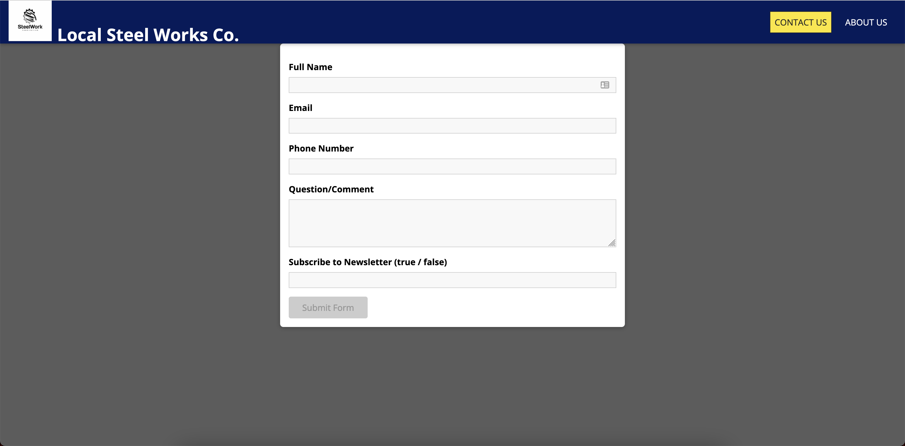
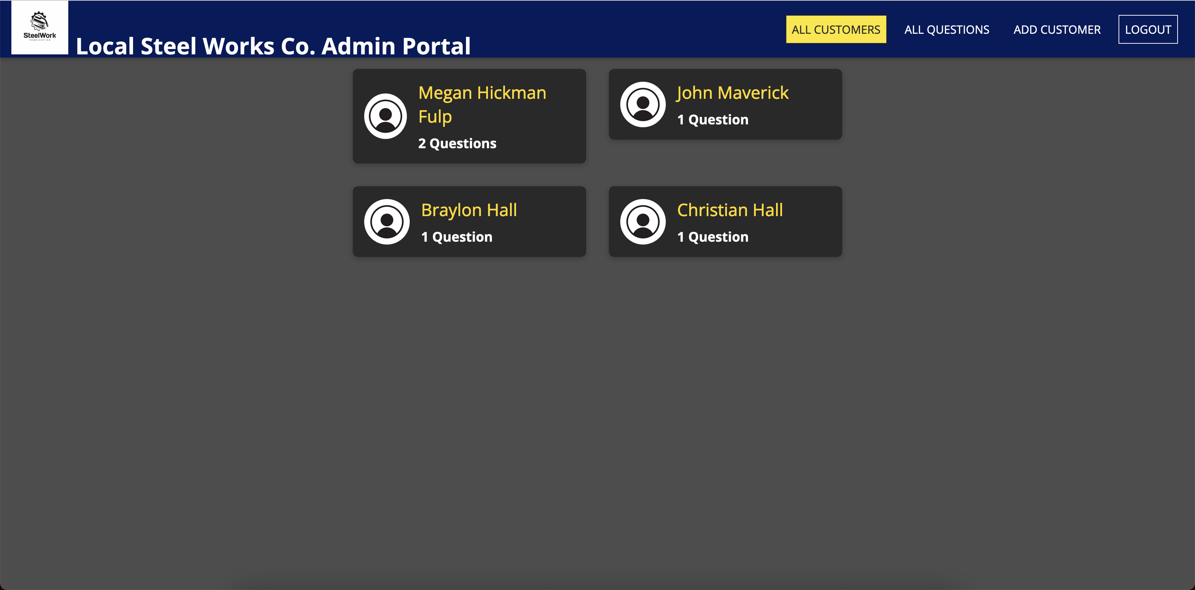
App In Action https://github.com/dkfulp/LocalSteelCo-MERN-Fullstack-

Slide 11
30 Minutes to Present:
- 10 minutes: Problem, Backend Design, Frontend Design
Problem
Technologies Used
Database Design – Customer Schema, Question Schema, Staff Schema
API Design – Table of API calls needed for the project
Front End Design – Pages needed for the project
- 10 minutes: Display Current Project in Action
- 10 minutes: Going through codebase
Go through a Get request
Go through a Post request
Go through a Patch request
Go through a Delete request
TODO: Populate Database with Better Results, Fix Button Color

