Slide 1

HYBRID INTRUSION DETECTION AND URL SAFETY ANALYSIS SYSTEM USING MACHINE LEARNING
Submitted By:
Anmol Sikka
(23FE10CSE00181)
Kartikay Panghaal
(23FE10CSE00196)
Guided By:
Dr. Gireesh Kumar Kaushik

Slide 2

Introduction
Rapid growth of internet, cloud, and IoT systems
Increase in multi-stage cyber attacks
Traditional systems:
Focus only on network OR application layer
Fail to detect combined attacks
Need for integrated security solution

Slide 3

Cyber attacks involve:
Malicious URLs (phishing)
Network intrusions
Existing systems are:
Reactive (blacklists)
High false positives
Proposed: Hybrid Detection System
Combines both layers

Slide 4

Literature Review – Machine Learning in Cybersecurity
Machine Learning widely used in Intrusion Detection Systems (IDS)
Algorithms like Random Forest, SVM, Decision Trees improve detection accuracy
Ensemble models handle high-dimensional network data effectively
Capable of detecting zero-day attacks
Limitation: Performance depends on dataset quality & imbalance

Slide 5
Literature Review – URL Detection & Research Gap
Traditional URL detection uses blacklists & signature-based methods
Ineffective against:
Zero-day attacks
Dynamically generated domains (DGA)
Modern approaches use:
Lexical feature extraction
Shannon Entropy analysis
Deep learning models:
High accuracy but high computational cost
🚨 Research Gap:
Lack of lightweight hybrid system combining network + URL detection

Slide 6

Problem Statement
Traditional cybersecurity systems fail to detect multi-layer cyber threats due to lack of integration between network intrusion detection and malicious URL analysis.

Slide 7

Objectives
Develop hybrid threat detection system
Detect network intrusions using ML
Analyze URLs using lexical features
Reduce false positives
Provide real-time detection

Slide 8
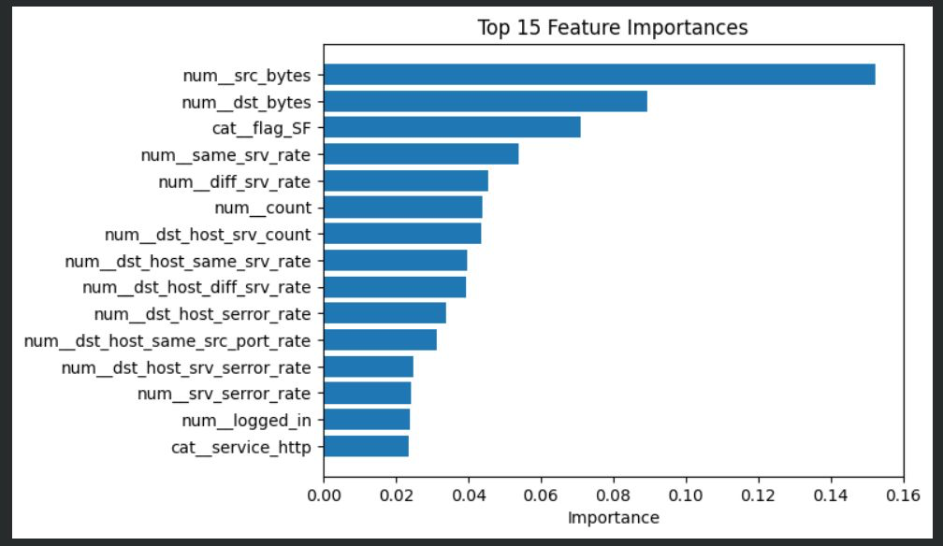
Dataset Description
NSL-KDD Dataset (Network Intrusion Detection)
Benchmark dataset for intrusion detection
Total Instances:
Training: 125,973
Testing: 22,544
Features: 41 attributes
Attack Categories:
DoS (Denial of Service)
Probe (Reconnaissance)
R2L (Remote to Local)
U2R (User to Root)
Balanced dataset (removes redundancy of KDD’99)

Slide 9
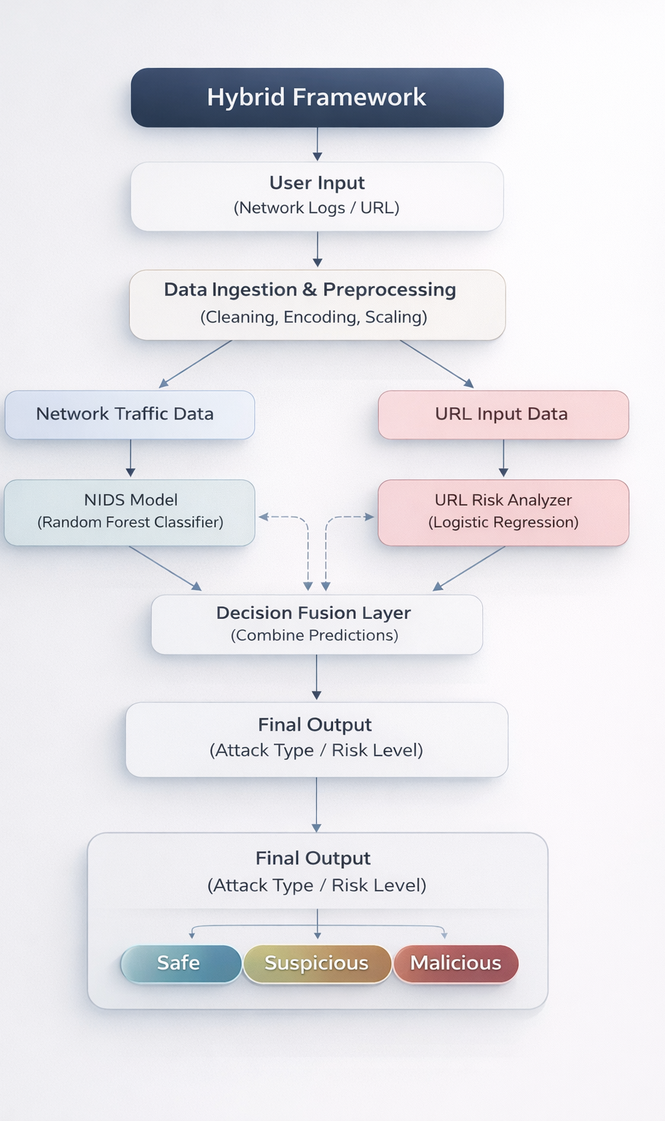
Proposed Methodology –System Overview
Two-layer hybrid system:
Network Layer (NIDS)
Application Layer (URL Scanner)
Step 1: Data Preprocessing
NSL-KDD dataset
Cleaning, normalization, encoding
Step 2: Intrusion Detection
Model: Random Forest
Detects:
DoS, Probe, R2L, U2R
Output: Normal / Attack classification

Slide 10
Proposed Methodology – URL & Integration
Step 3: URL Safety Scanner
Lexical feature extraction:
URL length, special characters, keywords
Shannon Entropy analysis
Model: Logistic Regression
Step 4: System Integration
Parallel execution of both modules
Unified decision system
Final Output:
Safe
Suspicious
Malicious

Slide 11
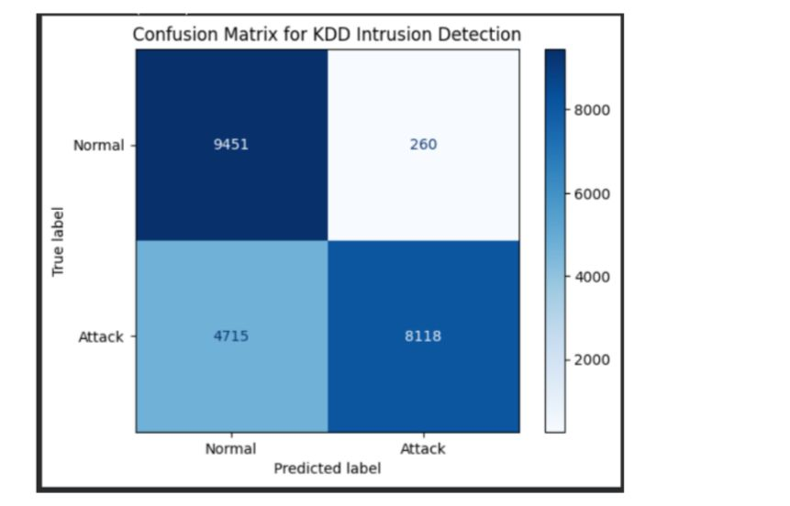
Results
Random Forest Performance:
Accuracy ≈ 87%
F1 Score ≈ 0.82
Strong detection of DoS & Probe attacks

Slide 12
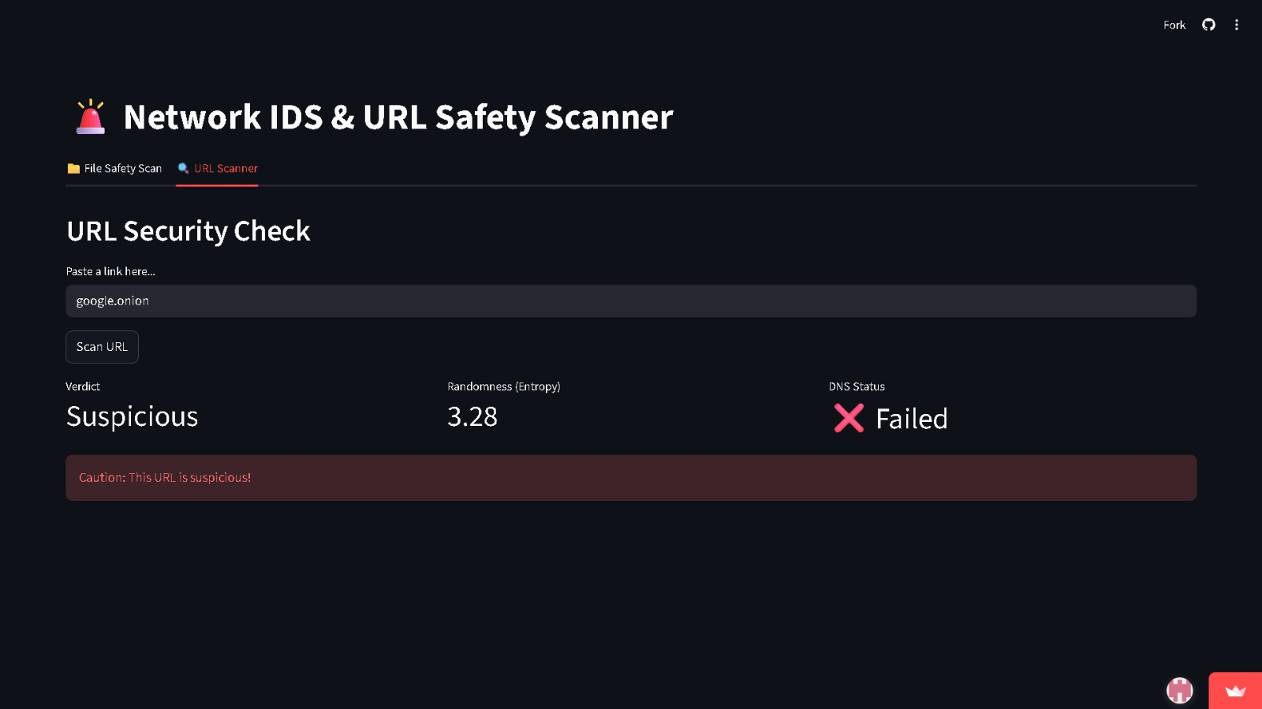
Results
URL Detection:
Fast real-time prediction
Detects unseen domains
Entropy-based detection improves accuracy

Slide 13

Outcome
Research Paper: ✅ Drafted
Hybrid System: ✅ Designed
Model Implementation: ✅ Completed
Real-time Deployment: 🔄 Partial

Slide 14

Conclusion
Hybrid system improves cybersecurity
Combines:
Network-level detection
URL-level analysis
Achieves:
High accuracy
Low latency
Better reliability

Slide 15

Future Work
Browser extension for real-time protection
Online learning for adaptive threats
Deployment in cloud & IoT systems
Advanced ensemble optimization

Slide 16
References
Satilmis et al., IEEE Access
Mathew et al., Computers & Security
Wang et al., IEEE Transactions
NSL-KDD Dataset
Shannon (Information Theory)

