Slide 1
Regularization for Machine Learning
Deepak K. Gupta
nXlearners sessions, 2018

Slide 2
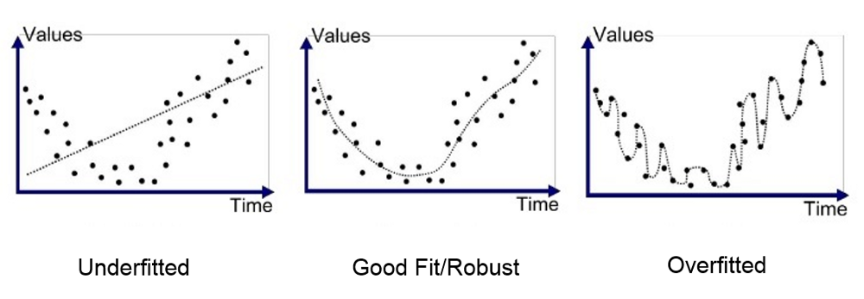
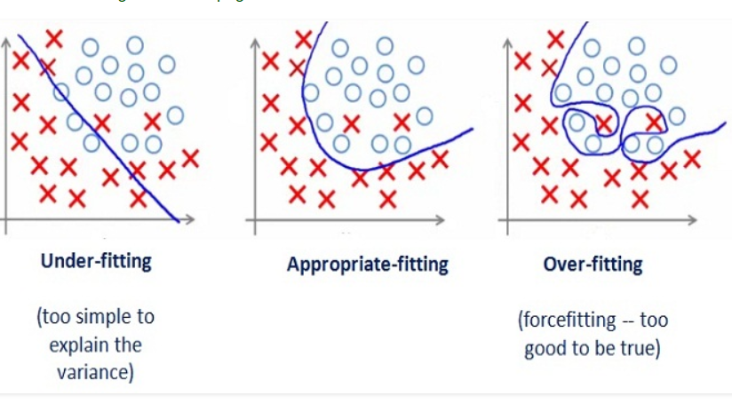
A quick recap of terms..
Underfitting, overfitting, bias and variance
A too simple model will always have an error: high bias
With a too complicated model, different training sets give a different set of weights in the presence of noise: high variance.

Slide 3

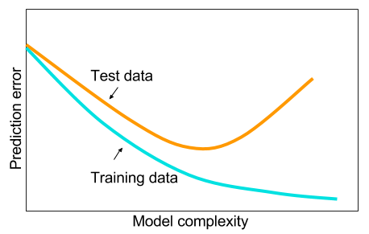
What do we want from machine learning?
Do we want our model to perform well on training data?
Do we want it to be awesome with the test data?
We need to reduce the test error, although we would never be happy in making a compromise with the training error!
Regularization constitutes the set of operations/modifications applied to a learning algorithm to reduce its generalization error, but not its training error.

Slide 4

Regularization in deep learning
Works by trading increased bias for reduced variance.
  Ideally, the goal is to significantly reduce variance, while not overly increase the bias.
In almost all cases, the best fitting model is a large model that has been regularized properly.
Some regularization approaches (covered today):
Parameter Norm Penalties
  $L^{2}$ Norm
  $L^{1}$ Norm
Norm Penalties as constrained optimization
Regularization for under-constrained problems
Dataset augmentation
Noise robustness
Semi-supervised learning
Multi-task learning

Slide 5
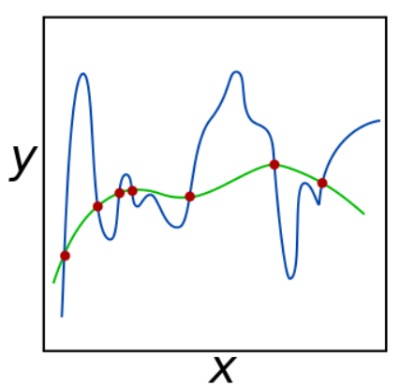

Parameter norm penalties
To limit the capacity of a fitting model, a penalty term $Ω(θ)$ can be added to the objective $J$:
$$\tilde{J}\left(θ;X, y\right)=J\left(θ, X, y\right)+αΩ(θ)$$
During minimization, measure of size of $θ$ also reduces, leading to reduced fluctuations.

Slide 6
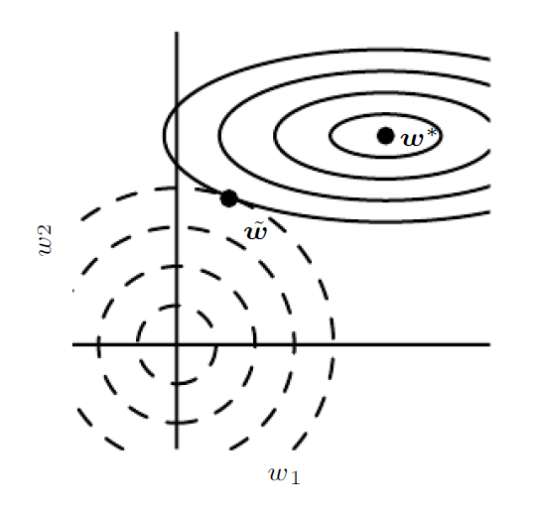

$L^{2}$ parameter regularization
Also known as ridge regression or Tikhonov regularization, can be stated as:
$$\tilde{J}\left(w;X, y\right)=J\left(w, X, y\right)+\frac{α}{2}w^{T}w$$
At every iteration, the gradient-based update on the weights can be stated as:
$$w_{i+1}=\left(1−εα\right)w_{i}−ε∇_{w}J(w;X, y)$$
Regularization impacts directions along which the eigen values of $H$ are relatively small. In a large hyperspace, components of $J$ along weak eigen modes are suppressed.
Directions along which the parameters contribute significantly to reducing the objective function are preserved relatively intact.
Addition of weight decay modifies the learning rule to shrink the weight term by a certain factor at each step.

Slide 7
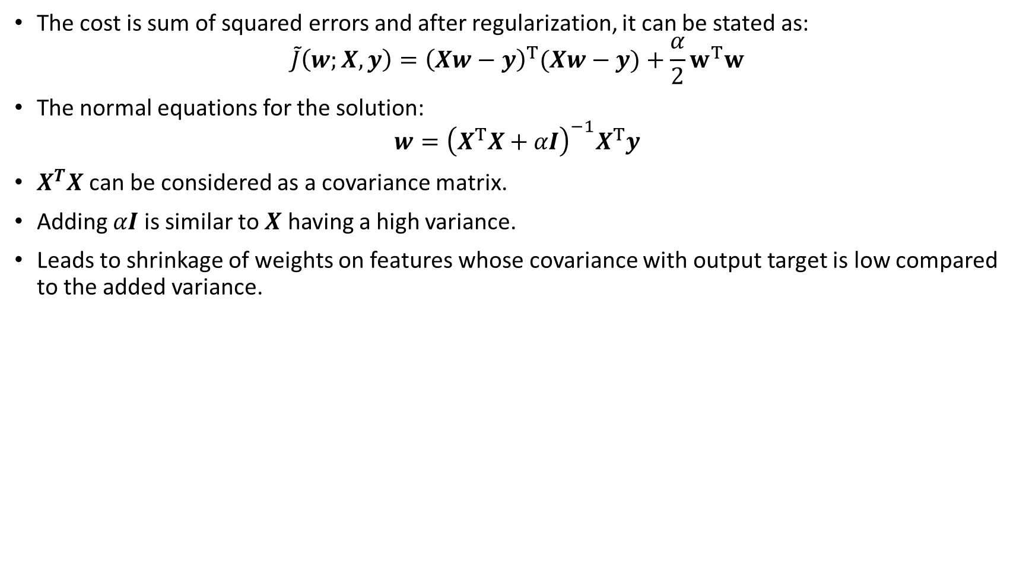
$L^{2}$ regularization in linear regression
The cost is sum of squared errors and after regularization, it can be stated as:
$$\tilde{J}\left(w;X, y\right)={\left(Xw−y\right)}^{T}(Xw−y)+\frac{α}{2}w^{T}w$$
The normal equations for the solution:
$$w={\left(X^{T}X+αI\right)}^{−1}X^{T}y$$
$X^{T}X$ can be considered as a covariance matrix.
Adding $αI$ is similar to $X$ having a high variance.
Leads to shrinkage of weights on features whose covariance with output target is low compared to the added variance.

Slide 8
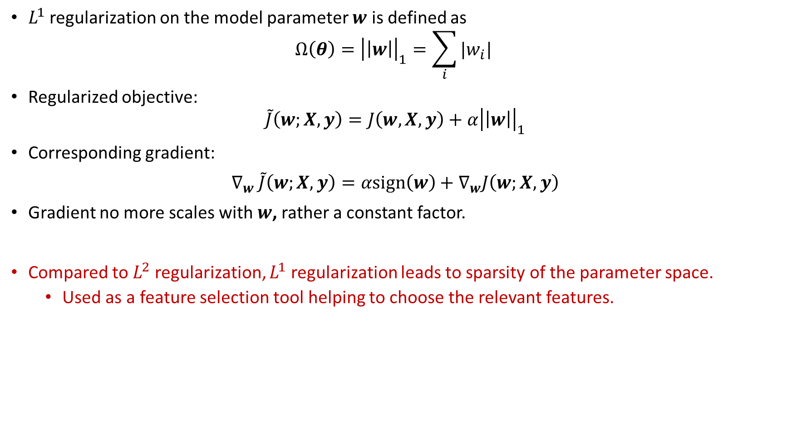
$L^{1}$ parameter regularization
$L^{1}$ regularization on the model parameter $w$ is defined as
$$Ω\left(θ\right)={\left|\left|w\right|\right|}_{1}=\sum_{i}{|w_{i}| }$$
Regularized objective:
$$\tilde{J}\left(w;X, y\right)=J\left(w, X, y\right)+α{\left|\left|w\right|\right|}_{1}$$
Corresponding gradient:
$∇_{w}$ $\tilde{J}\left(w;X, y\right)=αsign\left(w\right)+∇_{w}J\left(w;X, y\right)$
Gradient no more scales with $w$, rather a constant factor.
Compared to $L^{2}$ regularization, $L^{1}$ regularization leads to sparsity of the parameter space.
  Used as a feature selection tool helping to choose the relevant features.

Slide 9

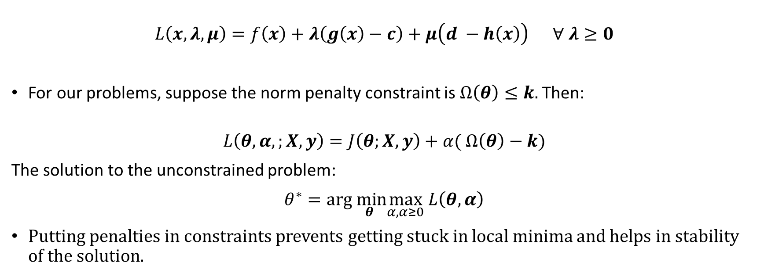
Norm Penalties as Constrained Optimization
$$L\left(x, λ, μ\right)=f\left(x\right)+λ\left(g\left(x\right)−c\right)+μ\left(d −h\left(x\right)\right) ∀ λ≥0$$
For our problems, suppose the norm penalty constraint is $Ω\left(θ\right)≤k.$Then:
$$L\left(θ, α,;X, y\right)=J\left(θ;X, y\right)+α( Ω\left(θ\right)−k)$$
The solution to the unconstrained problem:
$θ^{∗}=arg\min_{θ}\max_{α, α≥0}$ $L\left(θ, α\right)$
Putting penalties in constraints prevents getting stuck in local minima and helps in stability of the solution.

Slide 10
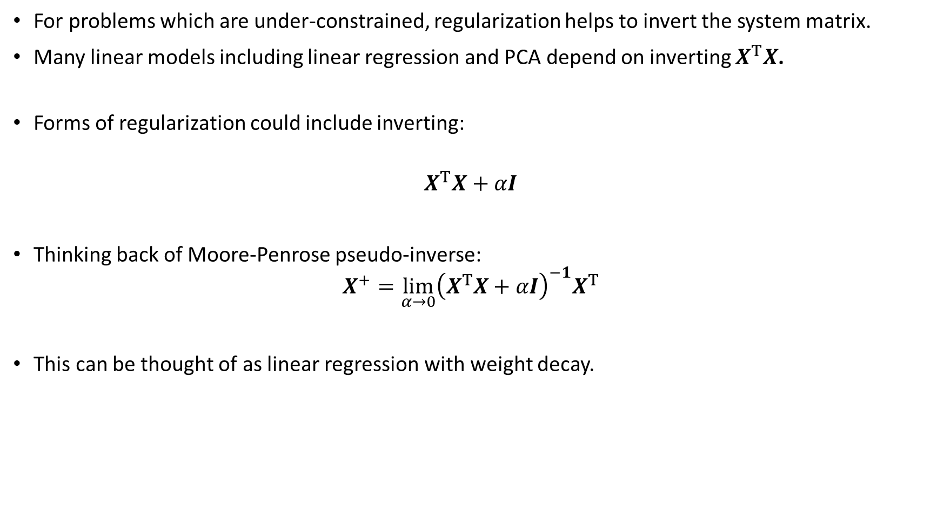
Regularization and under-constrained problems
For problems which are under-constrained, regularization helps to invert the system matrix.
Many linear models including linear regression and PCA depend on inverting $X^{T}X$.
Forms of regularization could include inverting:
$$X^{T}X+αI$$
Thinking back of Moore-Penrose pseudo-inverse:
$$X^{+}=\lim_{α→0}{\left(X^{T}X+αI\right)}^{−1}X^{T}$$
This can be thought of as linear regression with weight decay.

Slide 11
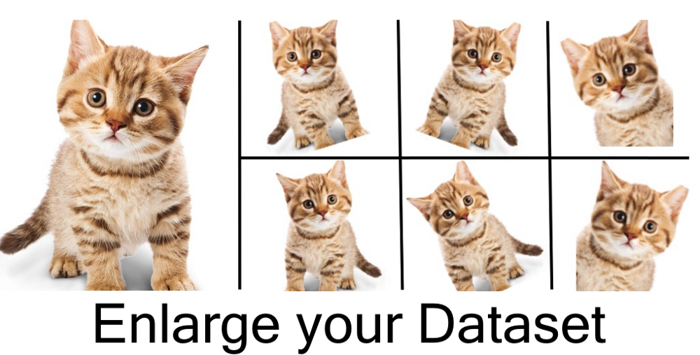
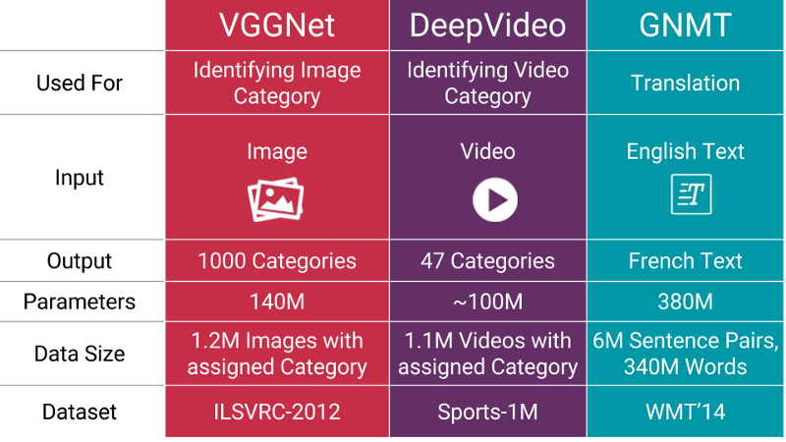

Dataset augmentation
Machine learning models generalize better in the presence of more data.
Generating fake data from the available data is a common practice:
  Exploring samples from the high-dimensional image space
  Partial translations using convolution, pooling, etc.
  Injecting different types of noise

Slide 12


Noise robustness
Noise applied to weights can be interpreted as a more traditional form of regularization, encouraging stability of the function to be learned.
  Is treated as an uncertainty associated with the weights in Bayesian learning.
  Intuitively, it helps to avoid overfitting.
Injecting noise at the output targets
  Pushing output to 0 or 1 when $y$ has some error, can be wrong
  Label smoothing on the output data is a common practice
Semi-supervised learning
Trading off supervised criterion $−logP\left(\frac{y}{x}\right)$ with unsupervised one ($−\log{x}$ or $−\log{x,y}$) helps to express a particular form of prior belief about the solution to the supervised learning problem.

Slide 13
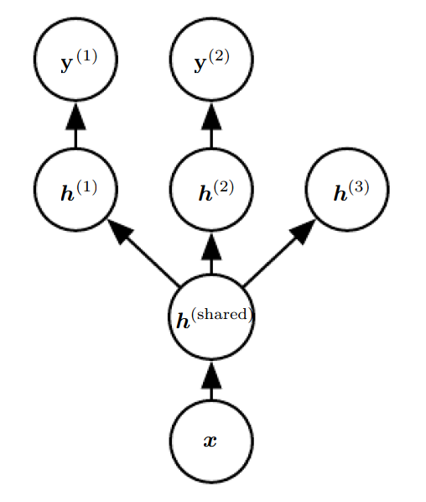
Multi-task learning
Way to improve generalization by pooling the example arising out of several tasks.
Model comprises two parts:
  Task specific parameters forming upper layers of the network.
  Generic parameters shared across all tasks.
With part of the model shared across several tasks, model is more constrained towards good values.

Slide 14
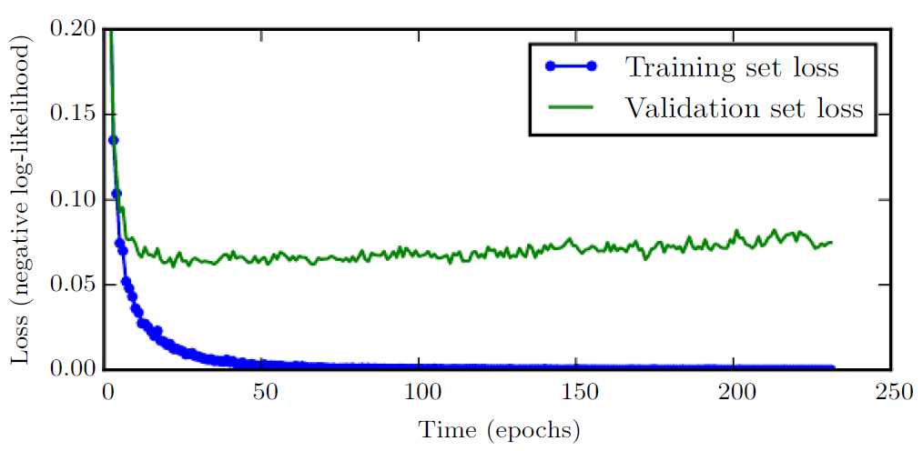
Early stopping
Training error steadily decreases over time, but validation error begins to rise again.
Early stopping meta-algorithm terminates when no parameters have improved over the best recorded validation error for some pre-specified number of iterations.
Very unobtrusive form of regularization, since it requires no change in the underlying training procedure and objective function.

