Slide 1
EDA Case Study
By Harpreet Virk & Dinesh Khambam

Slide 2
Problem Statement
As we are working for a finance company, the company wants to understand the driving factors behind loan default.
The company can utilize this knowledge for its portfolio and risk assessment.

Slide 3
Analysis Approach
As per the dataset and data dictionary given, we resorted to the approach as follows:
We first cleaned the dataset to remove unnecessary variables.
Did some basic transformations on the dataset to split certain variables into categories.
Next, we identified the variables that we would be needing for analysis and created some visualisations for the same.

Slide 4
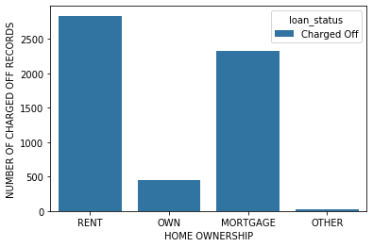
Visualizations and inferences
Plot 1: This shows the number of charged off accounts based on home ownership.
Inference:
As we can see, the borrowers who have listed their home ownership as rent are defaulters as compared to other borrowers who have their own houses or on mortgage.

Slide 5
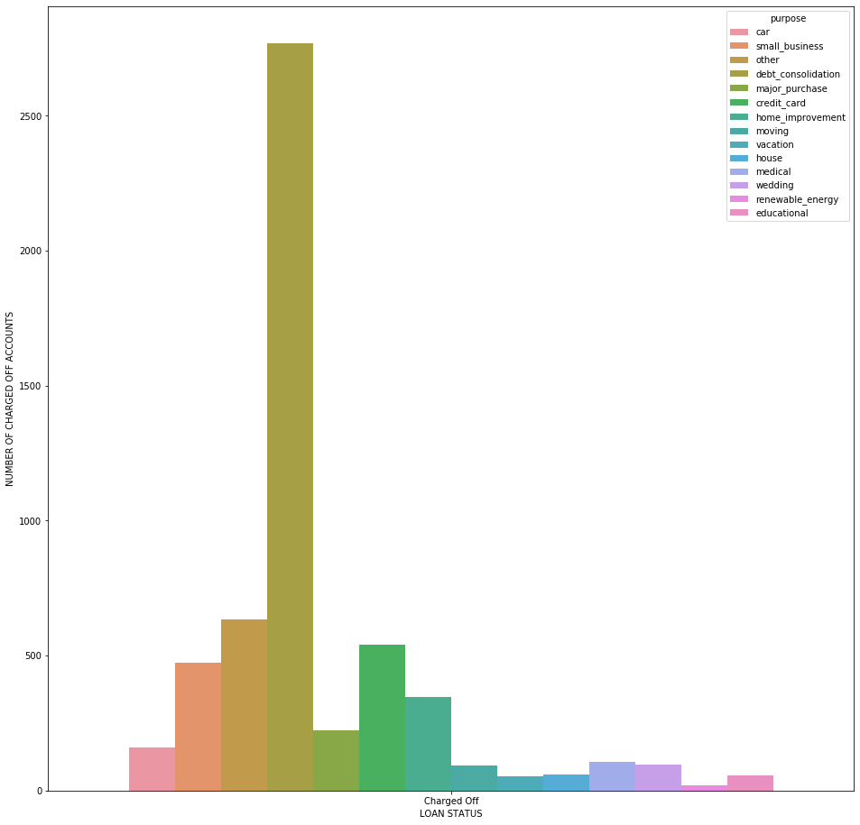
Plot 2: Number of charged off accounts for each purpose
Inference:
The highest number of charged off accounts is for ‘debt consolidation’ which means the borrower has issued a loan to pay off his debts.

Slide 6
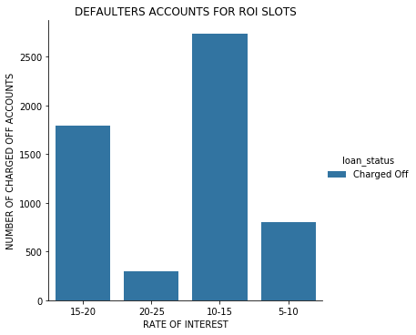
Plot 3: Plotting charged off accounts based on rate of interest slots
Inference:
The highest number of charged off accounts have Rate of interest between 10%-15%.

Slide 7
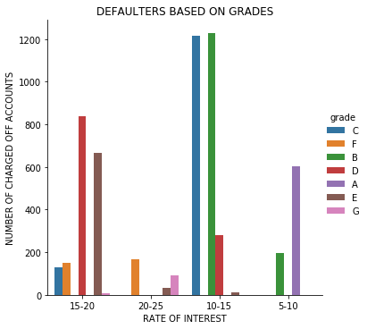
Plot 4: Plotting grades for the slotted 'int_rate‘
Inference:
Higher the grade, more is the rate of interest.
Highest number of defaulters are assigned Grade B which has Rate of interest between 10-15%

Slide 8
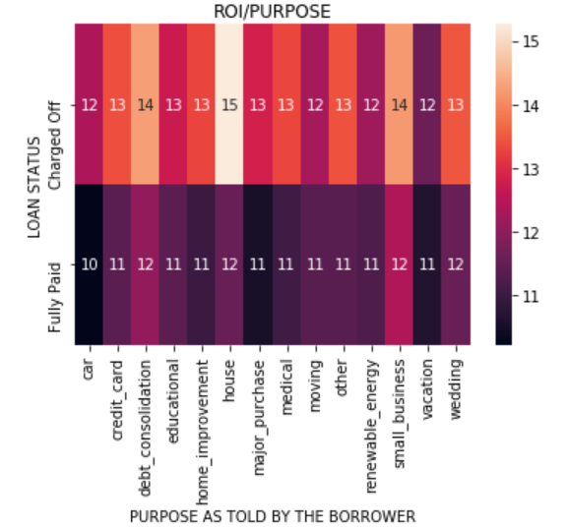
Plot 5: Heat-map showing average ROI with respect to purpose.
Inference:
This shows that there is a correlation between higher rate of interest and purpose .
ROI is the highest for House and is 2nd highest for Debt Consolidation and Small business this purpose under charged off accounts.

Slide 9
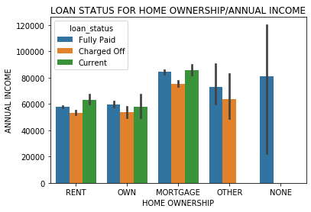
Plot 6: Plot showing annual income against home ownership with each loan status
Inference:
The borrowers with the highest annual income have listed their home ownership as mortgage for fully paid.

Slide 10
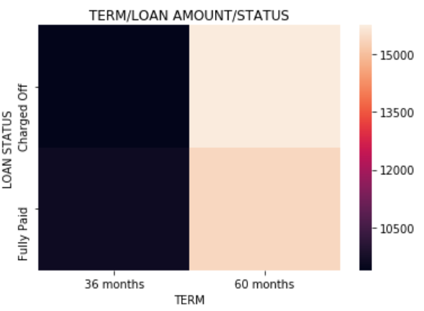
Plot 7: Heat-map showing loan amount for each loan status with the term
Inference:
The highest average amount of charged off accounts had the loan term recorded as 60 months.

Slide 11
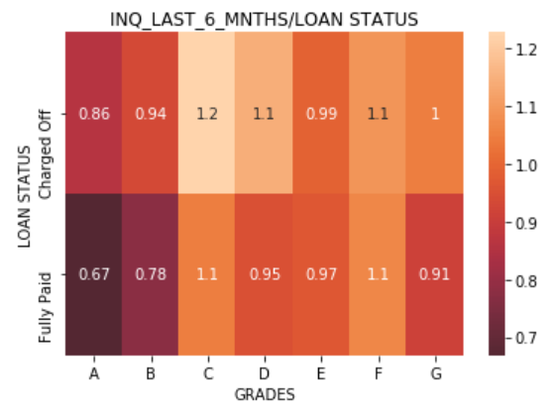
Plot 8: Heat-map showing 'inq_last_6_mnths' for grades
Inference:
The highest number of defaulter borrowers had a high rate of interest and have made highest number of inquiries in the last 6 months.

Slide 12
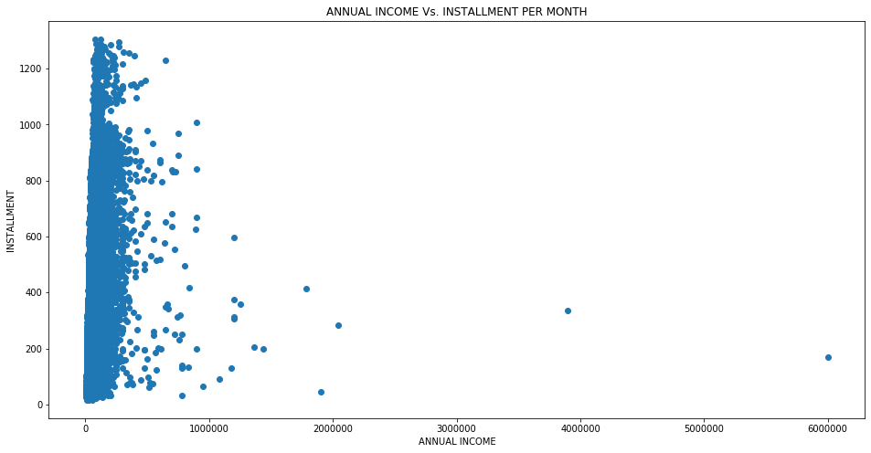
Plot 9: Scatter plot for income vs. Installment
Inference:
The lower the annual income, higher the installment leading to more defaulters.

Slide 13
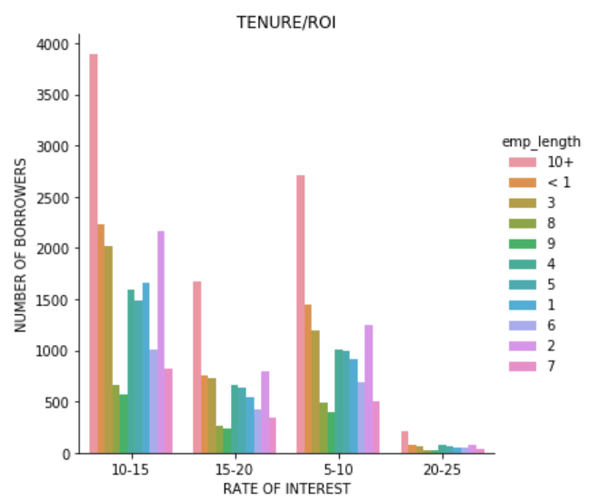
Plot 10: Plot showing the tenure of a borrower vs. the ROI he is charged at
Inference:
More the tenure, lesser the rate of interest as compared to employees with less tenure in the same company which increases the chance of defaulting

Slide 14
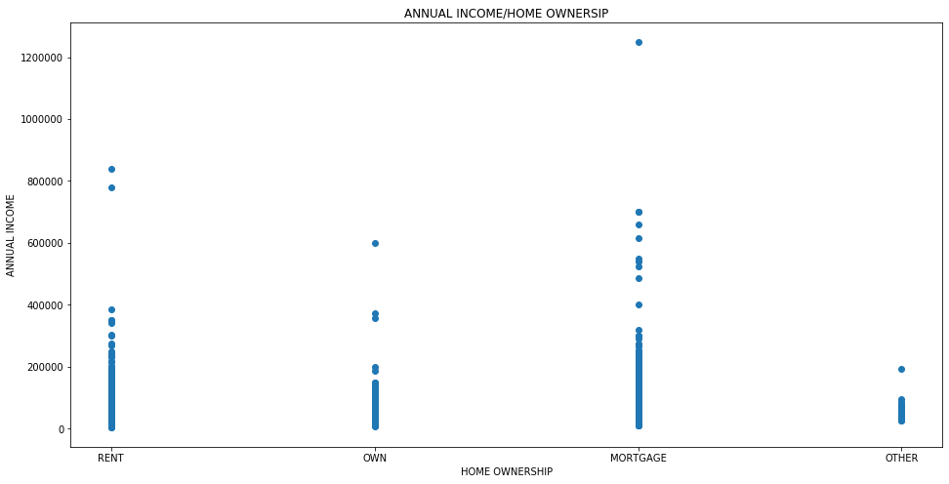
Plot 11: Scatter plot showing annual income vs. Home ownership
Inference:
The defaulter borrowers with the highest annual income have listed their home ownership as mortgage.

Slide 15
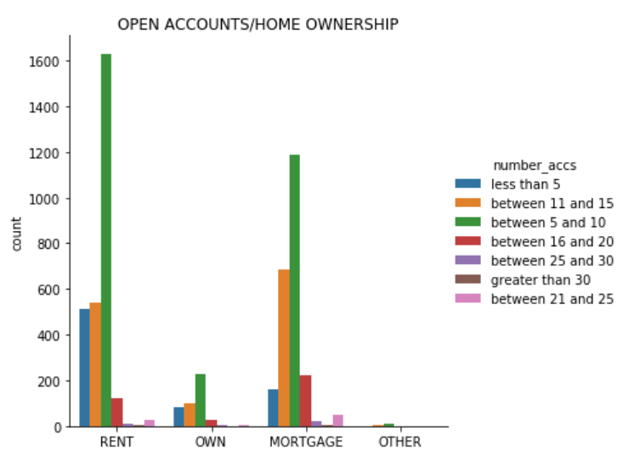
Plot 12: Number of open accounts for each home ownership
Inference:
The highest number of open accounts lie between 5 and 10 for defaulters and list home ownership as RENT.

Slide 16
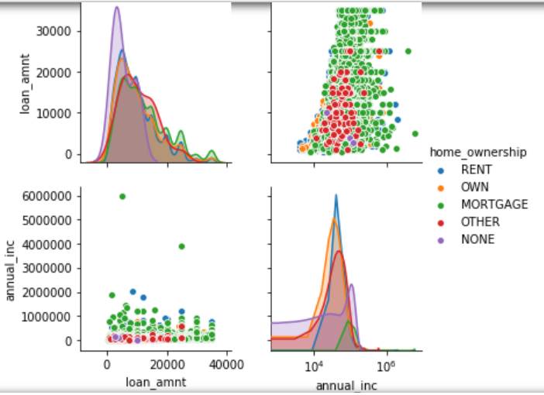
Plot 13: Pair-plot showing comparison among the main variables.
Inference:
Relation between among various variables pertaining to home ownership.

Slide 17
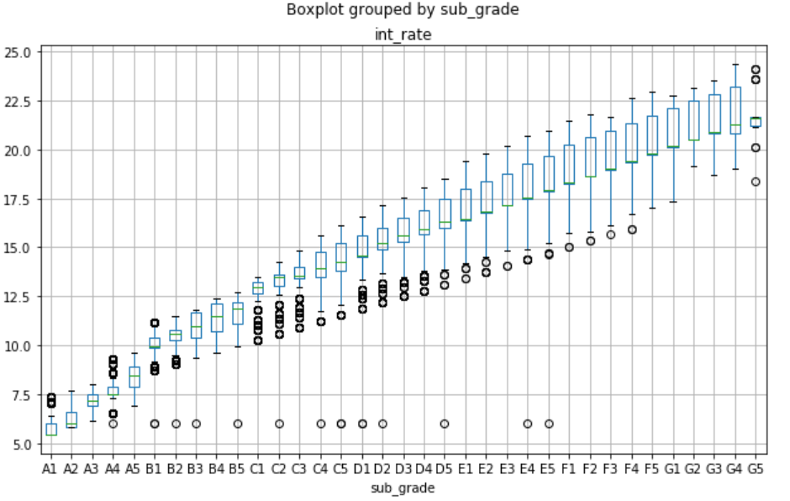
Plot 14: Boxplot showing Sub Grade Vs Interest Rates
Inference: Higher the Sub-Grade then higher is the Risk and so higher is the Interest Rate.

Slide 18
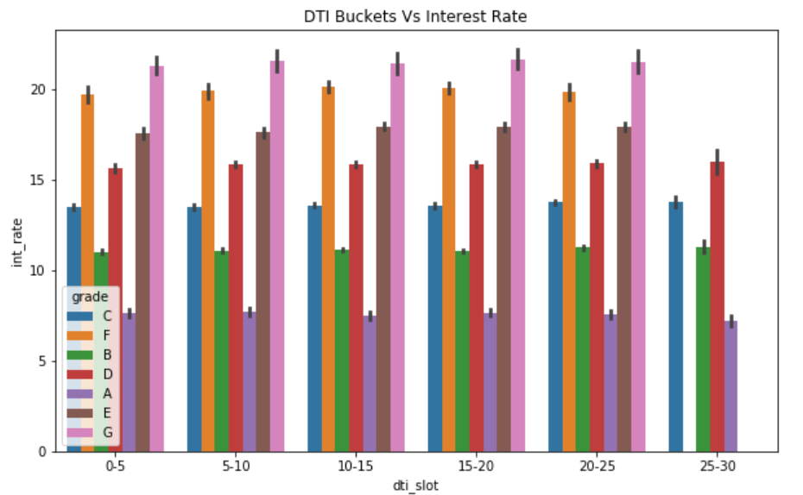
Plot 15: DTI Vs Interest Rates for different Grades (for Charged-off)
Inference:
Despite having Better DTI the loans with Higher grades still have High risk and their interest rates are Comparatively higher.

Slide 19
Conclusion:
To sum it up, the driving variables to identify loan defaulters as shown on visualization above are:
The Rate of Interest
Home ownership
Purpose
Installment per month
Annual income
Grade/Subgrade
DTI

Slide 20
Recommendations:
Customers with high DTI ratio needs to be charged a high interest rates as the risk associated with those loans is high (or) their Loan amount needs to be reduced (or) both based on the business preference.
Loans graded high risk if granted needs to be charged a high interest to mitigate the risk.
Loans for the purpose of Debt Consolidation have highest number of defaulters and the loan amount may be reduced (or) loans needs to be charged a high interest rate (or) both based on business preference.

