Slide 1
BPO Operations Analytics
SLA Performance & Systemic Bottlenecks
Executive Presentation & Strategic Recommendations
Danish Khan
Data Analyst

Slide 2
The Business Objective
Primary Question:
Why is the organization failing to meet its 48-hour Service Level Agreements, and how is this impacting customer satisfaction?
Goal:
Identify operational bottlenecks and process failures across channels to design targeted routing adjustments and staffing strategies.
Scope:
Analysis of over 200,000 historical customer support tickets.

Slide 3
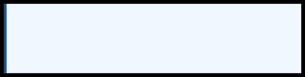
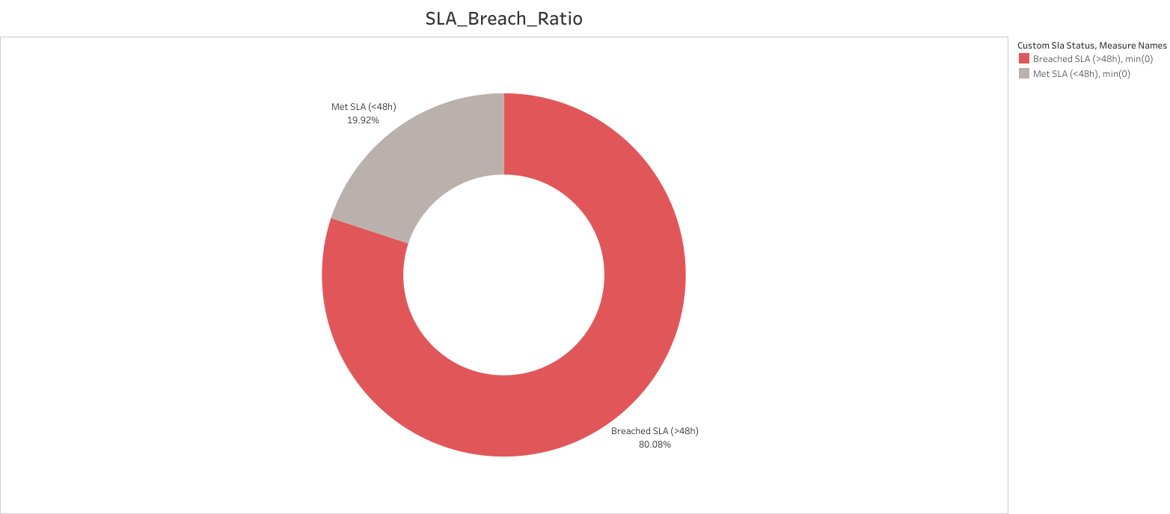
Overall SLA Performance :The 80% Crisis
Key Finding: 80% of all closed tickets fail to meet the 48-hour SLA deadline.
40,029 Total Closed Tickets
32,055 Breached SLA (>48h)
(80.08% - TheOperationalDeficit)
7,974 Met SLA (<48h)
(19.92% - TheSuccessfulCore)

Slide 4

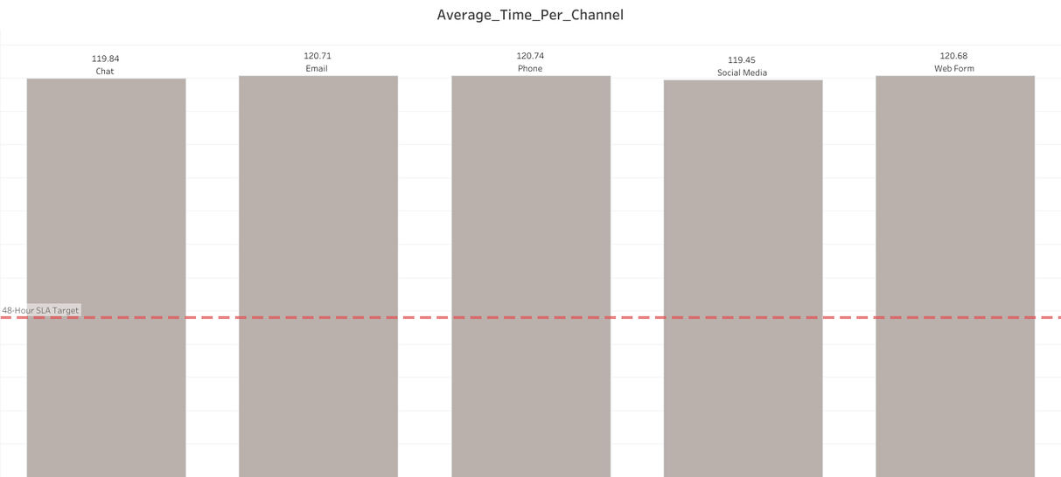
Channel Bottlenecks: Systemic Floor Delays
Key Finding: The failure is not isolated. Every single department is missing the 48-hour target by exactly the same margin.
Phone & Email (~120.7 hours):
Highest volume channels are trapped in identical backlog loops.
Chat & Social (~119.5 hours): Expected "rapid response" channels are failing to provide expedited resolution.

Slide 5
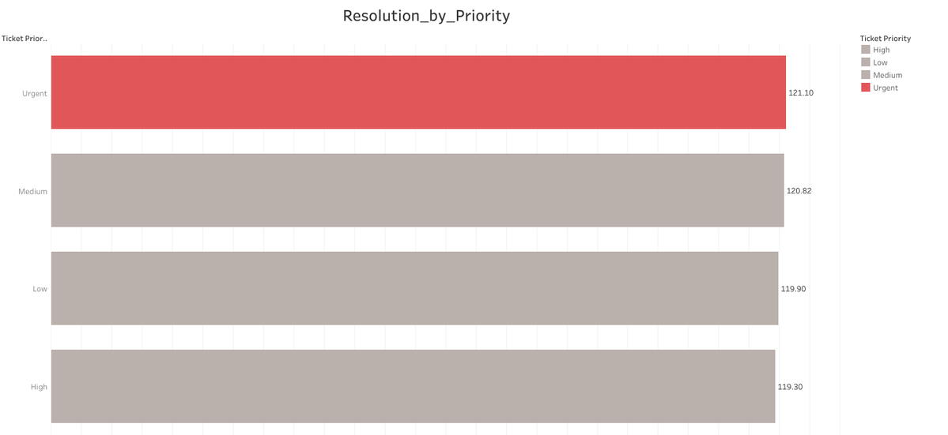
Priority Routing : Inverted Resolution Times
Key Finding: The internal IT routing system is actively failing its purpose.
Urgent (121.1 hours):
Automated systems tag tickets as "Urgent", but they take the longest time to resolve.
Low (119.9 hours):
Lowest priority tickets are being resolved faster than emergencies.
Insight: Agents are cherry-picking easier, low-priority tickets from the queue instead of adhering to forced priority routing.

Slide 6
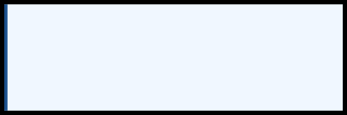
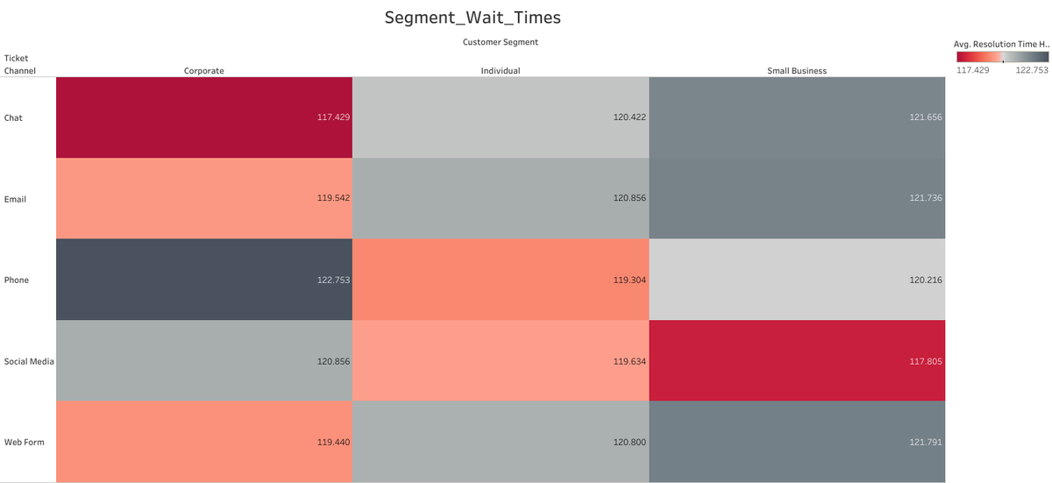
High-Value Revenue Risk
Key Finding: Corporate clients are waiting identically long as standard users, risking contract renewals.
Corporate Segment:
Our highest revenue drivers wait over 117 hours across all channels, receiving no dedicated expedited service.
Small Business & Individual:
Wait times are evenly distributed, proving there is no VIP routing protocol in place.

Slide 7
Strategic Recommendations
1. Audit IT Routing & Implement Force-Routing
Investigate the CRM logic immediately. Remove the UI capability for floor agents to manually cherry-pick easier tickets. Implement a strict "next-in-queue" automated push to ensure Urgent tickets are handled first.
2. Launch a Dedicated VIP Queue
Protect high-revenue contracts by pulling the top 10% of senior agents off the general floor. Dedicate this rapid- response unit strictly to the 'Corporate' customer segment.
3. Immediate Headcount & Budget Review
Process fixes cannot solve a fundamental lack of resources. Because all channels are operating at 2.5x the allowed SLA time, an immediate budget request for increased general headcount is required.

Slide 8
Thank You
Data-
Driven
Decisions
for BPO's
Future

