Slide 1
Cyclistic Bike-Share
Converting Casual Riders to Annual Members
Executive Presentation & Strategic Recommendations
Danish Khan Junior Data Analyst

Slide 2
The Business Objective
Primary Question: How do annual members and casual riders use Cyclistic bikes differently?
Goal: Identify behavioral patterns to design targeted marketing strategies to convert casual users into profitable annual members.
Scope: Analysis of over 3.7 million historical rides (Nov 2024 - Oct 2025).
Data Integrity: All data rigorously cleaned and validated. No Personally Identifiable Information (PII) was used, ensuring complete user privacy.

Slide 3
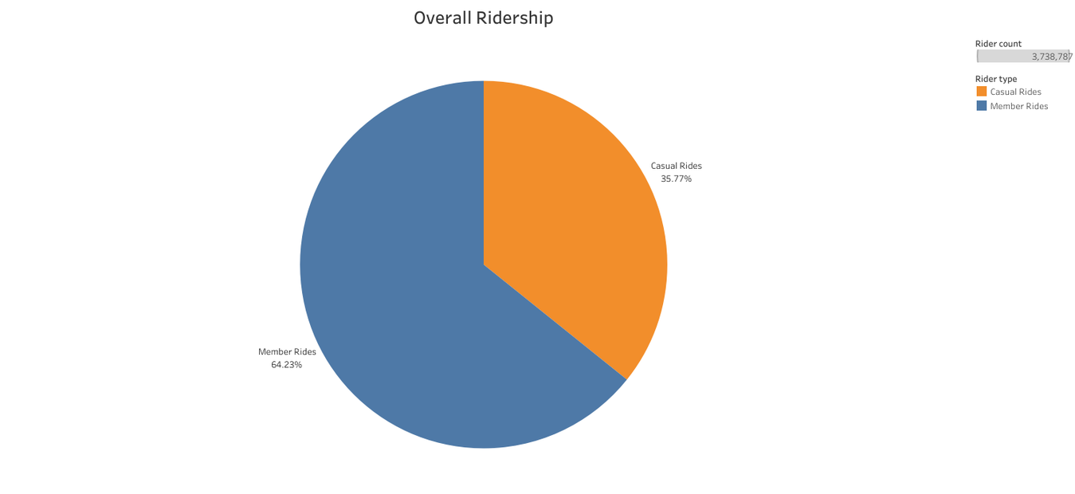
Overall Ridership: The Conversion Opportunity
3,738,787 Total Rides
64.2% Annual Members
(2.4MRides - TheStableCore)
35.8% Casual Riders
(1.3MRides - TheOpportunity)

Slide 4
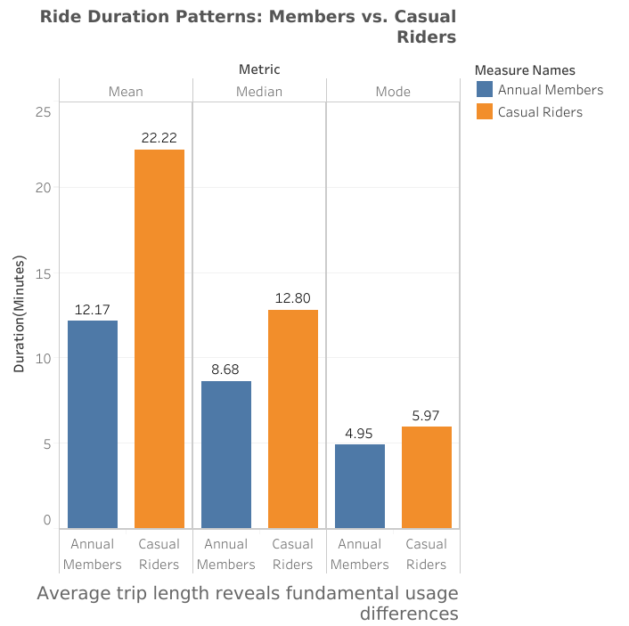
Ride Duration: Efficiency vs. Exploration
Key Finding: Casual riders take trips that are nearly twice as long as members (82% longer on average).
Members (12.2 mins): Focused, point-to-point utility and commuting.
Casuals (22.2 mins): Leisure, sightseeing, and recreational exploration.

Slide 5
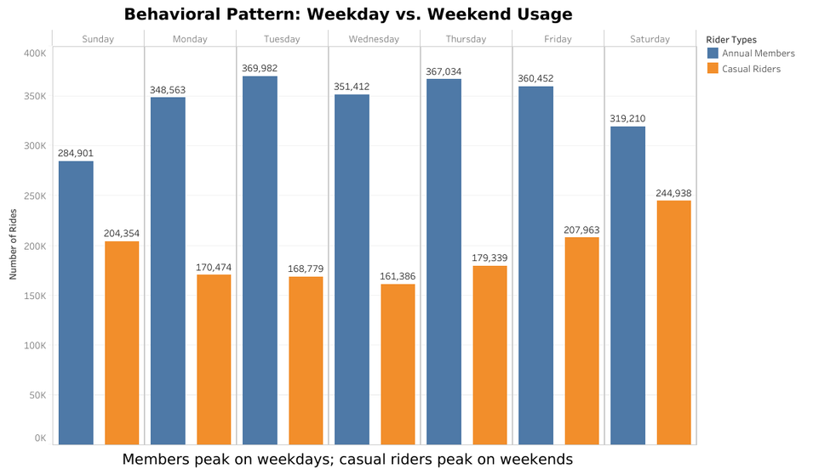
Day of Week Patterns: Commuters vs. Weekenders
Members: Dominate the work week (Monday-Friday), peaking mid- week.
Casuals: Experience a massive surge on weekends. Over 33% of
all casual rides happen on Saturday or Sunday.

Slide 6
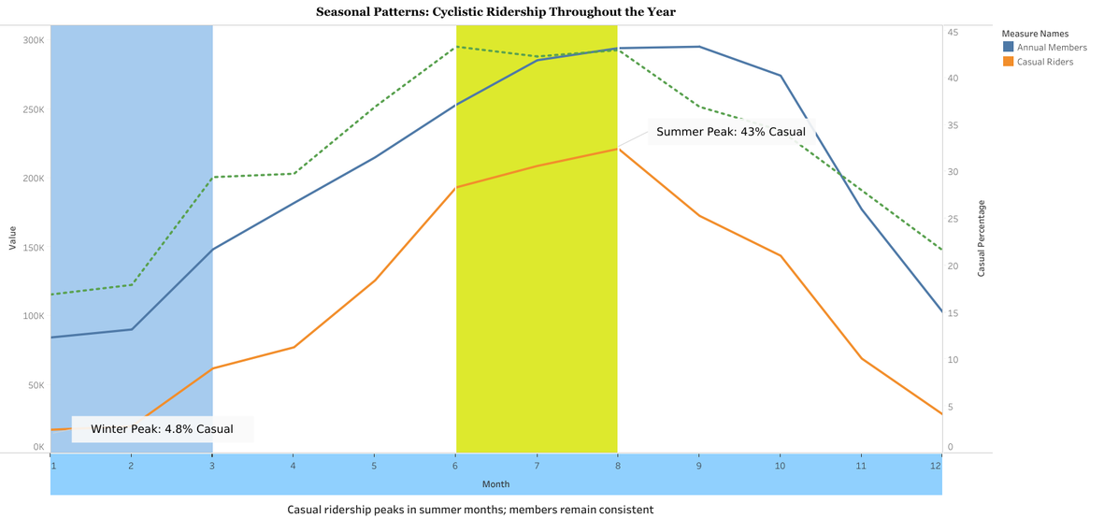
Seasonal Trends: The Summer Spike
The Winter Baseline: Members maintain steady usage year-round. Casual usage drops to ~17% of total rides.
The Summer Explosion: Casual ridership peaks dramatically in June, July, and August (reaching 43% of total volume).

Slide 7
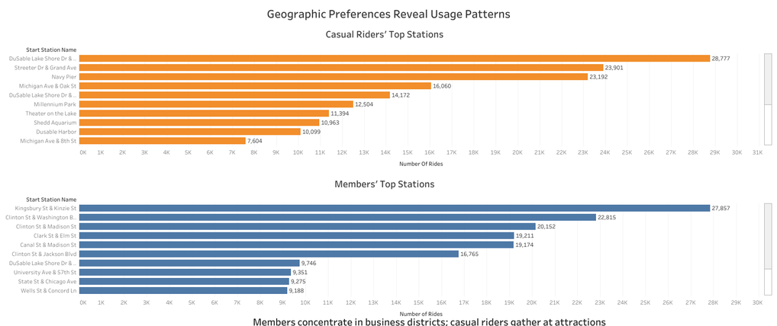
Geographic Preferences: Business vs. Leisure
Member Hubs: Centered around business districts and transit stations (e.g., Kingsbury St).
Casual Hotspots: Heavily clustered around tourist attractions and the lakefront (e.g., DuSable Lake Shore Dr, Navy Pier).

Slide 8
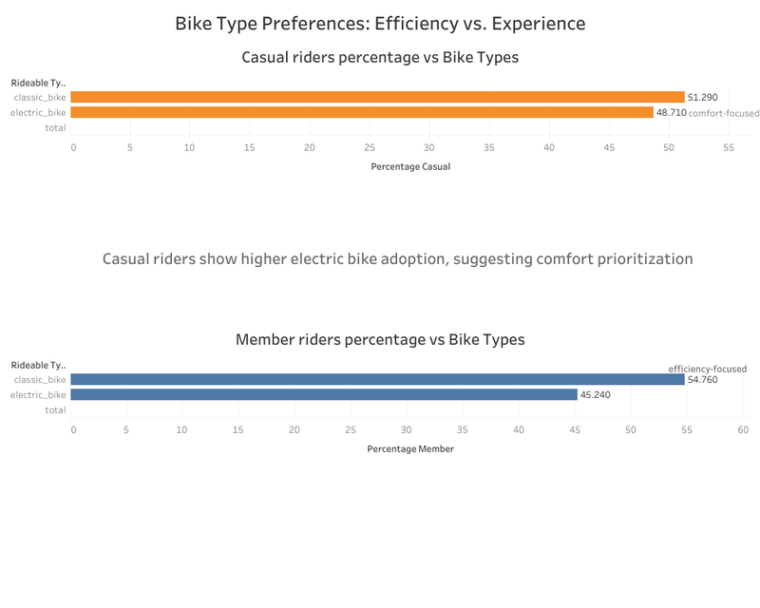
Bike Type Preferences
Classic Bikes (53.5%): Remain the dominant choice overall, particularly favored by Members for routine commutes.
Electric Bikes (46.5%): Seeing strong adoption from both groups, but Casual riders show a slightly more balanced preference.

Slide 9
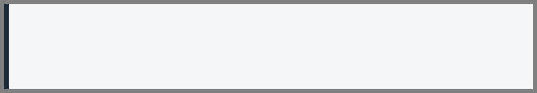
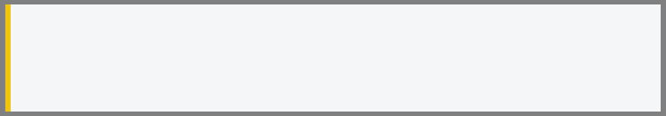

Strategic Recommendations
1. Target the "Weekend Explorer"
Casual usage spikes on Saturdays and Sundays. Introduce a targeted "Weekend-to-Annual" upgrade
promotion directly targeting weekend riders.
2. Launch a Summer Conversion Campaign
Concentrate the marketing budget on the June-August window. Deploy geo-fenced mobile ads and
physical signage at top casual stations like Navy Pier and DuSable Lake Shore Dr.
3. Emphasize "Duration Value" in Messaging
Casual trips average 22 minutes (82% longer than members). Marketing should emphasize the cost-
savings of an annual membership for long, leisurely rides to overcome price objections.

Slide 10
Thank You
Data-DrivenDecisionsforCyclistic's Future
Danish Khan | Junior Data Analyst

