Slide 1
New York City Taxi Fare Prediction
Gagan arora
Shagufta pathan
Deepak khirey

Slide 2
Proposal

Slide 3
Introduction
The New York City Taxi Fare Prediction dataset is a challenge hosted by Kaggle in partnership with Google Cloud and Coursera.
This dataset uses a selection from the massive New York City (NYC) Taxi and Limousine Commission (TLC) Yellow Cab dataset that is also publicly available on Big Query.
This is an open competition and is accepting late submissions.
Competition Link -
https://www.kaggle.com/c/new-york-city-taxi-fare-prediction#description

Slide 4
Dataset
The dataset is in the form of csv files.
The training set consists of 55M rows
The test set consists of 10K rows.
The target variable is the fare_amount (float) dollar amount of the cost of the taxi ride which is only available in the train.csv file.
Feature | Data Type | Description
pickup_datetime | timestamp | value indicating when the taxi ride started.
pickup_longitude | float | longitude coordinate of where the taxi ride started.
pickup_latitude | float | latitude coordinate of where the taxi ride started.
dopoff_longitude | float | longitude coordinate of where the taxi ride ended.
dropoff_latitude | float | latitude coordinate of where the taxi ride ended.
passenger_count | integer | indicating the number of passengers in the taxi ride.

Slide 5
Machine Learning Models Proposed
This is a Supervised Regression machine learning task
We aim to tackle this using regression algorithms
Linear Regression
Random Forest
Decision Trees
We will carry out Statistical Significance test to decide best performing model.
We will use cross-validation and hyper-parameter tuning techniques to improve accuracy of selected model.

Slide 6
Model Accuracy Metrics
We plan to use Root Mean Squared Error (RMSE) as the evaluation metric .
Same is used by Kaggle to evaluate entries.
This way we can benchmark against Public Leaderboard.
RMSE measures the difference between the predictions of a model, and the corresponding ground truth. One nice property of RMSE is that the error is given in the units being measured, so we can get directly accuracy of the model on unseen data.

Slide 7
Machine Learning Pipeline
Exploratory Data Analysis
Data Preparation
Feature Engineering
Model evaluation
Model Optimization
Pipeline Execution

Slide 8
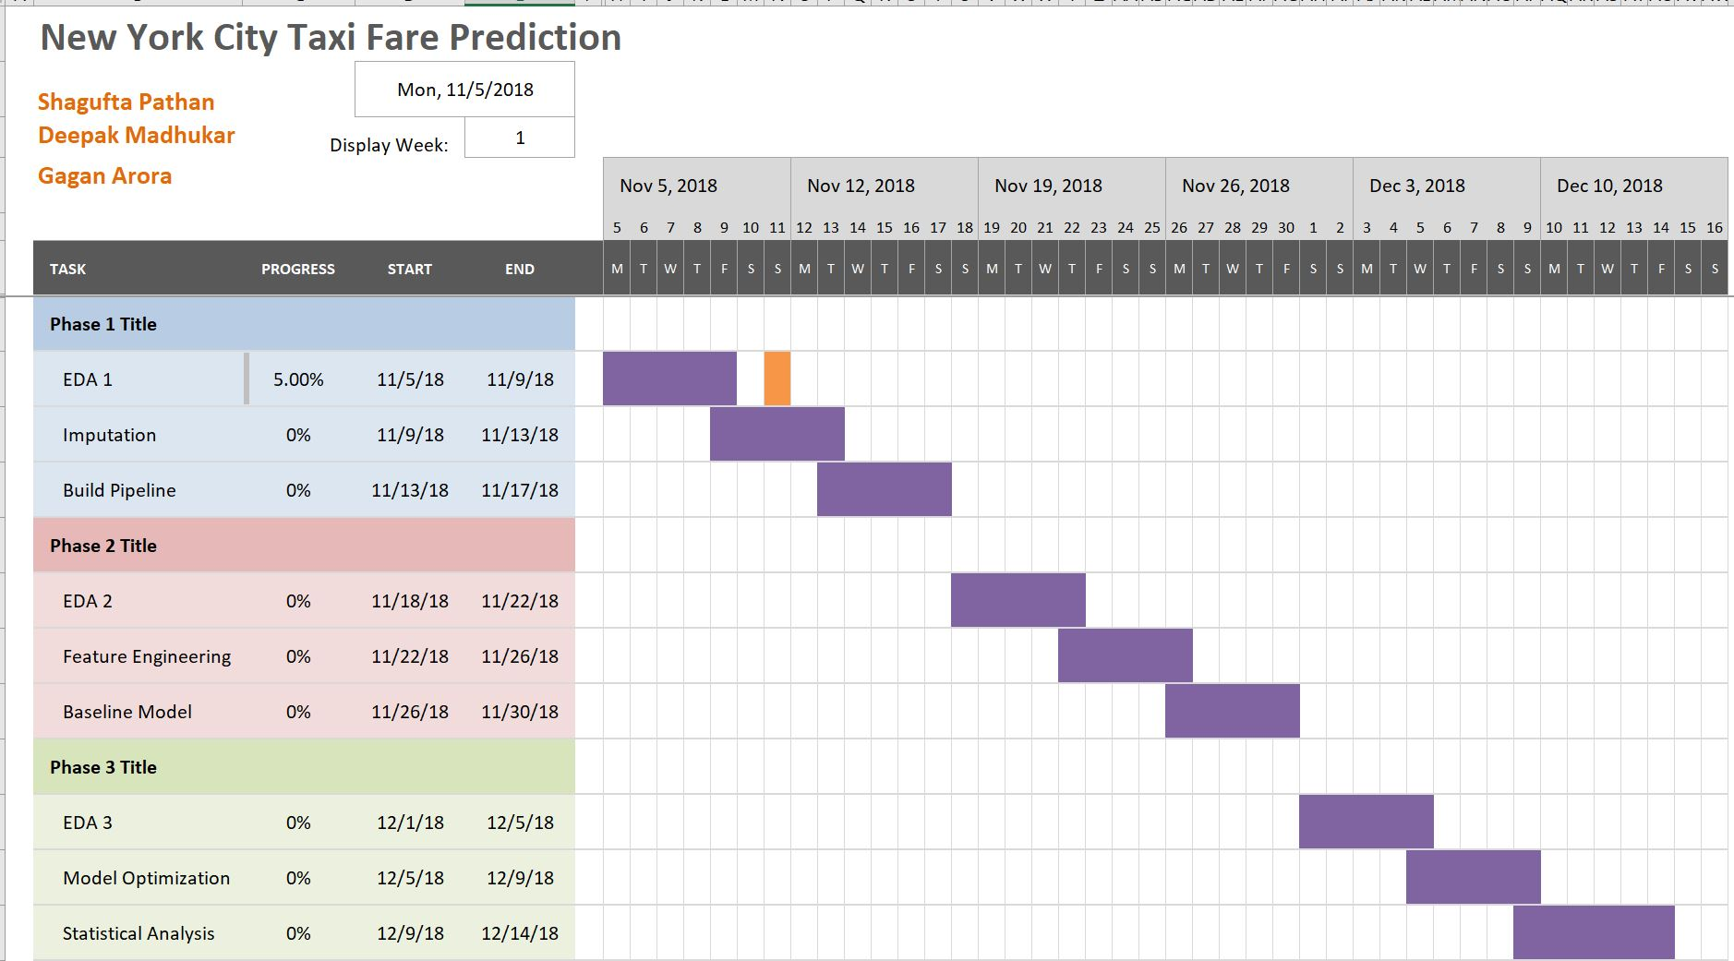
Project Timeline

Slide 9
Team Work
Gagan | Deepak | Shagufta | Team Effort
Data Cleaning including imputation of missing values, removing outliers etc. Building SkLearn pipelines | Basic EDA (1) Model Optimization using hyperparameter tuning techniques | Baseline Models Feature Engineering/ Feature Selection Basic EDA (2) | Integrating SKLearn pipelines Discussions, results and conclusions Creating slides and presentation.

Slide 10
Phase 1: New York City Taxi Fare Prediction

Slide 11
Data
Total Training Data Size – 55423856 X 7 Total Test Data Size – 9914 X 6
For Phase1, out of 55 million rows, we down sampled and utilized only 1 million rows.
Why?
We have limited compute power as compared to the huge dataset size
Smaller dataset allows to experiment easily as execution times are less

Slide 12
Exploratory Data Analysis
‘key’ column is duplicate of pickup_datetime column
dropoff_longitude and dropoff_latitude values are null (376 rows out of 55M)
Longitudes are beyond range (-180,180)
Latitudes are beyond range (-90,90)
‘fare_amount’ column has outliers (less than $2.5 and more than $100)
90% of the fare_amount is less than $20
‘passenger_count’ has outliers (more than 6 passengers)
All of the ‘Bad Data’ lies outside 96 percentile values
Plotted the pick up and drop off locations on the map of New York City
Some of the points are in water

Slide 13
Data Cleanup
Dropped Unwanted data
Removed the outliers in all the columns using percentile approach
Dropped rows where dropoff_longitude and dropoff_latitude are null using dropna
Dropped key column which is same as pickup_datetime column
Dropped rows where fare_amount is greater than $100
Dropped rows where fare_amount is less that $3.5
Dropped rows where passenger_count is greater than 6
Most of the ‘Bad Data’ lies outside 96 percentile range
874468
1000000
Data Cleanup

Slide 14
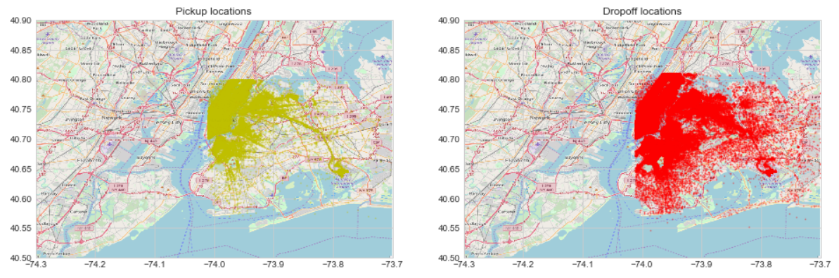
Dots on the Map

Slide 15
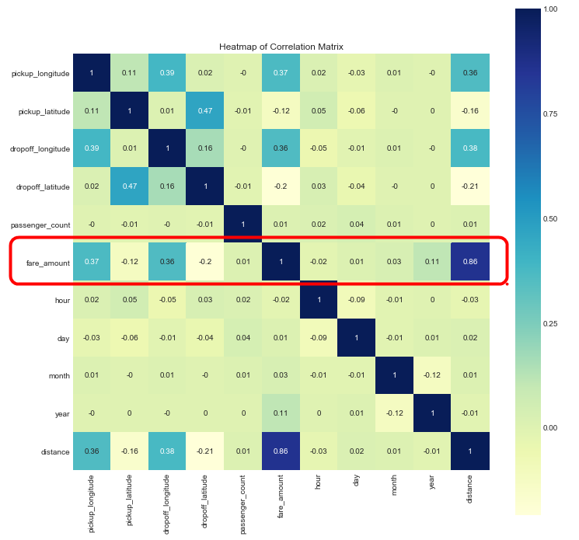
Feature Engineering
New Features
Timestamp related features (hour, day, month and year)
Distance feature using Haversine formula based on latitude and longitude columns
Feature Selection using SelectKBest Method
Feature Score for a linear regression using correlation
F Score P Value Support Attribute
9 1.986034e+06 0.000000e+00 True distance
0 1.071608e+05 0.000000e+00 True pickup_longitude
2 1.069375e+05 0.000000e+00 True dropoff_longitude
3 2.857348e+04 0.000000e+00 True dropoff_latitude
1 9.682635e+03 0.000000e+00 True pickup_latitude
8 8.578782e+03 0.000000e+00 True year
7 4.752072e+02 2.557569e-105 False month
5 1.687439e+02 1.405986e-38 False hour
4 1.116963e+02 4.183580e-26 False passenger_count
6 2.455670e+01 7.217172e-07 False day

Slide 16
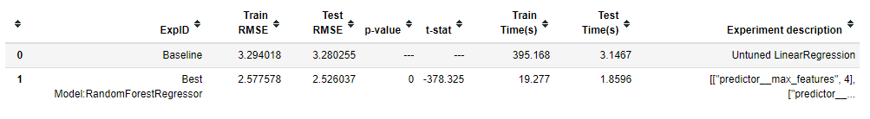
Model Evaluation
Model Evaluated
Linear Regression (Base Model)
RandomForestRegressor
…. And the winner is
RandomForestRegressor max_features=4,n_estimators=30
RMSE 2.52
Statistical Significance Test
The two machine learning pipelines are different (reject H0)
(t_stat, p_value) = (-378.33, 0.00000)

Slide 17
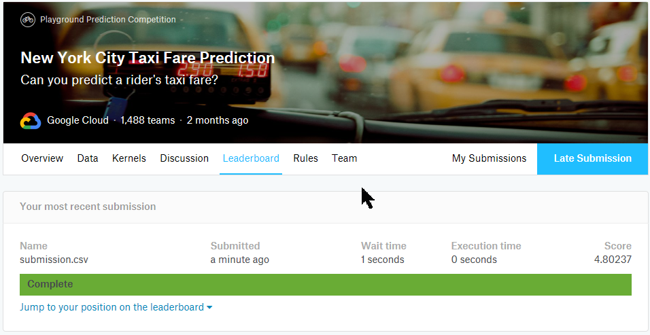
Kaggle Submission

Slide 18
Next Steps – Phase 2
Scale up
We will use more data as training set. Gradually we will use in steps of 5million, 10 million, ... considering our compute power.
Data Cleanup
We will use 99 percentile of fare amount
Remove geo locations falling in water area.
Feature Engineering
Addition of new features like travel direction, late night travels, experiment with different types of distances etc.
Perform PCA to find out best set of features
Model Evaluation
We will try new models like SupportVectorRegressor etc.
Randomized Search for evaluating range of parameters

Slide 19


